Slide 1
LENDING CLUB CASE STUDY
Abhishek Kumar
Date: 19-10-2020

Slide 2
Introduction
Abstract
The Lending Club company wants to understand the driving factors (or driver variables) behind loan default, i.e. the variables which are strong indicators of default. The company can utilise this knowledge for its portfolio and risk assessment.
Business Understanding
The objective is to identify the risky loan applicants, then such loans can be reduced thereby cutting down the amount of credit loss.
Raw Data
Loan - It contains the complete loan data for all loans issued through the time period 2007 t0 2011.
Data Dictionary - To understand meaning of variables

Slide 3
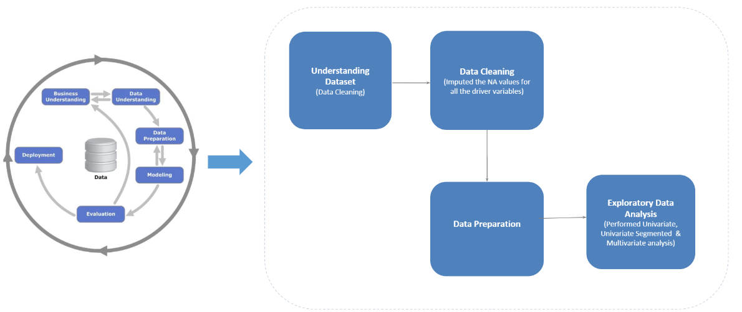
Problem Solving Methodology

Slide 4
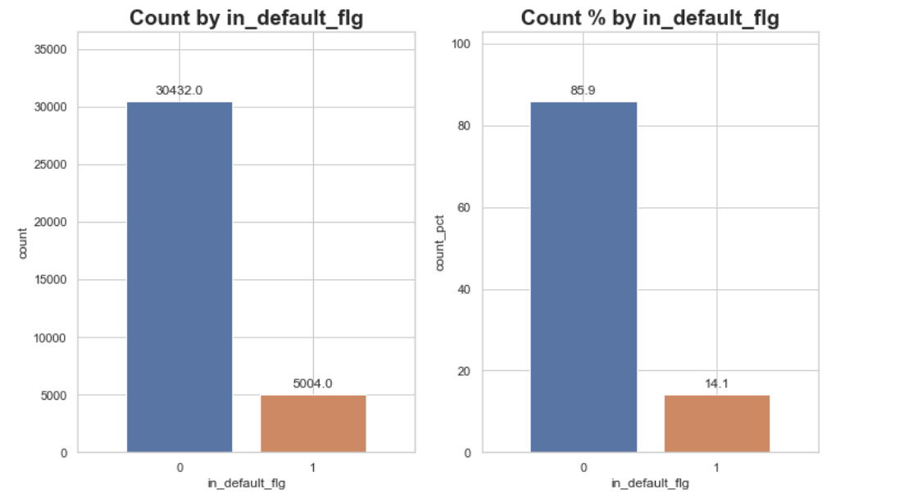
Overall Loan Status
There are 5004 defaulted loans that are being analysed here.
The defaulted loans account to 14.1 % of the total portfolio of loans.

Slide 5
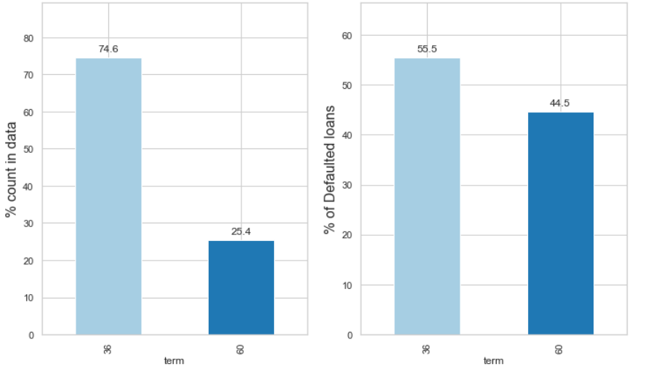
‘Loan Term’ Based Analysis
The 25.4% of entire loan is of 60 months term.
Out of this 25.4% approximately 45% are tend to be defaulters.
Loan term is an important parameter and thorough investigation should be done for 60 months term.

Slide 6
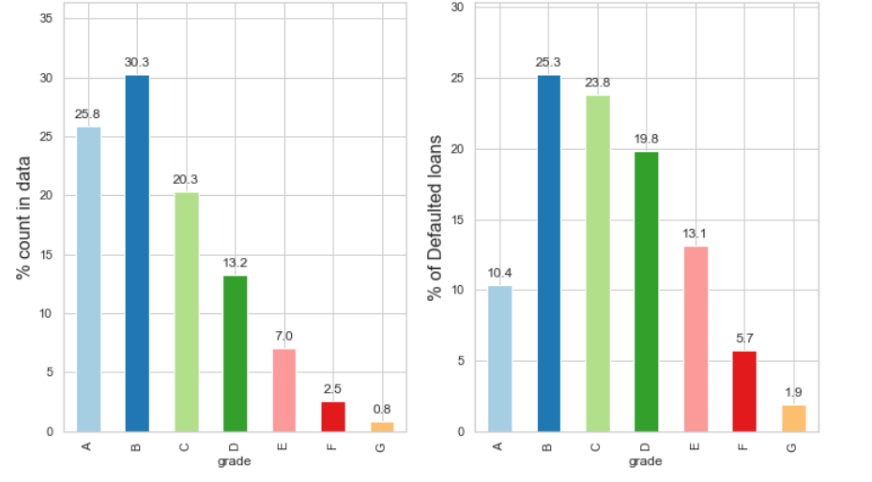
‘Grade n Sub-Grade’ Based Analysis
The default rate shoots up in the D E F G grades, proving the grading system is working correctly and hence an important parameter.

Slide 7
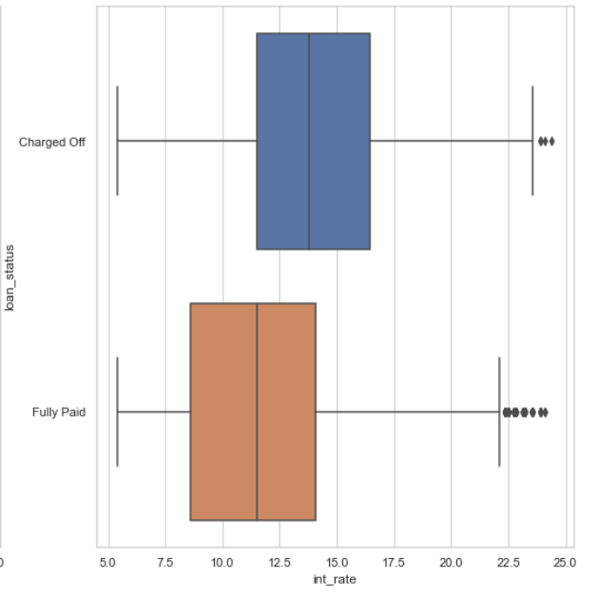
‘Interest’ Based Analysis
The default rate shoots up in the D E F G grades, proving the grading system is working correctly and hence an important parameter.

Slide 8
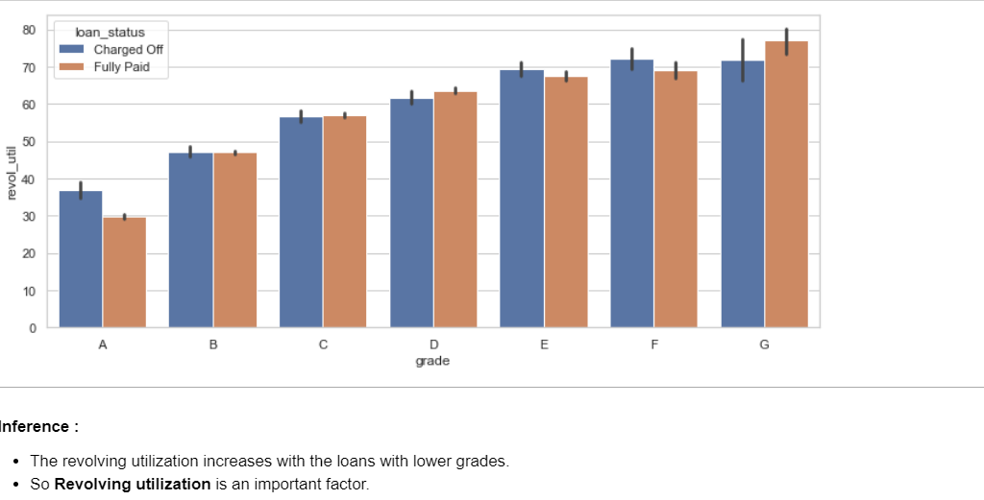
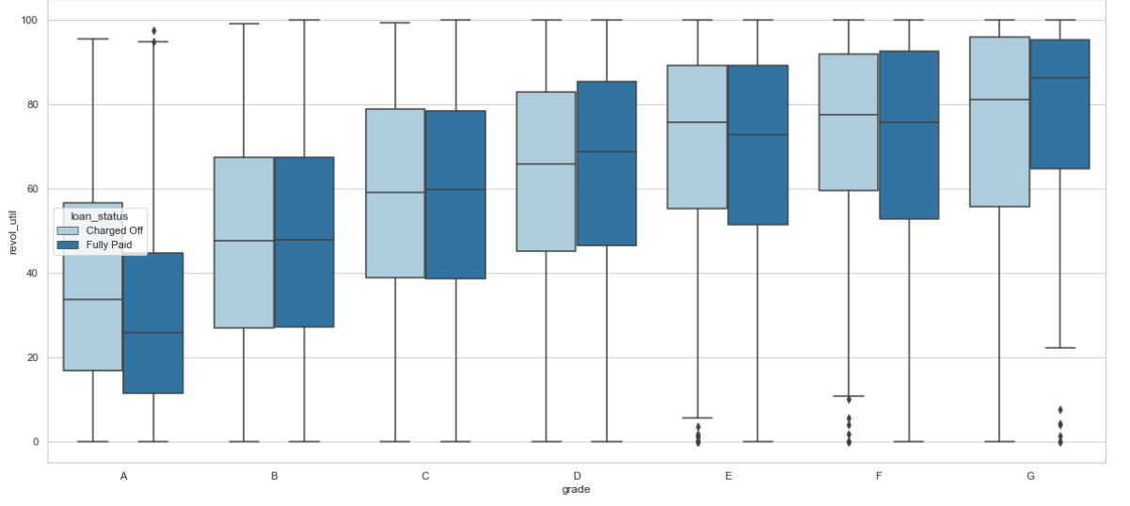
‘Revolving Utilization’ Based Analysis
With more revolving balance, customers tend to default more.

Slide 9
Conclusion
1. Lower grade loans tend to default more.
2. Loans having high interest have more defaulters.
3. WY – Wyoming state has only defaulters. Extra care
4. For term equal to 60, detailed check should be done

