Slide 1

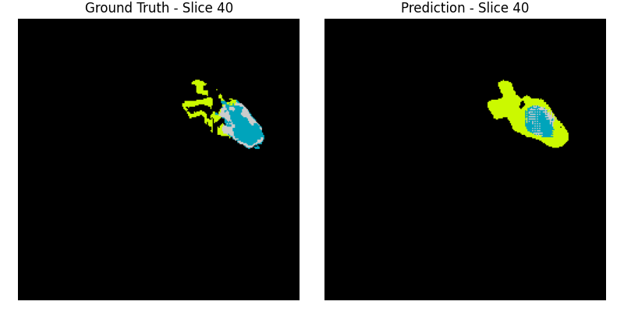
3D Brain Tumor Segmentation with UNet3D
MICCAI 2020 BraTS
Abhishek Maan
08/01/2025

Slide 2
What is Brain Image or MRI Segmentation?
Brain image segmentation is the process of dividing a brain scan (like an MRI or CT image) into different regions or classes, usually to identify specific structures (like gray matter, white matter, cerebrospinal fluid, tumors, lesions, etc.).
MRI uses strong magnetic fields and radio waves to generate images – no ionizing radiation like X-rays or CT scans.
Multiple contrast types or sequences (T1, T2, FLAIR, DWI, etc.) → each highlights different tissue properties.
In essence, MRIs are a type of scan used to collect unique contrast images of organ tissues and segmentation is the process of labeling normal and abnormal objects.

Slide 3
MRI Context and Information
Non-invasive medical imaging technique used to create detailed images of organs, tissues, and structures inside the body—especially soft tissues like the brain.
The magnet aligns hydrogen protons in your body. (Mostly in water and fat).
Why its important
High soft-tissue contrast → perfect for seeing brain structures, tumors, lesions, etc.
Multiple contrast types (T1, T1CE, T2, FLAIR, etc.) → each highlights different tissue properties.
Types of MRI sequences:
T1-weighted: Great for anatomy (white matter is bright, Cerebrospinal fluid is dark).
T1ce: T1-weighted MRI sequence taken after gadolinium-based contrast agent injected.
T2-weighted: Good for detecting fluid and inflammation (CSF is bright).
FLAIR: Suppresses CSF → makes lesions (e.g., MS plaques) more visible.

Slide 4
What’s the Problem?
Manual segmentation:
Gold Standard and Ground Truth. Manual segmentation from a trained professional is considered the most accurate and reliable reference for training and evaluating automated and semi-automated segmentation methods.
Challenge:
Manual segmentation is subjective and prone to variability both between different radiologists and even within the same radiologist repeating the task.
Segmenting a single 3D MRI scan can take hours. Radiologist has to trace tumor sub-region.
High cognitive load:
Requires deep anatomical and pathological knowledge.
Fatigue distraction or inexperience risks of errors.
In fast-paced hospitals, radiologists can be too tight on time to focus at that level of detail for long stretches.
Limited Access Globally
Not all hospitals or clinics have trained neuro-radiologists.

Slide 5
Objective
Goal:
Train a 3D convoluted neural network to accurately predict background, fluid, enhancing tumors, and core tumor regions in MRI scans.
Augment Radiologists through an automated pre-segmentation and quick verification workflow. (Applied Goal)
How:
Using the BraTS 2020 Data set of brain volumes to train the model and test for predictions.
The BraTS 2020 dataset gives multi-modal MRI scans (T1, T1ce, T2, FLAIR) and tumor masks for high-grade glioma patients. The images are preprocessed, 3D, and expertly labeled, making it a gold standard for developing and benchmarking brain tumor segmentation models.
Evaluation:
Labels will be grouped into three regions ( Necrotic Core, Edema, and Enhancing Tumor.)

Slide 6
Real World Application
Radiology Assistance
Tumor Segmentation and Detection: 3D U-Nets can precisely identify and delineate tumors in 3D medical images like CT and MRI scans. This can help radiologists quantify tumor burden, monitor treatment response, and differentiate between malignant and benign tissues.
Workflow Efficiency: Automated segmentation by 3D U-Nets can significantly reduce the time radiologists spend on manual delineation, allowing them to focus on other critical aspects of image interpretation.
Pre-surgical planning
3D Anatomical Models: 3D U-Nets can provide the infrastructure to facilitate the creation of detailed 3D anatomical models from patient imaging data.

Slide 7
Dataset and Preprocessing
Size, resolution, modality:
Dataset: BraTS 2020 Training Data (MICCAI_BraTS2020_TrainingData)
Volume Dimensions: 240×240×155 voxels per modality
Modalities: 4 MRI sequences (FLAIR, T1, T1CE, T2)
Sample Size: 100 patients (configurable via sample_size parameter)
Each patient (volume) contains 5 .nii files. Each modality and the segmentation.
Size: ~20 MB per file (compressed)
Memory: ~14 MB per volume in RAM
Preprocessing:
Normalization: Per-volume Z-score normalization using non-zero voxels
Slicing: Maintains 3D volumes, no 2D slicing

Slide 8
Model Architecture
Input (4×240×240×155)
↓Encoder 1: 32 channels → MaxPool (2,2,1)
↓Encoder 2: 64 channels → MaxPool (2,2,1)
↓Encoder 3: 128 channels → MaxPool (2,2,1)
↓Bottleneck: 256 channels
↓Upsample 3: 256→128 + skip connection
↓Upsample 2: 128→64 + skip connection
↓Upsample 1: 64→32 + skip connection
↓Final Conv: 32→4 channels (1×1×1)

Slide 9
Model Architecture
3D convolutions vs 2D:
3D Conv3d: Processes spatial information in all 3 dimensions
Depth preservation: Pooling only in x-y dimensions (2,2,1)
Memory efficient: Gradient checkpointing during training
Loss functions used:
Primary: CrossEntropyLoss
Dice Loss: Implemented in dice_score() and dice_per_class() functions
Why UNet3D is ideal for volumetric data:
Skip connections: Preserve spatial information across scales
Depth preservation: Maintains 3D spatial relationships
Memory efficient: Gradient checkpointing enables 3D training

Slide 10
Cross Entropy Loss Context
Cross Entropy Loss:
A loss function that measures the difference between predicted class probabilities and true class labels.
How it works:
Takes model output(4 channels for 4 classes) and ground truth labels.
Converts predictions to probabilities using SoftMax.
Penalizes confident wrong predictions heavily.
Formula: -log(p_correct_class) where p is predicted probability
Example: If model predicts 90% background but pixel is actually tumor, then loss is high.

Slide 11
Dice Loss and Score
Measures overlap between predicted and true segmentation masks
Formula: Dice = 2 x |A ∩ B| / ( |A| + |B| )
A = predicted mask, B = ground truth mask
Range: 0 (no overlap) to 1 (perfect overlap)
Utility in medical imaging
Focuses on segmentation quality, not just pixel accuracy
Better handles class imbalance than accuracy
Clinically meaningful metric

Slide 12
Data Loading and Training Setup
Hardware Constraints:
GPU: RTX 3070 VRAM 7GB, CUDA with mixed precision (AMP)
Batch size: 1 (memory-constrained)
Num Workers = 0
Memory management: torch.cuda.empty_cache(), gradient checkpointing
Data split:
Train: 70% (70 volumes of training per epoch)
Validation: 20% (20 volumes for training predictions)
Test: 10% (10 Unseen volumes for after the final epoch of learning)
Epochs, optimizer, learning rate:
Epochs: 30 (configurable)
Optimizer: Adam (lr=1e-4, weight_decay=1e-5)
Scheduler: ReduceLROnPlateau (patience=3, factor=0.5)

Slide 13
Metrics
Dice Score per class:
Background: 0.9947
Necrotic/Cystic: 0.9633
Edema: 0.0073
Enhancing Tumor: 0.4108
Why Dice is preferred for medical imaging:
Class imbalance handling: Less sensitive to class imbalance than accuracy
Overlap measurement: Directly measures region overlap
Medical relevance: Clinically meaningful for tumor segmentation
Improvement over epochs:
Available: Training logs show decreasing loss trend
Monitoring: Per-epoch validation dice scores tracked

Slide 14
Metrics
Training Epoch: 0
Epoch [1/30], Average Train Loss: 1.0884, Val Loss: 1.0706, Val Dice: 0.8844
Training Epoch: 1
Epoch [2/30], Average Train Loss: 0.8205, Val Loss: 0.7224, Val Dice: 0.9935
Training Epoch: 2
Epoch [3/30], Average Train Loss: 0.7077, Val Loss: 0.6117, Val Dice: 0.9928
Training Epoch: 3
Epoch [4/30], Average Train Loss: 0.6365, Val Loss: 0.5543, Val Dice: 0.9938
Training Epoch: 4
Epoch [5/30], Average Train Loss: 0.5717, Val Loss: 0.5502, Val Dice: 0.9636
Training Epoch: 5
Epoch [6/30], Average Train Loss: 0.5135, Val Loss: 0.4636, Val Dice: 0.9937
Training Epoch: 6
Epoch [7/30], Average Train Loss: 0.4614, Val Loss: 0.4345, Val Dice: 0.9938
Training Epoch: 7
Epoch [8/30], Average Train Loss: 0.4151, Val Loss: 0.3814, Val Dice: 0.9941
Training Epoch: 8
Epoch [9/30], Average Train Loss: 0.3755, Val Loss: 0.6309, Val Dice: 0.9268
Training Epoch: 9
Epoch [10/30], Average Train Loss: 0.3391, Val Loss: 0.3104, Val Dice: 0.9940
Training Epoch: 10
Epoch [11/30], Average Train Loss: 0.3066, Val Loss: 0.2876, Val Dice: 0.9941
Training Epoch: 11
Epoch [12/30], Average Train Loss: 0.2787, Val Loss: 0.2632, Val Dice: 0.9943
Training Epoch: 12
Epoch [13/30], Average Train Loss: 0.2525, Val Loss: 0.2169, Val Dice: 0.9942
Training Epoch: 13
Epoch [14/30], Average Train Loss: 0.2331, Val Loss: 0.2099, Val Dice: 0.9940
Training Epoch: 14
Epoch [15/30], Average Train Loss: 0.2126, Val Loss: 0.2300, Val Dice: 0.9927
Training Epoch: 15
Training Epoch: 18
Epoch [19/30], Average Train Loss: 0.1660, Val Loss: 0.1534, Val Dice: 0.9940
Training Epoch: 19
Training Epoch: 22
Epoch [23/30], Average Train Loss: 0.1458, Val Loss: 0.1422, Val Dice: 0.9946
Training Epoch: 24
Epoch [25/30], Average Train Loss: 0.1398, Val Loss: 0.1398, Val Dice: 0.9943
Training Epoch: 25
Epoch [26/30], Average Train Loss: 0.1361, Val Loss: 0.1273, Val Dice: 0.9945
Training Epoch: 26
Epoch [27/30], Average Train Loss: 0.1329, Val Loss: 0.1291, Val Dice: 0.9943
Training Epoch: 27
Epoch [28/30], Average Train Loss: 0.1302, Val Loss: 0.1308, Val Dice: 0.9944
Training Epoch: 28
Epoch [29/30], Average Train Loss: 0.1286, Val Loss: 0.1246, Val Dice: 0.9946
Training Epoch: 29
Epoch [30/30], Average Train Loss: 0.1270, Val Loss: 0.1215, Val Dice: 0.9947
Evaluating on Test Set:
Test Loss: 0.7471, Test Dice Score: 0.9271
Test Dice Scores: NCR: 0.9633, ED: 0.0073, ET: 0.4108

Slide 15
Visual Results
Slices from early + final epochs side by side:
Available: visualize_volume_prediction() saves epoch-specific visualizations
Output: Ground truth vs prediction comparisons every 5 epochs
Ground truth vs prediction comparison:
Available: visualize_test_detections() creates side-by-side comparisons
Output: Saved as PNG files in outputs/run-{run_number}_ss-{sample_size}/
Highlight failures:
ED class: Extremely poor performance (0.0073% dice)
Class imbalance: Model heavily biased toward background

Slide 16
Visual Results - 3D rotation animation view
3D visualization of labeled tumor region (red) overlayed on the brain (blue). This is a ground truth label.

Slide 17
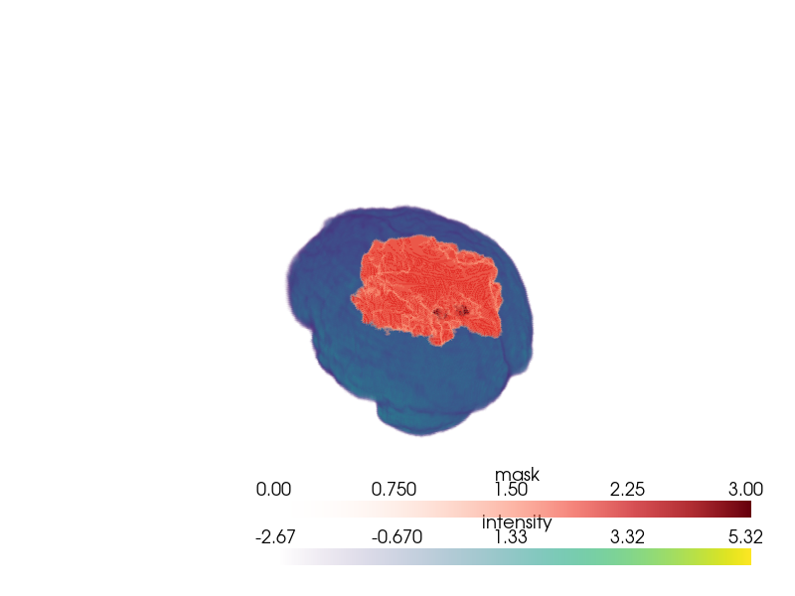
Visual Results – 3D angled view image
3D visualization of labeled tumor region (red) overlayed on the brain (blue). This is a ground truth label.

Slide 18
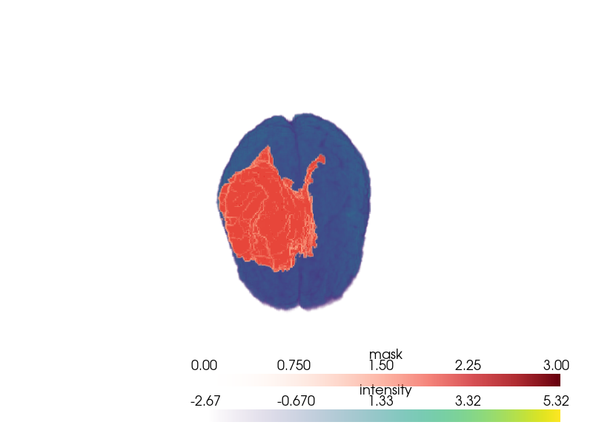
Visual Results – 3D top-down view image
3D visualization of labeled tumor region (red) overlayed on the brain (blue). This is a ground truth label.

Slide 19
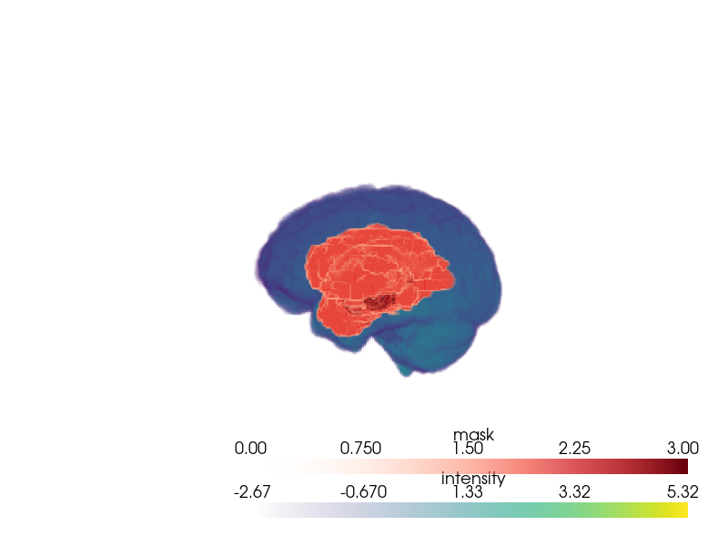
Visual Results – 3D side view image
3D visualization of labeled tumor region (red) overlayed on the brain (blue). This is a ground truth label.

Slide 20
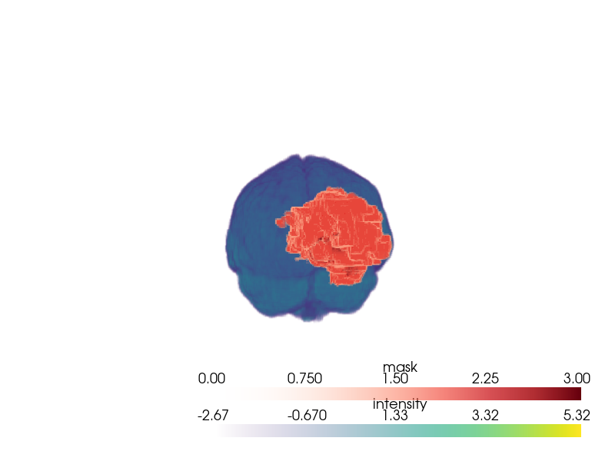
Visual Results – 3D front view image
3D visualization of labeled tumor region (red) overlayed on the brain (blue). This is a ground truth label.

Slide 21
Achievements
Technical Milestones
End-to-End 3D Segmentation Pipeline: Successfully implemented a full deep learning pipeline — preprocessing, training, validation, and testing — for 3D MRI brain tumor segmentation.
Custom 3D U-Net Implementation: Designed and trained a volumetric U-Net architecture from scratch with modular building blocks (ConvBlock).
Multi-Class Tumor Segmentation: Model predicts three distinct tumor regions (NCR, ED, ET) simultaneously
Performance Highlights
Achieved overall test Dice score of 0.9271.
High per-class accuracy for NCR (0.9633) and strong ET segmentation improvement compared to random baseline.
Stable validation Dice > 0.99 for most epochs — indicating good convergence and strong generalization to validation data.
Optimization Wins
Successfully trained without catastrophic overfitting despite high model capacity.
Reduced validation loss steadily over training.
Practical & Research Value
Visualizations tools built for side-by-side ground truth vs prediction – enabling qualitative inspection.
Framework adaptable for medical image segmentation beyond brain tumors (e.g. organs, other lesions).

Slide 22
Challenges
Class imbalance (ED class Dice was low):
Severe imbalance: Background dominates, ED class extremely poor
Possible Solutions: Class weighting, focal loss, data augmentation, increased training size.
Overfitting risk (small dataset):
Dataset size: 100 patients (small for medical imaging)
Mitigation: Data augmentation, regularization, early stopping
Hardware limitations (CUDA OOMs, batch size 1):
Memory constraints: Batch size limited to 1
VRAM (GPU Memory) 7 GB
Solutions: Gradient checkpointing, mixed precision, memory management

Slide 23
Future Work
Model Parameter Tuning:
Larger batch sizes with more GPU memory, more workers.
Divert some focus to Edema class during training to increase overall accuracy.
Increase the base learning rate for early training.
Increase Data Set Size:
The current subset dataset has a total population of 100 patient volumes. Of which 70 volumes are used for training, 20 are used for validation, and 10 are used for training.
Increasing the dataset to the entire population would increase the total unique exposure to various classes.

Slide 24
Conclusion
Recap: Built 3D tumor segmentation with high Dice on NCR/ET:
Success: Excellent performance on background (99.47%) and necrotic regions (96.33%)
Notable: moderate performance on Enhancing Tumor (ET) region (42.xx %)
Challenge: Poor performance on edema (0.0073%) due to class imbalance
Significance: Could enhance clinical workflows:
Automated segmentation: Reduces manual annotation time
Multi-modal analysis: Uses all 4 MRI modalities simultaneously
Early Detection: With supervised learning of specific feature(s), the model has potential to accurately detect enhancing tumors.
3D visualization: Provides volumetric tumor analysis
What you learned / how this connects to your future work:
3D medical imaging: Experience with volumetric data processing
Class imbalance: Understanding of medical imaging challenges
Memory optimization: Techniques for large 3D model training
Clinical relevance: Real-world medical imaging applications

Slide 25
Bibliography
Perelman School of Medicine, University of Pennsylvania – Brats Miccai Dataset
Nih.gov – Descriptive information in the powerpoint.

