Slide 1
SUPPORT VECTOR MACHINES
ABHISHEK MADIRAJU

Slide 2
INTRODUCTION
An approach for classification that was developed in the computer science community in the 1990s.
Generalization of a classifier called the Maximal Margin Classifier.

Slide 3
HYPERPLANE
In a p-dimensional space, a hyperplane is a flat affine subspace of dimension p − 1.

Slide 4
MAXIMAL MARGIN CLASSIFIER
Maximal Marginal Hyperplane is the separating hyperplane that is farthest from the training observations.
The maximal margin hyperplane is the separating hyperplane for which the margin is largest.
We can then classify a test observation based on which side of the maximal margin hyperplane it lies. This is known as the Maximal Margin Classifier.

Slide 5
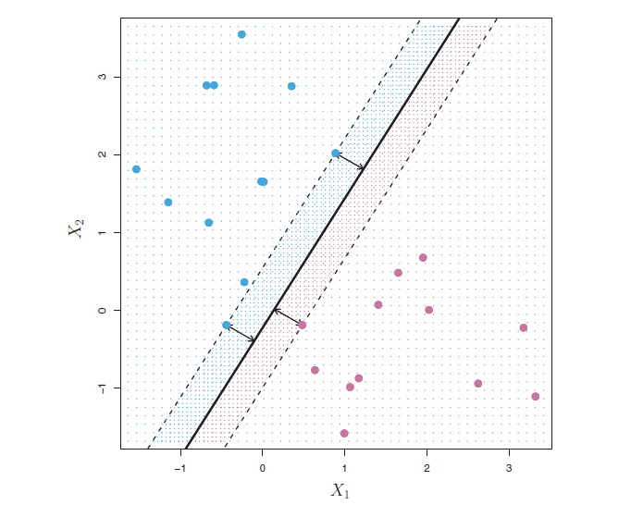
Three training observations are equidistant from the maximal margin hyperplane
These three observations are known as support vectors.

Slide 6
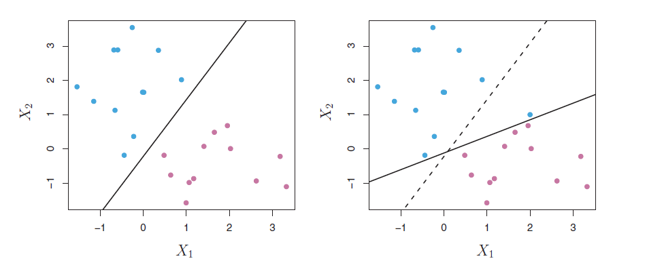
SUPPORT VECTOR CLASSIFIER
If a separating hyperplane does exist, then there are instances in which a classifier based on a separating hyperplane might not be desirable.

Slide 7
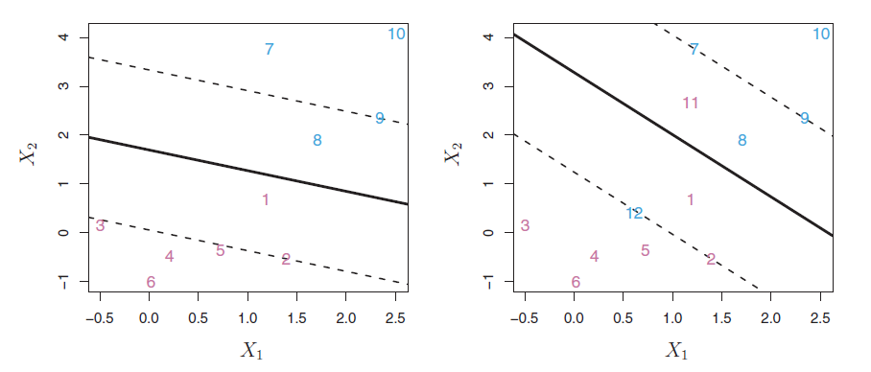
We allow some observations to be on the incorrect side of the margin, or even the incorrect side of the hyperplane.

Slide 8
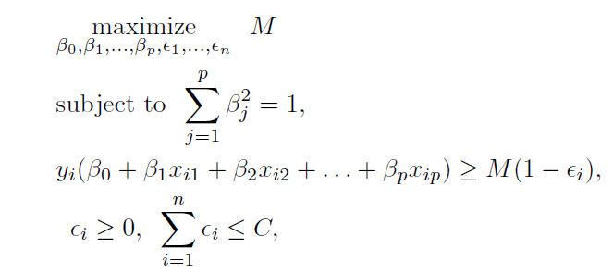
SUPPORT VECTOR CLASSIFIER

Slide 9
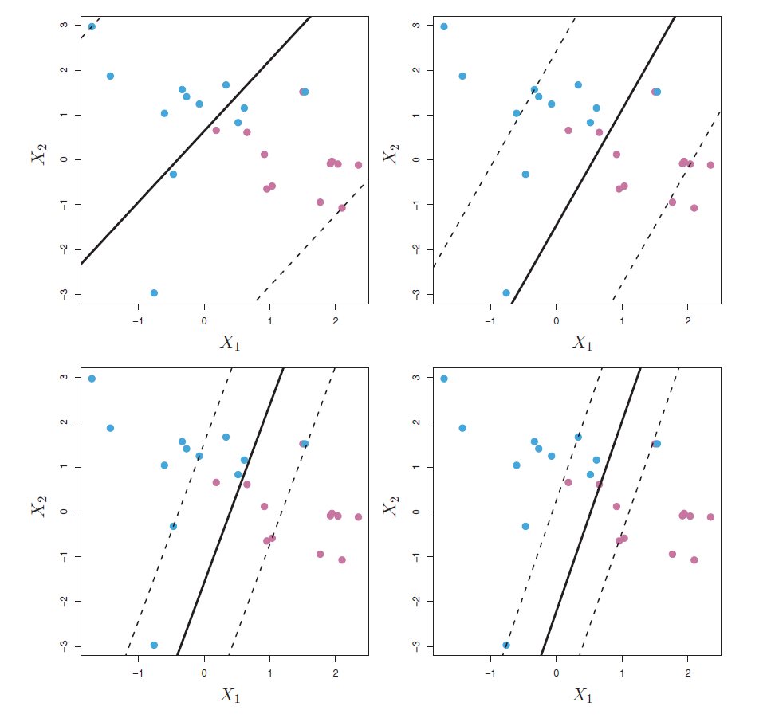
Fit for different values of C.
Higher the C value, higher the tolerance, higher the margin.

Slide 10
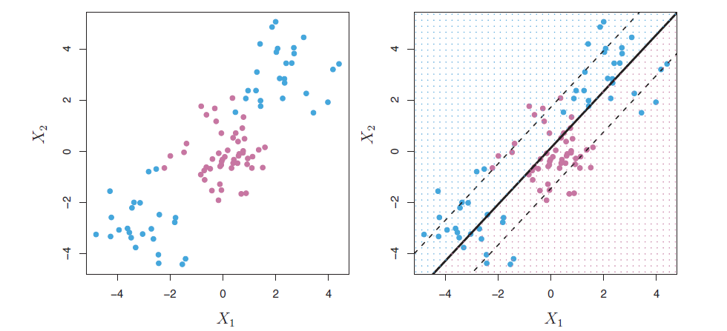
WHAT IF THERE IS A NON LINEAR BOUNDRY ?

Slide 11


SUPPORT VECTOR MACHINE
Support Vector Machine is an extension of the support vector classifier that results from enlarging the feature space in a specific way, using kernels.
Linear Support vector classifier can be represented as
Inner product can be replaced with the generalization
K is a function called as the kernel

Slide 12


A kernel is a function that quantifies the similarity of two observations.
The above equation would represent a linear kernel
In order to obtain a polynomial kernel of degree d, the kernel function can be written as

Slide 13

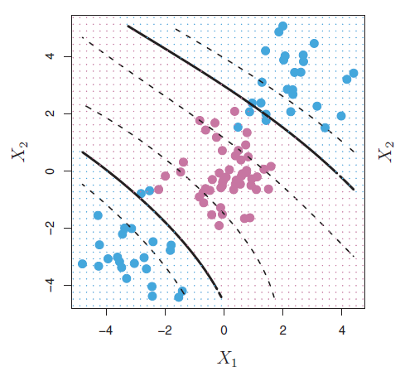
When the support vector classifier is combined with a non-linear kernel such , the resulting classifier is known as a support vector machine.

Slide 14
SUPPORT VECTOR CLUSTERING
Data points are mapped from data space to a high dimensional feature space using a Gaussian kernel.
The smallest sphere in feature space is found and then mapped back to the data space.
It forms a set of contours in data space which enclose the data points. These are interpreted as cluster boundaries.

Slide 15


CLUSTER BOUNDARIES
Find the smallest enclosing sphere
Introduce soft constraints

Slide 16
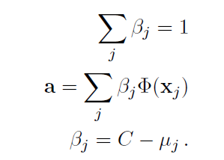

To determine BSV’s
The image of a point xi with ξi > 0 and βi > 0 lies outside the feature-space sphere.
Such a point has μi = 0, hence we conclude from that βi = C. This will be called a bounded support vector or BSV.

Slide 17
A point xi with ξi = 0 is mapped to the inside or to the surface of the feature space sphere.
If its 0 < βi < C then its image Φ(xi) lies on the surface of the feature space sphere. Such a point will be referred to as a support vector or SV.
SVs lie on cluster boundaries, BSVs lie outside the boundaries, and all other points lie inside them.
The radius of the sphere is: R = {R(xi) | xi is a support vector } .
The contours that enclose the points in data space are defined by the set {x | R(x) = R} .

Slide 18
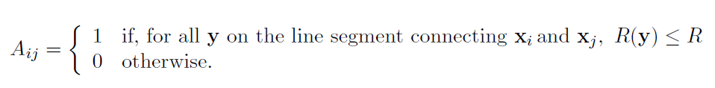
CLUSTER ASSIGNMENT

Slide 19
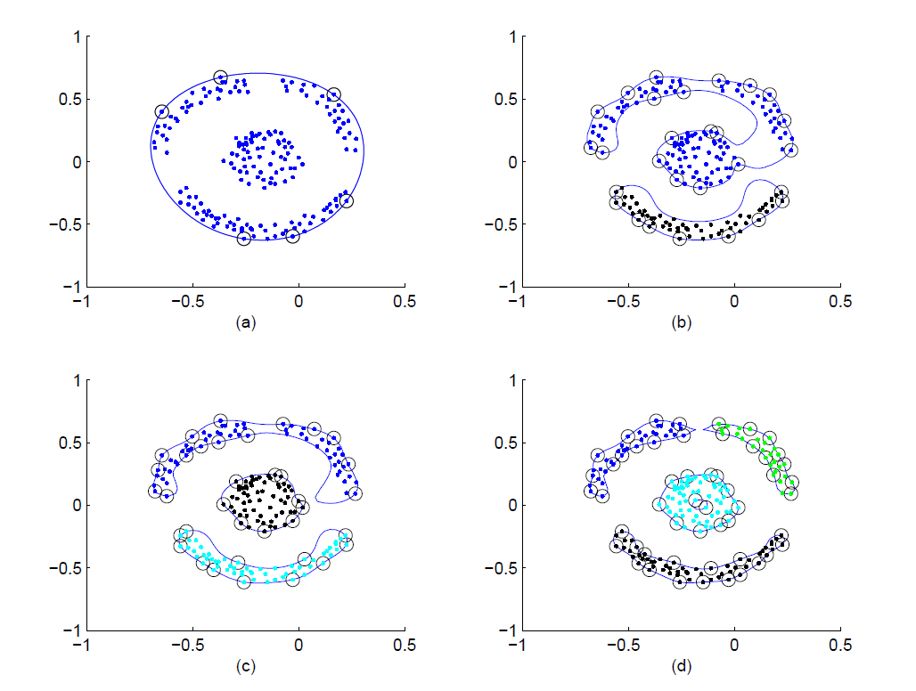
The shape of the enclosing contours in data space is governed by two parameters: q, the scale parameter of the Gaussian kernel, and C, the soft margin constant.
a) q=1 , b) q=20, c) q=24, d) q = 48

Slide 20
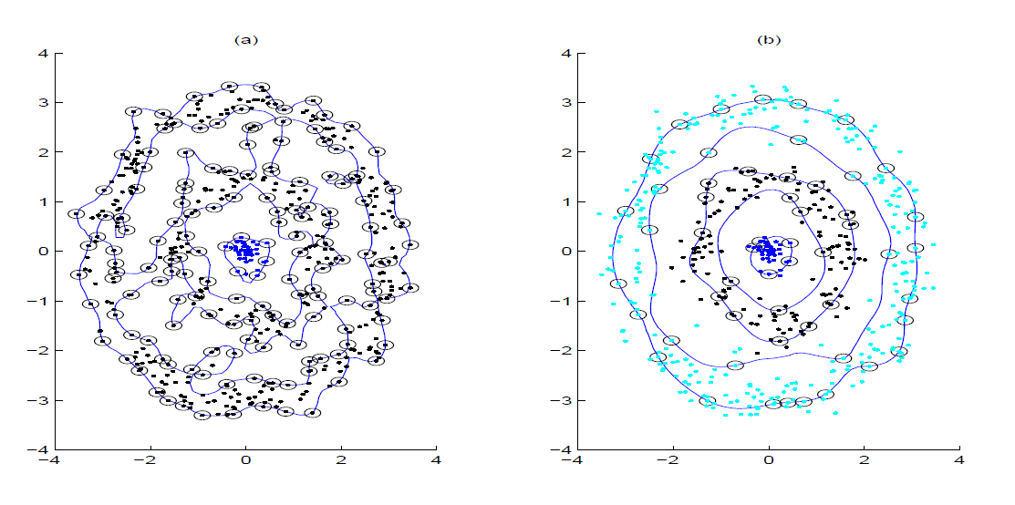
In order to observe splitting of contours, we must allow for BSVs.
The number of outliers is controlled by the parameter C.

Slide 21
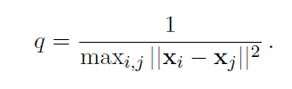
VARYING q and p
Initial value of q can be chosen as

