Slide 1

COORDINATORS:
K.PAVAN KUMAR SIR
M.BHANU PRAKASH SIR
TEAM MEMBERS:
M.ABHISHEK(14N81A0549)
ATHULYA.K (14N81A0589)
V.SAI TEJA (14N81A05C5)
A.AMANI (14N81A05K0)
UNDER GUIDANCE OF:
A. JYOSHNA MAAM

Slide 2
SPHOORTHY’S PROJECT BOARD

Slide 3
CONTENT
SNO | TOPIC
1 | INTRODUCTION OF IDEA
2 | EXPLAINING EXISTING SYSTEM
3 | DISADVANTAGES IN EXISTING SYSTEM
4 | PROPOSED SYSTEM
5 | ADVANTAGES IN PROPOSED SYSTEM
6 | POINTS OBSERVED DURING LITERATURE SURVEY
7 | FEASIBILITY STUDY
8 | REQUIREMENT ELICITATION
 | REQUIRMENT ANALYSIS
9 | DESIGNING OF MODULUS
10 | SYSTEM DESIGN

Slide 4
INTRODUCTION OF IDEA
In the current times of digital world, the education institutes try to do various projects with students containing different platforms, technologies and tools etc.
As time goes by many ideas being executed where this data can also be helpful to the coming students which will give as reference and also used them to give further extensions.
Hence we are here to develop a proper system to fulfill the above requirements.

Slide 5
EXISTING SYSTEM
Students tend to collect the ideas via web sources, seniors help and etc.
Some apps and the private institutes offers us various ideas
Internet is a huge pool for getting the right information on the go
Some of the systems or the websites present these kind of services are
Nevon Projects
1000 Projects
http://www.ieeefinalyearprojects.org/ and etc

Slide 6
DISADVANTAGES IN CURRENT SYSTEM
These references provide good ideas but doesn’t give information whether it is already executed or not
Sometime the faculties also tend to know if the idea is already implemented or not to remove the redundancy.

Slide 7
PROPOSED SYSTEM
Build a unified system to access the all the ideas that were previously executed IN OUR COLLEGE
Provide a small board where students can scan some of the best projects
Provide clean and graphical interface for the types of projects executed
Provide the additional details about the project idea which can help upcoming students while ideation process and simplify the searching process

Slide 8
ADVANTAGES IN PROPOSED SYSTEM
FOR STUDENTS
Ideas can be found at very moment,
Domains selection for an idea can be made easier,
They don’t have to spend money on random websites while searching for idea,
Time saving during searching process,
Get or implement new extension on existing projects,
Domain Information can be obtained freely

Slide 9
ADVANTAGES IN PROPOSED SYSTEM
FOR FACULTIES
Verify whether ideas are not redundant or not,
Maintaining a unified system about the projects made
FOR HEAD OF DEPARTMENTS
Collect a report of projects being done by the students every year
Keeping a digital system rather than using the third party application

Slide 10
POINTS OBSERVED DURING LITERATURE SURVEY
We came across various points to be covered in the project apart from of our team members aspects. The below are the some of them
What if the board is completely occupied?
It may give redundant ideas in the selection process
how does this help if the ideas are frequently logos removed from the board

Slide 11
FEASIBILITY STUDY
The types of feasibility studies discussed under our project are
TECHNICAL FEASIBILITY 1.1) STORAGE COMPATIBILITY 1.2) MAINTAINING UNIQUE LOGOS. 1.3) VERSION COMPATIBILITY
OPERATIONAL FEASIBILITY
ECONOMICAL/FINANCIAL FEASIBILITY : around Rs.250 to 480 per month for deploying and additional on extra cloud storage

Slide 12
REQUIREMENT ELICITATION.
The gathering can be clearly explained via three interfaces
SYSTEM INTERFACE:
Internet connection,
Database connection to the database containing image targets, their respective graphics and also information about the projects
A web server and website to deploy our website and be accessible at any time.
Tools used to develop the AR app and website.
Data regarding the project’s information

Slide 13
REQUIREMENT ELICITATION.
USER INTERFACE
All user can interact with the AR app or accessing website to know about projects.
Here the user can use his/her own system or our android app (which needs an android phone above KitKat version) to use our data.

Slide 14
REQUIREMENT ANALYSIS
SOFTWARE REQUIREMENTS
OPERATING SYSTEM : | Windows 7 or above, 64 bit only
COMPUTER LANGUAGES : | C#, HTML, CSS, JS, WIX-API’S
TOOLS USED : | Unity 2017.3 or above Any Browser WIX Vuforia (above 6.2)
BACKEND : | WIX Database
ADDITIONAL SOFTWARES REQUIRED : | Java JDK (1.8 or above) Android SDK (4.4 or later)

Slide 15
REQUIREMENT ANALYSIS
HARDWARE REQUIREMENTS
FUNCTIONAL REQUIREMENTS
Mobile phone (Android Above 4.4 version)/ Web Browser with Open GS above 3.0Internet connection
While scanning, if Logo is present in database display respective graphics
Display the list of projects done in a web browser
PROCESSOR(CPU) : | Recommended Intel Core i5
GPU : | Graphics card with DirectX9 or above
HARD DISK : | 7 GB or above
RAM : | 4 GB Recommended
APP REQUIRMENT : | Storage above 500 MB

Slide 16
REQUIREMENT ANALYSIS
NON FUNCTIONAL REQUIREMENTS
Maintenance
Storage Availability
Internet
Accessibility

Slide 17
DESIGNING OF MODULUS
MODULE -1 : For AR App
Design a basic cloud recognition app simple that projects details about scanned project logo.
Then make the view more interactive by having 3D objects or adding photos or videos for required project

Slide 18
DESIGNING OF MODULUS
MODULE -2 : For Web Application
Design web page template showing basic information about current projects
This page shows current year’s mini project as our operational data
Then Generate the auto posting of project where students can post their ideas into our website
The above process be controlled by a Admin for authentication

Slide 19
SOFTWARE MODEL
INCREMENTAL : as we need to update data year wise
PROTOTYPING : This is for designing Client layer involved in the project
System implementation
AR App Module
WEB Module
Requirement gathering
Quick design
Building prototype
Redefined product
Output evaluation

Slide 20
SYSTEM MODELS

Slide 21
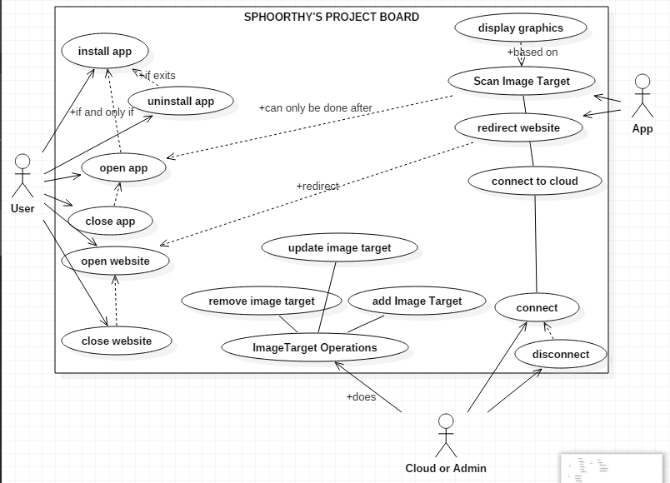
USE CASE DIAGRAM

Slide 22
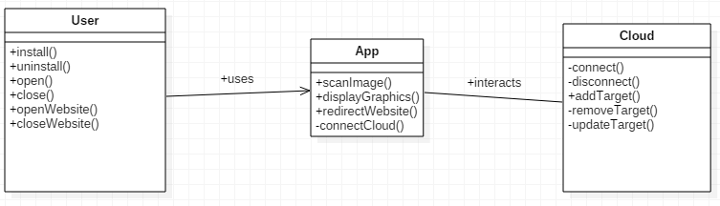
CLASS DIAGRAM

Slide 23
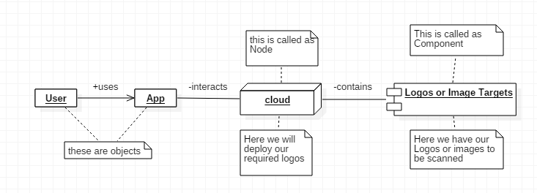
OBJECT DIAGRAM

Slide 24
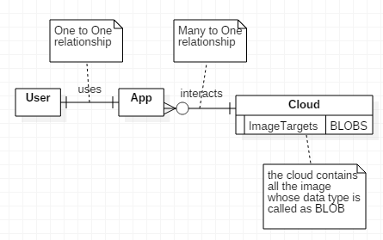
DATA FLOW DIAGRAM

Slide 25
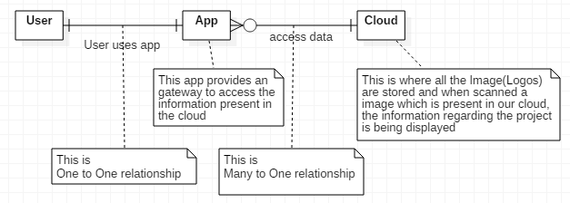
ER DIAGRAM

Slide 26
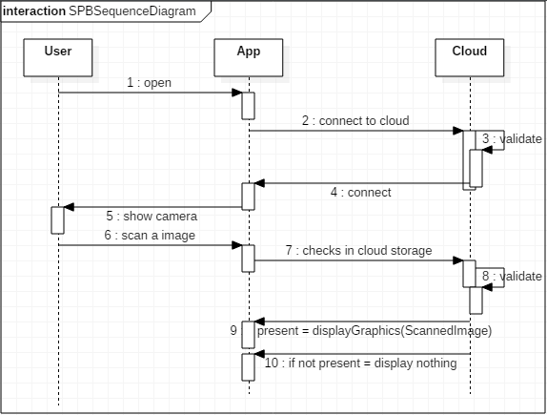
SEQUENCE DIAGRAM

Slide 27
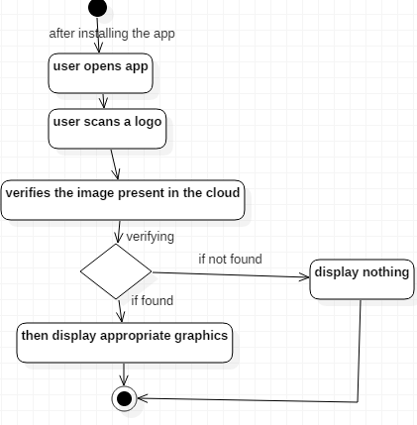
ACTIVITY DIAGRAM

Slide 28

THANK YOU
ANY QUESTIONS?

