Slide 1

COORDINATORS:
K.PAVAN KUMAR
M.BHANU PRAKASH
TEAM MEMBERS:
M.ABHISHEK(14N81A0549)
ATHULYA.K (14N81A0589)
V.SAI TEJA (14N81A05C5)
A.AMANI(14N81A05K0)
UNDER GUIDANCE OF:
A. JYOSHNA

Slide 2
SPHOORTHY’S PROJECT BOARD

Slide 3
CONTENT
SNO | TOPICS | SHEET
1 | OUTLINE OF PROJECT
2 | LITERATURE SURVEY
3 | SOFTWARE ANALYSIS SOFTWARE INTRODUCTION SOFTWARE REQUIREMENT ANALYSIS
4 | EXISTING SYSTEM
5 | PROPOSED SYSTEM
6 | FURTHER DEVELOPMENTS
7 | CONCLUSION

Slide 4
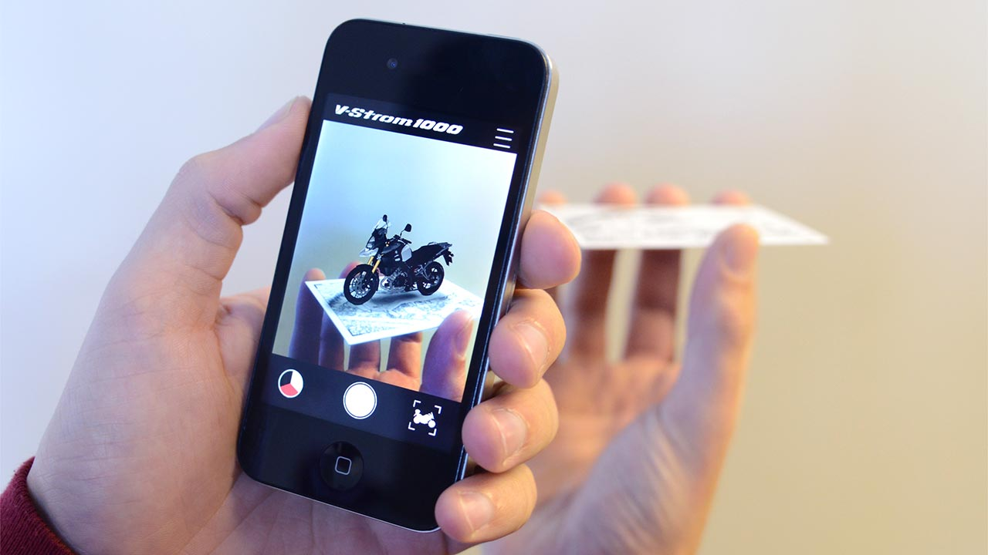
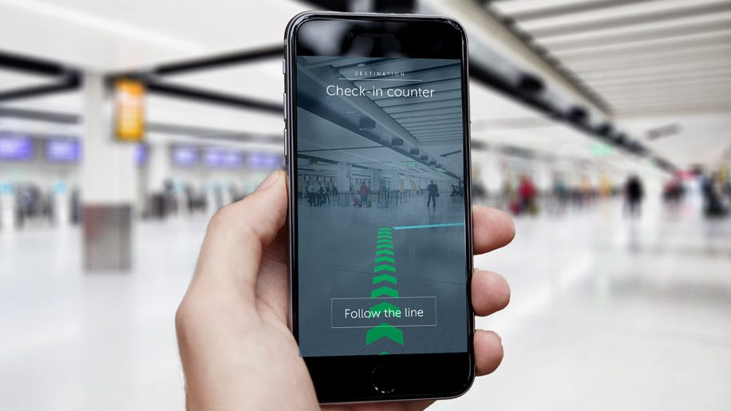
OUTLINE OF THE PROJECT
To display the previously executed projects in our college
This is done by using augmented reality technology

Slide 5
LITERATURE SURVEY
DURING THE LITERATURE SURVEY WE CAME ACROSS FOLLOWING PROBLEMS
WHAT HAPPENES IF THE BOARD IS COMPLETELY FILLED OUT
HOW DOES THIS HELP IF THE IDEAS ARE FREQUENTLY REMOVED FROM THE BOARD
IT MAY GIVE REDUNDANT IDEAS IN THE SELECTION PROCESS
PROVIGING THE WEB ACCESS WOULD IMPROVE MORE USAGE OF THE APPLICATION
HOW CAN U CREATE NEW PROJECTS.STUDENT MIGHT BE MOSTLY DOING THE EXISTING PROJECTS ONLY BUT MAY BE THEY MAY BE ADDING OR DELETE THE FUTURES

