Slide 1
PSCS_129_ DESIGN AND DEVELOPED A PRESONALIZED ONLINE MEETING FOR AICTIE
CSE 7101- Capstone Project
Review-5
Batch Number: CSE_271
Roll Number | Student Name
Under the Supervision of,
Dr.Hasan Hussain S
Professor
School of Computer Science and Engineering
Presidency University
20221CSE0116 | CHILMAKURI VARUN
20221CSE0110 | ABHISHEK MUTHANNA K
20221CSE0010 | AMARA HEMA HARSHITH
Name of the Program: CCS-Computer Science and Engineering
Name of the HOD: Dr. Blessed Prince , Dr. Asif Mohammed
Name of the Program Project Coordinator: Mr.Muthuraju V , Dr. Jayavadivel Ravi
Name of the School Project Coordinators: Dr. Sampath A K , Dr. Geetha A

Slide 2
Content
Problem Statement
Analysis of Problem Statement
Abstract
Literature Survey
Objectives
Existing Methods
Drawbacks
Proposed method & Feasibility Study
Architecture Diagram
Modules
Hardware and software details
Working Screenshot
Git hub Link
References
Timeline of the Project

Slide 3
Problem Statement
Existing web-based meeting platforms (e.g., Zoom, Google Meet, Teams) operate as generalized solutions and do not support AICTE-oriented customization such as centralized authentication, personalized user dashboards, academic meeting scheduling, or institution-specific data management.
There is currently no dedicated system that integrates:
Secure login using a unified database
Personalized meeting room creation
Web-based real-time communication
Scalable backend authentication
Custom interface for AICTE requirements
This lack of customized functionality creates difficulties for students and faculty in accessing secure, institution-managed online meeting environments. Hence, there is a need to design and develop a personalized online meeting platform tailored specifically for AICTE.

Slide 4
Analysis of problem Statement
The existing online meeting platforms used by AICTE institutions are generic tools that do not support academic-specific needs such as secure institutional login, personalized dashboards, or role-based meeting controls. They also pose challenges in data privacy, participant authentication, and customization for educational workflows. Because AICTE relies on third-party platforms, institutions lack control over user management, interface design, and meeting data storage. This highlights the need for a dedicated, customizable, and secure online meeting system designed specifically for AICTE to improve accessibility, personalization, and institutional data security.

Slide 5
Abstract
This project presents the design and development of a Personalized Online Meeting Platform for AICTE, aimed at creating a dedicated communication solution for students, faculty, and administrators across AICTE-approved institutions. Existing commercial meeting tools do not provide academic-specific customization, centralized authentication, or institution-controlled data management. To overcome these limitations, the proposed system integrates secure Supabase-based authentication, personalized user dashboards, role-based meeting rooms, and an intuitive interface built with Vite, React, Tailwind CSS, and TypeScript.
The platform enables users to schedule, join, and manage meetings seamlessly while ensuring data privacy, controlled access, and improved digital collaboration. By offering a customizable and scalable architecture, this solution supports institutional workflows, enhances online academic interactions, and reduces dependency on third-party platforms. Overall, the system delivers a secure, modern, and AICTE-aligned meeting environment that can be expanded with future features such as AI-powered transcripts, attendance tracking, and cloud recording.

Slide 6
Literature Survey
Previous research shows:
Existing platforms like Zoom, Google Meet, and Microsoft Teams provide video conferencing but lack institution-specific customization for AICTE.
Research shows that these tools do not support centralized authentication or role-based academic access.
Studies on WebRTC highlight its capability for real-time communication but do not address personalized dashboards or academic meeting management.
E-learning literature emphasizes the need for integrated platforms that combine teaching, communication, and user management in one system.
Security research identifies issues such as data privacy risks, external data storage, and unauthorized access when using third-party meeting tools.
Overall, literature points to the need for a custom, secure, and institution-controlled online meeting system tailored for educational environments like AICTE.

Slide 7
Objectives
Primary Objective
To design and develop a personalized, secure, and institution-specific online meeting platform tailored to the needs of AICTE institutions.
Secondary Objectives
To implement centralized authentication for students and faculty.
To create personalized dashboards for managing meetings and user profiles.
To enable features such as creating, scheduling, and joining meetings with ease.
To ensure data privacy and secure access control within the institution.
To use modern web technologies (React, Tailwind, Supabase) for scalability and performance.
To reduce dependency on external platforms by providing a custom AICTE-controlled solution.

Slide 8
Existing Methods
Existing Methods
Zoom, Google Meet, and Microsoft Teams are widely used for online classes and meetings.
These platforms support video conferencing, screen sharing, and chat, making them useful for general communication.
Institutions often rely on external login systems instead of centralized academic authentication.
Meeting links are typically shared manually, leading to security risks like unauthorized participants.
No built-in personalized dashboards for students or faculty to view scheduled academic sessions.
Data is stored on third-party servers, giving institutions limited control over privacy and access.
Lack of custom academic features such as attendance integration, institutional branding, or role-based meeting control.

Slide 9
Drawbacks
No centralized authentication, causing difficulty in verifying students and faculty.
Lack of institution-specific customization for AICTE needs.
No centralized authentication, causing difficulty in verifying students and faculty.
High risk of unauthorized access due to publicly shared meeting links.
No personalized dashboards for academic schedules or class-wise meetings.
Institutions have no control over data storage, creating privacy and security concerns.
Limited support for academic workflows like attendance tracking or role-based controls.
Heavy dependency on third-party platforms, reducing reliability and institutional autonomy.
Possible network issues and latency when large numbers of students join simultaneously.

Slide 10
Analysis and Design
Block Diagram:
+-----------+ +-------------------+ +------------------+
| User | ---> | Frontend (UI) | ---> | Authentication |
| (Student/ | | React + Tailwind | | (Supabase) |
| Faculty) | +-------------------+ +------------------+
| | |
| v v
| +-------------------+ +------------------+
| | Meeting Manager | <----> | Database |
| | (Create/Join/etc.)| | (Users, Meetings)|
| +-------------------+ +------------------+
| |
| v
| +-------------------+
+-------------> | Live Meeting UI |
| (Video/Controls) |
+-------------------+

Slide 11
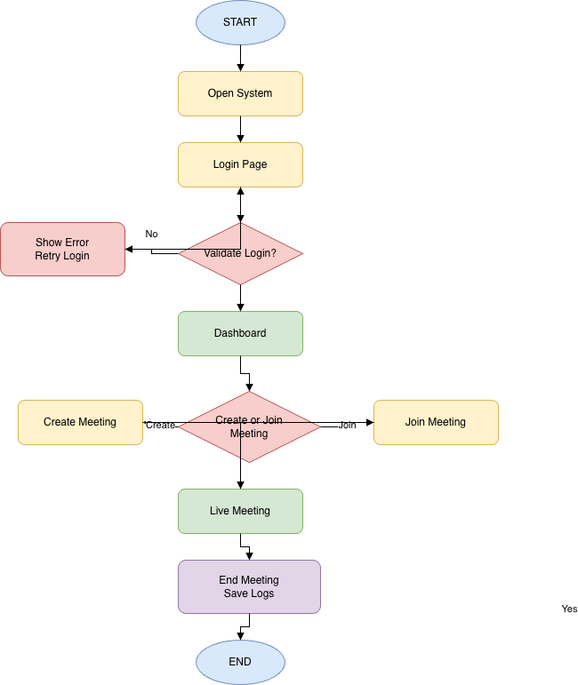
Analysis and Design
System flow chart:

Slide 12
Analysis of Algorithm
Algorithm: Admin Login & Dashboard
The system follows a modular algorithmic flow: user authentication → dashboard loading → meeting creation/join → log storage.
Authentication Algorithm:
Validates user credentials against the database.
Each login attempt is handled in O(1) average time using indexed lookups in Supabase.
Meeting Management Algorithm:
Creating a meeting involves inserting a single record into the database → O(1) time.
Joining a meeting requires fetching meeting details by ID → O(1) average time with indexing.
Dashboard Loading Algorithm:
Fetches all meetings related to a user.
Time complexity is O(n), where n is the number of meetings for that user.
Space Complexity:
Mainly depends on the number of stored users and meetings.
Overall space complexity is O(u + m), where u = users, m = meetings.
The algorithms are efficient, scalable, and suitable for real-time web applications, ensuring quick responses even when the number of users and meetings increases.

Slide 13
Technologies Used
Frontend Technologies
HTML5 – Structure and layout of the web interface.
CSS3 / Tailwind CSS – Styling, responsive design, and UI components.
JavaScript / TypeScript – Logic handling, type safety, and interactivity.
React + Vite – Fast, modern framework for building the user interface.
Backend & Database
Supabase Authentication – Secure user login and session management.
Supabase PostgreSQL Database – Stores user information, meetings, and logs.
Deployment & Tools
Node.js – Development environment and package handling.
Vite Dev Server – High-speed bundling and hot-reload development.
Git/GitHub – Version control and project hosting.

Slide 14
Modules
1. Authentication Module
Handles login and registration using Supabase Auth.
Verifies user credentials and manages secure sessions.
Supports student, faculty, and admin roles.
2. User Dashboard Module
Displays upcoming and past meetings.
Provides personalized meeting options and profile details.
Acts as the central control panel for users.
3. Meeting Management Module
Allows users to create, schedule, or join meetings.
Stores meeting details in the database.
Ensures role-based access and secure meeting entry.
4. Live Meeting Interface Module
Provides the meeting UI for the ongoing session.
Handles audio/video controls (or placeholders for future integration).
Enables real-time interaction between participants.
PostgreSQL.
5. Database Module
Manages all data related to users, meetings, and logs.
Ensures data integrity, retrieval, and storage using Supabase
6. Admin Module
Allows admin to monitor users and meetings.
Provides control over accounts, access, and platform data.

Slide 15
Hardware and Software details
Hardware:
Laptop / Desktop
Stable Internet Connection
Software:
HTML, CSS, JavaScript / TypeScript
React + Vite
Tailwind CSS (UI Framework)
Supabase Authentication
Supabase PostgreSQL Database
VS Code (Code Editor)
Node.js (Runtime Environment)
GitHub (Version Control)

Slide 16
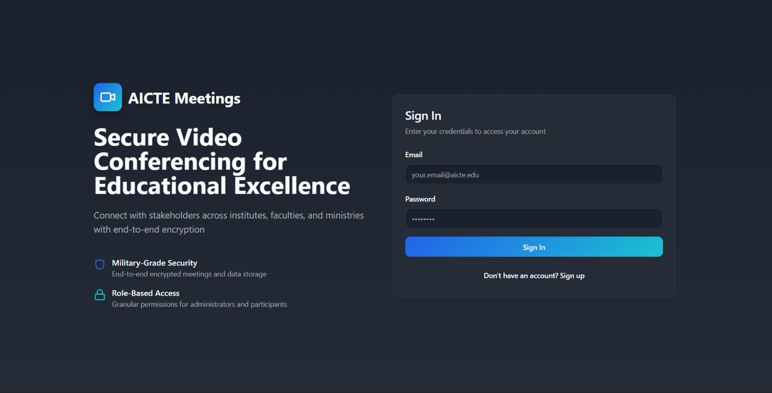
Screenshots
User login page

Slide 17
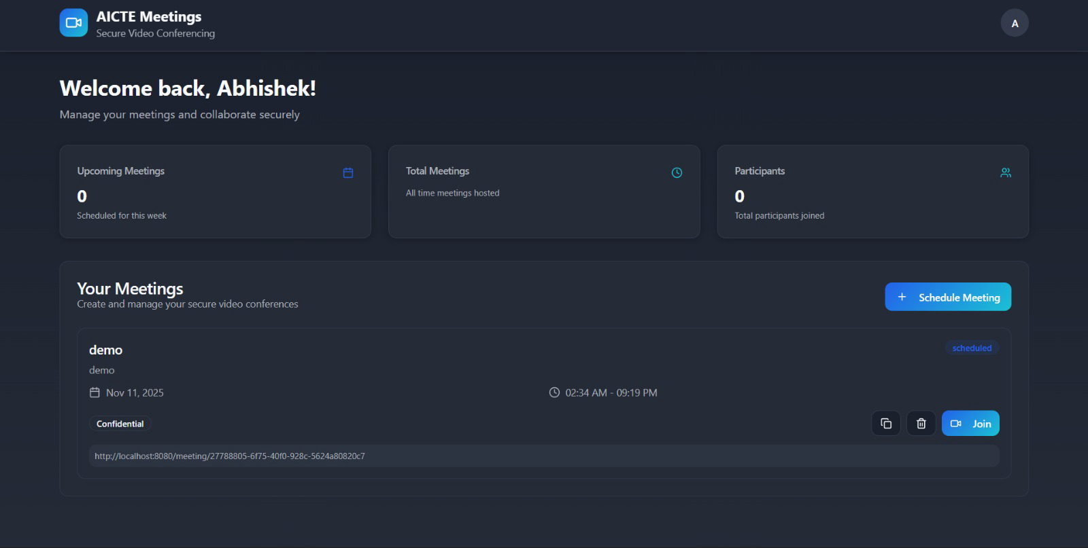
Apps main Page

Slide 18
Github Link
Deployment and Repository
Git Hub
Link: https://github.com/AbhishekMuthannaK/secure-aicte-connect.git
User translator Page
Apps Translator Page

Slide 19
Results
Successfully developed a personalized online meeting platform tailored for AICTE institutions.
Implemented secure authentication using Supabase, ensuring only authorized users can access the system.
Designed a user-friendly dashboard that displays meetings, user information, and controls in a clean interface.
Enabled users to create, schedule, and join meetings seamlessly through the system.
Integrated a responsive frontend using React, Vite, and Tailwind CSS for smooth performance across devices.
Achieved fast data access and storage through Supabase PostgreSQL database integration.
System provides a customized alternative to external platforms like Zoom or Google Meet.
Ensures better institutional control, improved security, and enhanced user experience for academic communication.

Slide 20
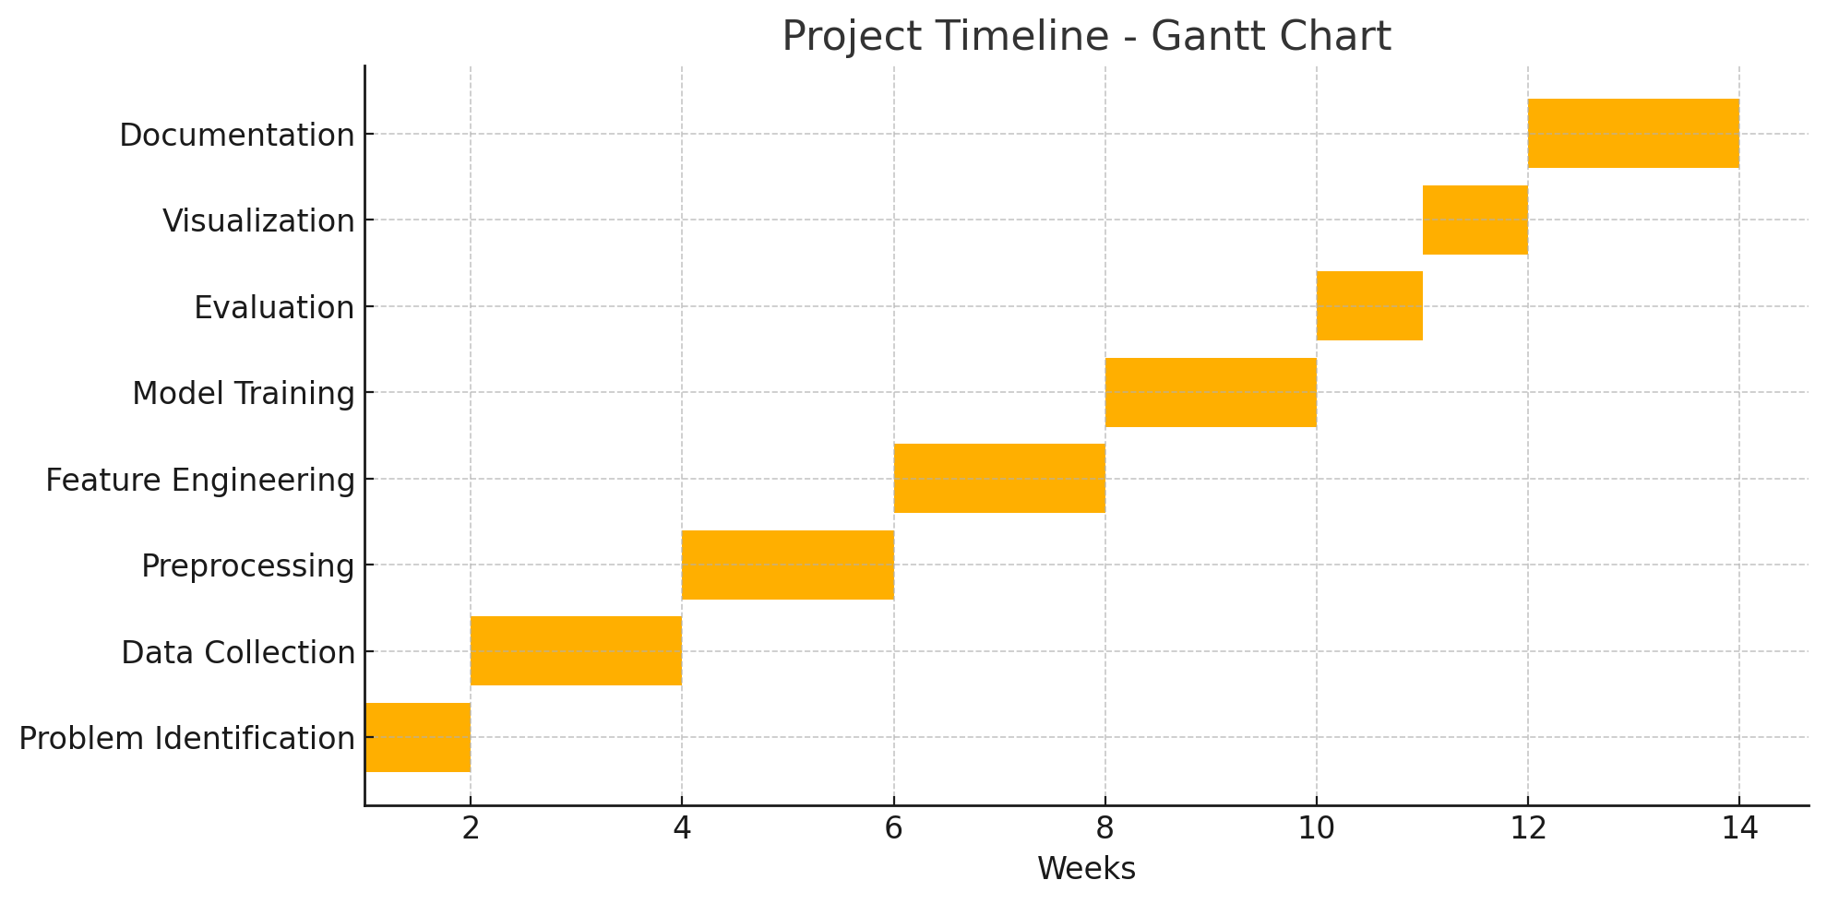
Timeline of the Project (Gantt Chart)
Gantt Chart

Slide 21
References (IEEE Paper format)
[1] M. S. Hossain, ”A Survey of Real-Time Audio-Video Conferencing Platforms,” IEEE Communications Surveys & Tutorials, vol. 23, no. 2,
pp. 110-128, 2021.
[2] AICTE, ”All India Council for Technical Education,” [Online]. Avail-able: https://www.aicte-india.org/
[3] S. K. Gupta, et al., ”Performance Analysis of Zoom, Microsoft Teams,and WebEx,” in 2021 IEEE International Conference on Communications (ICC).
[4] J. A. Kroll, ”Data Sovereignty and the Cloud: A Governance Challenge,”IEEE Security & Privacy, vol. 18, no. 4, pp. 55-61, 2020.
[5] A. Johnston and D. C. Burnett, ”WebRTC: The Definitive Guide,”O’Reilly Media, 2019.
[6] R. K. Sharma, ”An Analysis of Open-Source Video Conferencing Tools for E-Learning,” IEEE Transactions on Learning Technologies, vol. 14,no. 3, pp. 287-295, 2021.
[7] N. V. Kumar and K. R. R. Kumar, ”Blockchain for Secure E-Governance and Digital Identity,” IEEE Access, vol. 8, pp. 14721-14730, 2020.
[8] E. Androulaki, et al., ”Hyperledger Fabric: A Distributed Operating System for Permissioned Blockchains,” in Proc.
13th EuroSys Conf.,2018.
[9] Government of India, ”Digital India Initiative,” [Online]. Available:
https://www.digitalindia.gov.in/
[10] United Nations, ”SDG 9: Industry, Innovation and Infrastructure,” [On-line]. Available: https://sdgs.un.org/goals/goal9
[11] A. Jennings, ”Understanding WebRTC Security,” O’Reilly Media, 2018.
D. J. Bernstein and T. Lange, ”Post-quantum cryptography,” Nature,
vol. 549, pp. 188-194, 2017.

Slide 22


