Slide 1
Comparison of Classification Models for Bank Marketing
Abhishek Nagrecha (1097663) Sahand Asri (1114548) Prerak Patel (1117675)

Slide 2

Introduction
Bank Telemarketing
Our Goal
To find a classifier that can correctly predict whether a client will subscribe to a bank term deposit or not
Using Data-Mining Techniques
Using five Different Classifiers

Slide 3
Objective
Our objective is to analyze the performance change for multiple classifiers when applied to the original and pre-processed dataset.
The results of these classifiers will help the bank in the future making any decision about their target audience which in a way increase the overall campaign eﬀiciency by using direct marketing.

Slide 4

Dataset
Bank Marketing Dataset
UCI Dataset
20 Attributes
10 Numerical
10 Categorical
Binary Output (Classification)
Two classes specifying whether client has subscribed to bank deposit or not
41189 Instances

Slide 5
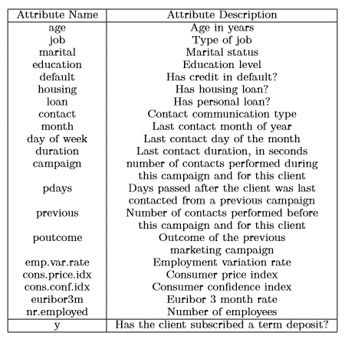
Attribute Information:

Slide 6

Literature Review
To satisfy our motive we worked on finding different papers published over this dataset.
There were many papers about the comparison among the classification models.
Most of them needed some kind of pre-processing on the data.
In “Bank direct marketing based on neural network and c5. 0 models” by H. A. Elsalamony and A. M. Elsayad, they compared Decision Tree (C5.0) and Multi-Layer Perceptron (MLP). As we know, MLP is one of the best classification model yet C5.0 decision tree model showed slightly more performance than MLP.

Slide 7
Literature Review (2)
As our dataset is imbalanced, the classification model becomes biased towards the majority class. In “Evaluation of classification algorithms with solutions to class imbalance problem on bank marketing dataset using weka” by A. Verma they made use of WEKA, a Machine Learning Tool written in Java. There are many facilities in WEKA to artificially balance the dataset. And there after they applied multiple classification models on that processed data.
There is a great impact on performance of our classification model by important features selection. In “Using data mining techniques for detecting the important features of the bank direct marketing data” by T. Parlar and S. K. ACARAVCI, Information Gain (IG) and Chi-square methods are used for selection of important features for a Naive Bayes classifier. They had a great increase in performance of classifier by used of these methods.

Slide 8

Methodologies
Dataset
Numerical and Categorical Features
Missing Values
Unbalanced Dataset
Feature Selection
Classification Models
Hyper-Parameter Tuning

Slide 9
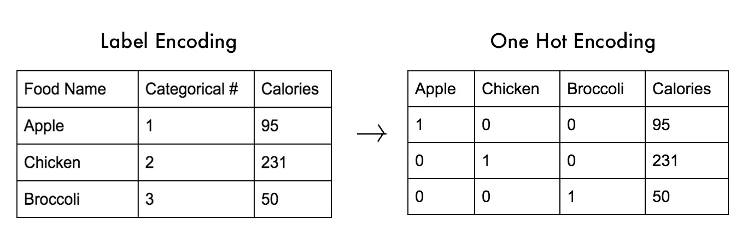
Categorical and Numerical Features
We Convert Categorical Features to Numeric Features
Label Encoding
One-hot Encoding

Slide 10
Job | Marital | Education | Poutcome | Month | Day_of_Week
job_1 | marital_1 | education_1 | poutcome_1 | month_1 | day_of_week_1
job_2 | marital_2 | education_2 | poutcome_2 | month_2 | day_of_week_2
job_3 | marital_3 | education_3 |  | month_3 | day_of_week_3
job_4 |  | education_4 |  | month_4 | day_of_week_4
job_5 |  | education_5 |  | month_5
job_6 |  |  |  | month_6
job_7 |  |  |  | month_7
job_8 |  |  |  | month_8
job_9 |  |  |  | month_9
job_10
job_11

Slide 11
Label encoding and One hot encoding
In Label Encoding a unique number will be assigned to each unique value in the feature column but a major issue with this method would be the assumption that the label sizes represent ordinality (i.e. a label of 3 is greater than a label of 2).
For one hot encoding, a new feature column will be created for each unique value in the feature column. That is value would be 1 if the value was present for that observation and 0 otherwise.
For our dataset we initially had 21 features but after dropping one feature and applying encoding methods we now have 49 features.

Slide 12

Missing Values
Many Missing Values in Dataset
6 Categorical Features
1 Numeric Feature
Deal with Missing Values
Remove entries with missing values
Recover the missing values
Imputation Techniques
Mean/Median Imputation
Common Imputation
Regression Imputation

Slide 13
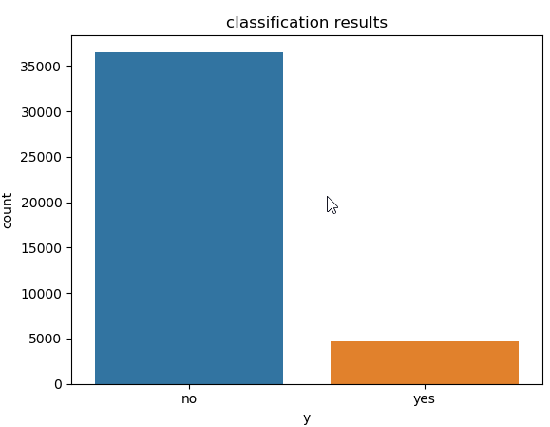
Unbalanced Dataset
Highly Imbalanced Dataset
Dataset contains almost 89% records of clients without term deposit subscription and only 11% records of clients with term deposit subscription.
Thus while applying different classifiers we got very high accuracy scores but when we checked the recall score and confusion matrix
We realized that the models were not able to classify clients who have subscription for term deposits.

Slide 14
Unbalanced Dataset (2)
There are mainly 2 ways to deal with an unbalanced dataset:
Over-Sampling
Synthetic Minority Oversampling Technique (SMOTE)
Under-Sampling
NearMiss Undersampling

Slide 15
Synthetic Minority Oversampling Technique (SMOTE)
What it does is, it creates synthetic (not duplicate) samples of the minority class.
Hence it makes the minority class(‘yes’) equal to the majority class(‘no’).
It does this by selecting similar records and altering that record one column at a time by a random amount within the difference to the neighboring records.

Slide 16
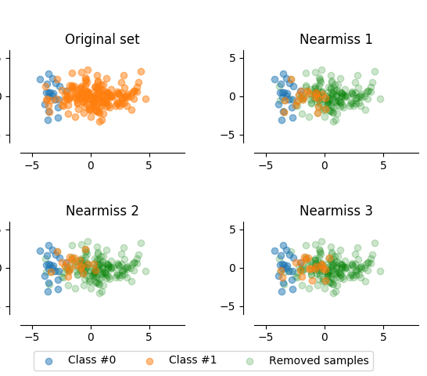
NearMiss Undersampling
NearMiss is an under-sampling technique.
It aims to balance class distribution by randomly eliminating majority class examples.
When instances of two different classes are very close to each other, we remove the instances of the majority class to increase the spaces between the two classes.

Slide 17

Feature Selection
Univariate Selection
scikit-learn Library
Correlation Matrix (Heatmap)
seaborn Library
Zero Importance Feature Elimination
LightGBM Library
Low Importance Feature Elimination
LightGBM Library
Normalization
scikit-learn Library

Slide 18
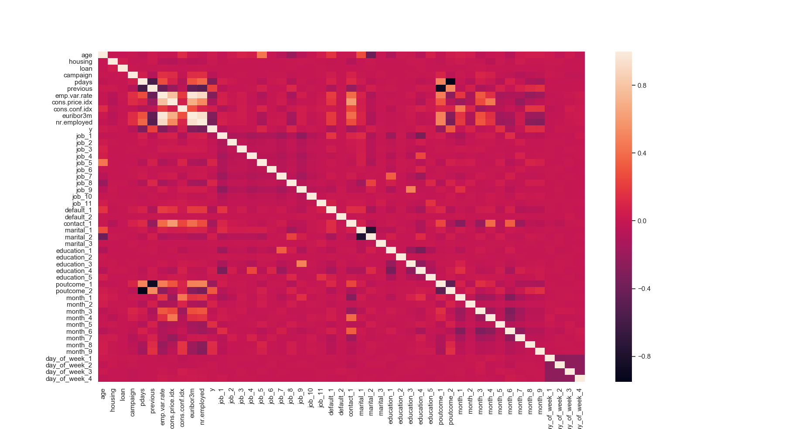
Correlation Matrix (Heatmap)

Slide 19
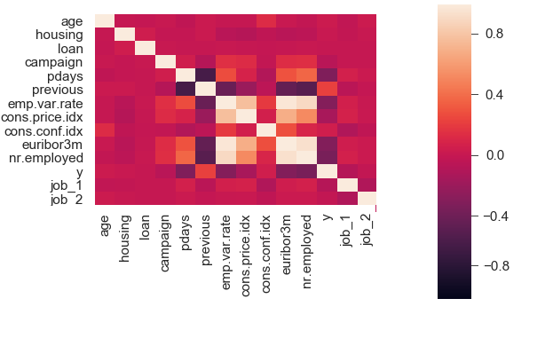
Correlation Matrix (Heatmap)

Slide 20
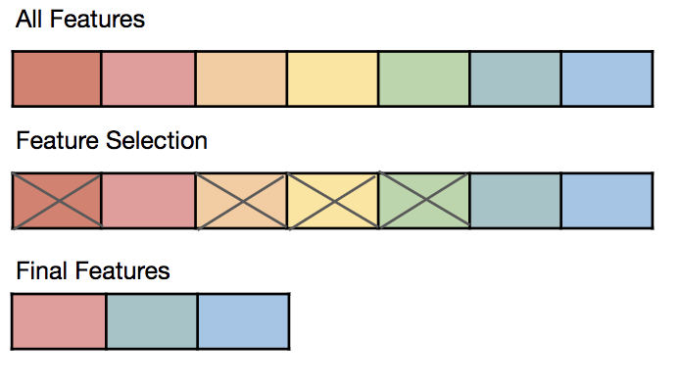
Feature Selection
Feature Exploration
We Dropped ‘duration’ feature as:
We intend to have a
realistic predictive model.
This attribute highly affects the
output target
(if duration=0 then y='no’).
intention is to have a realistic predictive model.

Slide 21
Normalization
Normalization is a scaling method used in pre-processing stage to get a better prediction. There are various types of normalizations such as Z-Score, Min-Max, and Decimal Scaling.
This dataset has both categorical and numerical attributes. Besides, the numerical attributes vary to a great extent and need to be normalized to get better results. Hence, for the numeric attributes, we are planning to normalize them using the Minmax scalar function from the sklearn library.
Minmax Scalar Function: The Minmax scalar function. Transforms the features by scaling each feature to a given range. This estimator scales and translates each feature individually such that it is in the given range on the training set [10]. For instance, transform our data to the range of zero and one.

Slide 22
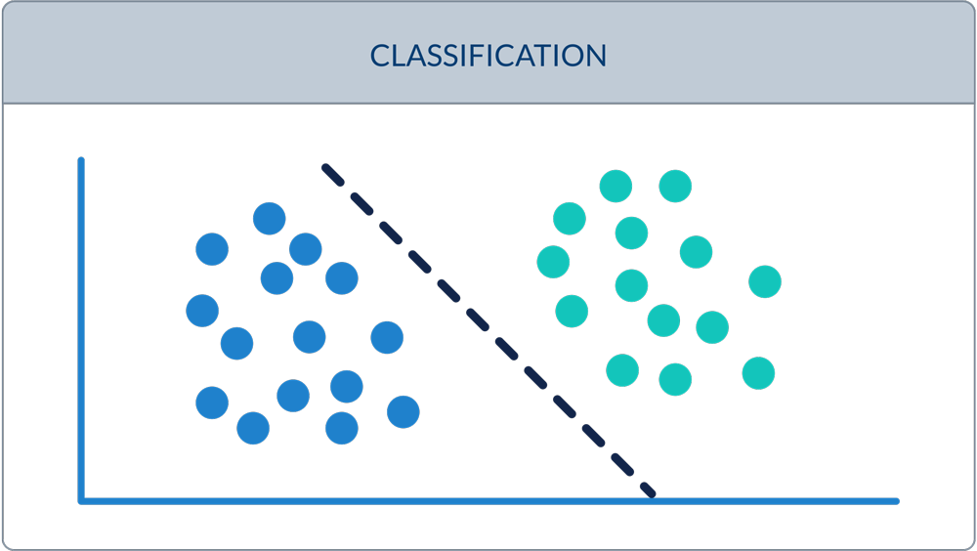
Classification Models
Logistic Regression(LR)
sklearn.linear_model module
Support Vector Machines (SVM)
sklearn.svm module
Decision Tree (DT)
sklearn.tree module
Random Forest (RF)
sklearn.ensemble module
Multilayer Perceptron (MLP)
sklearn.neural_network module

Slide 23
The Logistic Regression classifier is a machine learning classification algorithm that predicts the probability of a categorical dependent variable. In other words, the logistic regression model predicts P(Y=1) as a function of the input X. in our classifier the goal is to predict whether the client will subscribe to a term deposit (Y=1) or not (Y=0)
Decision Trees is a good choice for this dataset as we are not sure whether the data is linearly separable or not, to add to that we have a mixed data and DT works well with such data.
Random forest helps in avoiding overfitting as we use many decision trees, to add to that since the data is slightly imbalanced, we feel it will prove to be a good classifier.
We have used MLP as it can prove to be very beneficial for such classification tasks, Also it can differentiate data which is not linearly separable as it has multiple layers with a non-linear activation function. We have implemented a MLP having 3 layers for testing purpose.
SVM can also prevent overfitting as it has a regularization parameter which we are going to determine in hyperparameter tuning.to add to that SVM can determine non linear decision boundary through kernel method and can work well with such dataset.

Slide 24
Hyper-Parameter Tuning For Our Models
The best way to determine the hyperparameters is to try as many different combinations as possible for evaluating the performance of the model.
For this purpose, we will perform k-fold Cross-Validation for each of the mentioned classifier models.
Model | Parameters to be tuned
Logistic Regression | Regularization(C), size of penalty,max_iter and type of solver using GridSearchCV
Decision Trees | Criterian(gini,entropy),random state,max_depth,min_samples_split and min_samples_leaf by using RandomizedSearchCV
Support Vector Machine | Kernel, Error Rate(penalty parameter C),gamma value using GridSearchCV
Multilayer Perceptron | Hidden layer sizes(3 or more), max_iterations,activation and solver
Random Forest | Criterian,number of estimators (trees) and maximum number of features used in the model using RandomizedSearchCV
Notes:
In contrast to model parameters which are learned during training, model hyperparameters are set by the data scientist ahead of training and control implementation aspects of the model. Hyperparameters can be thought of as model settings. These settings need to be tuned because the ideal settings for one data set will not be the same across all data sets. When tuning the hyperparameters of an estimator, Grid Search and Random Search are both popular methods.Grid Search can be thought of as an exhaustive search for selecting a model. In Grid Search, the data scientist sets up a grid of hyperparameter values and for each combination, trains a model and scores on the testing data. In this approach, every combination of hyperparameter values is tried which can be very inefficient.
By contrast, Random Search sets up a grid of hyperparameter values and selects random combinations to train the model and score. This allows you to explicitly control the number of parameter combinations that are attempted. The number of search iterations is set based on time or resources.

Slide 25
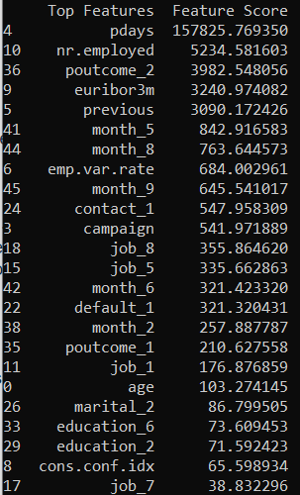
Results
These are top 24 features after applying Univariate Selection.
According to the table, pdays is the best feature in the dataset.
Based on the table, Features like loan, housing, and day_of_week have the lowest importance

Slide 26
Results(Imbalanced Data)
The Performance of Classifiers on the imbalanced dataset Without Applying Hyper-Parameter Tuning and Pre-Processing Steps
MODEL | ACCURACY | RECALL | PRECISION | F1-Score
Logistic Regression | 0.9011 | 0.22 | 0.68 | 0.45
Decision Tree | 0.8317 | 0.34 | 0.28 | 0.31
SVM | 0.8584 | 0.27 | 0.31 | 0.29
Random Forest | 0.8936 | 0.29 | 0.55 | 0.42
MLP | 0.8677 | 0.28 | 0.57 | 0.42
Notes:
Precision means the percentage of your results which are relevant. On the other hand, recall refers to the percentage of total relevant results correctly classified by your algorithm.

Slide 27
Results(balanced Data)
MODEL | ACCURACY | RECALL | PRECISION | F1-Score
Logistic Regression | 0.8242 | 0.61 | 0.35 | 0.48
Decision Tree | 0.8387 | 0.52 | 0.36 | 0.44
SVM | 0.8972 | 0.08(?) | 0.62
Random Forest | 0.8917 | 0.36 | 0.50 | 0.43
MLP | 0.8441 | 0.48 | 0.35 | 0.42

Slide 28
Conclusion
By performing current experiments we are able to conclude that different classification model’s performance will be improved by our pre-processing steps which include feature selection methods like univariate selection & identifying and removing correlated features.
Hyper parameter tuning will help in increasing the performance of classification model by adding some important parameters to the classification method.
As our performance is not too good right now but these pre-processing steps will improve it.

Slide 29
Future Works
Anomaly Detection Algorithms such as Isolation Forest, and One Class SVM can be applied to the dataset
Testing Other algorithms such as Gaussian Naïve Bayes, K-Nearest Neighbour, Multinomial Naïve Bayes, AdaBoost,Gradient Boosting and Deep Neural Network
Applying Clustering Models such as K-means, to find similarity between clients

Slide 30
Acknowledgments(Team Member Contributions)
Abhishek Nagrecha | Hyper Parameter Tuning, SMOTE, Classification Models and Normalization
Sahand Asri | Feature Selection, Missing Value Imputation and Near Miss Under sampling
Prerak Patel | Literature Review, One-Hot Encoding, Label Encoding and Dataset Exploration

Slide 31
THANK YOU

