Slide 1

COMPUTER NETWORKS PROJECT ( COMP-5213) GROUP-2 ROUTING ALGORITHM TO REFORM MOBILE NETWORK USING SDN AND CLOUD COMPUTING
Alisha dodia(0891080)
Abhishek Hedaoo(1116828)
Abhishek Nagrecha(1097663)
Yashar Ghemi(1126449)

Slide 2
CONTENT
INTRODUCTION
SURVEY
METHODOLOGY
RESULTS
ROUTING ALGORITHMS
COMPARISION MATRIX
CONCLUSSION

Slide 3
INTRODUCTION
Considered SDN& cloud computing as an on-line routing algorithm.
used to develop mobile network specific security techniques with no loss of data and network traffic will be reduced.
Using SDN and cloud computing technology to enhance the efficiency & ability of wireless networks.

Slide 4
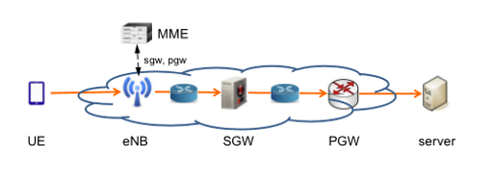
Routing in 4G LTE mobile network

Slide 5
LIMITATIONS
Strategy can’t fully utilize the networks to meet customers needs
poor flexibility during asymmetric traffic fluctuations
lacks fine- grained optimization of network resources and end-to-end traffic steering.

Slide 6
OUR AIM
to manage traffic flows in order to optimize the aggregate traffic.
Optimize the use of network resources for the security functions.

Slide 7
SDN
control plane and information plane are decoupled
control plane accumulated in a SDN controller

Slide 8
Cloud Computing
used to scale central controller in the SDN framework
Instead of using a single super-scheduler
Distribute these tasks to many servers

Slide 9
METHODOLOGY
Why we used SDN & Cloud Computing?
latency limitations on 5 G mobile networks call for comprehensive resource replication and Network Components, creating more complexity to network efficiency and traffic routing.
used SDN to avoid complex routing and cloud computing to significantly reduce the high cost of Network element

Slide 10
PdCsp: Proposed Algorithm
end-to-end primal-dual constrained shortest-path routing.
recommended efﬁcient online algorithm that is conscious of bandwidth variations
follows primary dual approach to assign link lengths
Performs shortest path routing, restricted to end-to-end latency.

Slide 11
Routing Algorithms Compared with PdCsp:
Sp
Ml

Slide 12
RESULTS
Compared the effectiveness of algorithms by simulation
Mobile network & traffic flows built for simulation to reflect the real word latencies.

Slide 13
COMPARISON MATRIX
Evaluation basis | Sp | Ml | PdCsp
NE Density | ✓ | ✓ | ✓
Network Latency | × | ✓ | ✓
Budget constraint | × | × | ✓
Congestion awareness | × | × | ✓
Reliability | × | × | ✓
Our proposed algorithm PdCsp outperforms other alternative routing algorithms under NE density, latency, budget constraints, congestion awareness and reliability.

Slide 14
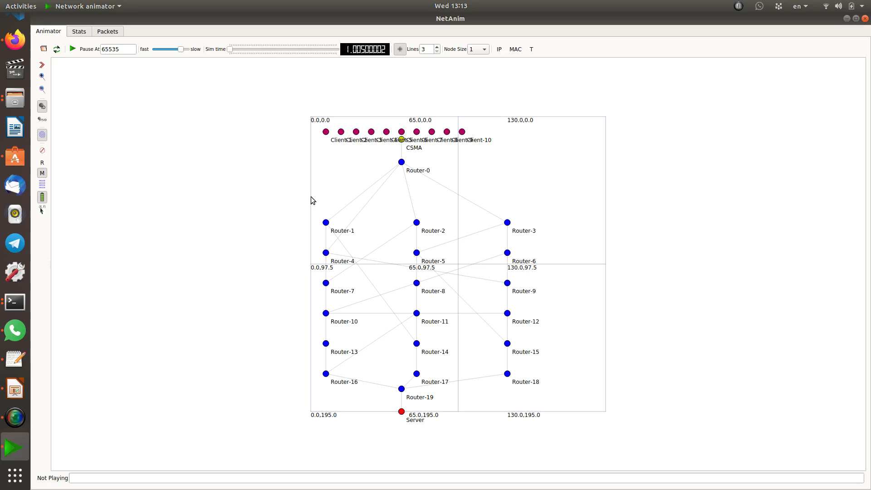

Slide 15
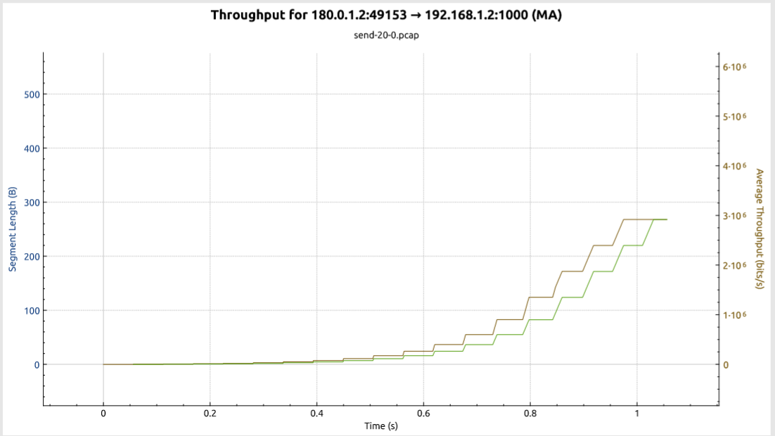
Throughput for Ml and Sp Algorithms

Slide 16
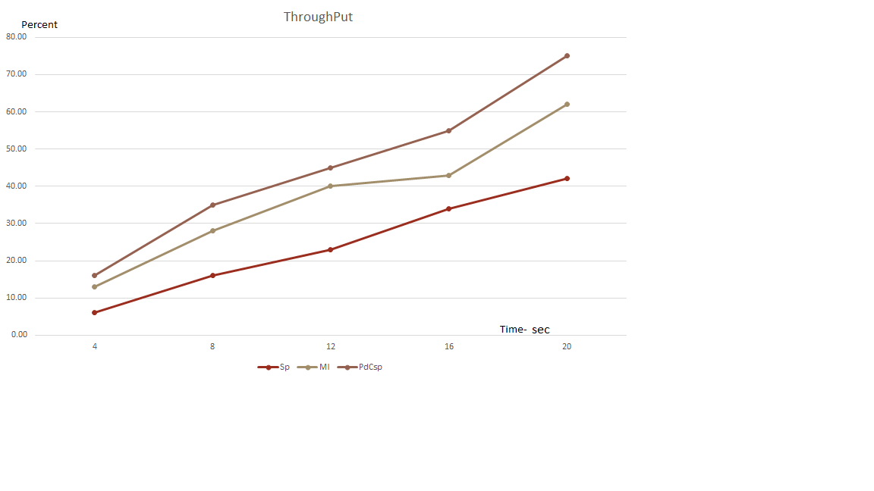

Slide 18
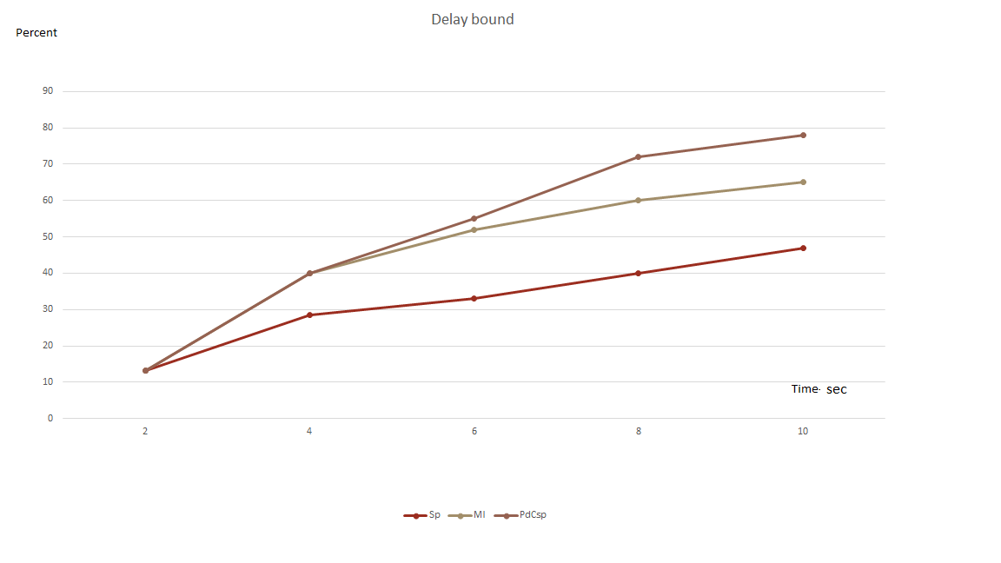

Slide 19
CONCLUSION
SDN-based architecture with cloud computing ease steering traffic flows in a cellular network to maximize the total amount of traffic accepted over time.
Simulation shows that PdCsp outperforms other alternative algorithms under considerations of NE density, latency, budget constraints, congestion control and reliability, hence better data speed and improved QoS.
Results also show that due to end-to-end optimization, congestion / budget awareness, and primal-dual approximation, algorithm significantly outperforms prevalent heuristics.

Slide 20
THANK YOU

