Slide 1
Named Entity Recognition IN Hindi+ English CODE Mixed Raw Text
Team number :
Abhishek Narayanan 01FB16ECS016
Abhishek Prasad 01FB16ECS017
Abijna Rao 01FB16ECS019
UE16CS333 project submission

Slide 2
About the project
This Project is aimed at achieving Named Entity Recognition in Hindi + English code mixed raw text data obtained from online social media like Twitter
The named entities incorporated in our experiments include standard CONLL Tags (Person, Organization and Location ), following the IOB format
There has significant research conducted on NER on resource rich languages, with minimal effort towards code mixed text, which is very popular at regional level in online social media
NER in code mixed text is a fairly challenging task owing to the unstructured nature of tweets and lack of consistency due to frequent usage of misspellings as acronyms and urls, etc. which might convey negligible or no meaning
Since there are hardly a handful of research works in related domain, the task is challenging as we have to model a solution which should be reasonably precise compared to human standard annotators, using only the very minimum data available for this purpose
We model this research problem by a deep learning solution through extensive experimentation with various embeddings and state-of-the-art deep learning techniques

Slide 3
LITERATURE SURVEY
Remmiya Devi et al in FIRE’16 proposed usage of word embeddings (trigram embedding) and stylometric features at word level fed to an SVM classifier. However they did not achieve any drastic improvement over baseline approaches possibly because SVM classifier is more suited to a binary classification problem and not recommended for NER.
Vinay et al.(2018) made their contribution by creating a dataset of annotated code mixed tweets by employing professional linguists for the task. They proposed and engineered various word level and lexical features but did not account for long term context dependency as their contextual features only include n grams where n=2 or 3
Singh et al. performed language recognition and NER on code mixed Hindi-English and proposed a bidirectional RNN for NER with hand-crafted features, but still lacked contextual information in the feature set, thereby leading to scope for improvement
Note: Referred Papers are attached

Slide 4
Uniqueness and analysis
We hypothesize that context in which an entity occurs in text has more significance and might result in improvement over the very few existing state-of-the-art approaches which employed word level or lexical features with minimal or no context and semantics taken into account
We performed experimentation with different embeddings to preserve semantic information by taking local or global context into account and propose feeding of these semantic vector representations to machine learning models. We also attempt an ensemble model of ML techniques to fit our purpose.
Inspired by state-of-art researches in related domains, we model this problem as a deep learning NER solution and propose a novel character level bidirectional recurrent neural network to tackle context and long term dependencies of entities, in an attempt to improve upon the minimal research existing

Slide 5
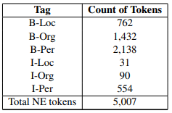
Dataset source
Dataset source : The dataset was obtained upon request from Vinay et al. [1], who made their major contribution towards this task by creating a manually tagged dataset of Hindi-English Code mixed text scraped from Twitter
Annotation of the Dataset for NE tags in the tweets was carried out by two human annotators having linguistic background and proficiency in both Hindi and English, as appointed by the authors and the Inter-Annotator agreement was computed
Using the twitter API we retrieved 1,10,231 tweets. After manually filtering as described in Section 3, we are left with 3,638 code-mixed tweets. Containing 68506 tokens.
The data statistics of useful tagged tokens
is provided alongside
Reference Paper :
[1] Singh, V., Vijay, D., Akhtar, S. S., & Shrivastava, M. (2018, July). Named entity recognition for hindi-english code-mixed social media text. In Proceedings of the Seventh Named Entities Workshop (pp. 27-35).

Slide 6
PRE-PROCESSING STEPS :
Serial No | Briefly mention the pre processing done
1. | Removal of noisy tweets which convey no information (Eg : only contain urls, etc.) and tweets which are not in code mixed Hindi- English
2. | Normalization of text to lower case. Though Punctuations and special characters are usually removed commonly at pre-processing stage in various NLP problems, we preserve them as they might convey significant meaning as Tweets frequently employ numbers or special characters to represent words. For instance, before can be typed as b4, idiot may be represented as !diot, etc.
3. | Tokenization of text by observing occurrences of continuous tokens in our corpus. For example : ‘Modi.ji.Ke.Liye’ is splitted into : [‘Modi’, ‘ji’, ‘Ke’, ‘Liye’]
4. | Stop word removal using a dictionary of Hindi-English stop words specific to our domain, to smooth out and normalize our tag distribution to inhibit the frequent occurrence of function words which carry little or no meaning, but occur frequently in our corpus and contribute to the ‘OTHERS’ tag, making its presence dominant. NOTE : This step is done for experiments with the word level and lexical features and not performed when training models like word2vec as they might contribute to the grammatical arrangement of words in sentences and hence might contribute to the contextual semantics of entities.

Slide 7
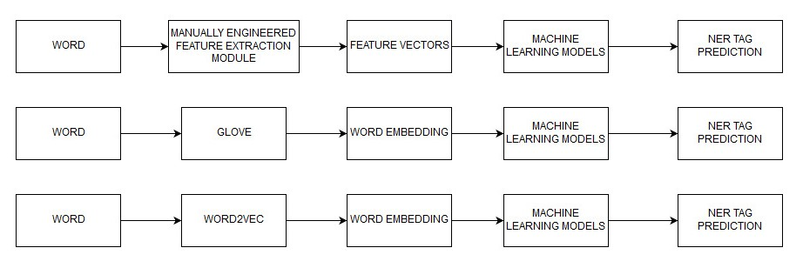
Quantity of work - High level block diagram of our implementation

Slide 8
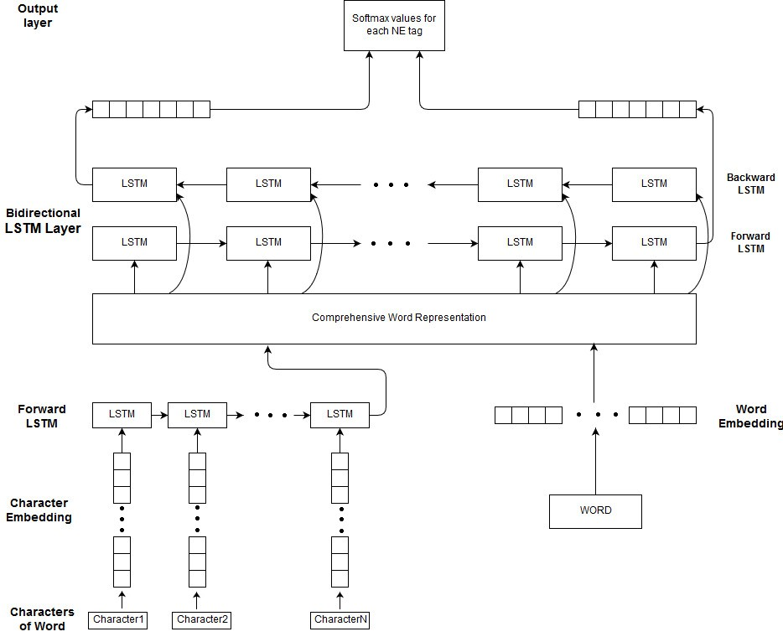
Quantity of work - High level block diagram of our implementation

Slide 9
Quantity of work – the main code modules
Serial no | Code module description | Status (% ) | What it does ?
1. | Pre-Processing module (not employed for neural embedding generation and char level RNN) | 80% | Normalizes code mixed tweets, using domain specific pre-processing techniques
2. | Feature Extraction module (manually engineered word level and lexical features) | 100% | Extracts minimal contextual features like char n grams or word n grams, lexical Boolean features such as presence of capitalization. #tags, numbers, etc
3. | Neural embedding Feature Extraction module (word2vec) | 100% | Generates word embeddings by training word2vec on our corpus to account for local context
4. | Global Vector Generating module for word representation (Glove) | 100% | Generates Glove embeddings to account for global context
5. | Basic Machine Learning module | 100% | Performs Training and Inference of basic models such as decision tree, random forest, naïve bayes
6. | Ensemble learning module to combine basic ML techniques | 100% | Trains an ensemble of above models by Voting Technique
7. | Deep learning via word level LSTMs module | 100% | Trains an LSTM network to account for word level long term dependencies
8. | Deep learning via Character Level Bidirectional LSTMs | 100% | Trains the proposed model to account for character level dependencies
9. | Model Evaluation module | 100% | Evaluate a model using metrics like precision, recall and F-Score

Slide 10
Quality of work – CODE MODULES working well
Serial no | Code Module from previous slide | Status (% complete) | Comments if there are minor issues
1. | Pre-Processing module | 80% | Pre-processing steps mentioned Successfully Deployed. Could improve upon by adding language specific rules for stemming and normalization, though this step is optional as deep learning techniques don’t need this
2. | Feature Extraction module (manually engineered word level and lexical features) | 100% | Successfully Deployed
3. | Neural embedding Feature Extraction module (word2vec) | 100% | Successfully Deployed
4. | Global Vector Generating module for word representation (Glove) | 100% | Successfully Deployed
5. | Basic Machine Learning module | 100% | Successfully Deployed
6. | Ensemble learning module to combine basic ML techniques | 100% | Successfully Deployed, does not cause drastic improvement as all models, though being reasonably accurate seem to make error predictions in the same instance space
7. | Deep learning via word level LSTMs module | 100% | Successfully Deployed, results in improvement over basic ML models as it considers word level long term dependencies, but context is uni-directional only, could be improved upon
8. | Deep learning via Character Level Bidirectional LSTMs | 100% | Successfully Deployed, survey in related literatures in other domains indicates that code mixed data usually have char level dependencies and the previous models tested above are independent of this factor to a large extent. This model gives better results over other models
9. | Model Evaluation module | 100% | Successfully Deployed, precision, recall and F-score being used, commonly employed in NER

Slide 11
Our top three learning in this project
Serial No | Top Learning in this project
1 | Usually for convenience, we take up problem statements involving a single or pure resource rich language. In this project, by taking up the challenge of performing NER on code mixed Hindi-English data, we learnt the challenges involved in performing Natural Language Processing of regional native languages, especially Indian with sparse data availability and how to make use of the existent minimal data to tackle the challenge. Hence we get more insight into the significance and need of research developments and contributions to this domain
2 | Learnt modelling Named Entity Recognition as a Language-Independent task by modelling the problem through Deep Learning solutions. In this process learnt, the pros and cons of various models in different situations and the usage of appropriate models to tackle appropriate tasks
3 | Learnt the problems involved in usage and engineering of certain features and solving the issues involved using state-of-the-art approaches

Slide 12
RESULTS
Serial No | Model | F1 Score
1 | Engineered Features fed to ML Ensemble model | 95.83%
2 | Word2Vec with ML models | 96.0%
3 | Glove with ML models | 96.0%
4 | Word2Vec with LSTM | 94.1%
5 | Glove with LSTM | 94.0%
6 | Character Level RNN | 96.0%
OBSERVATIONS :Our models have led to improvement in identifying the useful entities rather than the “Others” Tag
In the basic ML models, the F-Score appears very boosted as majority of tags are “Others” category are classified correctly but the important entities were identified with poor performance.
However, the 0.96 value in proposed novel char Bidirectional RNN model ignores the “Others tag and is for the significant entities, which is surely an improvement over existing approaches in identifying entities in code mixed data. If we include the “Others” tag as well, the F Score should shoot up further for our proposed approach.

Slide 13
Top Challenges unresolved so far
Serial No | Brief description of challenge | Type of challenge (scope/data/design/implementation / others)
1 | Tweets scraped are highly unstructured in raw code mixed text. The usage of various misspellings and typos as acronymns or representing named entities via hashtag is challenging as such things are usually removed by standard pre-processing techniques. In order to tackle this problem of handling local dialect, we need to include normalization and stemming techniques very specific to the language used. | Data Pre-processing/ Normalization of raw text scraped
2 | There is no publicly available large corpus of manually tagged datasets for convenient usage. The only dataset available was of the authors of the aforementioned paper, which is not of considerably large size and it was likely that the models might overfit if we did not apply appropriate regularization techniques | Data Availability
3 | The current state-of-art of our approach does not tackle pure Hinglish ( usage of Hindi text like आइए with English ), our scope is limited to code mixed text like Aaiye | Scope
4 | The generation of character level embeddings via LSTM takes into account context in uni-direction, though these embeddings are fed to a Bidirectional network. The generation of character embeddings should also be extended to account for Bidirectional context | Implementation
5 | The other models trained on the existing literature’s feature and word embeddings generated by word2vec or GloVe would fail in case of occurrence of Out of Vocabulary Words in an unseen instance supplied for prediction. Though this is taken care by introducing character level embeddings fed to the Bidirectional LSTM model which would generalize better than the previous approaches | Design

Slide 14
Our Going forward plan (if any)
Serial No | What you plan to do ? | When you plan to do ? Indicate month/year
1 | Attempt to create and open source a single large corpora tagged with commonly used entities to facilitate more research in this domain | June-July 2019
2 | Introduce novel pre-processing techniques (text normalization techniques such as stemming or spell correctors) specific to the code mixed social media data | June-July 2019
3 | Extend the generation of char-level embeddings to account for bidirectional context. We also propose exploration and experimentation with integrated models such as adding a CRF ( Conditional Random Field) layer with the deep learning network) or use a Convolutional Neural Network to learn salient features from the supplied input | June-July 2019

