Slide 1



Real Estate
Price Prediction
Using ML
Presented by Abhishek Negi

Slide 2

Problem Teardown
We are given dataset of house prices with some features like no of bathrooms, no of bedrooms, etc.
Our task is to create a model which will predict the price for any new house by looking at the given features.
While learning about Machine Learning it is best to actually work with real-world data, not just artificial datasets.
There are hundreds of open datasets to choose from. I have taken the data from UCI machine Learning repository.

Slide 3

Introduction..
Problems faced during buying a house
01
02
Finding and Buying a house in a stressful thing.
Buyers are not generally aware of factor that influence the house prices
03
04
Many problems are faced during buying the house such as not aware of the society, not having any finance background .
Real estate agents are trusted with the communication between buyers and sellers as well as laying down a legal contract for the transfer, this just create some middle man increases the cost of houses.

Slide 4
Finding The Type of Model To Build
01
02
Supervised, Unsupervised or Reinforcement Learning.
Classification task or regression task.
03
Batch Learning or online learning technique

Slide 5

Technology Used
1.Machine Learning
In general and Machine Learning problem can be assigned to one of two below classifications :
Supervised learning and unsupervised learning

Slide 6
Supervised Learning
Supervised Learning
In supervised learning , we are given a data set and already know what are correct output should look like. having the idea that gives the relationship between the input and the output. Supervised learning problems are categorised into “regression” and “classification” problem
Regression Problem :- In regression problem, we are trying to predict results within a continuous output meaning that we are trying to map input variables to some continuous function
Classification Problem :- In a classification problem, we are trying to predict results in a discrete output. In other words we are trying to map into prime vehicles into discrete categories.

Slide 7
Unsupervised Learning
Unsupervised Learning
Unsupervised learning allows us to approach problems with little or no idea why our results should look like. We can derive structure from data where we don’t necessarily know the effect of the variables. We can derive this structure by clustering the data fields on relationship among the variables in the data, with unsupervised learning there is no feedback based on the prediction results.

Slide 8

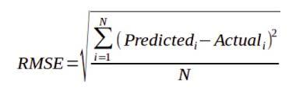
Selecting a Performance Measure
A typical performance measure for Regression problems is Root Mean Square Error (RMSE).
RMSE is generally the preferred performance measure for regression tasks, so we choose it for this particular problem we are solving for any dataset.
Other performance measures include Mean Absolute Error , Manhattan Norm, etc. but I have used RMSE for this problem.

Slide 9
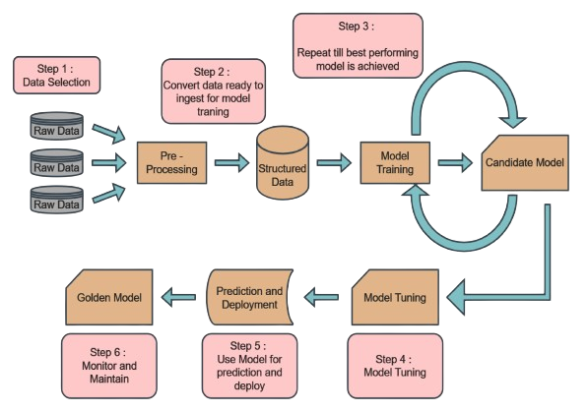
Block Diagram

Slide 10
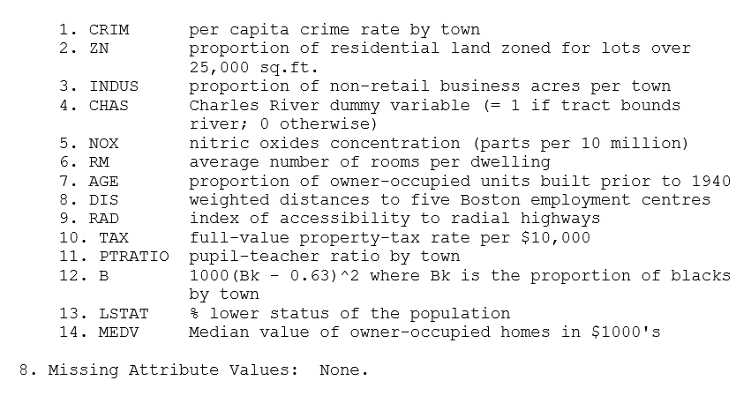
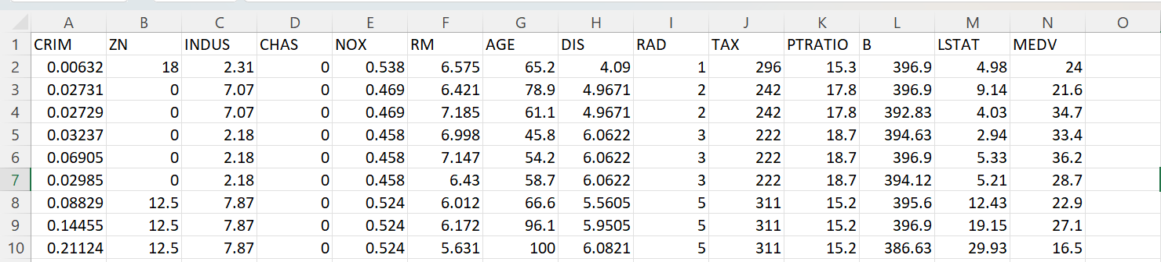
Attributes and Data Used

Slide 11

Thank You
Signing off
-Abhishek Negi

