Slide 1
PRDA-01: Profit Analysis
Impact of R&D, Administration & Marketing Spend on Startup Profit
Regression Analysis | Power BI Visualization | Business Recommendations

Slide 2
Problem Understanding
As defined in the PRD (PRDA-01)
Objective
Determine how spending on R&D, Administration, and Marketing affects a startup's Profit.
Predict
Use the model to predict Profit for two new startups given their R&D, Administration and Marketing spend.
Visualize
Build visualizations in Power BI to present the dataset and derive business insights.
Recommend
Provide data-backed suggestions to the company on where to prioritize spend.

Slide 3
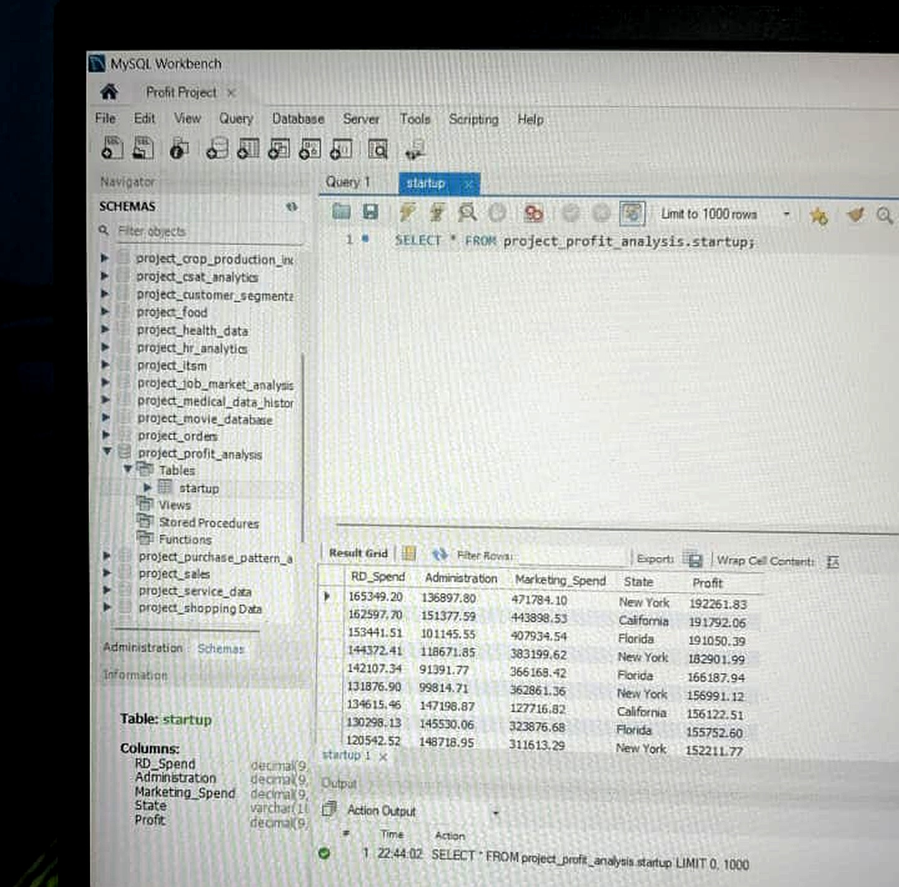
About the Dataset
50 startups across New York, California and Florida
R&D Spend
Administration
Marketing Spend
State
Profit
Amount spent on Research & Development
Amount spent on administrative overhead
Amount spent on marketing strategies
Location of the startup (NY / CA / FL)
Profit made by the startup
Dataset Source Confirmation: sourced from a MySQL Database (table: startup, DB: project_profit_analysis) via credentials provided in the PRD.

Slide 4
Methodology
Steps followed for this analysis
1
Connected to the MySQL database using the given credentials (Host, DB name, Table name) via MySQL Workbench.
2
Exported the 'startup' table (50 rows) to CSV for analysis.
3
Verified the data: no missing values, correct numeric types for RD_Spend, Administration, Marketing_Spend and Profit.
4
Performed Multiple Linear Regression in Excel using the Data Analysis ToolPak, with Profit as the dependent variable.
5
Used the regression equation to predict Profit for the two new input rows.
6
Built visualizations in Power BI to explore relationships and state-wise patterns.

Slide 5
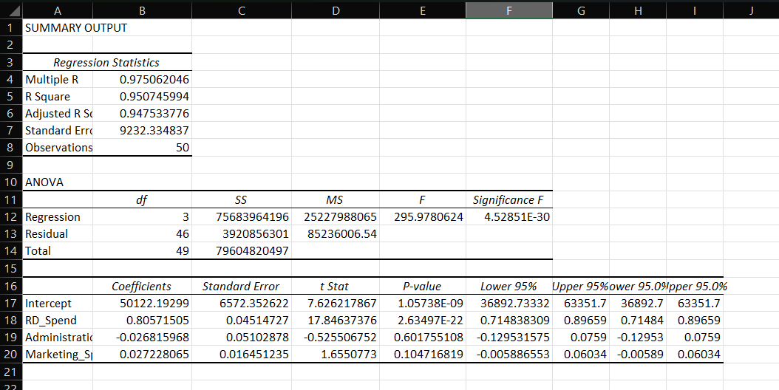
Regression Output
Excel Data Analysis ToolPak — Multiple Linear Regression
Model Summary
Multiple R
0.9751
R Square
0.9507
Adjusted R Square
0.9475
Standard Error
9232.34
Observations
50
Coefficients & Significance
Variable | Coeff. | P-value
Intercept | 50122.19 | 1.06E-09
R&D Spend | 0.8057 | 2.63E-22
Administration | -0.0268 | 0.6018
Marketing Spend | 0.0272 | 0.1047

Slide 6
What the Regression Tells Us
Interpreting coefficients and p-values (significance threshold: 0.05)
R&D Spend
Marketing Spend
Administration
Coefficient 0.81 | P-value ≈ 0.00
Coefficient 0.03 | P-value 0.10
Coefficient -0.03 | P-value 0.60
Highly significant. Every ₹1 spent on R&D adds ~₹0.81 to Profit. The strongest driver by far.
Not statistically significant (p > 0.05), though it shows a mild positive trend.
Not statistically significant. Administration spend shows no reliable relationship with Profit.
Overall model fit: R² = 0.9507 — the three predictors together explain ~95% of the variation in Profit.

Slide 7
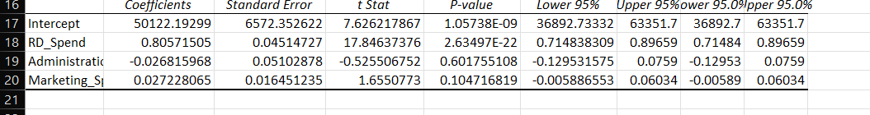
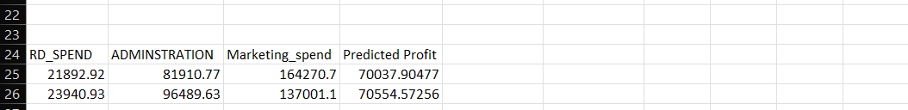
Profit Prediction for New Inputs
Using the regression equation from Excel
Coefficients used (from Excel regression)
Regression Equation
Profit = 50122.19 + (0.8057 × R&D Spend) + (-0.0268 × Administration) + (0.0272 × Marketing Spend)
Predicted Results (from Excel)
Both predictions fall well within the training data's Profit range (~₹35K to ₹192K), indicating reasonable, non-extrapolated estimates.

Slide 8
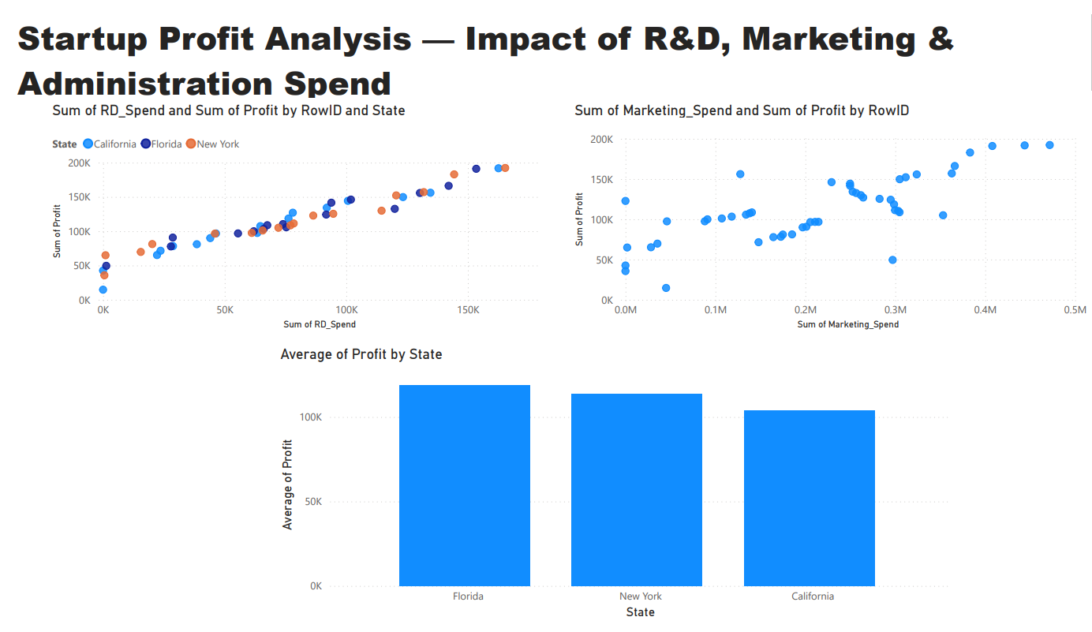
Power BI Visualizations
RD_Spend vs Profit | Marketing_Spend vs Profit | Average Profit by State

Slide 9
Key Insights
R&D Spend is the dominant driver of Profit — a near 1:1 relationship, and the only statistically significant predictor.
Marketing Spend shows a mild positive trend with Profit, but it is not statistically strong enough to confirm on this dataset.
Administration Spend has no meaningful relationship with Profit — higher admin spend does not translate into higher profit.
State/location has little impact — average profit is broadly similar across New York, Florida and California.
The regression model explains ~95% of the variation in Profit (R² = 0.95), making it a strong fit for this dataset.

Slide 10
Recommendations to the Company
Prioritize R&D investment
Since R&D spend is the strongest and only statistically significant driver of Profit, allocating a larger share of budget here is likely to yield the best returns.
Re-evaluate Administration spend
Administration spend shows no measurable link to Profit — consider auditing this budget for cost-saving opportunities.
Test Marketing spend cautiously
Marketing shows a weak positive trend; controlled experiments (A/B testing spend levels) could clarify its real impact before scaling it up.
Location is not a limiting factor
Since State has little effect on Profit, expansion decisions can be driven by other factors (talent, cost of living, market access) rather than profit potential alone.

Slide 11
Thank You
PRDA-01 — Profit Analysis | Data Source: MySQL Database | Tools: MySQL Workbench, Excel, Power BI

