Slide 1

PORTFOLIO PROJECT · MACHINE LEARNING CASE STUDY
Telecom Customer
Churn Prediction
Predicting customer attrition for ConnectTel with explainable, end-to-end machine learning
Python
scikit-learn
XGBoost
SHAP
GridSearchCV
Abhishek Panchal
Data Science & Machine Learning Portfolio | 2026

Slide 2
TABLE OF CONTENTS
What We’ll Cover
3
Project Overview
12
Random Forest
4
Problem Statement
13
XGBoost
5
Objectives
14
Model Comparison
6
Dataset Overview
15
ROC Curve
7
Data Cleaning
16
SHAP Explainability
8
Exploratory Data Analysis
17
Business Recommendations
9
Feature Engineering
18
Future Scope
10
Machine Learning Workflow
19
Conclusion
11
Logistic Regression
20
Thank You

Slide 3




INTRODUCTION
Project Overview
This project builds an end-to-end machine learning pipeline that predicts customer churn for ConnectTel — a telecom provider — using demographic, account, and service data. The workflow spans data cleaning, exploratory analysis, feature engineering, model training, hyperparameter tuning, and explainable AI.
Data
EDA
Modeling
Explainability
Clean & prepare 7,043 customer records
Uncover behavioral churn patterns
Train & tune 3 classification models
Interpret drivers with SHAP
TOOLS & TECHNOLOGIES
Python
Pandas & NumPy
scikit-learn
XGBoost
SHAP
Matplotlib & Seaborn
GridSearchCV
Abhishek Panchal • ConnectTel Churn Prediction
3

Slide 4

THE BUSINESS CHALLENGE
Problem Statement
ConnectTel is facing customer churn, which results in direct revenue loss. The objective of this project is to build a machine learning model that predicts whether a customer is likely to churn, based on demographic, service, and account information.
WHY CHURN PREDICTION MATTERS
26.5%
Retaining an existing customer is far more cost-effective than acquiring a new one
of ConnectTel customers churned in the observed dataset
Early identification of at-risk customers enables targeted, timely retention offers
Reducing churn protects recurring revenue and long-term customer lifetime value
A churn rate this size represents a significant, addressable revenue risk — and a clear opportunity for a predictive, proactive retention strategy.
Abhishek Panchal • ConnectTel Churn Prediction
4

Slide 5






PROJECT GOALS
Objectives
Explore the Data
Engineer Features
Uncover behavioral patterns that precede churn
Strengthen the predictive signal beyond raw fields
Build & Compare Models
Tune the Best Model
Train Logistic Regression, Random Forest & XGBoost
Optimize XGBoost with GridSearchCV
Explain Predictions
Drive Business Action
Apply SHAP for model transparency
Translate insights into retention strategy
Abhishek Panchal • ConnectTel Churn Prediction
5

Slide 6
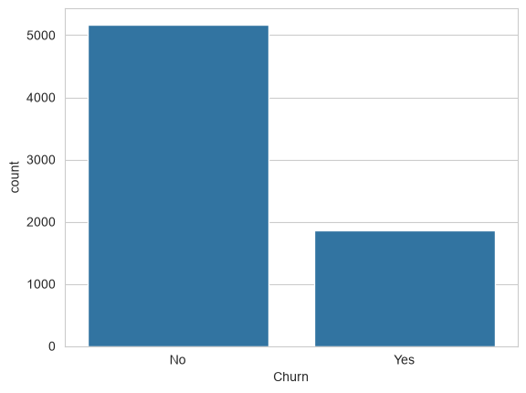
DATA FOUNDATION
Dataset Overview
7,043
21
26.5%
Yes / No
Customer Records
Original Features
Churn Rate
Target Variable
FEATURE CATEGORIES
Churn Distribution — Actual Chart from Notebook
Demographics
Gender, senior citizen status, partner, dependents
Account Details
Tenure, contract type, billing, payment method, charges
Subscribed Services
Phone, internet, security, backup, streaming & support
5,174 customers retained • 1,869 customers churned
Abhishek Panchal • ConnectTel Churn Prediction
6

Slide 7





PREPARING THE DATA
Data Cleaning
Type Correction
Missing Values
"TotalCharges" was stored as text and converted to a proper numeric type for modeling.
11 records with missing "TotalCharges" (blank strings) were identified and removed.
Duplicate Check
Clean Dataset Ready
The dataset was checked for duplicate records — none were found.
The cleaned data was saved and carried forward into feature engineering.
7,043 rows
7,032 rows × 21 columns
Final, model-ready dataset after cleaning
Abhishek Panchal • ConnectTel Churn Prediction
7

Slide 8
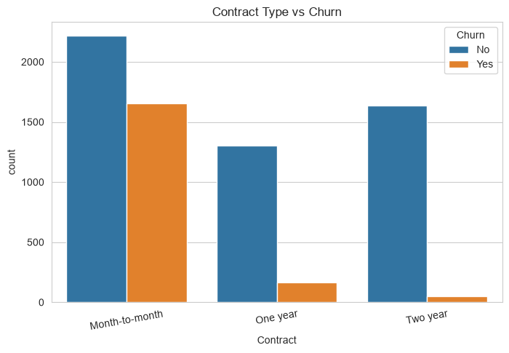
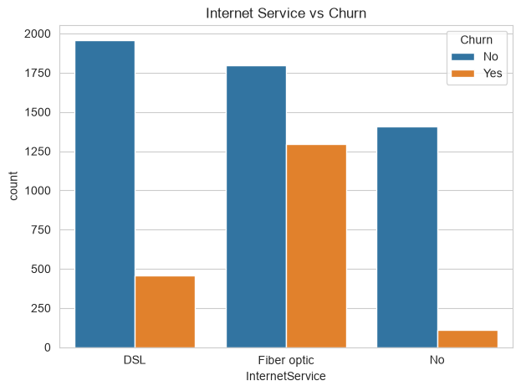
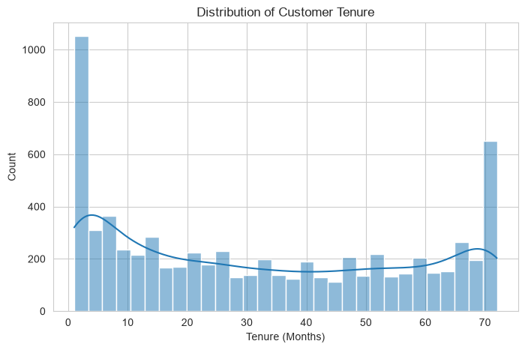
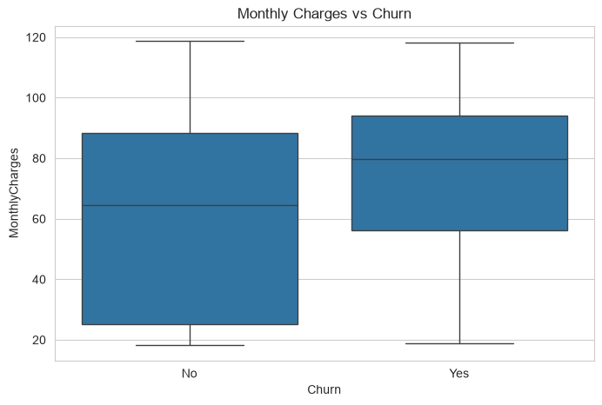
UNCOVERING CHURN PATTERNS
Exploratory Data Analysis
Month-to-Month customers churn the most
Fiber Optic users churn more than DSL
Many customers are still early in tenure
Churners tend to pay higher monthly charges
Abhishek Panchal • ConnectTel Churn Prediction
8

Slide 9



ENGINEERING PREDICTIVE SIGNALS
Feature Engineering
New features were derived from existing fields to strengthen the model’s predictive power beyond the raw dataset.
TotalChargesPerTenure
ServiceCount
LongTermCustomer
TotalCharges ÷ tenure
Sum of active add-on services
tenure ≥ 24 months → 1, else 0
Average monthly spend across a customer’s full tenure, smoothing outliers for new customers.
Total number of subscribed services per customer — a proxy for account engagement.
A binary flag identifying established, long-tenured customers.
19 predictor columns
33 model-ready features
after one-hot encoding categorical variables (drop_first=True)
Abhishek Panchal • ConnectTel Churn Prediction
9

Slide 10




END-TO-END PIPELINE
Machine Learning Workflow
1
2
3
4
Dataset
Data Cleaning
EDA
Feature
Engineering
8
7
6
5
Prediction
SHAP Analysis
Evaluation
Model Training
Stages 1–4 form the data foundation; stages 5–8 build, evaluate, and explain the predictive model.
Abhishek Panchal • ConnectTel Churn Prediction
10

Slide 11
BASELINE MODEL · MODEL 1 OF 3
Logistic Regression
Logistic Regression serves as the baseline classification model. It predicts the probability that a customer will churn using a linear combination of scaled numeric and encoded categorical features.
80.60%
65%
Accuracy
Precision (Churn)
KEY CHARACTERISTICS
58%
61%
Fast to train, with highly interpretable coefficients
Recall (Churn)
F1-Score (Churn)
Serves as the benchmark for the ensemble models that follow
Trained on standardized (scaled) numeric features
CONFUSION MATRIX — TEST SET (n = 1,407)
Model Insight
 | Predicted: No | Predicted: Churn
Actual: No | 917 | 116
Actual: Churn | 157 | 217
Despite its simplicity, Logistic Regression achieved the highest raw accuracy and a strong ROC-AUC of 0.835 — a solid, interpretable baseline for the ensemble models to beat.
Abhishek Panchal • ConnectTel Churn Prediction
11

Slide 12
ENSEMBLE MODEL · MODEL 2 OF 3
Random Forest
Random Forest builds many decision trees on random subsets of data and features, then averages their predictions. This reduces overfitting and typically improves generalization over a single tree.
79.74%
65%
Accuracy
Precision (Churn)
KEY CHARACTERISTICS
51%
57%
Trained with 100 decision trees (n_estimators = 100)
Recall (Churn)
F1-Score (Churn)
Robust to outliers and less prone to overfitting than a single tree
Validated with 5-fold cross-validation for reliability
CONFUSION MATRIX — TEST SET (n = 1,407)
5-Fold Cross-Validation
 | Predicted: No | Predicted: Churn
Actual: No | 930 | 103
Actual: Churn | 182 | 192
79.19%
Fold scores: 79.3%, 80.1%, 77.2%, 80.4%, 79.0%
average accuracy
Abhishek Panchal • ConnectTel Churn Prediction
12

Slide 13
OPTIMIZED MODEL · MODEL 3 OF 3
XGBoost
XGBoost (Extreme Gradient Boosting) builds decision trees sequentially, with each new tree correcting the errors of the ones before it. It is prized for high performance, speed, and regularization.
76.47%
Baseline XGBoost — Accuracy (before tuning)
HYPERPARAMETER TUNING
GridSearchCV searched across parameter combinations with 5-fold cross-validation, optimizing for ROC-AUC — the most reliable metric for this imbalanced churn classification problem.
TUNED XGBOOST
BEST MODEL
79.82%
0.8399
accuracy
ROC-AUC (best of all models)
BEST HYPERPARAMETERS (SELECTED VIA GRIDSEARCHCV)
0.1
3
100
0.8
learning_rate
max_depth
n_estimators
subsample
Abhishek Panchal • ConnectTel Churn Prediction
13

Slide 14
CHOOSING THE FINAL MODEL
Model Comparison
PERFORMANCE SUMMARY
Model | Accuracy | ROC-AUC
Logistic Regression | 80.60% | 0.8354
Random Forest | 79.74% | 0.8165
XGBoost ★ | 79.82% | 0.8399
XGBoost Selected
as the final model
XGBoost achieved the highest ROC-AUC (0.840) — the most reliable metric for this imbalanced churn dataset — while remaining competitive on accuracy. It was carried forward for hyperparameter tuning and SHAP interpretation.
Abhishek Panchal • ConnectTel Churn Prediction
14

Slide 15
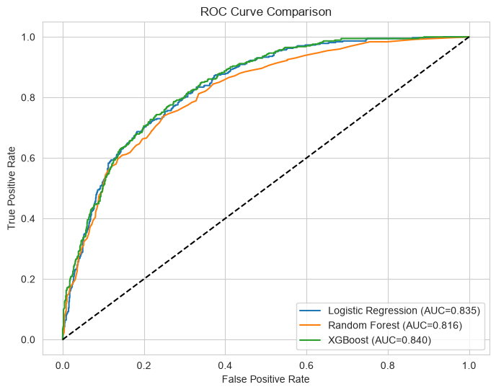
MODEL DISCRIMINATION PERFORMANCE
ROC Curve
The ROC Curve plots the True Positive Rate against the False Positive Rate across classification thresholds. A larger Area Under the Curve (AUC) means stronger separation between churned and retained customers.
ROC Curve Comparison — Actual Chart from Notebook
AUC SCORECARD
Logistic Regression
0.835
Random Forest
0.816
XGBoost
0.840
Abhishek Panchal • ConnectTel Churn Prediction
15

Slide 16
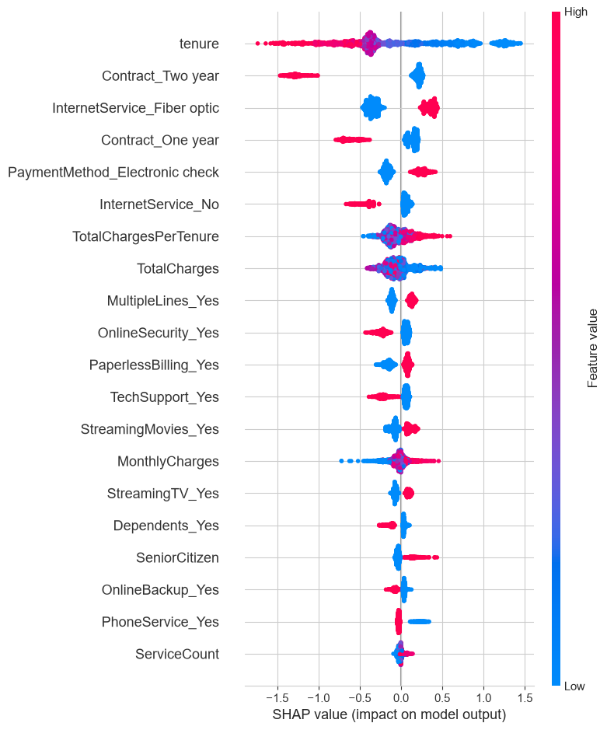
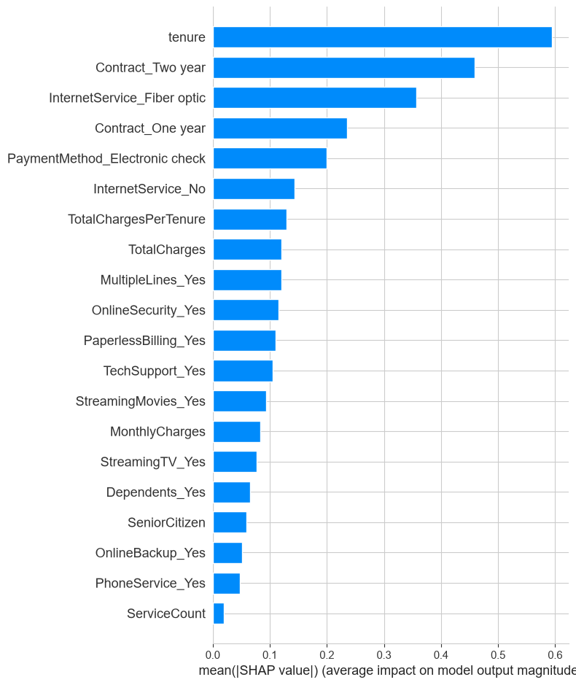
EXPLAINABLE AI
SHAP Explainability
SHAP Summary Plot
Feature Importance (Mean |SHAP|)
TOP CHURN DRIVERS IDENTIFIED BY SHAP
Contract Type
Tenure
Monthly Charges
Internet Service
Service Count
Abhishek Panchal • ConnectTel Churn Prediction
16

Slide 17





TURNING INSIGHTS INTO ACTION
Business Recommendations
1
2
3
Contract Migration Offers
Fiber Optic Service Review
High-Value Retention Campaigns
Offer promotional discounts to Month-to-Month customers to encourage migration to 1- or 2-year contracts.
Review the pricing and service quality of Fiber Optic internet plans, which show higher churn rates.
Launch personalized retention campaigns for customers with high monthly charges.
4
5
6
First-Year Loyalty Rewards
Promote Value-Added Services
Early-Warning Monitoring
Provide loyalty rewards during customers’ first 12 months to improve long-term retention.
Promote Online Security and Tech Support to increase customer engagement.
Use the churn model as an early warning system to flag high-risk customers before they leave.
Abhishek Panchal • ConnectTel Churn Prediction
17

Slide 18



WHAT’S NEXT
Future Scope
Explore Additional Algorithms
Evaluate LightGBM, CatBoost, or stacked ensembles to further improve predictive performance.
Address Class Imbalance
Apply techniques such as SMOTE or class-weighting to better capture minority-class churners.
Deploy as a Live Prediction Service
Package the model as a real-time API or dashboard for customer service and retention teams.
Enrich with Additional Data
Incorporate support tickets, NPS, or satisfaction survey data to strengthen the feature set.
Establish Periodic Retraining
Schedule regular model retraining to keep pace with evolving customer behavior.
Abhishek Panchal • ConnectTel Churn Prediction
18

Slide 19

PROJECT SUMMARY
Conclusion
This project delivered a complete, end-to-end machine learning pipeline for predicting customer churn at ConnectTel — spanning data cleaning, exploratory analysis, feature engineering, model training, hyperparameter tuning, and explainable AI.
Among all evaluated models, XGBoost achieved the best overall ROC-AUC performance and was selected as the final predictive model.
0.840
The developed solution enables ConnectTel to proactively identify customers at high risk of churn and implement targeted retention strategies — reducing attrition and protecting revenue.
Final ROC-AUC — XGBoost
Key SHAP drivers: Contract Type, Tenure, Monthly Charges, Internet Service, Service Count
Abhishek Panchal • ConnectTel Churn Prediction
19

Slide 20

PORTFOLIO PROJECT · MACHINE LEARNING CASE STUDY
Thank You
Questions & Discussion
Abhishek Panchal
Data Science & Machine Learning Portfolio | ConnectTel Churn Prediction

