Slide 1

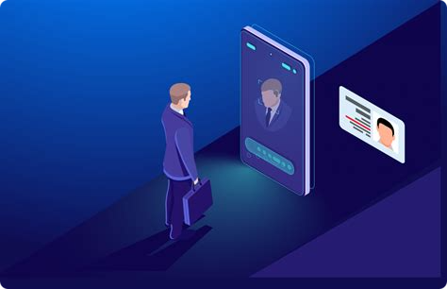

Attendance Management System Using Facial Recognition
An attendance management system using facial recognition can significantly modernize the traditional attendance process by providing a faster, more secure, and automated solution. Traditional attendance methods, such as manual roll calls or card-based systems, are often time-consuming, prone to errors, and susceptible to manipulation (e.g., buddy punching, where one person clocks in for another). With facial recognition, the process becomes streamlined, reducing the time it takes to mark attendance and minimizing inaccuracies.
The system works by using cameras and Python algorithms to identify each person’s unique facial features. When someone arrives at the designated location, the system captures an image, compares it with stored profiles, and automatically records the attendance if a match is found. This eliminates the need for individuals to carry ID cards or remember passwords, making the system more convenient and secure.

Slide 2

The Power of Facial Recognition in Attendance Management
Facial recognition technology has emerged as a game-changer in the realm of attendance management. By leveraging sophisticated Python algorithms and advanced camera systems, our solution can accurately identify individuals, eliminating the need for traditional, error-prone methods.
This system not only enhances security by ensuring only authorized individuals can mark attendance but also significantly reduces the time spent on this daily task. The system's ability to operate contactlessly is particularly valuable in today's health-conscious environment, minimizing touch points and promoting hygiene.
1
Image Capture
High-resolution camera capture facial images as individuals approach the attendance point.
2
Feature Extraction
The system analyzes the image, extracting unique facial features to create a digital signature.
3
Database Comparison
The extracted features are compared against the database of registered users for identification.
4
Attendance Marking
Upon successful match, the system automatically records the attendance in real-time and saves in a Excel file.

Slide 3






Step-by-Step: How the App Works
Our Attendance Management App is designed with simplicity and efficiency in mind. The user-friendly interface guides individuals through each step of the process, from initial registration to daily attendance marking. Let's walk through the key stages of using this innovative system:
Register Yourself
Capture Images
Save Profile
Mark Attendance
Users begin by entering their unique ID and name, establishing their profile in the system. This one-time setup ensures seamless future interactions.
The app prompts users to take multiple photos, capturing various angles and expressions to create a comprehensive facial profile for accurate recognition.
Once images are captured, the system processes and securely stores the facial data, completing the registration process.
Daily attendance is as simple as clicking a button. The app uses facial recognition to verify identity and instantly mark attendance.
This streamlined process not only saves time but also ensures accuracy and eliminates the possibility of fraudulent check-ins.

Slide 4






Key Features: Enhancing Workplace Efficiency
Our Attendance Management System is packed with features designed to revolutionize how organizations handle time and attendance tracking. These key elements work in harmony to create a robust, efficient, and user-friendly system that addresses the needs of both employees and management.
Biometric Security
Seamless Attendance Marking
Utilizes advanced facial recognition for foolproof identification, ensuring the highest level of security and eliminating buddy punching.
With just a click, users can mark their attendance in real-time. The system immediately verifies their identity through facial recognition, ensuring accuracy and reducing time.
Data Management and Security
Elimination of Buddy Punching
The system saves attendance data and user details in an Excel file, which provides a secure and organized way to manage and retrieve records as needed.
The use of facial recognition ensures that only the registered individual can mark their attendance, preventing issues like buddy punching.

Slide 5

User-Friendly Interface: Simplifying Daily Tasks
At the heart of our Attendance Management System lies an intuitive and user-friendly interface. We understand that technology is only as good as its usability, which is why we've prioritized creating an interface that is accessible to users of all technical backgrounds.
Intuitive Design
Clear Instructions
Responsive Feedback
The app's layout is crafted for simplicity, featuring large, clearly labeled buttons and a logical flow between screens. This design ensures that users can navigate the system effortlessly, reducing the learning curve and increasing adoption rates across organizations.
Each step of the process, from initial setup to daily use, is accompanied by concise, easy-to-follow instructions. This guided approach minimizes confusion and helps users complete tasks quickly and accurately, enhancing overall efficiency.
The system provides immediate visual and textual feedback for all actions, confirming successful operations or guiding users through error resolution. This responsive design builds user confidence and reduces the need for technical support.

