Slide 1
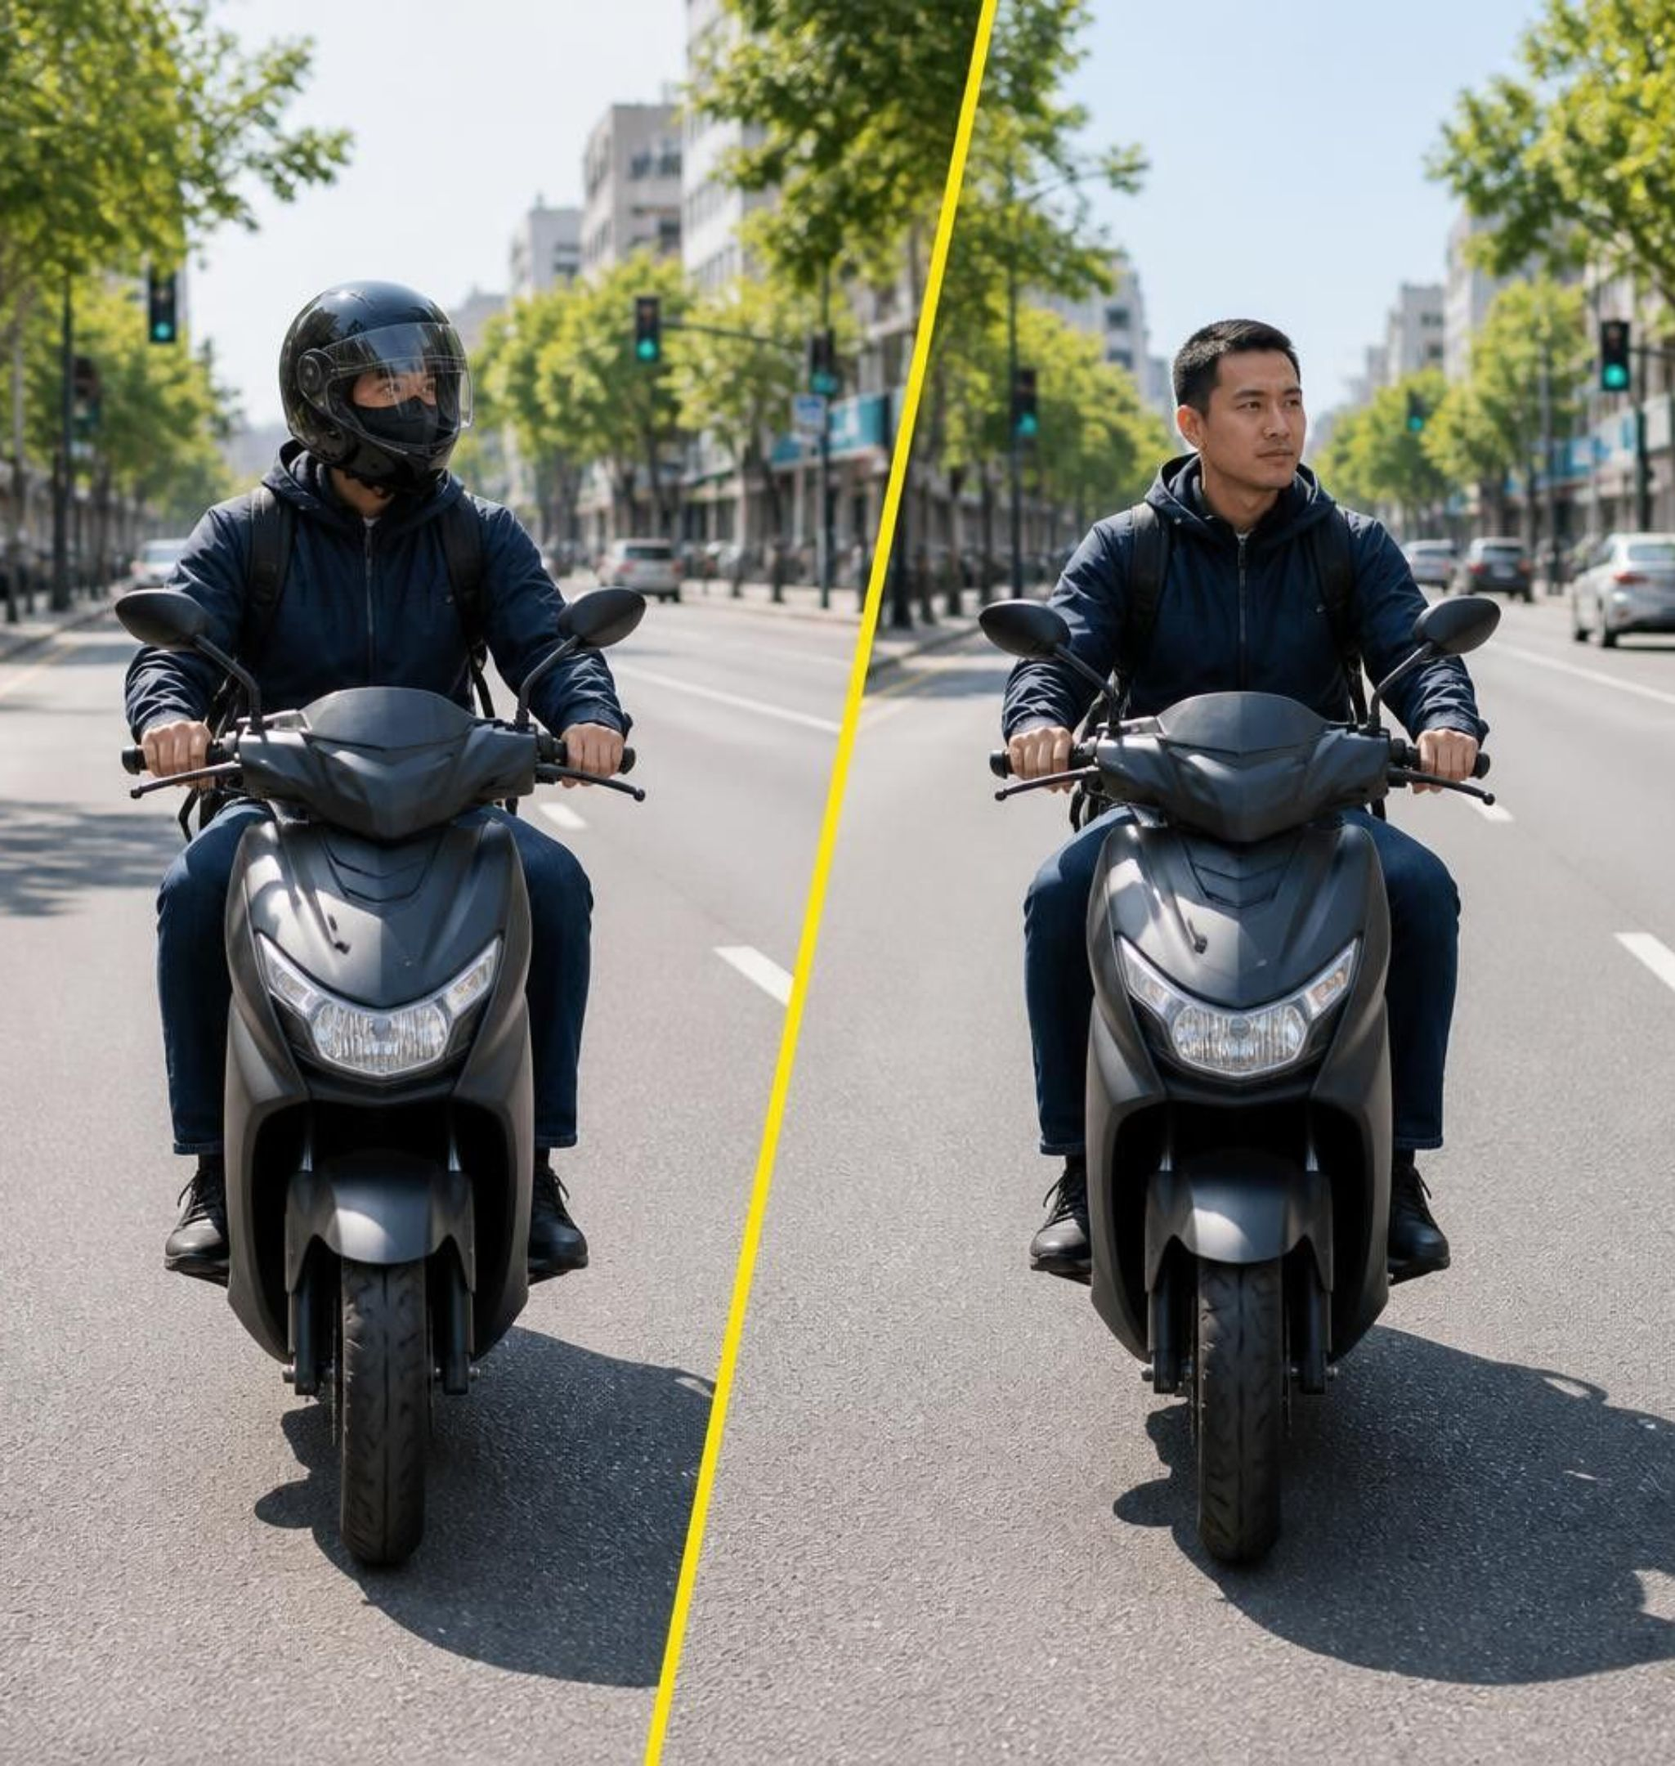
HELMET / MASK DETECTION USING A CNN
Team: Abhishek · Abhishek S Poojary · Deekshith Poojary · K Anujnya Shenoy
Notes:
Good morning everyone. Today our team is presenting our ABA-2 computer vision project: automated helmet and mask detection using a Convolutional Neural Network. We built a binary classification pipeline to verify whether riders and workers are wearing protective headgear and face masks from single camera frames.

Slide 2
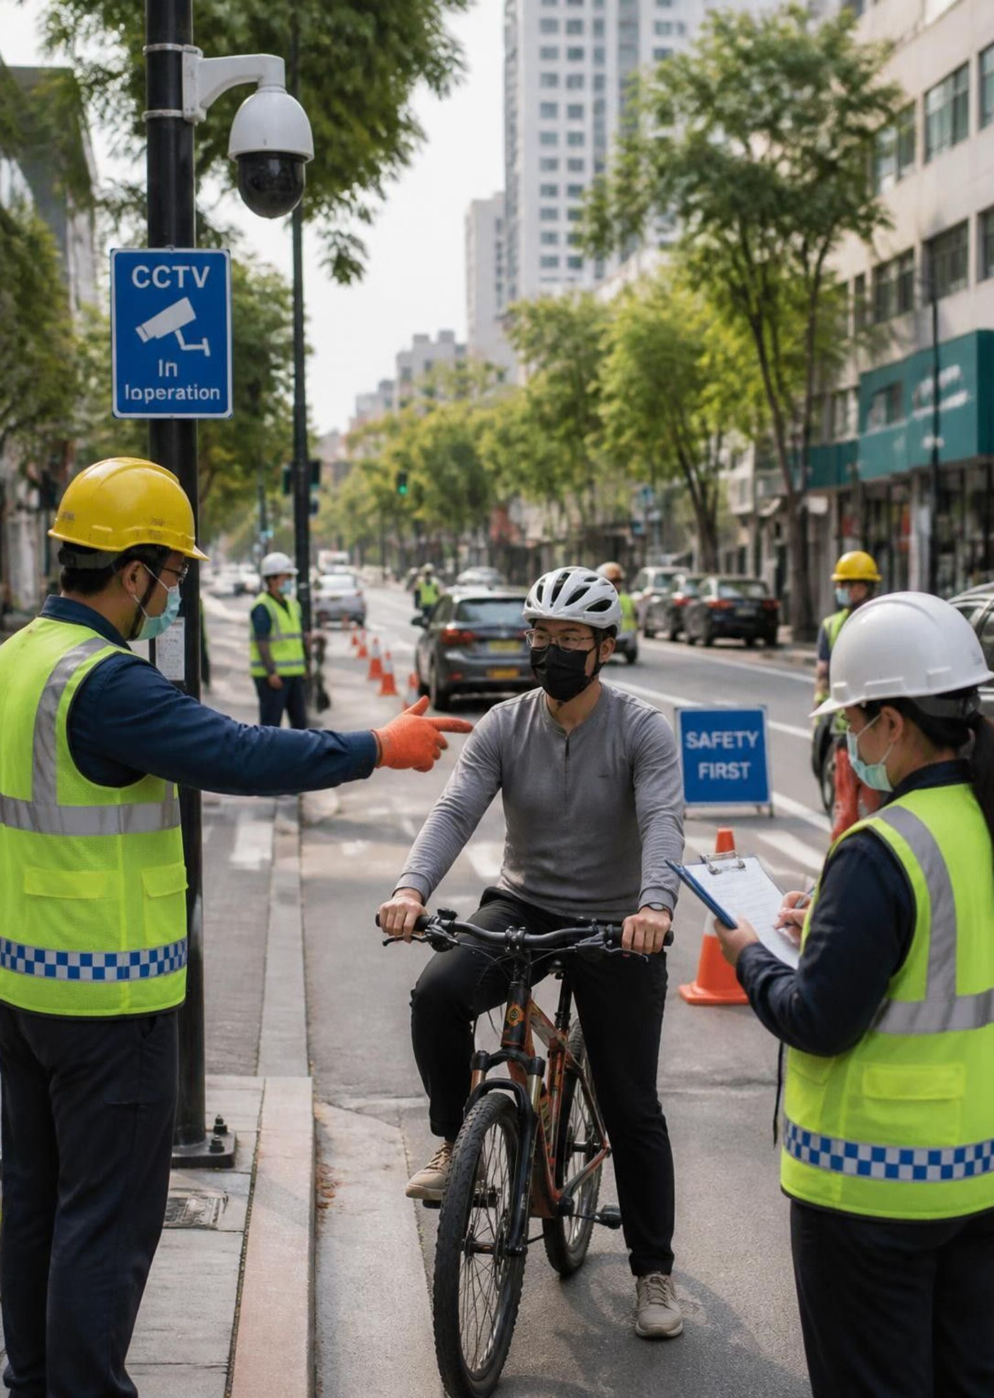


IS SAFETY GEAR BEING WORN?
Binary image classification
Camera Feed
CNN Model
Riders & workers
Feature extraction
✓ Wearing helmet/mask
✗ Not wearing
Notes:
Safety compliance monitoring in high-traffic or industrial environments is critical. Our objective is to take raw surveillance frames of cyclists, motorcyclists, and construction workers and reliably answer one binary question: is the individual wearing their required protective gear?

Slide 3
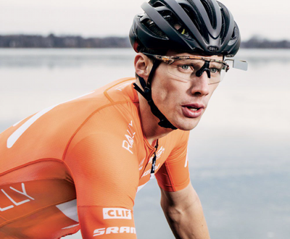
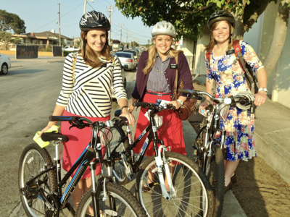
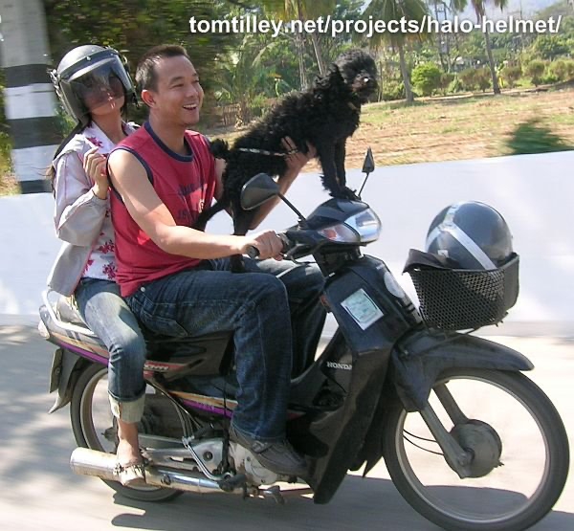
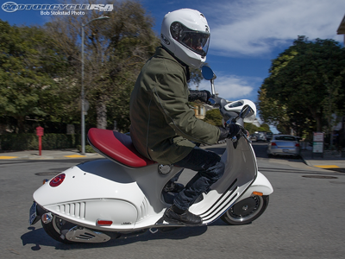
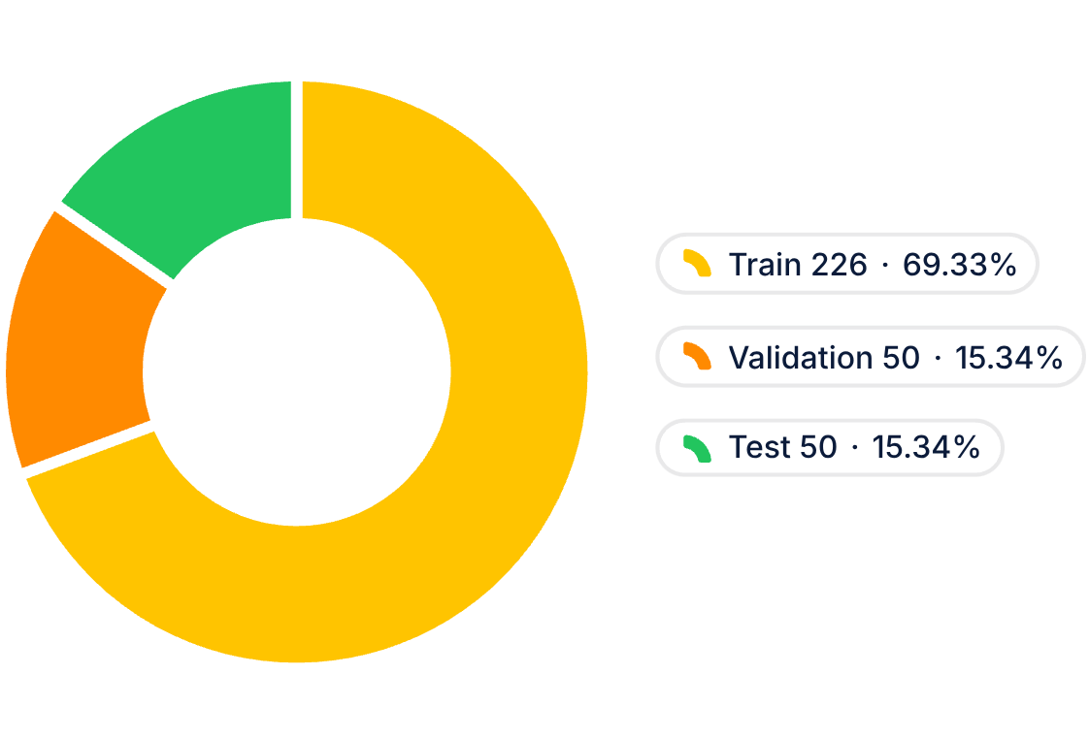
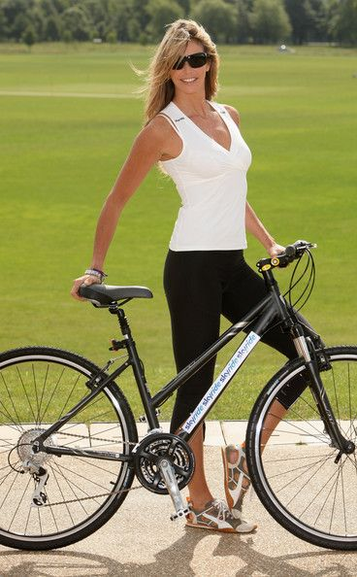
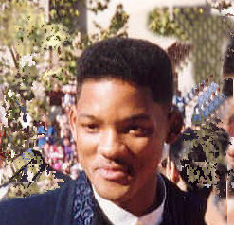
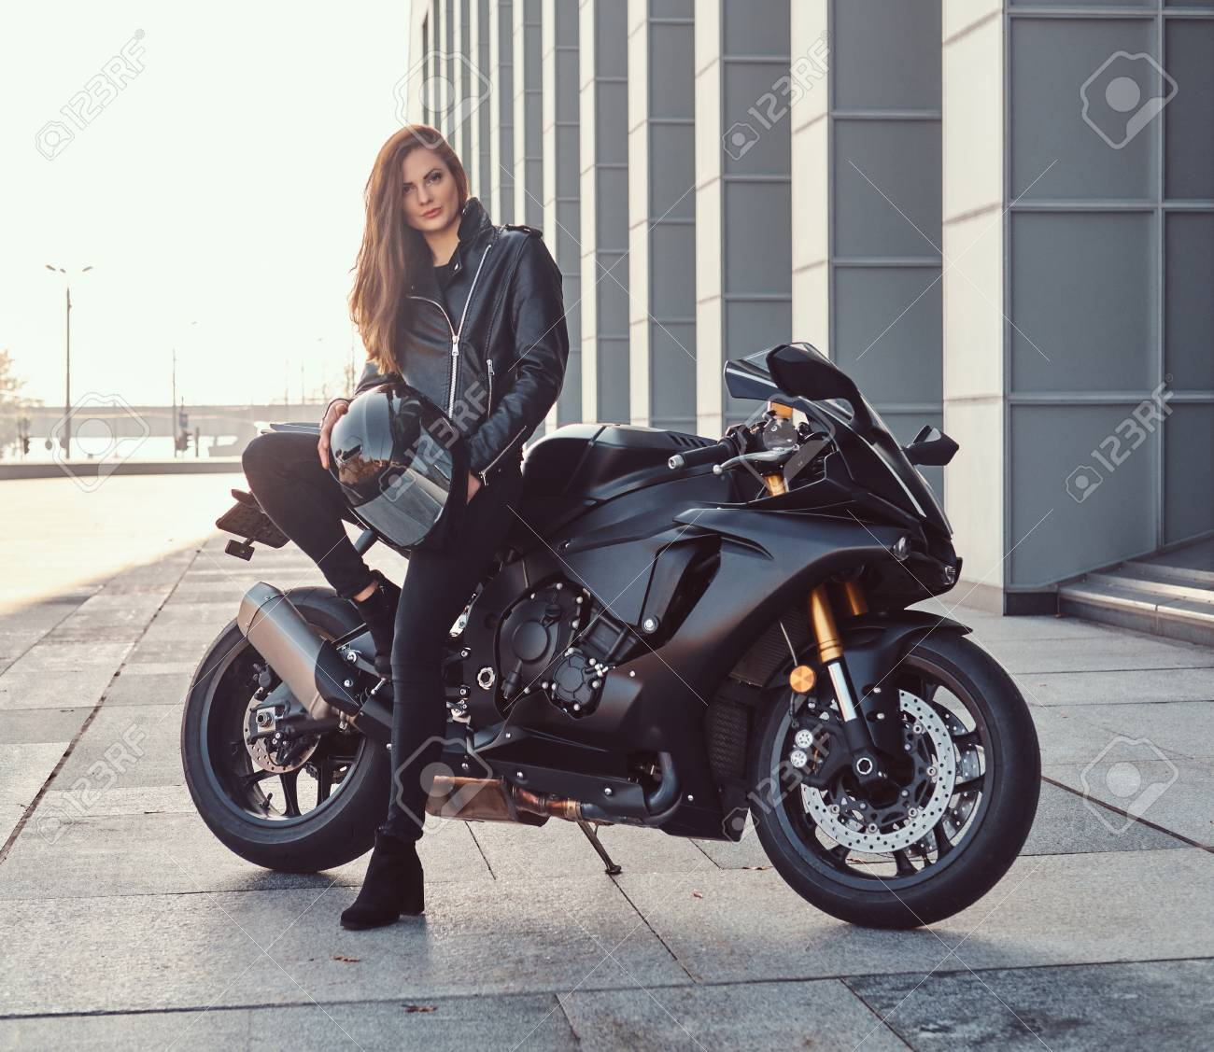
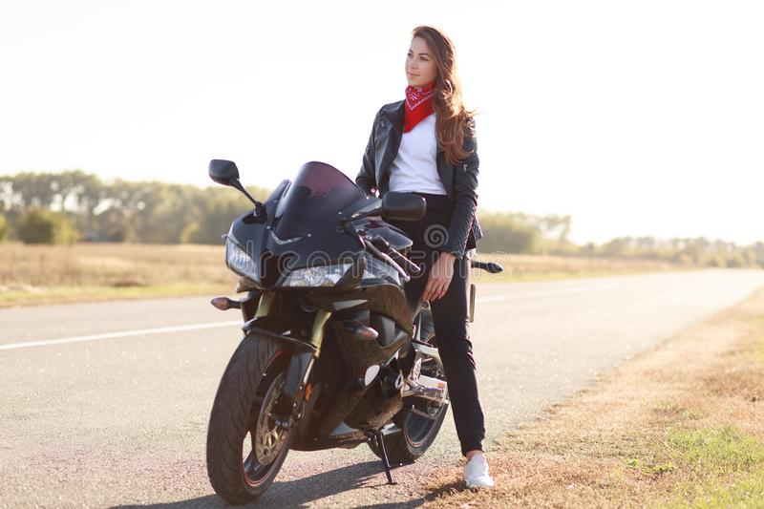
326 PHOTOS, TWO BALANCED CLASSES
Strict 50/50 balance across train, validation, and test splits
Train 113 / 113
Validation 25 / 25 · Test 25 / 25
Total: 326 curated images
Notes:
Our dataset consists of 326 carefully curated images split into 226 training, 50 validation, and 50 test samples. Every single split maintains a 50/50 balance between the helmet/mask class and the non-gear class, preventing training bias.

Slide 4
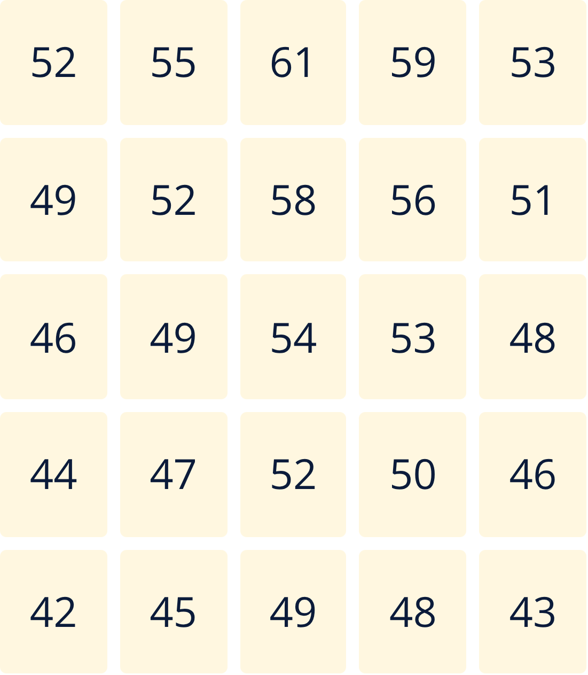
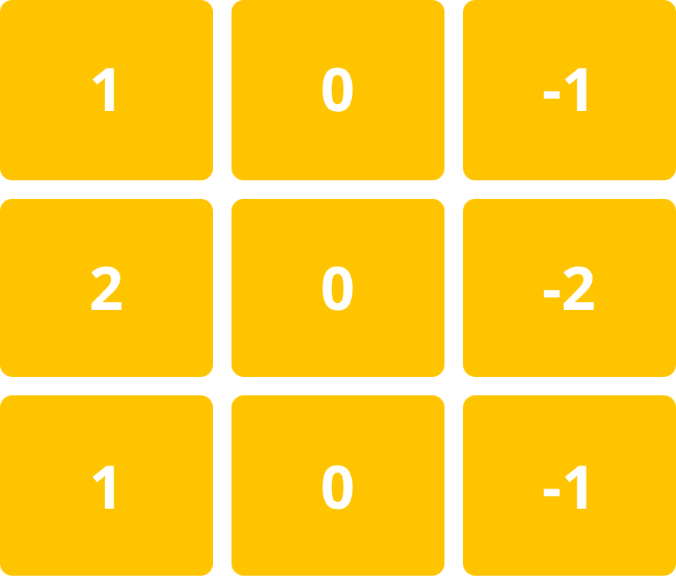
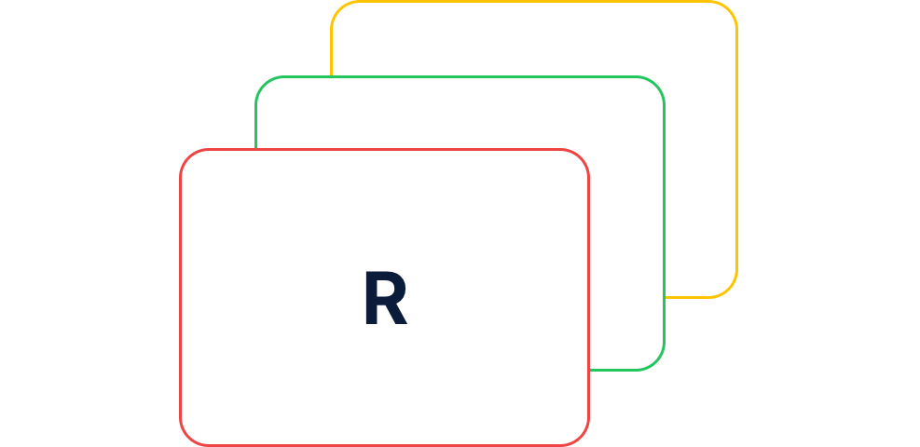
AN IMAGE IS A GRID OF NUMBERS
Step 1 & 2: Raw pixels represented as RGB tensors
1. Image
2. Kernel
3. Conv
4. Feature Map
5. ReLU
6. Pooling
7. Decision
RGB TENSOR
5×5 PIXEL VALUES (0–255)
3×3 SOBEL EDGE KERNEL
128 × 128 × 3
Red, Green, Blue channel matrices stacked across pixel coordinates.
Vertical edge detector matrix
Notes:
To a computer vision model, an image is purely a tensor of numerical intensity values between 0 and 255. In our pipeline, each resized 128 by 128 photo is represented across three color channels, ready to be scanned by specialized convolutional filters like this vertical Sobel edge detector.

Slide 5
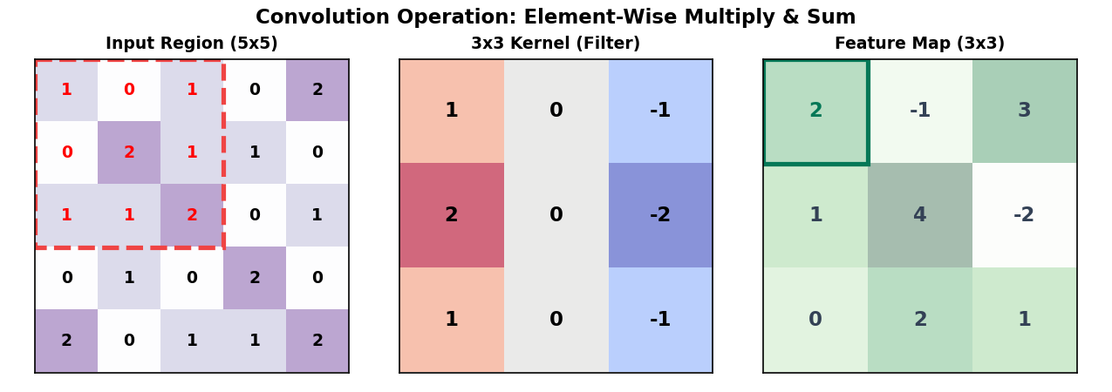
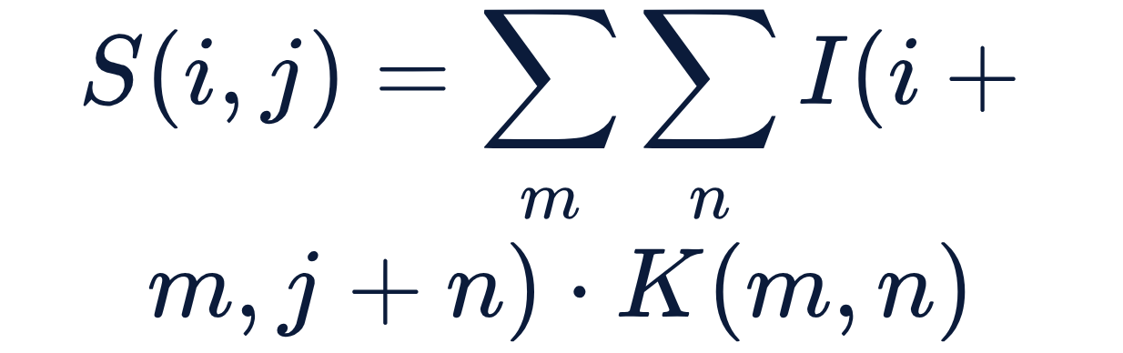
SLIDING THE KERNEL MAKES A FEATURE MAP
Step 3 & 4: Convolution mathematical operation
1. Image
2. Kernel
3. Conv
4. Feature Map
5. ReLU
6. Pooling
7. Decision
CONVOLUTION FORMULA
Element-wise sum of overlapping receptive field products.
Notes:
As the convolution kernel slides across the input matrix, it performs element-wise multiplication and sums the result to generate a new feature map. This mathematical transformation extracts localized spatial features such as helmet contours and face mask boundaries regardless of where they appear in frame. A sliding 3×3 kernel dot-product over 128×128 input creates the feature activation map.

Slide 6
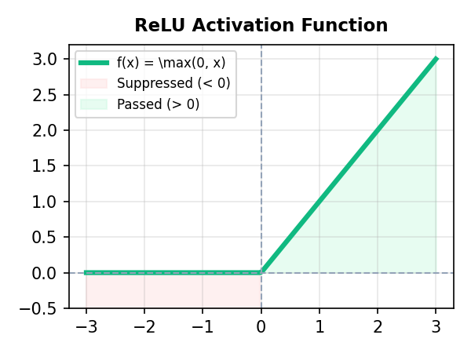
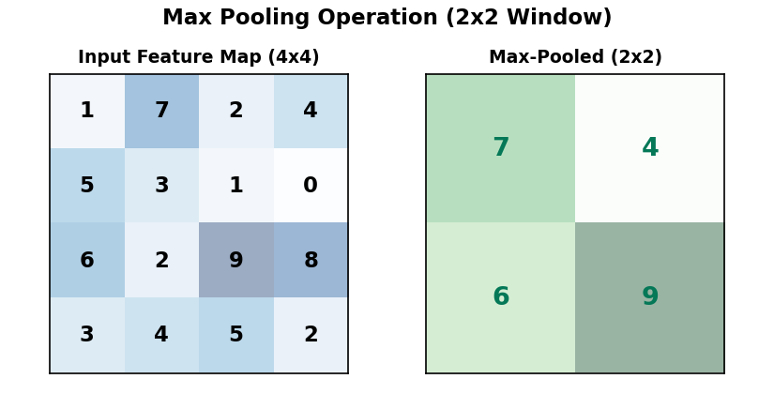
RELU KEEPS POSITIVES, POOLING KEEPS THE STRONGEST
Step 5 & 6: Activation and spatial dimensionality reduction
1. Image
2. Kernel
3. Conv
4. Feature Map
5. ReLU
6. Pooling
7. Decision
ACTIVATION FUNCTION
MAX POOLING 2×2
Negatives become 0
Halves size, keeps the strongest signal
Notes:
Following convolution, the Rectified Linear Unit, or ReLU, clamps all negative values to zero to introduce non-linearity. Next, 2 by 2 Max Pooling cuts both height and width in half, preserving only the most prominent activations while drastically reducing computation.

Slide 7
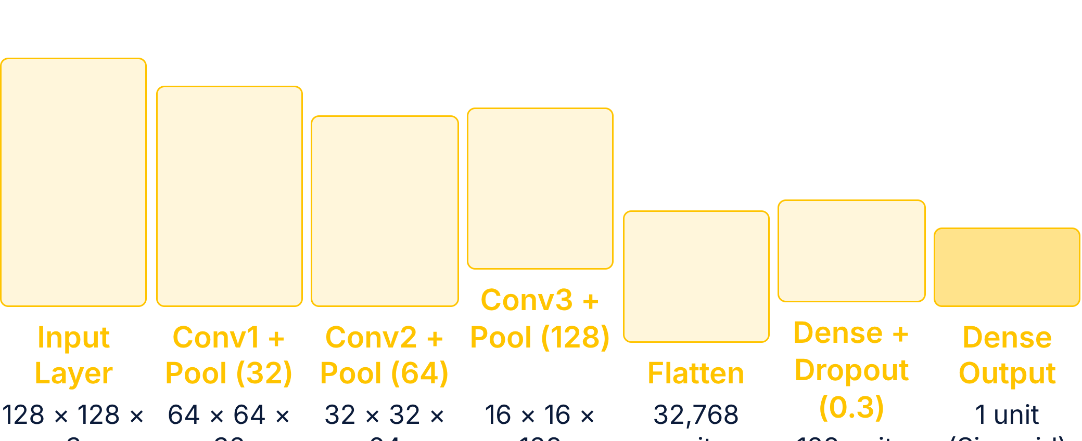

FROM PIXELS TO ONE SIGMOID DECISION
1. Image
2. Kernel
3. Conv
4. Feature Map
5. ReLU
6. Pooling
7. Classification
END-TO-END CNN PIPELINE
SIGMOID DECISION HEAD
Threshold: 0.5
< 0.5 → with_helmet_mask (0)
≥ 0.5 → without_helmet_mask (1)
Notes:
Our complete architecture stacks three convolutional blocks with doubling filters, followed by a 32,768-dimensional flattened vector and dropout regularization. The final single dense neuron applies a sigmoid activation, predicting class 0 below 0.5 and class 1 above. Now Member 3 will show how we built this in code.

Slide 8
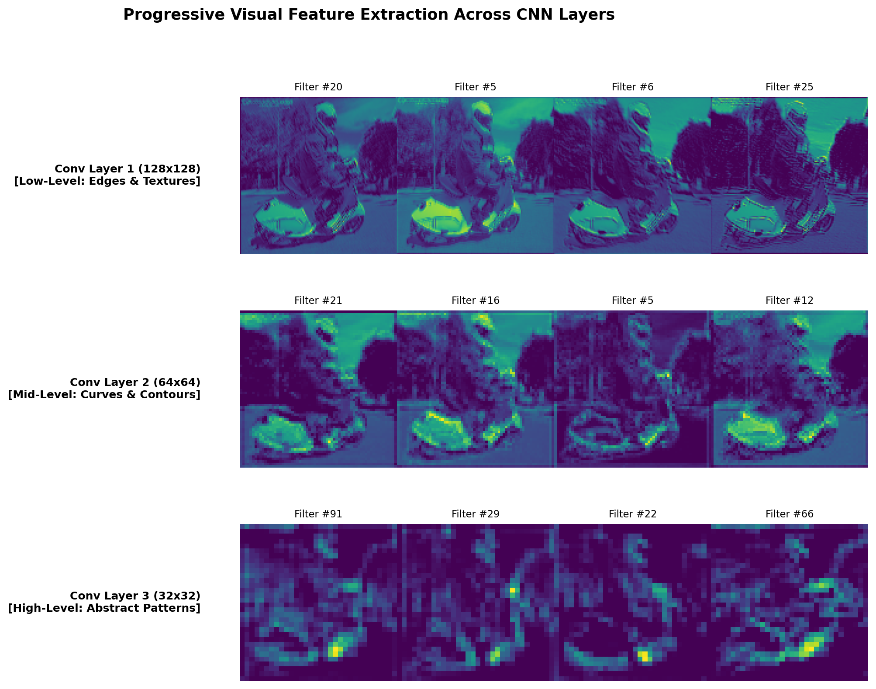
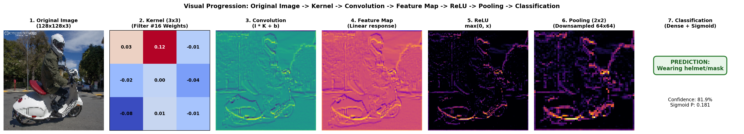
HOW THE CNN SEES: EDGES TO SHAPES TO OBJECTS
Hierarchical visual abstraction across convolutional depth
REAL IMAGE PROGRESSION
LAYER HIERARCHY
7-stage feature evolution from input frame to output map
Notes:
Visualizing intermediate representations reveals how the network learns representation hierarchies. Early filters capture fundamental high-frequency edges, the middle layers combine these into curves and straps, and deeper layers recognize cohesive helmet crowns and head silhouettes.

Slide 9
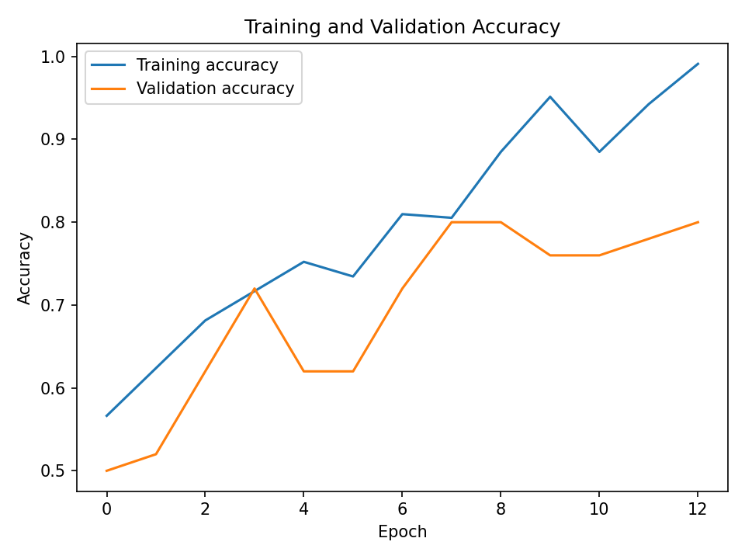
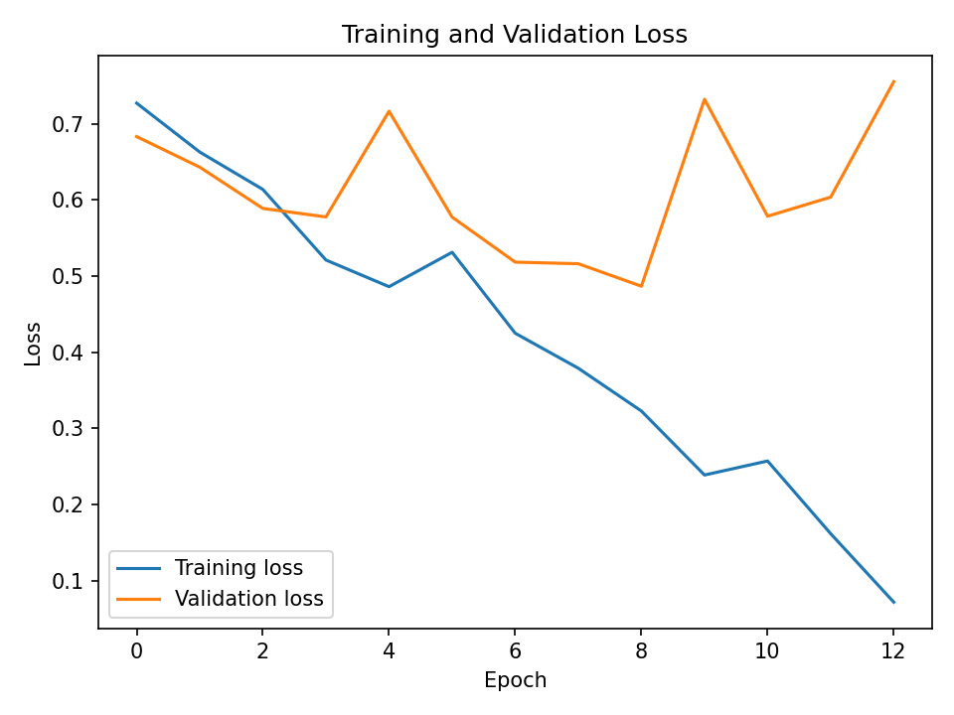
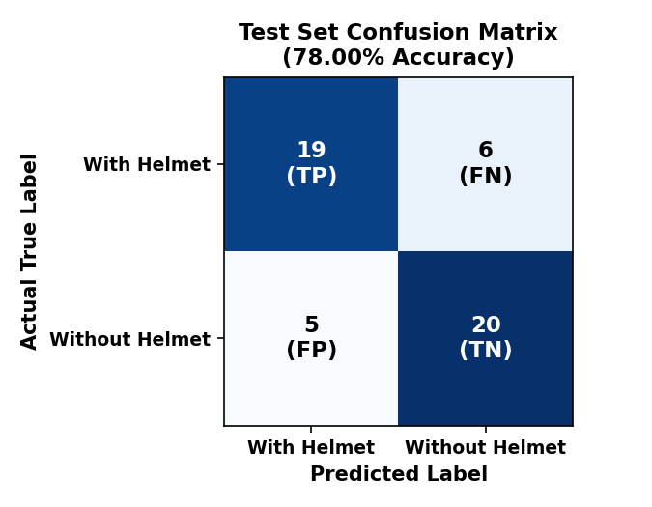
78% ACCURACY ON UNSEEN PHOTOS
Evaluation on 50 independent test samples
78%
Overall Accuracy
Balanced performance on both classes
Notes:
On our 50 test images, the model reached 78% overall test accuracy with a test loss of 0.5148. The confusion matrix contains 19, 6 / 5, 20 (TN: 19, FP: 6, FN: 5, TP: 20). Breaking this down per class, with helmet/mask achieved a precision of 0.79, recall of 0.76, and an F1-score of 0.78, while without gear yielded a precision of 0.77, recall of 0.80, and an F1-score of 0.78, showing balanced sensitivity across both outcomes.

Slide 10
WHAT WE BUILT, AND WHAT'S NEXT
Project milestones and technical roadmap
ACHIEVED
ACHIEVED
ACHIEVED
Built full end-to-end CNN
Visualised feature extraction layers
Achieved 78% test accuracy
NEXT STEPS
NEXT STEPS
NEXT STEPS
Expand dataset volume & diversity
Transfer learning with MobileNet
Deploy real-time webcam detection
Thank you
Team: Abhishek · Abhishek S Poojary · Deekshith Poojary · K Anujnya Shenoy
Notes:
In summary, we designed and verified an end-to-end CNN classifier achieving 78% test accuracy with clear intermediate layer interpretability. Moving forward, expanding the dataset, implementing transfer learning with MobileNet, and integrating live video streams will make this ready for real-world automated compliance.

