Slide 1


Slide 2
AJAX
Submitted to::
Veena A
Presented By:
Abhishek Mahesh Powar

Slide 3
Index
INTRODUCTION
WHAT IS AJAX?
TECHNOLOGIES
AJAX WORKS
MAKING REQUESTS
ADVANTAGES
DISADVANTAGES
CONCLUSIONS
REFERENCES

Slide 4
INTRODUCTION
Ajax stands for asynchronous JavaScript and XML.
It is a group of interrelated web development techniques used on the client-side to create interactive web applications .
AJAX is about updating parts of a web page, without reloading the whole page.
Ajax uses a combination of HTML and CSS to mark up and style information .

Slide 5
WHAT IS AJAX?
Asynchronous JavaScript and XML (AJAX).
Not a stand-alone language or technology.
Combines a set of known technologies in order to create faster and more user friendly web pages.
Client side technology.
Makes web pages more responsive by exchanging small amounts of data.
Allows the web page to change its content without refreshing the whole page.
Web browser technology independent of web server software.

Slide 6
TECHNOLOGIES
HTML or XHTML and CSS for presentation
The Document Object Model for dynamic display of and interaction with data
XML for the interchange of data, and XSLT for its manipulation/JSON
The XMLHttpRequest object for asynchronous communication
JavaScript to bring these technologies together

Slide 7
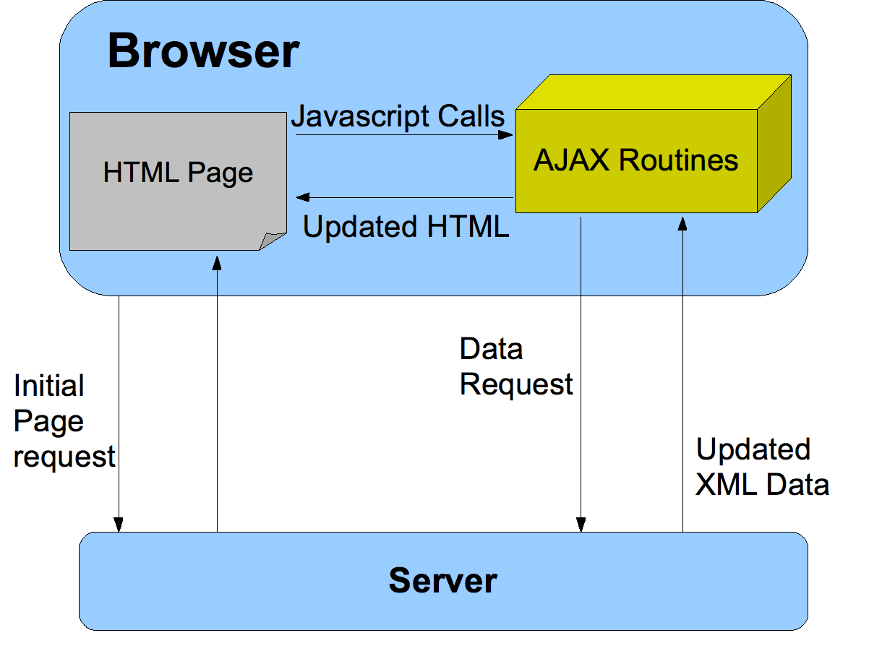

Slide 8
AJAX Works
AJAX allows web pages to be updated asynchronously by exchanging small amounts of data with the server without reloading the whole page.
Classic web pages,must reload the entire page if the content should change.
Examples of applications using AJAX: Google Maps, Gmail, Youtube, and Facebook tabs.

Slide 9
AJAX Example
The AJAX application contains one div section and one button.
The div section will be used to display information returned from a server.
The button specify and hold function.
The script section contains the function.

Slide 10
Performing GET request using XHR
const Http = new XMLHttpRequest();
const url = 'http://yourdomain.com/';
Http.open('GET', url);
Http.send();
Http.onreadystatechange = (e) => {
console.log(Http.responseText);
};

Slide 11
Performing GET Request in Fetch API
fetch('https://www.yourdomain.com', {
method: 'get'
})
.then((response) => response.json())
.then((jsonData) => console.log(jsonData))
.catch((err) => {
//error block
});

Slide 12
Performing GET Request in Fetch API
$.ajax({
type: 'GET',
url: 'https://www.yourdomain.com',
dataType: "JSON", // data type expected from server
success: function (data) {
console.log(data);
},
error: function(error) {
console.log('Error: ' + error);
}
});

Slide 13
Other ways
Jquery
Axios
request

Slide 14
ADVANTAGES
Page can be refreshed dynamically
Response of the interface to user is faster
Load much faster because the payload is much smaller
Reduces the demand for bandwidth
Allows the web applications to be much more efficient
Operate more like an application rather than a standalone program

Slide 15
DISADVANTAGES
Integration of browsers
With AJAX, all functions are loaded on a dynamic page, clicking the back or refresh button would take you to an entirely different web page or to the beginning of what your dynamic web page was processing
AJAX opens up another attack vector for malicious code that web developers might not fully test for.

Slide 16
CONCLUSIONS
Ajax provides functionality to create a robust web application.
If an Ajax web application is coded properly it will run faster than and as secure as a non-Ajax program.
Ajax also allows websites to reduce their overall bandwidth usage and server load by reducing the amount of full page loads.

Slide 17
REFERENCES
www.google.com
www.wikipedia.com
International Research Journal of Engineering and Technology Journal

Slide 18
THANKS

