Slide 1
Project 1
FINA 6333 – Spring 2024 Richard Herron

Slide 2
Strategy 1
Initial Value taken = 10000 Shares Purchased = 402.5653881927974 Total returns strategy 1 = 1945.072468814769 Annual Risk of Strategy 1 = 0.18744173002015077

Slide 3
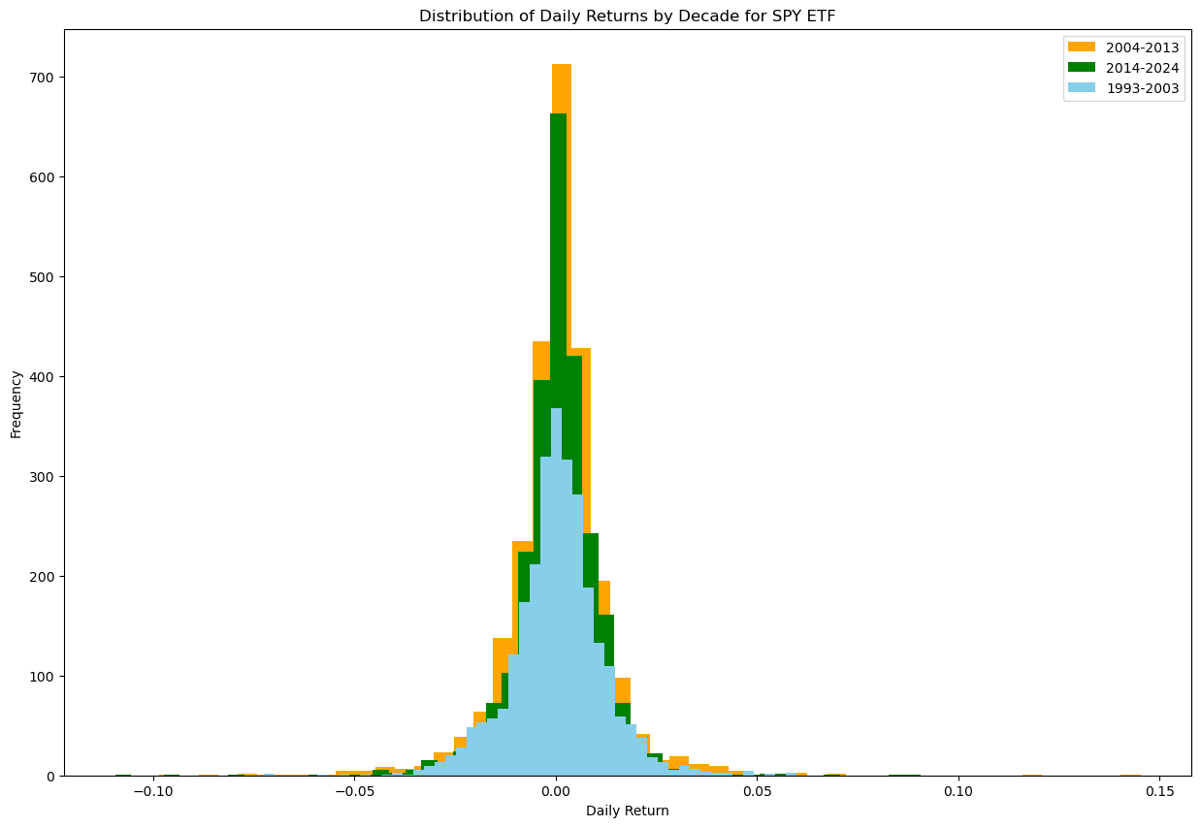
Distribution of daily returns

Slide 4
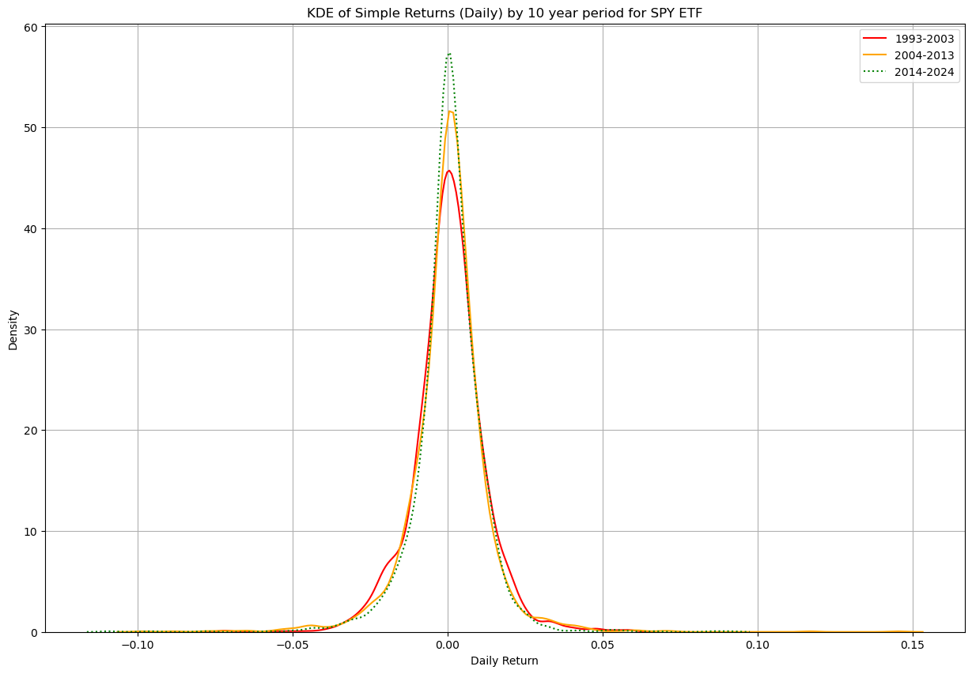
Kernel density of 10 year returns

Slide 5
In Strategy 1 we are holding the SPY shares from its inception and therefore we get all the gains from the share, in terms of capital gains and the dividend payments. This is the reason that this strategy provides the highest retruns among the 4. Due to this reason, this strategy also has the highest annual risk.

Slide 6
Strategy 2
Initial Value = 10000.0
Final Value = 11866.391069041256
Total returns of Strategy 2 = 0.18663910690412558
Annual Risk of Strategy 2 = 0.15319427021344442

Slide 7
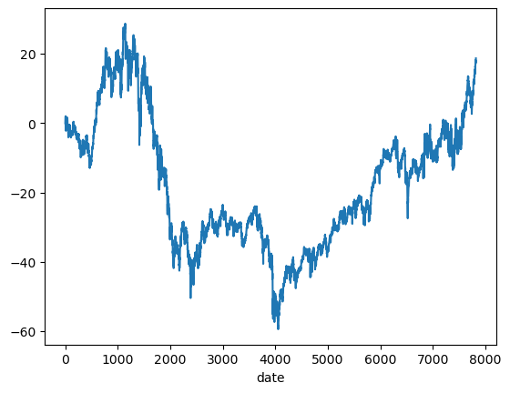
Change in Investment value over the time period

Slide 8
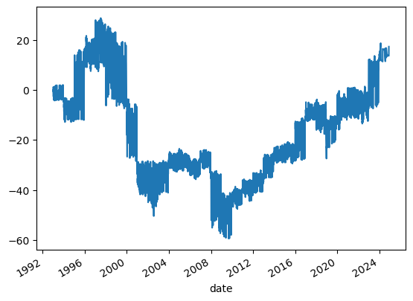
Change in Investment value over the time period

Slide 9
In Strategy 2 we are buying at the open price and selling at the close price of the spy, which means we can never be eligible for the payment of a dividend as you need to hold a stock for at least 2 days prior to the record date and we disobey that rule as we never really own the ETF as we always sell it at the close price.

Slide 10
Strategy3
Initial Value = 10000.0 Final Value = 97268.73562533264 Total Returns of Strategy 3 = 8.726873562533264 Annual Risk of Strategy 3 = 0.10642743367291121

Slide 11
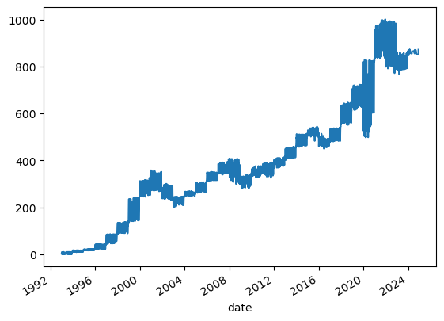
Change in Investment value over the time period

Slide 12
If we see the SPY’s prices in the form of candlesticks, we would see that sometimes the stocks open price on a day is way higher than the previous days closing price, which I call a gap-up opening. So if we buy the SPY at the close price and sell it at the open price we would miss out on the gains. Therefore in strategy 2 we miss out on these gap up gains. We capture these gains in strategy 3 but we forgo the gains that occur during the day.

Slide 13
strategy 4
Total returns of Strategy 4 where n is 1 = 1905.198978988837 Total returns strategy 4 where n is 2 = 1891.4500630346133 Total returns of Strategy 4 where n is 3 = 1919.1993090113378 Annual Risk of Strategy 4 where n is 1= 0.1825339007728034 Annual Risk of Strategy 4 where n is 2= 0.1845815822636617 Annual Risk of Strategy 4 where n is 3= 0.18099453993320716

Slide 14
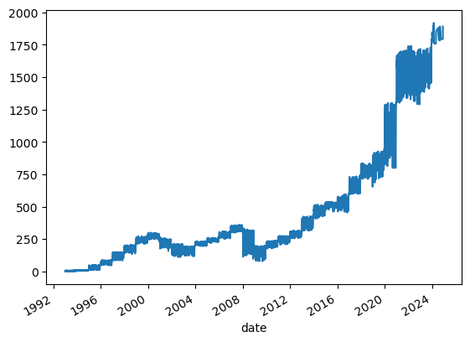
Change in Investment value over the time period

Slide 15
This strategy is similar to the first strategy, the only change is that we are eliminating the highest 3 returns and the lowest 3 returns. This results in us having a slightly lesser risk and return than the first strategy, which has the highest risk and return. Overall this strategy has performed better than the 2nd and 3rd strategy. By eliminating the extreme values we smoothen the data.

Slide 16
Summary of risk and return of all strategies
index Total_returns Annual Risk 0 Strategy_1 1945.072469 0.187442 1 Strategy_2 0.186639 0.153194 2 Strategy_3 8.726874 0.106427 3 Strategy_4_n_3 1919.199309 0.180995 4 Strategy_4_n_2 1891.450063 0.184582 5 Strategy_4_n_1 1905.198979 0.182534

Slide 17
Interpretation
According to our Analysis, strategy 1 gives the best returns as you are holding the spy throughout without any breaks in between, so we benefit from the dividends as well as the capital gains.
Strategy 2 gives the lowest returns with the lowest risk, as in this strategy we do not benefit from dividends. We also miss out on the gains from gap up opening in the next day.
Strategy 3 allows us to capture the gains from gap up openings and this strategy is better than strategy 2 whereby it provides better returns at a lower risk.
A risk averse investor can consider strategy 4 and its different elements. Eliminating the best 3 and worst 3 returns provides the highest returns at a lower risk than eliminating either the best/worst 2 returns or best/worst 1 return

Slide 18
Limitations
The real world limitations of executing these strategies are that no one can perfectly buy and sell exactly at the close and open prices, as we have done in strategy 2 and 3. As no one can predict the exact close and open prices. In the real world we will have to bear transaction costs in terms of brokerage and taxes while executing these strategies and these costs can significantly eat into your returns.

