Slide 1


Slide 2

Hping
Abhishek(251055990)
Kanika(251056785)
Parth(251054678)
Shreyas(251054240)
ECE

Slide 3
Overview
Hping is essentially a command-line oriented TCP/ IP packet assembler and analyzer.
It supports TCP, UDP, ICMP and RAW-IP protocols.
It has a traceroute mode.
It has the ability to send files between a covered channel.

Slide 4
Applications
Firewall testing
Advanced port scanning
Network testing, using different protocols, TOS, fragmentation
Manual path MTU discovery
Advanced traceroute, under all the supported protocols
Remote OS fingerprinting
Remote uptime guessing
TCP/IP stacks auditing

Slide 5
Flags we used for hping attacks
1.--flood
Sending packets as fast as possible, without taking care to show incoming replies. Flood mode.
2.-c 100000
Number of packets to send.
3.-d 120
Size of each packet that was sent to target machine.
4.-S
Sending SYN packets only.
5.-p 21
Destination port (21 being FTP port).

Slide 6
Attacks using hping3
DOS attack
An attack meant to shut down a machine or network, making it inaccessible to its intended users by flooding it with traffic.

Slide 7
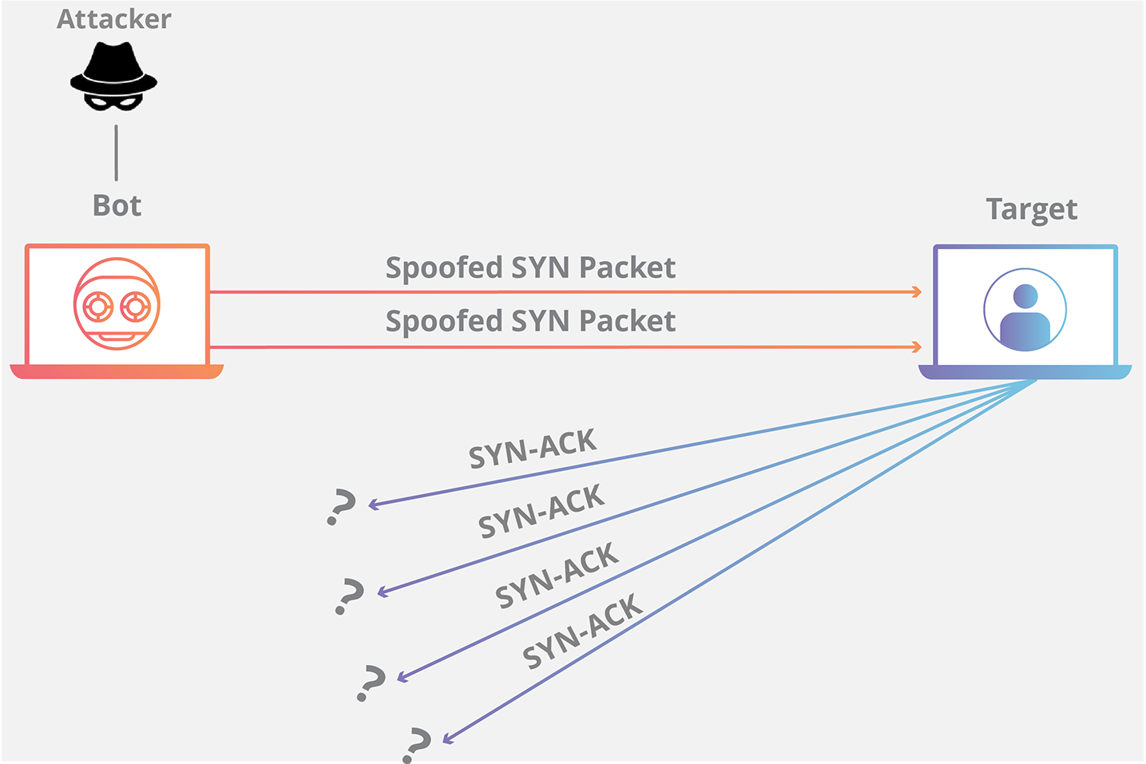
SYN Flooding
SYN flood attacks work by exploiting the handshake process of a TCP connection.

Slide 8
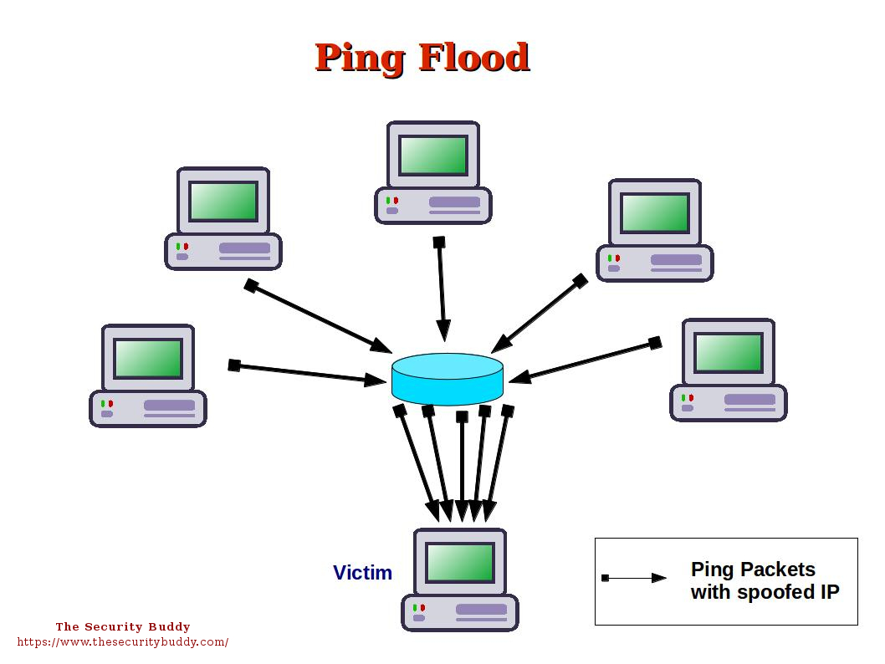
ICMP Flooding

Slide 9
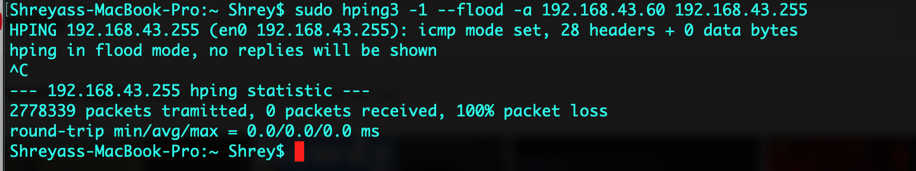
ICMP Attack

Slide 10
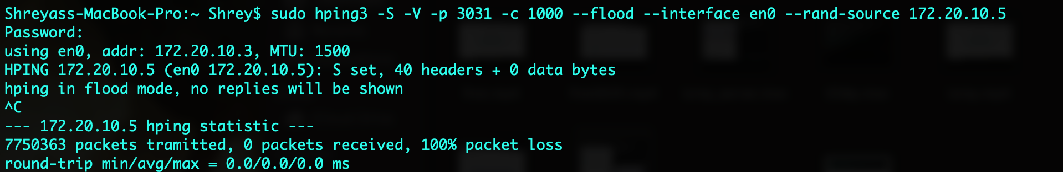
SYN Flood Attack

Slide 11

Thanks!

