Slide 1


Slide 2

CVE-2018-3883 :
SQL Injection in ERPNext Software
Kanika Gupta(251056785)
Abhishek(251055990)
Parth(251054678)
Shreyas(251054240)
ECE9069

Slide 3
SQL Injection Attack
Web Applications that take user input from form are vulnerable
SQL query submitted to a database
This is done by placing SQL statements in the user input
ECE9069

Slide 4
Consequences of SQL Injection
Leakage/Modification of sensitive information
Reputation decline
Loss of control over the database server
Data Loss
DOS

Slide 5
Steps to find vulnerabilities
Submit a single quote as input
Submit two single quotes as input
Try with string/numeric operators

Slide 6
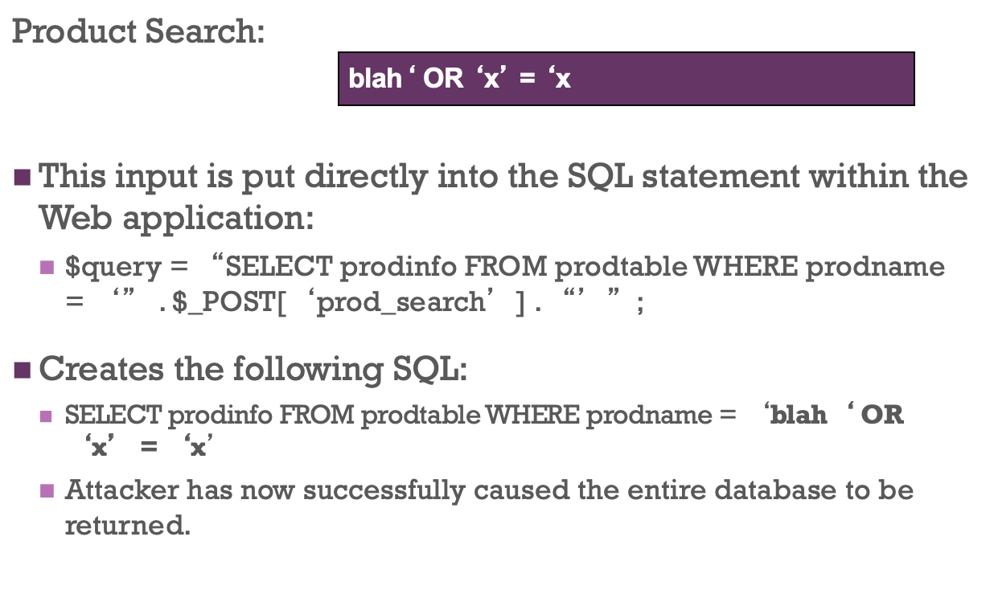
Example - SQL injection attack

Slide 7
Case Study SQL attack
Yahoo! Voices was hacked in July. The attack acquired 453,000 user email addresses and passwords. The perpetrators claimed to have used union-based SQL injection to break in.
LinkedIn.com leaked 6.5 million user credentials in June. A class action lawsuit alleges that the attack was accomplished with SQL injection.
An SQL injection vulnerability resulted in an urgent June bugfix release of Ruby on Rails 3.x.

Slide 8
CVE-2018-3883
SQL injection vulnerability exists in the authenticated part of ERPNext v10.1.6.
Web requests can cause SQL injections tends to data compromise.
The employee and sort order parameter can be used to perform an SQL injection attack.
An attacker can use a browser to trigger these vulnerabilities, and no special tools are required.

Slide 9
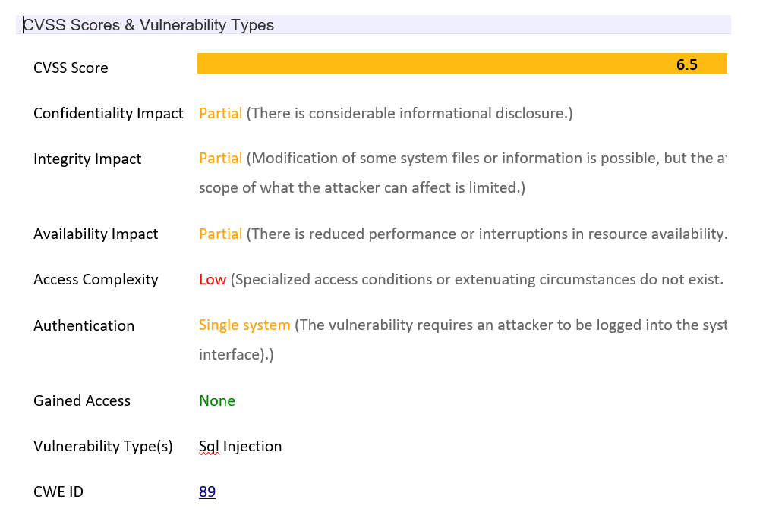

Slide 10
Enterprise resource planning(ERP)
ERP is a business management software — typically a suite of integrated applications—that an organization can use to store, collect, interpret, and manage data from these many business activities.
ERPNext is a free and open-source integrated ERP software developed by Frappé Technologies Pvt. Ltd. and is built on MariaDB database system using a Python based server-side framework.

Slide 11
Impact of the exploit
Confidentiality is an agreement is a legally binding contract between two or more parties, in which at least one of the parties agrees not to disclose certain information. Any software or application being made accessible only to authorized parties
Integrity is the characteristic of not having been altered by an unauthorized party. Integrity can extend to how data is stored, processed, and retrieved by the users.
Availability is the characteristic of being accessible and usable during a specified time period. Particular aspects of the service – quality, availability, responsibilities – are agreed between the service provider and the service user.

Slide 12

Vulnerabilities Details
ECE9069

Slide 13
Vulnerabilities - Explained
The attacks performed on the ERPNext v10.1.6 system exploits different parameters provided by the system like search fields, user input fields and requesting a particular resource.
All the attacks are done by manipulating the HTTP requests (GET, POST).
The attacks were performed using both browser and command-line tools.

Slide 14
Discovery of the vulnerabilities
Brian Hyde, a security researcher, posted the searchfield parameter vulnerability on the vulnerability disclosure program provided by by the makers of ERPNext systems.
Consequently, the company assigned a CVE for the vulnerability and provided users with patch to address the issue.
In the process the company also discovered several other parameters where SQL injection attack may occur and disclosed them as well.

Slide 15
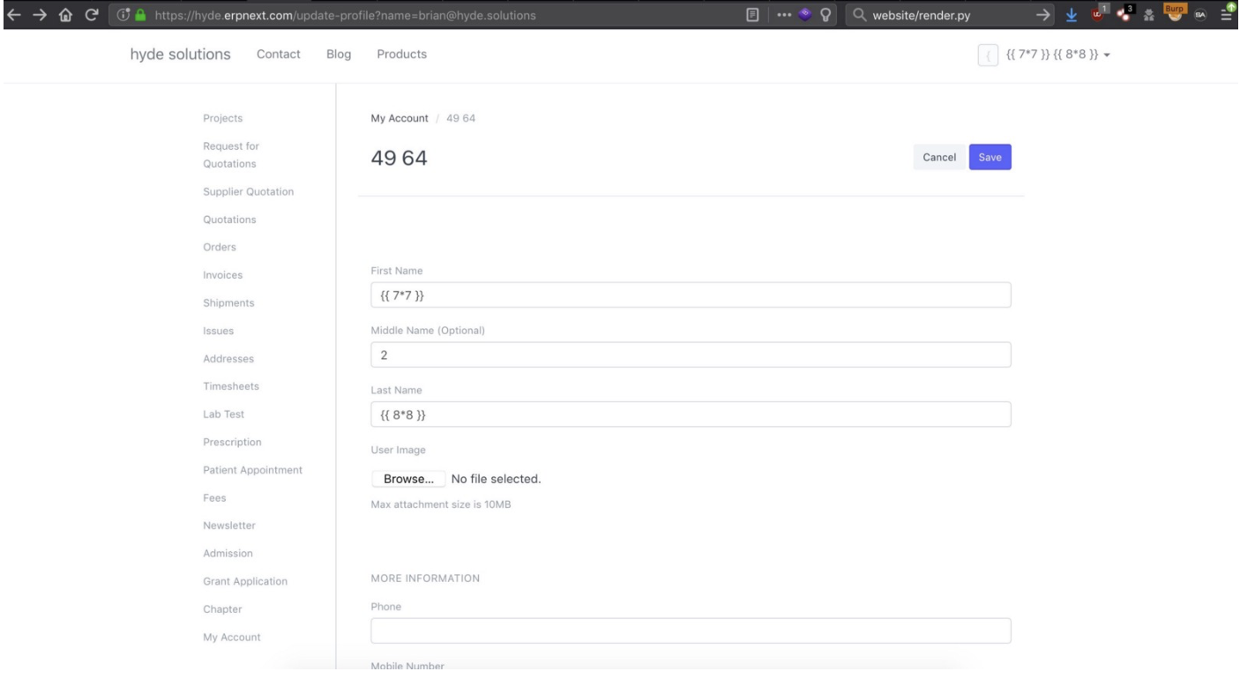
Case: user-input parameter vulnerability

Slide 16
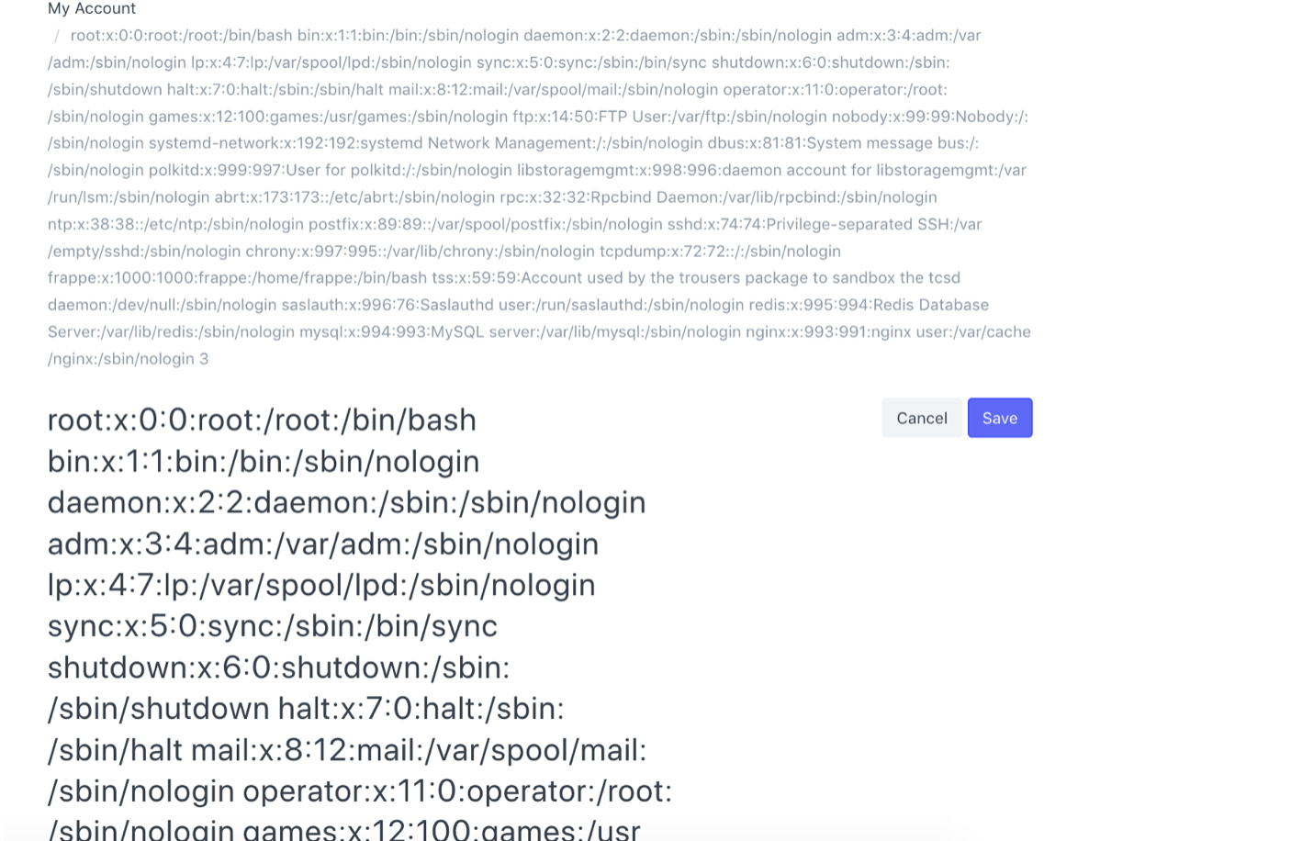
Read Permissions

Slide 17
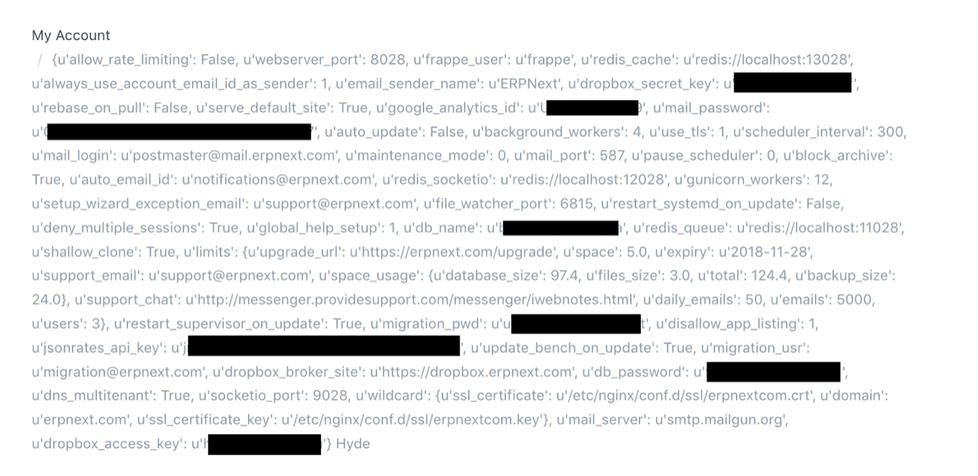
Write Permission

Slide 18
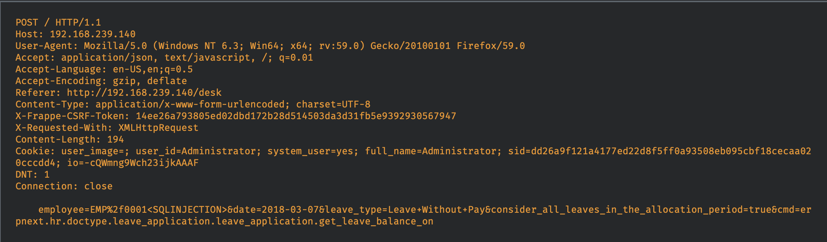
Parameters Vulnerable to SQL injection attack
employee parameter

Slide 19
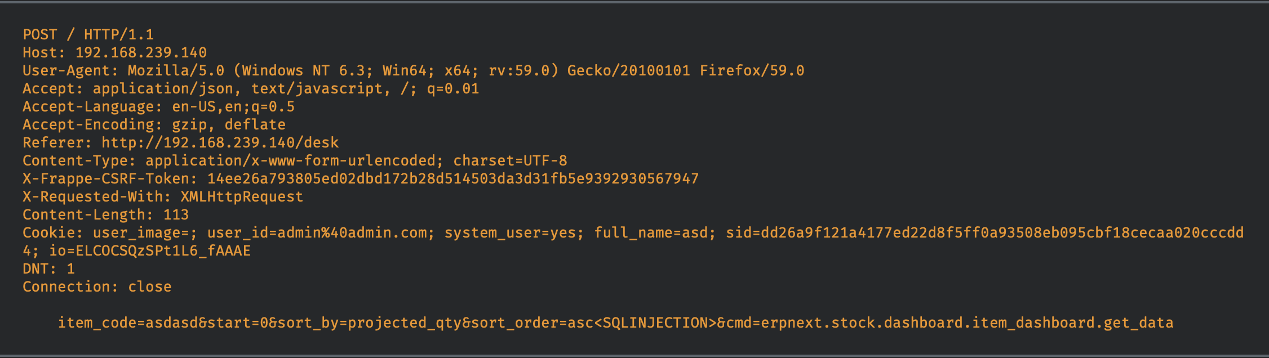
Parameters Vulnerable to SQL injection attack
sort_order parameter

Slide 20
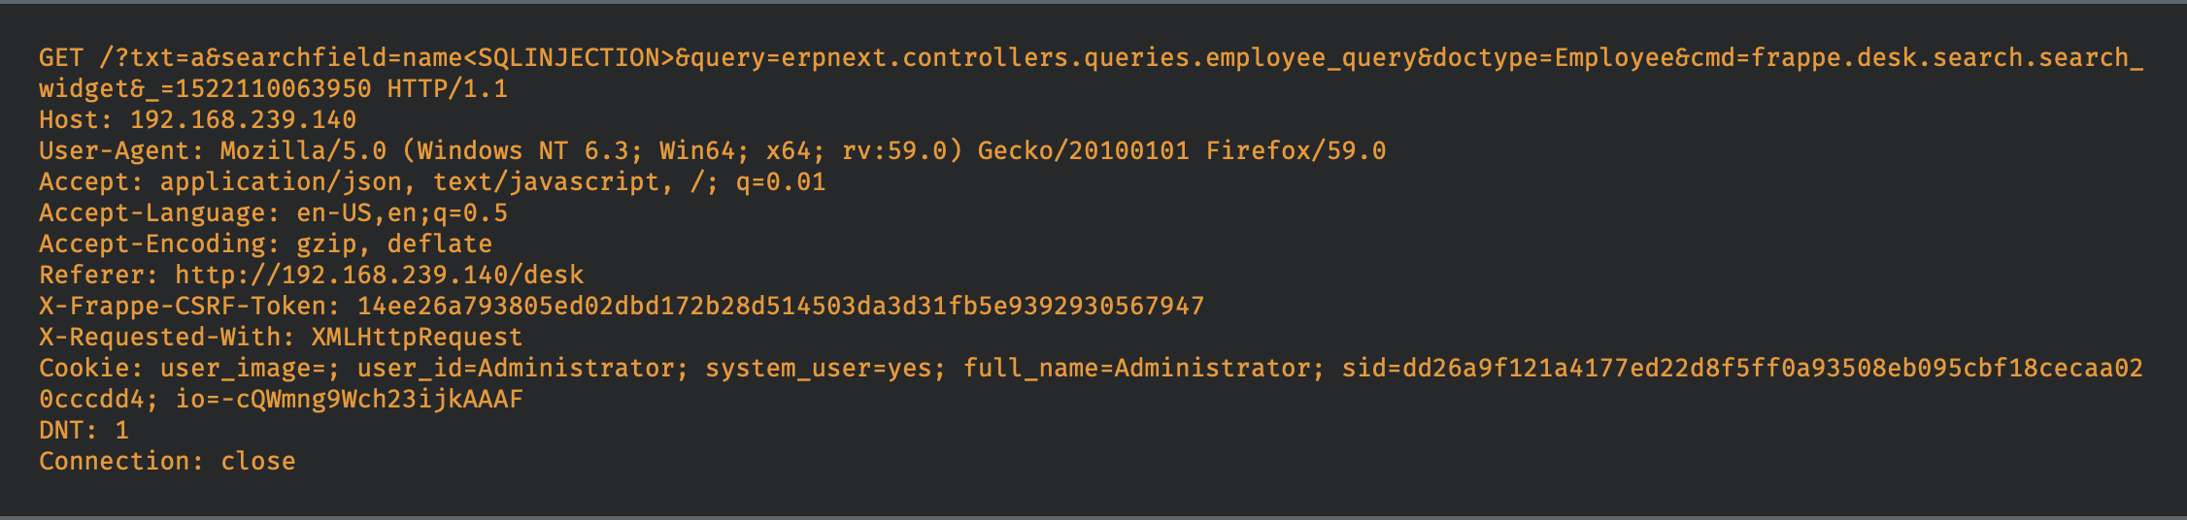
Parameters Vulnerable to SQL injection attack
searchfield parameter

Slide 21
SQL Injection Countermeasures
Web Framework :-PHP provides Magic Quotes
Prepared statements:-Prepared statements force developers to use static SQL query and then pass in the external input as a parameter to query. This approach ensures the SQL interpreter always differentiates between code and data.
Stored procedures:- SQL statements defined and stored in the database itself and then called from the application
Use input validation, maintain a whitelist of acceptable inputs
Instruction-Set Randomization:-inputs random values into the runtime SQL query statement of a web application and checks for volatility to detect SQL injection attacks. SQLrand[14] places a proxy between the web server and the database server and randomizes SQL queries. If the random value can be predicted, this method is not effective.

Slide 22
References
https://medium.com/bugbountywriteup/frappé-technologies-erpnext-server-side-template-injection-74e1c95ec872
https://nvd.nist.gov/vuln/detail/CVE-2018-3883
https://talosintelligence.com/vulnerability_reports/TALOS-2018-0560
https://cwe.mitre.org/data/definitions/89.html
https://erpnext.com

Slide 23
Thank You

