Slide 1
Analysis of Features In Future
Ensemble Method
Ensemble methods are technique used in machine learning model to combine the multiples model to improve the accuracy of the result .This method are used to reduce the generalise error of predictions. The process involves using multiple diverse method to predict an outcome .
It can produce more accurate result than a single method .
Steps for System Design:
Ensembles of decision tree
Bagging : Combine of weak learners of high variance to produce a model with lower variance than the individual weak models

Slide 2
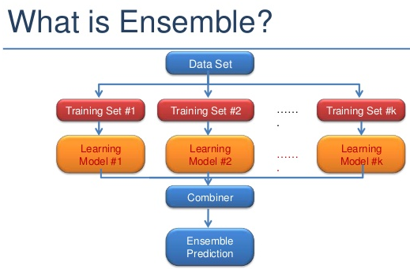
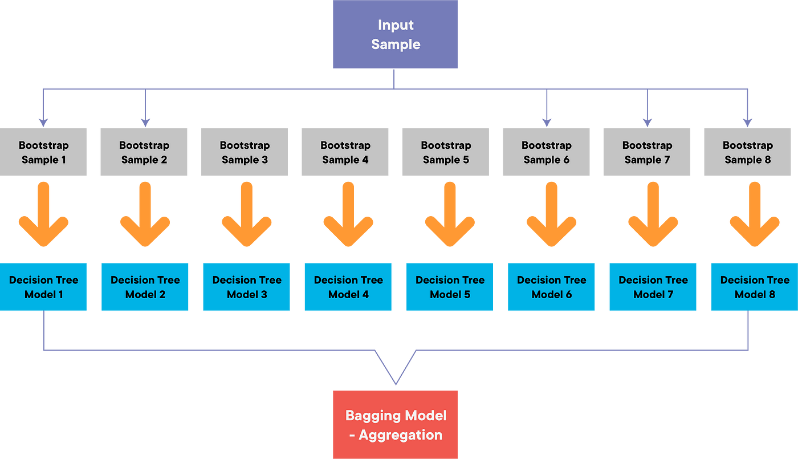
Methodology used

Slide 3
Objectives of the Work Model
Primary Objective:
Reduce the error of heavy/high impact rain events: With the help of the ensemble method . We can reduce the error of the decision baking by emerging the multiple models into one single model . Which is shown how the model works in a methodology .
INCLUDES
Improved Decision-Making: Multiple decision trees will decide the final outcome prediction with the help of bagging .

Slide 4
Future Scope
Multi-Model Ensembles: Integrating different types of rainfall prediction models within an ensemble framework can provide a more comprehensive and accurate prediction. This may involve combining numerical weather prediction models, statistical models, and machine learning models to leverage the strengths of each approach.
Accuracy : Will decrease in error variance as compare to other models
Ensemble Forecasting: Provide probabilistic forecasts for uncertainty assessment.
Multi-Model Fusion: Combine forecasts from diverse sources for reliability.
Visualization Tools: Develop user-friendly tools for better understanding

Slide 5
Current Model Drawbacks
Prone to Overfitting
One of the primary disadvantages of decision trees is their ability to overfit the training data. Overfitting occurs when the tree is too deep and complex, capturing noise in the data rather than the underlying patterns. This leads to poor generalization to new, unseen data. To address this, techniques like tree pruning and setting a maximum depth are used to limit tree complexity.
Lack of Smoothness
It create a series of discrete, step-like decision boundaries, which can result in a lack of smoothness in the predictions. Regression tasks can lead to predictions with a staircase-like appearance rather than a smooth curve. For some applications, this lack of smoothness may be undesirable.
Greedy Nature
Decision trees use a greedy approach to split the data at each node, choosing the feature that provides the best immediate reduction in impurity or error. However, this greedy nature may not always lead to the best overall tree structure. Getting stuck in suboptimal solutions is possible, especially when dealing with high-dimensional data.
Poor Generalization to Unseen Data
Sometimes, decision trees may not generalize well to unseen data, even after addressing overfitting issues. This can occur when the training data does not adequately represent the distribution of the target variable in the real world. Ensuring the representativeness of the training data is essential for decision tree models to perform well.

Slide 6
Ensemble vs decision tree accuracy
The performance of ensemble methods and decision tree methods can vary based on the dataset, features, and specific characteristics of the problem at hand. In general, ensemble methods tend to offer better predictive performance than individual decision trees due to their ability to mitigate overfitting and improve generalization. However, the choice between the two depends on the specific requirements of your rainfall prediction system.
Here's a general overview:
Decision Tree: The accuracy percentage of decision tree is generally 70-80 percent
Decision trees are prone to overfitting, especially when they are deep and complex.
They may not capture the underlying patterns in the data as effectively as ensemble methods.
Decision trees can be interpretable, making them useful for understanding the decision-making process.
Ensemble Method (e.g., Gradient Boosting): Meanwhile the accuracy of ensemble method is 80-90 percent
Ensemble methods combine the predictions of multiple models, reducing overfitting and improving generalization.
They are more robust and tend to provide better accuracy on unseen data compared to individual decision trees.
Ensemble methods often exhibit higher predictive performance, especially in complex and high-dimensional datasets.

Slide 7
THANK YOU

