Slide 1
Prediction of Heavy/High Impact Rain Events Using Satellite Data
Submitted in the partial fulfillment for the award of the degree of
BACHELOR OF ENGINEERING
IN
BIG DATA ANALYTICS
Submitted by:
Abhishek Rana (20BCS3818)
Ashutosh Kumar Singh (20BCS3804)
Sumit Choudhary (20BCS3829)
Under the Supervision of:
Mrs. Shweta (E12791)
Department of AIT-CSE
DISCOVER . LEARN . EMPOWER

Slide 2
Preliminary design of Project
Weather Forecasting Using Muti-Model Embed
IMD Uses Multi-Model Ensemble
Product features
Product experience
Product relationship
Product value
Product identity
Methodology of Model
Preliminary evaluation
Of Design
Hosting the Model on the Web
Ideation
Preliminary
Investigation
Detailed
Investigation
Development
Testing and
Validation
G5
Post implementation
Review
G1
Initial
Screen
G2
Second
Screen
G3
Decision on
Business Case
G4
Postdevelopment
Review

Slide 3
Why Multi Model Embed ?
Embedding multiple models in weather forecasting offers several advantages, which can be summarized in points as follows:
Enhanced Accuracy: Combining forecasts from multiple models helps in reducing biases and uncertainties inherent in individual models, resulting in more accurate predictions.
Improved Reliability: By considering outputs from various models, forecasters can better assess the range of possible outcomes, leading to more reliable forecasts, especially for extreme weather events.
Increased Robustness: Having multiple models in place ensures resilience against model failures or biases, as the impact of any single model's deficiencies is mitigated by the ensemble approach.
Coverage of Diverse Weather Phenomena: Different models may excel in predicting specific weather phenomena or patterns. Combining them broadens the scope of forecasted parameters, such as precipitation, wind, temperature, etc.

Slide 4
Does Multi Model Makes A Difference?
Yes it absolutely does, Indian Meteorological department use multi model weather ensemble to generate forecasting models.
Reason stated by IMD “Provides better forecasting against extreme rainfall events over India” https://mausamjournal.imd.gov.in/index.php/MAUSAM/article/view/6118
Using the Multi Model ensemble we are able improve the forecasting capability of the aggregated model.
It reduces the blind spots and biases, said parameters being crucial in extreme rainfall condition.
At the end it depends on the AI modeler which models are best suited together in ensembled model namely Machine Learning and Neural Network being one.

Slide 5
Methodology used
Methodology used in the project is Ensemble Learning.
Why Ensemble Learning?
Model Diversity:
Different forecasting models can be utilized.
Various Model Selection:
Various forecasting models can be selected based on their strengths
and weaknesses.

Slide 6
Methodology used
Training and Calibration:
Each model used in project can be trained and calibrated accordingly.
Ensemble Combination:
After training, the models can be combined to generate more
accurate results.
Verification and Evaluation:
Model’s verification will be done against the observed weather
condition.

Slide 7
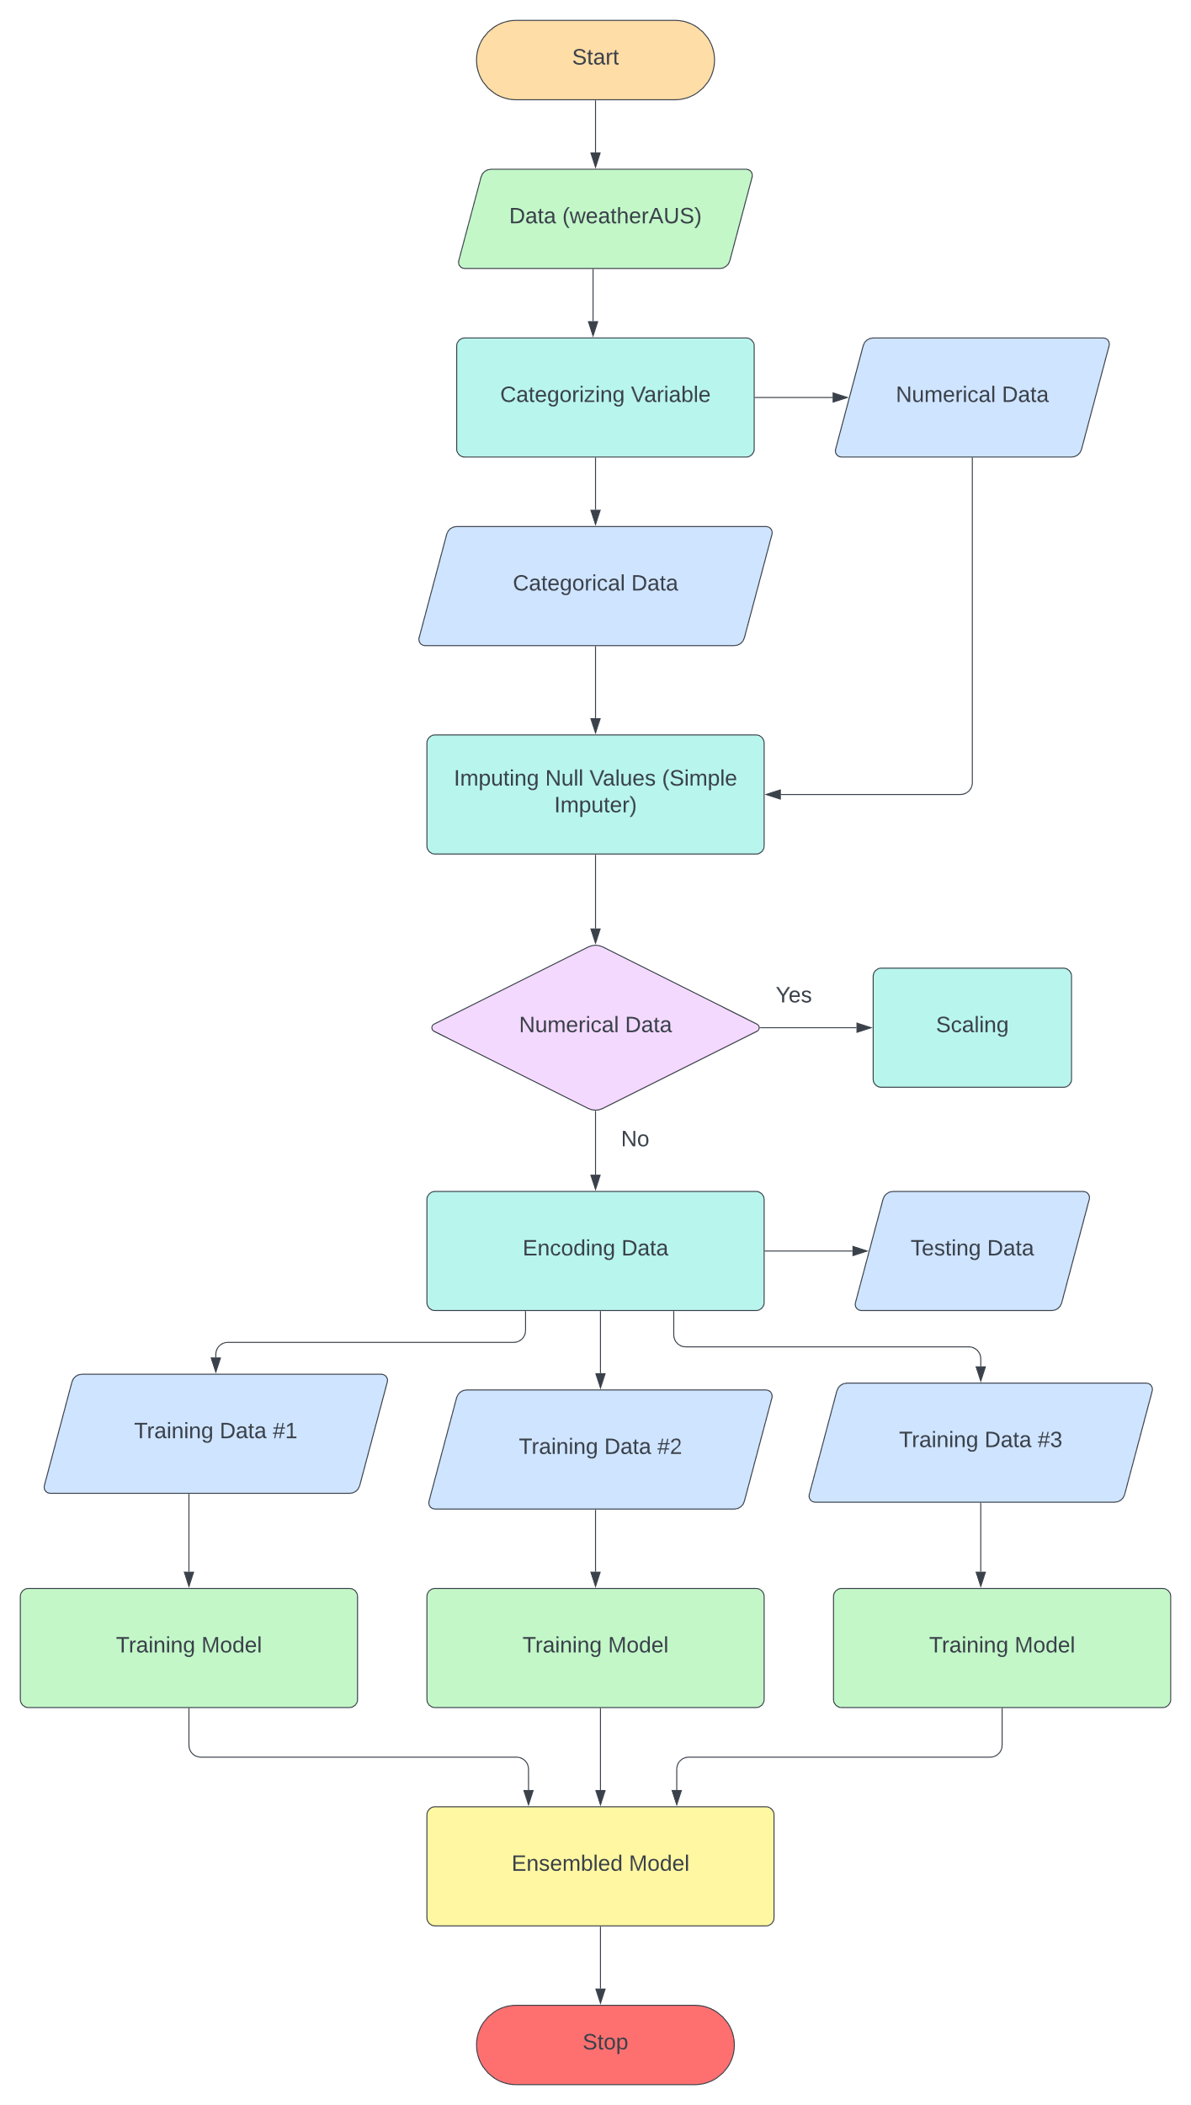
Data Pipeline for Forecasting Model

Slide 8
Methodology used
Algorithms used in the Ensemble Learning:
CNN (Convolutional Neural Networks):
Helps in leveraging the spatial relationship in the data.
Regression:
Used to forecast the continuous variable.
Decision Tree:
Decision trees offer interpretability, as their structure is easy to
understand and visualize.

Slide 9
References
[1] Gao, Y., Zhu, X., Fu, C., & Smethie, W. B. (2020). Prediction of heavy rainfall events using multi-source remote sensing data and a deep learning model. Remote Sensing of Environment, 247, 112002
[2] Liu, Y., Ouyang, T., Guan, X., Zhou, Y., & Zhang, H. (2020). Convolutional neural network for predicting high-impact rainfall events using satellite-based precipitation estimates. Advances in Space Research, 65(2), 575-587.
[3] Nogueira, D. S., de Brito, R. R., de Carvalho Júnior, O. A., & de Oliveira, R. A. L. (2020). Convolutional neural network based approach for rain intensity estimation in satellite imagery. Remote Sensing, 12(10), 1683.

Slide 10
Analysis of Features In Future
Ensemble Method
Ensemble methods are technique used in machine learning model to combine the multiples model to improve the accuracy of the result .This method are used to reduce the generalise error of predictions. The process involves using multiple diverse method to predict an outcome .
It can produce more accurate result than a single method .
Steps for System Design:
Ensembles of decision tree
Bagging : Combine of weak learners of high variance to produce a model with lower variance than the individual weak models

Slide 11
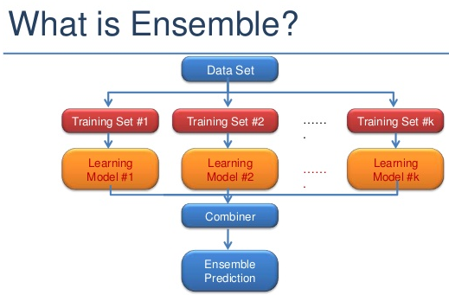
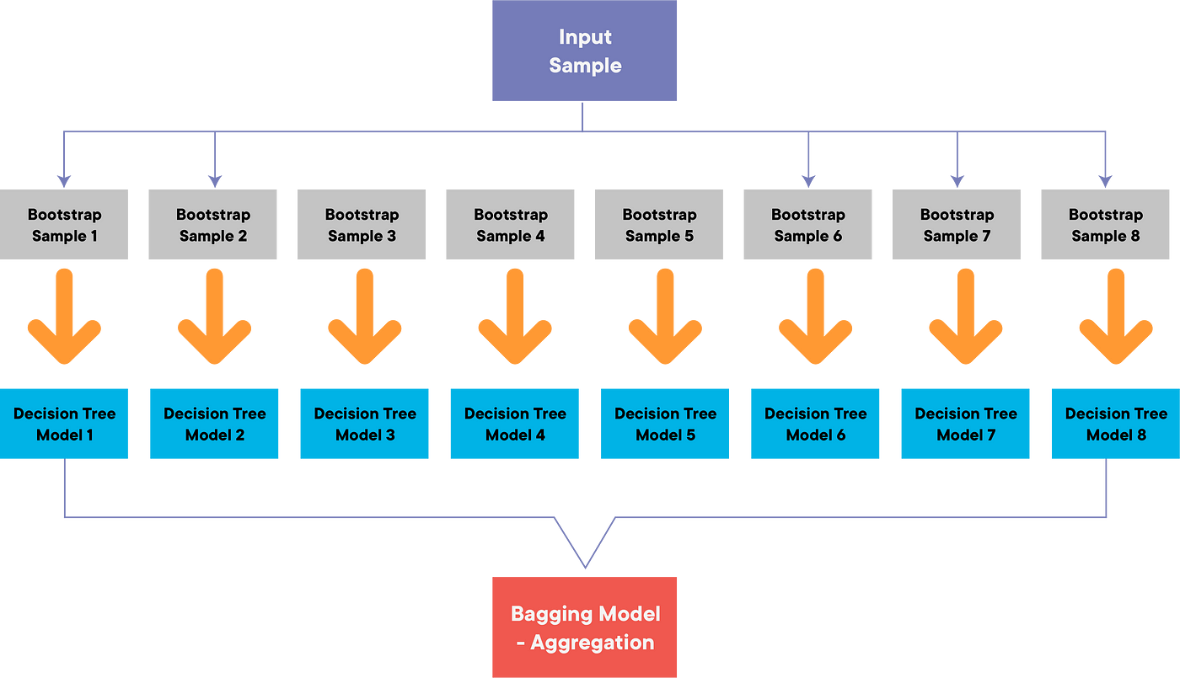
Methodology used

Slide 12
Objectives of the Work Model
Primary Objective:
Reduce the error of heavy/high impact rain events: With the help of the ensemble method . We can reduce the error of the decision baking by emerging the multiple models into one single model . Which is shown how the model works in a methodology .
INCLUDES
Improved Decision-Making: Multiple decision trees will decide the final outcome prediction with the help of bagging .

Slide 13
Future Scope
Multi-Model Ensembles: Integrating different types of rainfall prediction models within an ensemble framework can provide a more comprehensive and accurate prediction.
Accuracy : Will decrease in error variance as compare to other models
Ensemble Forecasting: Provide probabilistic forecasts for uncertainty assessment.
Multi-Model Fusion: Combine forecasts from diverse sources for reliability.
Visualization Tools: Develop user-friendly tools for better understanding

Slide 14
Current Model Drawbacks
Prone to Overfitting
One of the primary disadvantages of decision trees is their ability to overfit the training data. Overfitting occurs when the tree is too deep and complex, capturing noise in the data rather than the underlying patterns. This leads to poor generalization to new, unseen data. To address this, techniques like tree pruning and setting a maximum depth are used to limit tree complexity.
Lack of Smoothness
It create a series of discrete, step-like decision boundaries, which can result in a lack of smoothness in the predictions. Regression tasks can lead to predictions with a staircase-like appearance rather than a smooth curve. For some applications, this lack of smoothness may be undesirable.
Greedy Nature
Decision trees use a greedy approach to split the data at each node, choosing the feature that provides the best immediate reduction in impurity or error. However, this greedy nature may not always lead to the best overall tree structure. Getting stuck in suboptimal solutions is possible, especially when dealing with high-dimensional data.
Poor Generalization to Unseen Data
Sometimes, decision trees may not generalize well to unseen data, even after addressing overfitting issues. This can occur when the training data does not adequately represent the distribution of the target variable in the real world. Ensuring the representativeness of the training data is essential for decision tree models to perform well.

Slide 15
Ensemble vs decision tree accuracy
Here's a general overview:
Decision Tree: The accuracy percentage of decision tree is generally 70-80 percent
Decision trees are prone to overfitting, especially when they are deep and complex.
They may not capture the underlying patterns in the data as effectively as ensemble methods.
Decision trees can be interpretable, making them useful for understanding the decision-making process.
Ensemble Method (e.g., Gradient Boosting): Meanwhile the accuracy of ensemble method is 80-90 percent
Ensemble methods combine the predictions of multiple models, reducing overfitting and improving generalization.
They are more robust and tend to provide better accuracy on unseen data compared to individual decision trees.

Slide 16
THANK YOU

