Slide 1
SHRI RAMSWAROOP MEMORIAL UNIVERSITY
Lucknow - Deva Road, Barabanki (Uttar Pradesh)
PROJECT PRESENTATION
8-BIT MINI
PROCESSOR
DESIGN AND SIMULATION
CPU CORE
An accumulator-based educational CPU with an 8-bit datapath,
compact instruction set, control unit and functional simulator.
ACC • ALU • CONTROL
SUBMITTED BY
Abhishek Saxena
M.Tech (CS) | Roll No. 2020610101070005
Subject: Digital Electronics & Computer Organization | PCS1001
SUBMITTED TO: Prabhat Srivastava | Faculty, Digital Electronics & Computer Organization (PCS1001)
GitHub Repository: [INSERT REPOSITORY URL BEFORE SUBMISSION]

Slide 2
01 / INTRODUCTION
Project overview
A compact CPU model designed to make the essential processor operations easy to trace.
What is being designed?
What does it demonstrate?
How is it validated?
An 8-bit accumulator-based processor with instruction memory, data memory, an ALU, a control unit and an output register.
Instruction fetch, decode and execution; data transfer; arithmetic and logic; status flags; conditional branching.
A reference software simulator runs a short program and six functional checks. The final demo output is 0x03.
8-BIT DATAPATH
16 x 8 ROM
16 x 8 RAM
16 OPCODES
FUNCTIONAL SIM
Design principle
Keep the architecture small enough to inspect, but complete enough to show how a CPU moves, processes and stores data.

Slide 3
02 / OBJECTIVES
Objectives and project scope
The scope is an educational functional design, not a commercial processor implementation.
01
Define architecture
Registers, memory, datapath and control organisation.
02
Specify the ISA
Fixed 8-bit instruction word with opcode and operand fields.
03
Explain the ALU
Arithmetic, logical operations and status flags.
04
Trace instruction flow
Fetch, decode, execute and branch behaviour.
05
Validate execution
Run a demo program and repeatable functional tests.
Boundary: instruction-level functional simulation; no gate-delay, FPGA or physical-hardware claim.

Slide 4
03 / SYSTEM DESIGN
Processor specification
A fixed small architecture keeps instruction decoding and simulation straightforward.
Parameter
Specification
Role
Data width
8 bits
ALU, ACC, memory word and output width
Address range
0 to 15 for program and data locations.
Instruction word
8 bits
4-bit opcode + 4-bit operand
Program counter
4 bits
Addresses 16 instructions
Immediate range
Program memory
16 x 8
Stores instruction bytes
LDI carries a 4-bit value: 0 to 15.
Data memory
16 x 8
Stores values and intermediate results
Main register
ACC, 8-bit
Primary working register
Arithmetic range
Status flags
Z and C
Zero; carry/borrow status
8-bit results wrap modulo 256.
Output register
OUT, 8-bit
Captures accumulator output

Slide 5
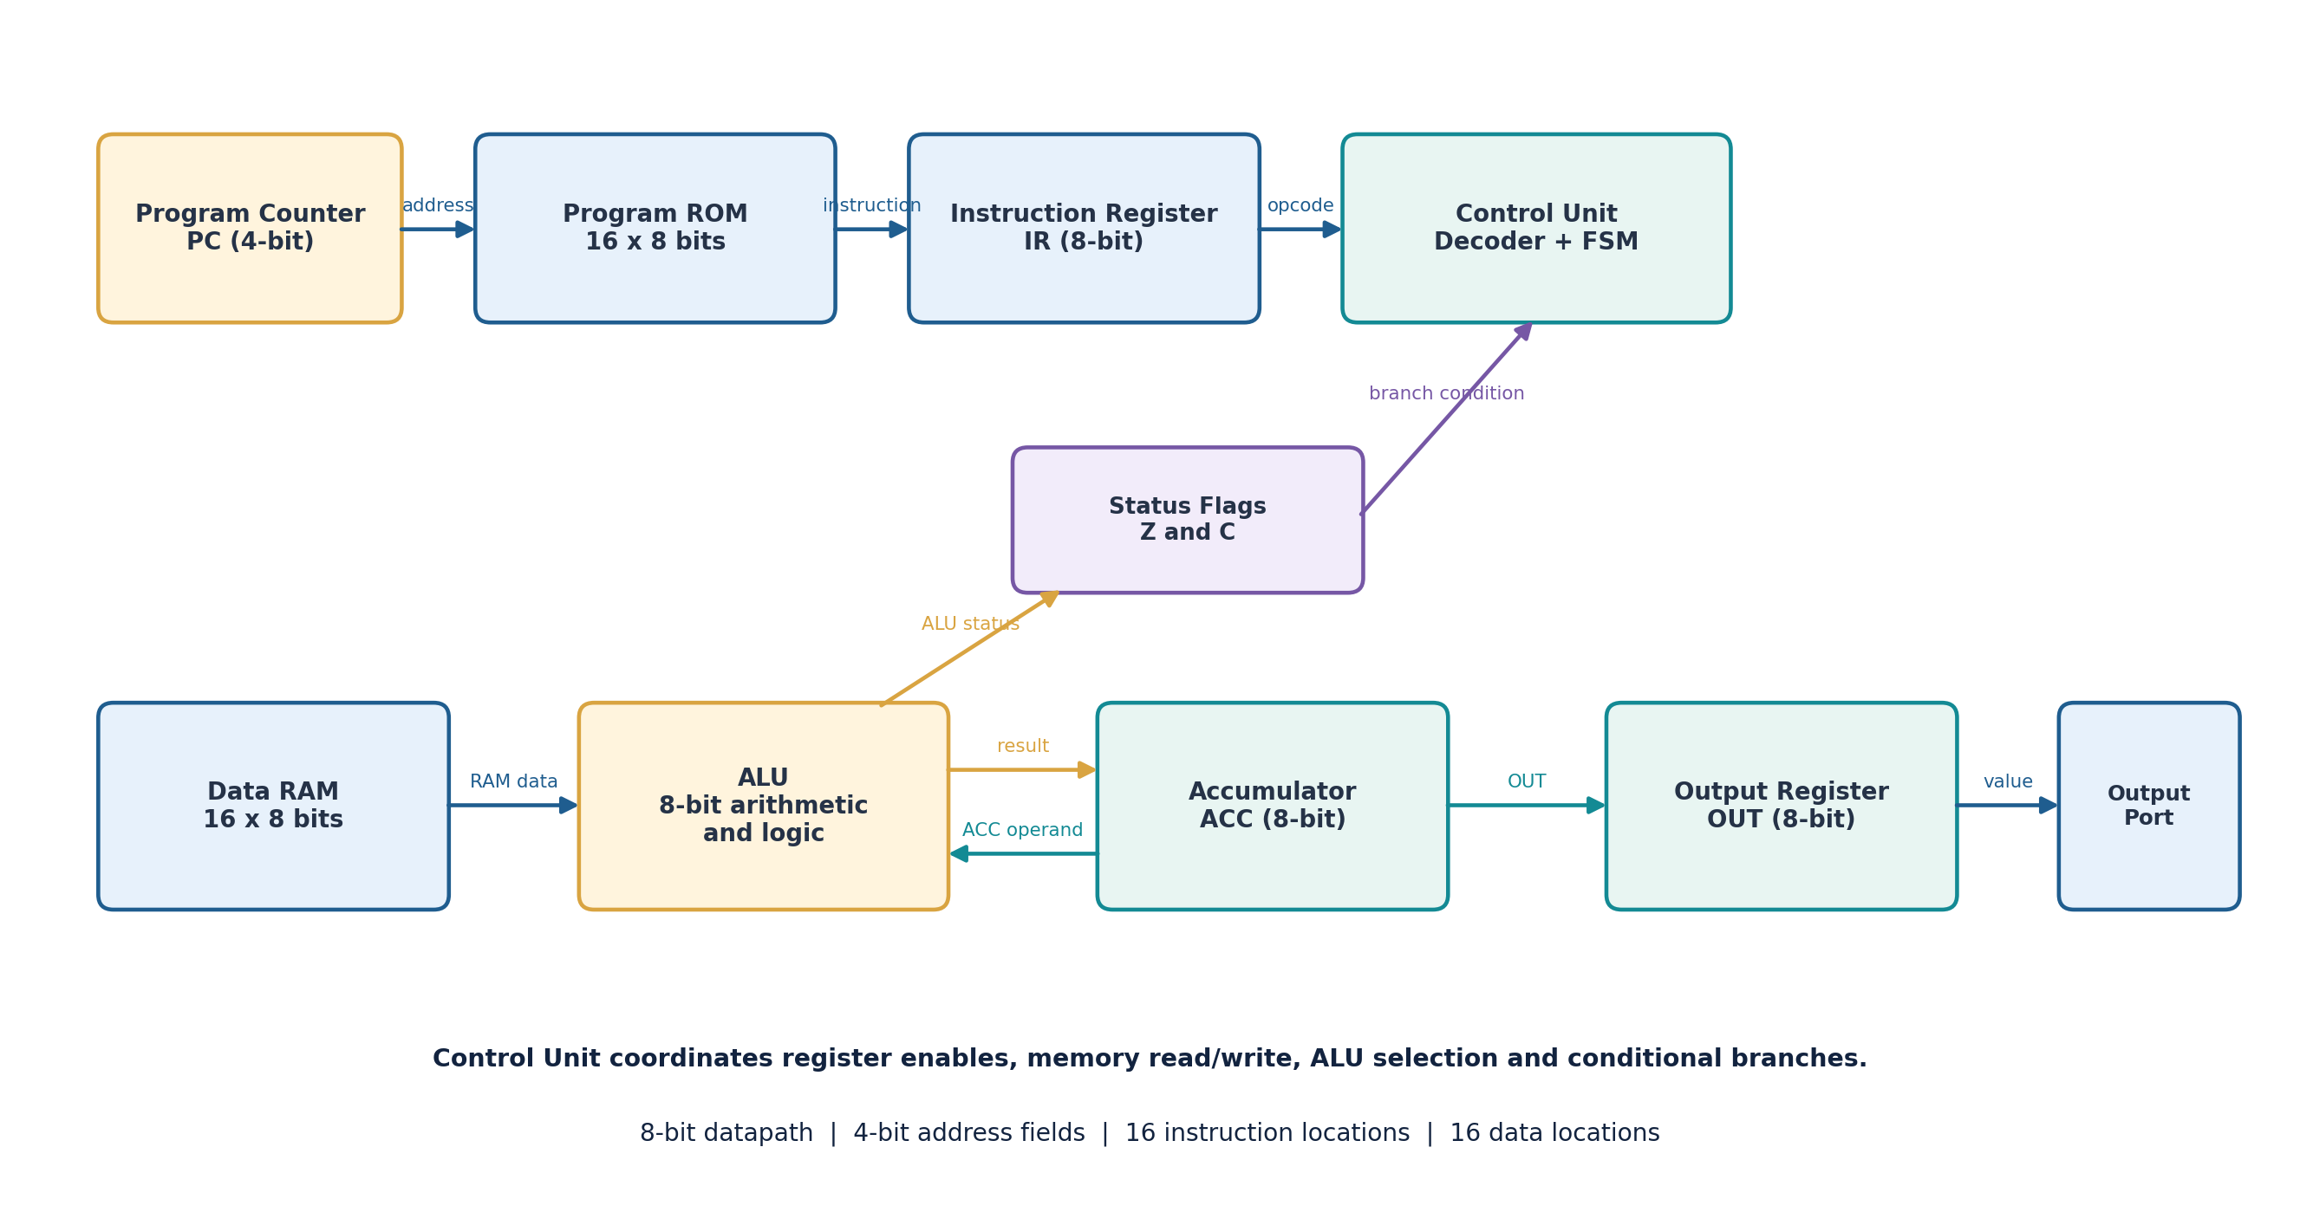
04 / ARCHITECTURE
Top-level architecture
The processor is divided into instruction control, datapath, memory and output blocks.
Figure: processor block diagram (instruction path, control path, datapath and output path).

Slide 6
05 / HARDWARE UNITS
Core components
Every block has a defined state or control responsibility.
PC
IR
ACC
ALU
4-bit next-instruction address
Holds the current 8-bit instruction
8-bit working register
ADD, SUB, AND, OR, XOR
Control
RAM / ROM
Flags
OUT
Opcode decoder + sequencing FSM
16 x 8 data / program storage
Z = zero; C = carry or borrow
8-bit result latch
Single-accumulator design: most ALU instructions combine ACC with one value read from data memory.

Slide 7
06 / INSTRUCTION SET
Instruction format
Each instruction is exactly one byte, split into two 4-bit fields.
7 6 5 4
3 2 1 0
OPCODE
OPERAND
Opcode field
Operand field
Selects one of 16 operations using bits [7:4].
Immediate value, data address or branch target using bits [3:0].
Example: 0x15 = 0001 0101 -> LDI 5 -> ACC = 0x05

Slide 8
07 / INSTRUCTION SET
Instruction set overview
The 16 opcodes cover data movement, arithmetic, logic, control flow and output.
Opcode
Mnemonic
Operation
0000
NOP
No operation
0001
LDI k
Load immediate into ACC
0010
LDA a
Load ACC from RAM[a]
0011
STA a
Store ACC to RAM[a]
0100
ADD a
ACC + RAM[a]
0101
SUB a
ACC - RAM[a]
0110
AND a
Bitwise AND
0111
OR a
Bitwise OR
1000
XOR a
Bitwise XOR
1001
JMP a
Unconditional jump
1010
JZ a
Jump if Z=1
1011
JNZ a
Jump if Z=0
1100
INC
ACC + 1
1101
DEC
ACC - 1
1110
OUT
Copy ACC to OUT
1111
HLT
Stop execution
a = 4-bit address | k = 4-bit immediate value

Slide 9
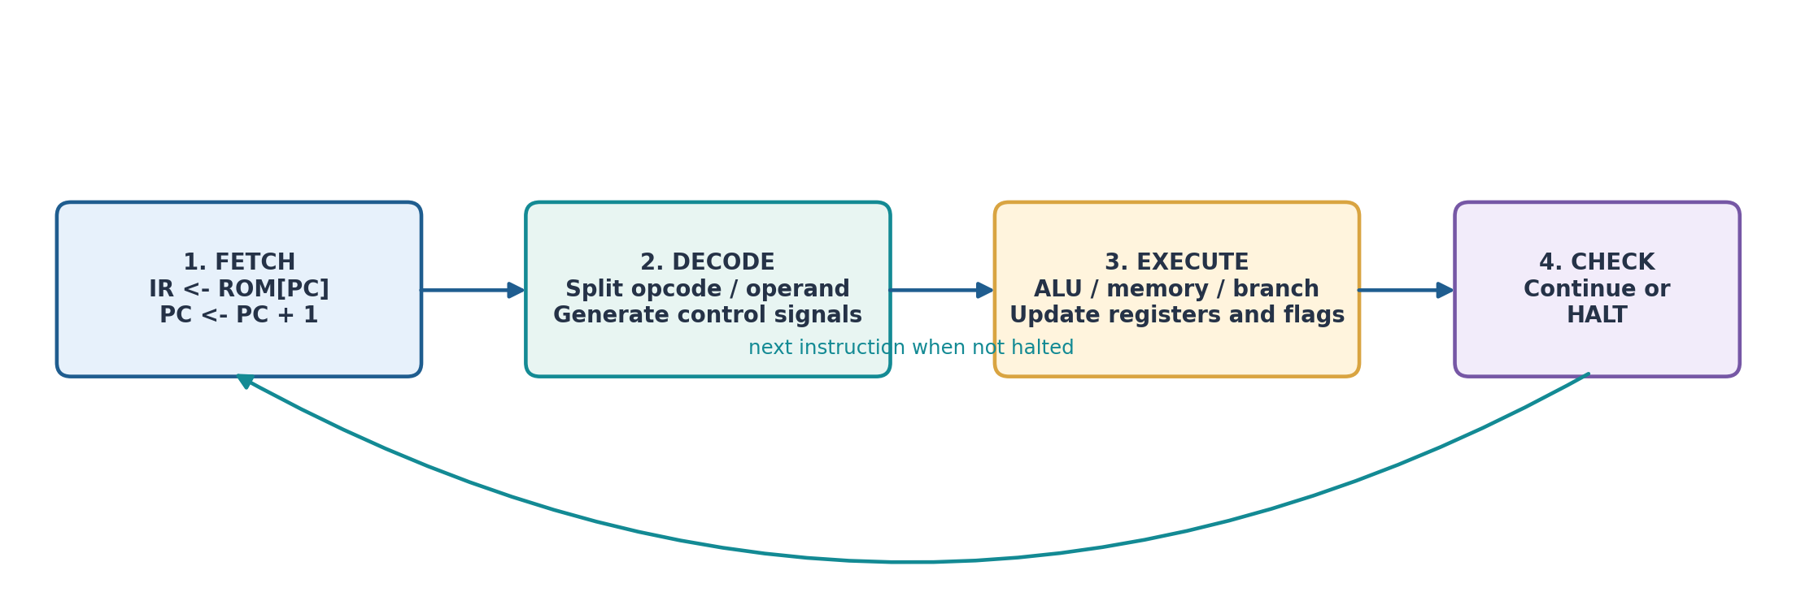
08 / INSTRUCTION CYCLE
Fetch - decode - execute
The same high-level sequence is repeated until HLT is encountered.
Fetch: IR <- ROM[PC], PC <- PC + 1
Decode: separate opcode / operand
Execute: update datapath / flags

Slide 10
09 / CONTROL LOGIC
Control unit and sequencing
The decoder converts the opcode into the control actions required by each instruction.
FETCH
DECODE
EXECUTE
HALT CHECK
Read ROM[PC]
Increment PC
Split opcode and
operand fields
ALU / RAM / branch /
output action
Stop on HLT; else
fetch next instruction
HLT = 1
HLT = 0 -> return to FETCH
Register controls
Memory controls
ALU controls
PC load, ACC write, IR load
ROM read, RAM read / write
Operation select and flag update

Slide 11
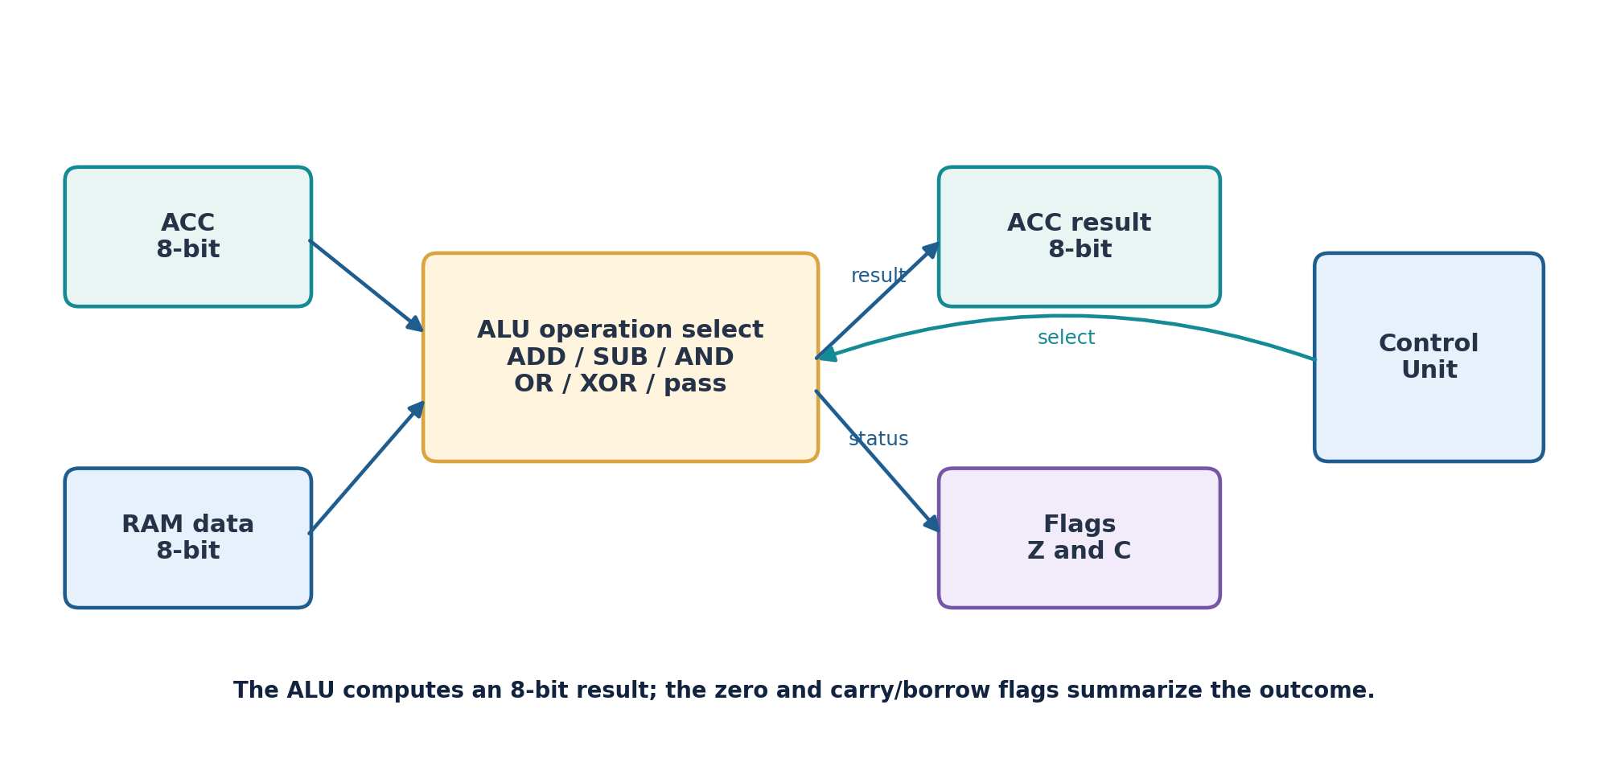
10 / DATAPATH
ALU and status flags
The ALU operates on two 8-bit values and returns an 8-bit result.
Z - Zero flag
Z = 1 when the result stored in ACC is 0; otherwise Z = 0.
C - Carry / borrow
ADD and INC set C on unsigned carry. SUB and DEC set C when a borrow is required.

Slide 12
11 / STORAGE
Memory and I/O organisation
Separate instruction and data storage keeps the processor model easy to follow.
PROGRAM ROM
CPU CORE
16 locations x 8 bits
Instruction bytes
PC, IR, ACC, ALU
Control and flags
OUTPUT REGISTER
8-bit latch
OUT <- ACC
Program addresses: 0x0 - 0xF
DATA RAM
16 locations x 8 bits
Operands / results
Data addresses: 0x0 - 0xF
OUT captures the current ACC value; a physical display or peripheral is outside this version.

Slide 13
12 / PROGRAM
Demonstration program
The program computes 8 - 5 and copies the result to the output register.
PC
IR
Instruction
Action
00
15
LDI 5
ACC <- 5
Input values
01
30
STA 0
RAM[0] <- 5
5 and 3
02
13
LDI 3
ACC <- 3
03
40
ADD 0
ACC <- 3 + 5 = 8
Arithmetic
04
31
STA 1
RAM[1] <- 8
3 + 5 = 8; then 8 - 5 = 3
05
21
LDA 1
ACC <- 8
06
50
SUB 0
ACC <- 8 - 5 = 3
FINAL OUT
07
E0
OUT
OUT <- 3
0x03
08
F0
HLT
Stop execution

Slide 14
13 / RESULTS
Simulation trace
State values are recorded after each instruction in the demonstration program.
Step
PC
IR
Instruction
ACC
RAM[0]
RAM[1]
OUT
1
00
15
LDI 5
05
00
00
00
2
01
30
STA 0
05
05
00
00
3
02
13
LDI 3
03
05
00
00
4
03
40
ADD 0
08
05
00
00
5
04
31
STA 1
08
05
08
00
6
05
21
LDA 1
08
05
08
00
7
06
50
SUB 0
03
05
08
00
8
07
E0
OUT
03
05
08
03
9
08
F0
HLT
03
05
08
03
Z = 0 throughout the final state • C = 0 after the final SUB • HLT stops the sequence

Slide 15
14 / VALIDATION
Verification and test cases
Six independent functional checks cover arithmetic, logic, branching and halt behaviour.
ADD 5 + 3
0x08
PASS
ADD carry: 250 + 10
0x04; C=1
PASS
SUB 8 - 5
0x03
PASS
AND: 0xAA & 0x0F
0x0A
PASS
JZ after LDI 0
Branch taken
PASS
HLT instruction
Stops after 2 steps
PASS
6 / 6 TESTS PASSED
Functional software simulation only - not a gate-level or timing verification result.

Slide 16
15 / RELEVANCE
Applications and design value
The project is primarily educational, with clear paths to hardware-lab extensions.
Digital logic learning
Computer organisation
Lab extension
Connects Boolean operations, registers, memory and control signals into one working system.
Shows how instruction encoding, the PC, IR, ALU and memory work together.
Can be extended into Logisim, Verilog/VHDL, RTL simulation and FPGA experiments.
Why the model is useful
Small address space makes every instruction easy to trace.
A single accumulator keeps the datapath compact.
The same test program can be reused in a future HDL implementation.

Slide 17
16 / NEXT STEPS
Limitations and future enhancements
The design is intentionally compact; the next phase is hardware-level verification.
Current limitations
Future enhancements
• Only 16 program and data addresses
• 4-bit immediate values (0-15)
• One main working register
• No stack, interrupts or pipelining
• No clock-accurate or gate-delay model
• Output is a logical register, not a physical display
• Expand address and memory widths
• Add general-purpose registers
• Add shifts, compare and stack instructions
• Implement the CPU in Verilog or VHDL
• Create a testbench and inspect timing waveforms
• Prototype on an FPGA with LEDs / display
Suggested path: Architecture -> RTL -> Testbench -> Synthesis -> FPGA prototype

Slide 18
17 / SUMMARY
Conclusion
A small but complete architectural model of instruction-driven data processing.
KEY TAKEAWAYS
REFERENCES
M. Morris Mano - Computer System Architecture
Mano & Ciletti - Digital Design
William Stallings - Computer Organization and Architecture
Patterson & Hennessy - Computer Organization and Design
Defined an 8-bit accumulator-based processor with 16 x 8 program and data memories.
Specified a one-byte instruction format and 16 operations.
Explained the ALU, flags, control unit and fetch-decode-execute sequence.
Demonstration output: 3 (0x03); all six functional tests passed.
GitHub Repository: [INSERT YOUR REPOSITORY URL BEFORE SUBMISSION]

