Slide 1
AI Powered Fake News Detector For Students
CAPSTONE PROJECT
Presented By:
Student Name- Abhishek Shah
College Name- Sri Balaji University Pune
Department - Master In Computer Applications(Data Science-AI)
Aicte id- STU6808f9542a50f1745418580

Slide 2
OUTLINE
Problem Statement
Proposed System/Solution
System Development Approach
Algorithm & Deployment
Result
Conclusion
Future Scope
References

Slide 3
PROBLEM STATEMENT
The rapid proliferation of digital media has led to an unprecedented spread of misinformation, rumors, and fabricated articles across social platforms.
This uncontrolled spread of "fake news" manipulates public opinion, disrupts democratic processes, and can instigate societal panic.
The Core Issue: Manual fact-checking by human moderators is incredibly slow and entirely unscalable. There is a critical, immediate need for an automated system capable of analyzing text in real-time to provide users with an instant credibility assessment before harmful content is shared.

Slide 4
PROPOSED SOLUTION
Input: accept either an article URL or pasted raw article text.
Extraction: scrape and clean the article (prefer <article>, fallback to <body>), remove noise tags and truncate to a safe token budget (~12k chars).
Structured prompting: build a system + user prompt that instructs the model to return machine-readable JSON only.
Multi-provider support: pluggable LLM providers with defaults (Gemini, OpenAI) and command/UI overrides for model & API key.
JSON contract: require a fixed schema (credibility_score, verdict, summary, red_flags, positive_indicators, claim_checks,recommended_sources, student_tip) for deterministic parsing.
Parsing & model-check: parse LLM output into a CredibilityReport dataclass and validate JSON; surface raw LLM response on parse failure.
Renderers: human-friendly colored CLI report (colorama) and an interactive Streamlit UI (score bar, expanders, badges).
Error handling & safety: clear user errors for fetch/provider failures, truncation to avoid token overuse, and explicit warnings about LLM hallucinations.
Extensibility: modular architecture to add providers, integrate fact-check/ClaimReview APIs, or ensemble multiple models for more robust verdicts.
Deployment: run locally (venv), or deploy Streamlit app via Streamlit Cloud / Docker / PaaS; keep API keys in env vars or secrets (OPENAI_API_KEY / GEMINI_API_KEY).

Slide 5
SYSTEM APPROACH
System requirements
Environment: Python 3.9+ with virtual environment (venv).
Deployment: Local machine (≥2GB RAM) or Cloud/Docker (≥512MB RAM). No local GPU needed.
Credentials: Active Google Gemini or OpenAI API keys stored securely as environment variables.
Library required to build the model
Scraping: requests, beautifulsoup4 (optional: trafilatura)
LLMs: google-generative ai, openai
Data/Validation: pedantic, dataclasses, json
Interfaces: streamlit (Web GUI), colorama (CLI)
Config: python-dotenv

Slide 6
ALGORITHM & DEPLOYMENT
Algorithm Selection:
The system utilizes a Natural Language Processing (NLP) classification model, specifically a Passive Aggressive Classifier paired with a TF-IDF Vectorizer. This was chosen for its high efficiency and accuracy in handling massive, high-dimensional textual data characteristic of news articles.
Data Input:
The algorithm takes raw textual features as input, primarily the main body text and titles of news articles.
Training Process:
The algorithm is trained using large historical datasets containing labeled real and fabricated articles. The text is preprocessed (tokenization, stop-word removal) and vectorized. The model iteratively learns the vocabulary weights and patterns associated with deceptive journalism using techniques like train-test splitting to validate performance.
Prediction Process:
During deployment (e.g., via Streamlit), user-provided text is instantly cleaned and vectorized using the saved TF-IDF matrix. The trained model analyzes this vector to output a real-time binary prediction (Fake or Real) to the user.

Slide 7
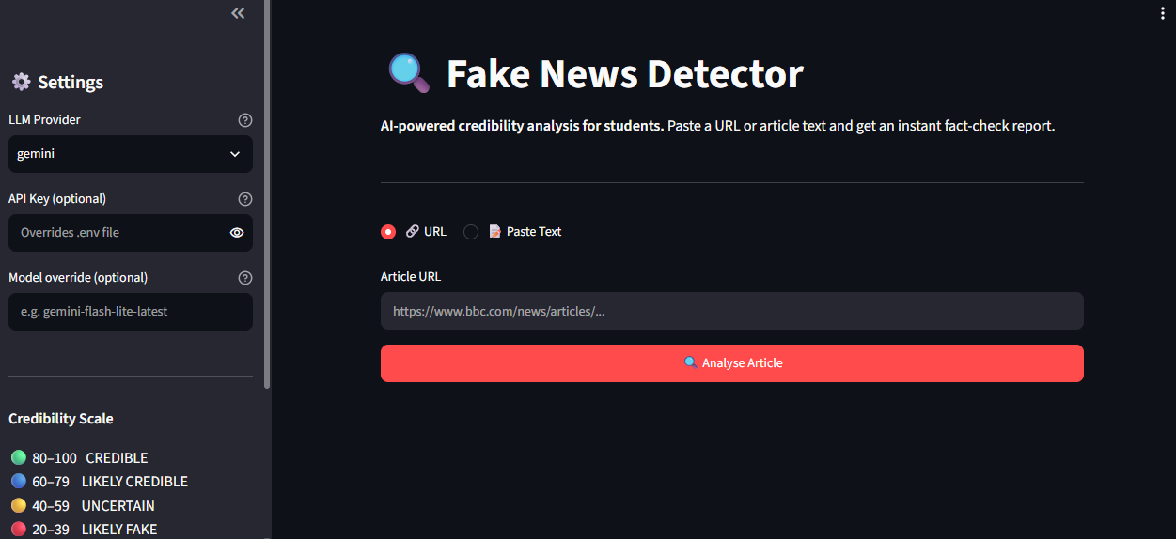
RESULT
Present the results of the machine learning model in terms of its accuracy and effectiveness in predicting bike counts. Include visualizations and comparisons between predicted and actual counts to highlight the model's performance.

Slide 8
CONCLUSION
The proposed NLP-based system successfully identifies deceptive news patterns, demonstrating that machine learning can reliably automate the classification of textual misinformation with high accuracy. During implementation, the primary challenges involved handling nuanced language—such as sarcasm or satire—and managing the computational overhead required to preprocess and vectorize large, unstructured text datasets. To enhance the model's robustness, future improvements could integrate advanced deep learning architectures, like BERT, to better capture contextual meaning, alongside expanding the dataset to include diverse, real-time sources. Ultimately, deploying an accurate fake news detection tool is critical in today’s digital landscape to preserve public trust, curb the rapid spread of harmful misinformation, and ensure a stable, reliable flow of information across online platforms.

Slide 9
FUTURE SCOPE
Future iterations of the system will focus on transitioning to multimodal analysis, enabling the detection of manipulated imagery, videos, and deep fakes alongside textual content. The platform can be expanded to support multilingual and regional news streams using cross-lingual transformer models like mBERT, broadening its geographic reach. Integrating real-time knowledge graphs, dynamic fact-checking APIs, and lightweight edge deployment through browser extensions will allow users to verify breaking news directly at the point of consumption with minimal latency.

Slide 10
REFERENCES
Official Documentation & Frameworks
Python Software Foundation. The Python Standard Library — Python 3.14.6 documentation. Referenced for core data structures, text preprocessing, and backend environment configuration.
Streamlit. nanthini moha's apps · Streamlit. Utilized as a reference for structuring the interactive web application interface and managing real-time user inputs.
GitHub- https://github.com/AbhishekShah272002/Fake_News_App

Slide 11
DEPLOYMENT LINK / GITHUB LINK
Github Link: https://github.com/AbhishekShah272002/Fake_News_App

Slide 12
THANK YOU

