Slide 1
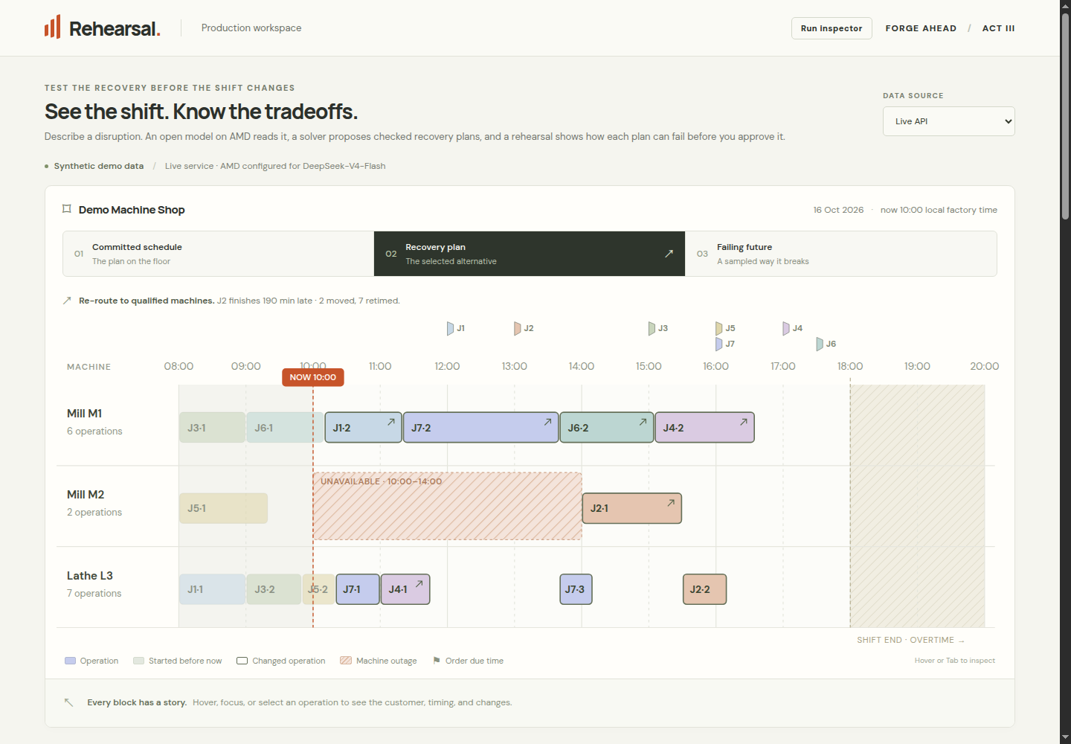
REHEARSAL
INTELLIGENT INDUSTRY
Rehearsal.
Test the recovery
before changing
the shift.
Checked recovery decisions
for production planners.
Abhishek Sharma + Muskan Verma
Working AWS app • Real AMD extraction • Synthetic demo data
FORGE AHEAD / AMD DEVELOPER HACKATHON: ACT III
01
Notes:
Rehearsal helps a production planner test a recovery before changing the shift. The screenshot is from the verified public AWS application. All factory data is synthetic.

Slide 2
REHEARSAL
THE DECISION
One breakdown.
Seven delivery promises.
The production planner has to decide what to move, what runs late, and what to approve.
10:00
16:00
A decision
M2 stops
J7 must ship
Own the tradeoff
Work is already in progress.
Its hard deadline must hold.
A revised plan needs a clear
handoff.
FIRST USER
A production planner in a make-to-order machine shop
Evidence / source
FORGE AHEAD / AMD DEVELOPER HACKATHON: ACT III
02
Notes:
At 10:00, M2 is unavailable until 14:00 while J7 still has a hard 16:00 deadline. The planner needs a defensible decision and a usable dispatch handoff.

Slide 3
REHEARSAL
FROM A MESSAGE TO A DECISION
The note becomes
a plan you can inspect.
“Mill M2 is unavailable until 14:00. Order J7 still needs to ship at 16:00.
Overtime requires approval.”
READ ON AMD
REVIEW
SOLVE + CHECK
REHEARSE
APPROVE + EXPORT
Machine outage
Hard deadline
Proposed option
M2 · 10:00–14:00
J7 · 16:00
Overtime · approval needed
Unknown machines and missing required times are flagged for human review.
Evidence / source
FORGE AHEAD / AMD DEVELOPER HACKATHON: ACT III
03
Notes:
The real AMD model turns a free-text note into typed, source-linked proposals. Validation and human review precede CPU planning. Conditional overtime is a proposed option, not prior approval.

Slide 4
REHEARSAL
THE CHECKED RECOVERY
Save J7.
Show the cost.
KEEP ORIGINAL MACHINES
RE-ROUTE TO QUALIFIED MACHINES
Infeasible
J7 on time
J7’s hard deadline cannot be met
under this policy.
J2: 190 minutes late
The hard date is not silently moved.
0 overtime minutes · Independent checker passed
That late delivery is an explicit concession for a person to approve.
Evidence / source
FORGE AHEAD / AMD DEVELOPER HACKATHON: ACT III
04
Notes:
The saved live run proves keep-machines infeasibility for J7. Re-routing meets J7’s hard date while J2 finishes 190 minutes late. There is no overtime in this selected plan, and the independent checker passed.

Slide 5
REHEARSAL
REHEARSE BEFORE COMMITTING
On paper, on time.
In rehearsal, exposed.
J4
239 / 500
A CONCRETE COUNTEREXAMPLE
Sampled future #24
simulated scenarios finish on time
J4 finishes at 18:01
61 minutes late. Its M1 operation waits
70 minutes longer than planned.
Planned finish: 16:35 · Due: 17:00
500 samples · seed 7 · duration factors 0.9–1.3 · repairs 0–90 min late
Synthetic uncertainty; these counts are not measured factory reliability.
Evidence / source
FORGE AHEAD / AMD DEVELOPER HACKATHON: ACT III
05
Notes:
J4 is on time nominally, but on time in 239 of 500 scenarios under declared synthetic assumptions. Sample 24 finishes at 18:01, 61 minutes late. These are not calibrated factory probabilities.

Slide 6
REHEARSAL
HUMAN APPROVAL AND HANDOFF
A decision someone owns.
A record you can keep.
01
Accept the tradeoff
ACTUAL DISPATCH EXPORT · EXCERPT
Required late-delivery and overtime concessions
are explicit.
machine job op start end
M1 J1 2 10:10 11:20
M1 J7 2 11:20 13:40
M1 J6 2 13:40 15:05
M1 J4 2 15:05 16:35
02
Approve a stored plan
The server checks its own schedule again before
export.
03
Keep both exports
Dispatch CSV + a decision JSON with AMD trace
and rehearsal evidence.
Approval locks the decision. Identical retries return the same exports.
Evidence / source
FORGE AHEAD / AMD DEVELOPER HACKATHON: ACT III
06
Notes:
Approval reads the stored server plan, recalculates concessions and checks the schedule again. The CSV excerpt is from the saved public workflow. The JSON preserves trace and rehearsal evidence.

Slide 7
REHEARSAL
APPLICATION OF TECHNOLOGY
AMD reads the message.
The checks control the decision.
AMD TOKEN FACTORY
VERIFIED LIVE REQUEST
DeepSeek-V4-Flash
Provider
AMD Token Factory
Typed proposals + exact source spans
Model
DeepSeek-V4-Flash
Host
developer.amd.com.cn
WEB CONTAINER · CPU
React + FastAPI
Latency / attempts
7,866 ms / 1 attempt
Fallback
Disabled; no fallback used
OR-Tools CP-SAT → independent checker
→ NumPy rehearsal → approval / exports
No GPU replay or GPU speedup is claimed. The model API is the AMD workload.
Evidence / source
FORGE AHEAD / AMD DEVELOPER HACKATHON: ACT III
07
Notes:
AMD inference is the model API workload. OR-Tools, the independent checker and NumPy replay run on CPU. This is one observed successful request, not a latency benchmark; a separate browser request needed a retry.

Slide 8
REHEARSAL
EVIDENCE AND ITS LIMITS
Small tests.
Visible limits.
Extractor / labels
Complete changes
Wrong “OK”
Review raised
Rules / Muskan
13 / 23
2
9 / 12
AMD / Muskan
23 / 23
0
12 / 12
Same AMD / Abhishek
21 / 23
0
9 / 10
23 team-written messages; they informed prompt tuning. Two provisional label sets.
No independent benchmark or final reconciled extraction score is claimed.
Also recorded: 7 frozen synthetic recovery scenarios, including an infeasible case.
The repository retains unchanged outcomes and tradeoffs, not just improvements.
Evidence / source
FORGE AHEAD / AMD DEVELOPER HACKATHON: ACT III
08
Notes:
Both provisional label sets are shown. The same 23 team-written messages informed prompt tuning, so this is development evidence, not an independent benchmark. Recovery evaluation retains unchanged cases and tradeoffs.

Slide 9
REHEARSAL
BUSINESS VALUE AND THE NEXT PILOT
A clear first user.
A measurable next step.
WHO USES IT
SHADOW PILOT
Use real historical disruptions
Production planners
Replay cases alongside a planner’s current workflow.
Small, make-to-order machine shops
handling disruption-driven replanning.
Measure the decision
Time to a correct approved plan; missed commitments and wrong
accepted changes.
The aim: faster, clearer recovery decisions
with an auditable handoff.
Start with the handoff
Validate CSV exports before connecting factory systems.
Current limits: synthetic data · one-day fixture · no ERP integration · no validated ROI
Evidence / source
FORGE AHEAD / AMD DEVELOPER HACKATHON: ACT III
09
Notes:
The intended user is a planner in a small make-to-order shop. The next validation step is a shadow pilot with real historical cases and measured decision quality/time. Adoption and ROI are unvalidated.

Slide 10
REHEARSAL
FORGE AHEAD
Rehearse before
you commit.
Abhishek Sharma + Muskan Verma
Intelligent Industry / AMD Developer Hackathon: ACT III
OPEN THE LIVE APP
VIEW CODE + EVIDENCE
github.com/AbhishekSharma55/amd-act-3
WATCH THE DEMO / youtu.be/XCLzMpVXXHU
FORGE AHEAD / AMD DEVELOPER HACKATHON: ACT III
10
Notes:
The app, code and video links are clickable. The application is live with AMD configured and fallback disabled. The repository is public and includes setup, licenses, source and reproducible evidence. Demo video: https://youtu.be/XCLzMpVXXHU

