Slide 1

AMR FINAL PRESENTATION
TEAM RCB
ABhiSHEK SHIVAYYA

Slide 2
Agenda
Things to Do
Sorting Goals
Algorithm Flow
Parameters Tuned
Further Improvements

Slide 3
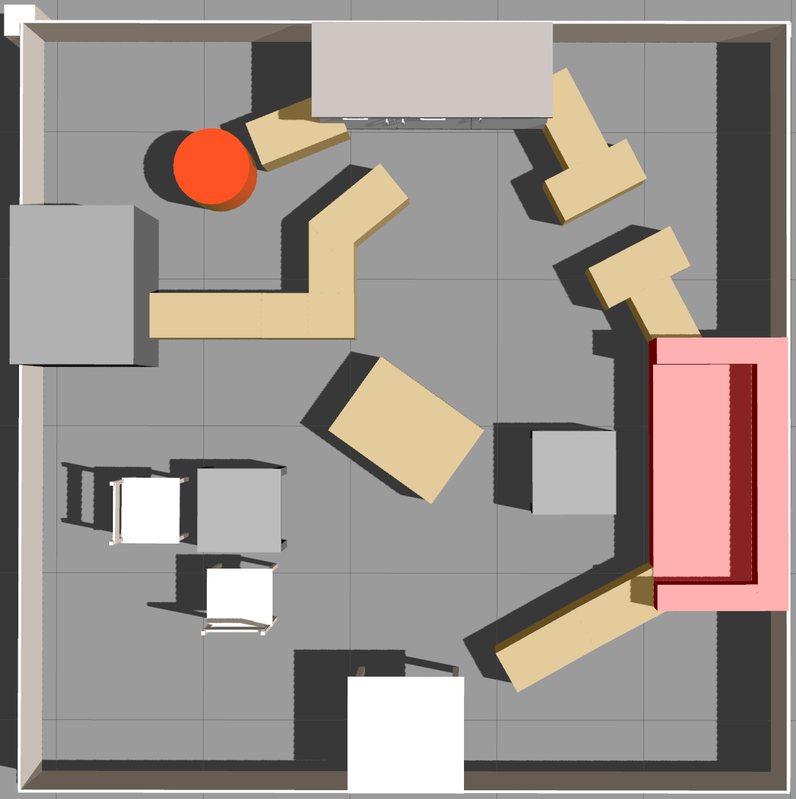
Task to Do
Reach as many goals as possible published by the goal publisher within 10 min by avoiding obstacles and collision between the other robots.

Slide 4
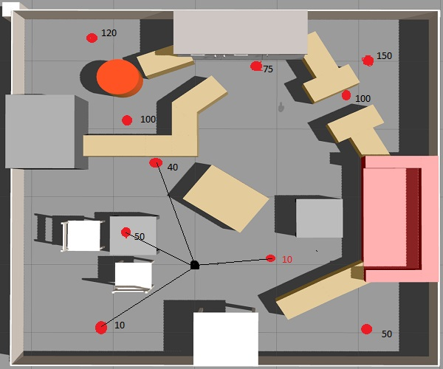
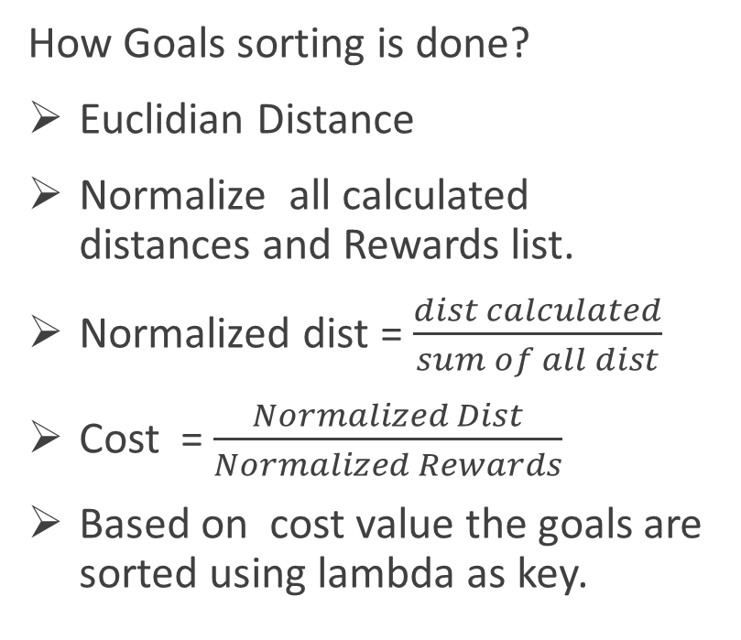
Sorting Goals
How Goals sorting is done?
Euclidian Distance
Normalize all calculated distances and Rewards list.
Normalized dist = $\frac{dist calculated}{sum of all dist}$
Cost = $\frac{Normalized Dist}{Normalized Rewards}$
Based on cost value the goals are sorted using lambda as key.

Slide 5
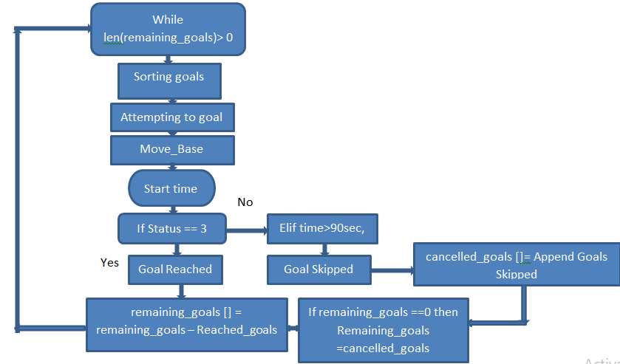
Algorithm Flow

Slide 6
Parameters
Which parameters are tuned?
xy_goal_tolernace = 0.175 meters
Yaw_goal_tolerance = 3.13
Inflation_radius (IR) = 0.2
Cost scaling factor(CSF) = 5.0

Slide 7
Further Improvements
Problems encountered?
Goals sorting based on Euclidian distance raised a problem, when the goal point is on the other side of the obstacle.
Narrow path between the obstacles.
What improvements I have to make ?
I should have used `move_base/NavfnROS/make_plan` service for planning the global path from the robots current position to goal position.
Using Manual driving if move_base fails to make a path between narrow paths.

Slide 8
Thank You

