Slide 1
Sizing VMs for a stated risk, not a percentile
REVIEW 3 · EVALUATION AND EVIDENCE
64 GB
32 GB
16 GB given
8 GB
4 GB chosen
Risk-Quantified Virtual Machine Right-Sizing for Private Cloud Capacity Reclamation
Evaluated on the GWA-T-12 Bitbrains fastStorage and Rnd traces
2 GB
Memory catalog. VM 332 was given 16 GB and is sized up to 4 GB
Abhishek Singh 23BCE5044 · Purusharth Kumar 23BCE1908 Faculty: Indra Priyadharshini S
Notes:
Good morning. This is Review 3 of our right-sizing project: the evaluation and the evidence. The idea in one line: instead of shrinking a VM to a usage percentile, the operator states a risk, the chance the VM runs out within the next nine days, and the method picks the smallest catalog flavour that meets it. Review 1 built the testbed and baselines, Review 2 built the method, and today we put intervals on every number and give a verdict on all three pre-registered hypotheses. All three fail, and this deck shows why.

Slide 2
What we set out to show
The problem
Hypotheses, fixed before any result
Right-sizing tools report the capacity they free and leave the risk unpriced. Under P95 sizing, only 37% of active VMs stay violation-free over 9 held-out days, while it reports 69% of their memory reclaimed.
M(ε) against the baselines on 792 VMs: 21 days observed, 9 days held out
H1
At P95's measured risk, reclaim at least 15% more vCPU-hours and 10% more GB-hours than P95
Objectives
O1
Measure the gap between allocated and used capacity
H2
Stated risk is calibrated: fewer than 2 of 5 ε points outside the 95% binomial interval, and ECE below 0.05
O2
Recommend a catalog flavour from utilisation history
H3
Reclaim at least 25% of vCPU-hours or 20% of GB-hours with zero violations
O3
Give each recommendation a probability of exhaustion
O4
Show reclaimed capacity against induced risk as a frontier
None of these thresholds moved after results existed.
Notes:
A quick recap so the results make sense. Four objectives from the problem statement, and three hypotheses we wrote down before any result existed: beat P95 at its own risk, state a risk that can be trusted, and reclaim something at zero risk. None of the thresholds moved afterwards. That rule costs us all three, and we show that honestly.

Slide 3


Two fleets, six splits, 10,000 resamples
1,250
792
316
10,000
fastStorage VMs, one CSV each, 5-minute samples over 30 days
usable after four data-quality gates; 425 of them idle
usable Rnd VMs: a second fleet, August 2013
paired bootstrap resamples over VMs, seed 16
How each run works
Workloads and variance
Recommenders see the first 21 days only; the last 9 are held out
As-provisioned, peak, P95 and capped peak against M(ε) for ε from 0.001 to 0.6
Every choice snaps up to the catalog: vCPU 1–16, memory 2–64 GB
Memory violation: one sample over. CPU: two consecutive samples over
Two fleets: fastStorage (792 VMs) and Rnd (316 VMs), pipeline unchanged
Six observation/evaluation splits: headline 21/9, four 14/9 runs (A0–A3), one 7/9
95% paired bootstrap interval on every reclamation, risk, gap and ablation shift
Seed 17 re-run moves interval endpoints by at most 0.4 pp
GWA-T-12, Grid Workloads Archive, TU Delft. This trace was graciously provided by Bitbrains IT Services Inc.
Notes:
Here is the evaluation. The Bitbrains fastStorage trace: 1,250 VMs, 792 usable after four data-quality gates. Every recommender sees the first 21 days only and is scored on the last 9. Multiple workloads: a second fleet, Rnd, run with nothing changed. Variance: six splits, four of which are repeated 14/9-day runs, plus a paired bootstrap over VMs with 10,000 resamples on every number.

Slide 4

Every objective, mapped to its evidence
Objective | Implemented in | Evidence | Status
O1 Measure the allocated-versus-used gap | src/inspect_traces.py src/baselines.py | 1,250 VMs profiled, 792 usable. Peak sizing alone frees 37.6% of vCPU-hours and 33.0% of GB-hours; repeated on Rnd (slides 3, 14) | Done
O2 Recommend a catalog flavour | src/baselines.py src/sweep_eps.py | Peak, P95, capped peak and M(ε) each pick an upward-snapped flavour from the observation window only (slides 5, 19) | Done
O3 Probability of exhaustion | src/baselines.py (GPD, θ) src/hypotheses.py | P(exhaustion within 9 days) for every recommendation, tested on held-out data (slides 8–10) | Built; H2 fails
O4 Risk/reclamation frontier | src/sweep_eps.py src/bootstrap.py | ε swept 0.001–0.6 against every baseline, 95% CIs on both axes, matched-risk gaps (slides 6, 7) | Done
All four objectives are evidenced with code, tests and results. O3's risk figure exists; the test of whether it can be trusted fails, and we report that as a result.
Notes:
This is the evidence matrix: each objective, where it lives in the code, and what proves it. O1, O2 and O4 are done. O3 is built and tested as code; its calibration test, H2, fails, and that failure is itself reported as a result.

Slide 5

Size for a probability, not a percentile
1
2
3
4
Set a threshold
Fit the tail
Correct for clustering
Choose a flavour
u = 95th percentile of observation-window demand. Keep only the tail above it.
A Generalized Pareto fit on the excesses gives p(c), the per-sample chance demand beats capacity c.
Extremal index θ (Ferro–Segers): one long spike counts as one event, not forty.
Smallest catalog flavour whose p(c) meets the target, capped at the original allocation.
The operator's dial
Why the cap
p* = 1 − (1 − ε)^(1/θn)
Demand in the trace is clipped at the allocation, so the true tail above it is never seen. The cap was fixed on 22 September 2026, before any frontier existed.
ε is the chance of at least one violation in 9 days. n is the number of samples in that horizon.
Notes:
Recap for anyone who missed Review 2. The operator picks epsilon, a probability of at least one violation over the nine-day horizon. The method turns it into a per-sample target and returns the smallest flavour that meets it. The cap at the original allocation was fixed before any frontier existed, because demand in the trace is clipped at that allocation. That cap will turn out to matter more than anything else.

Slide 6
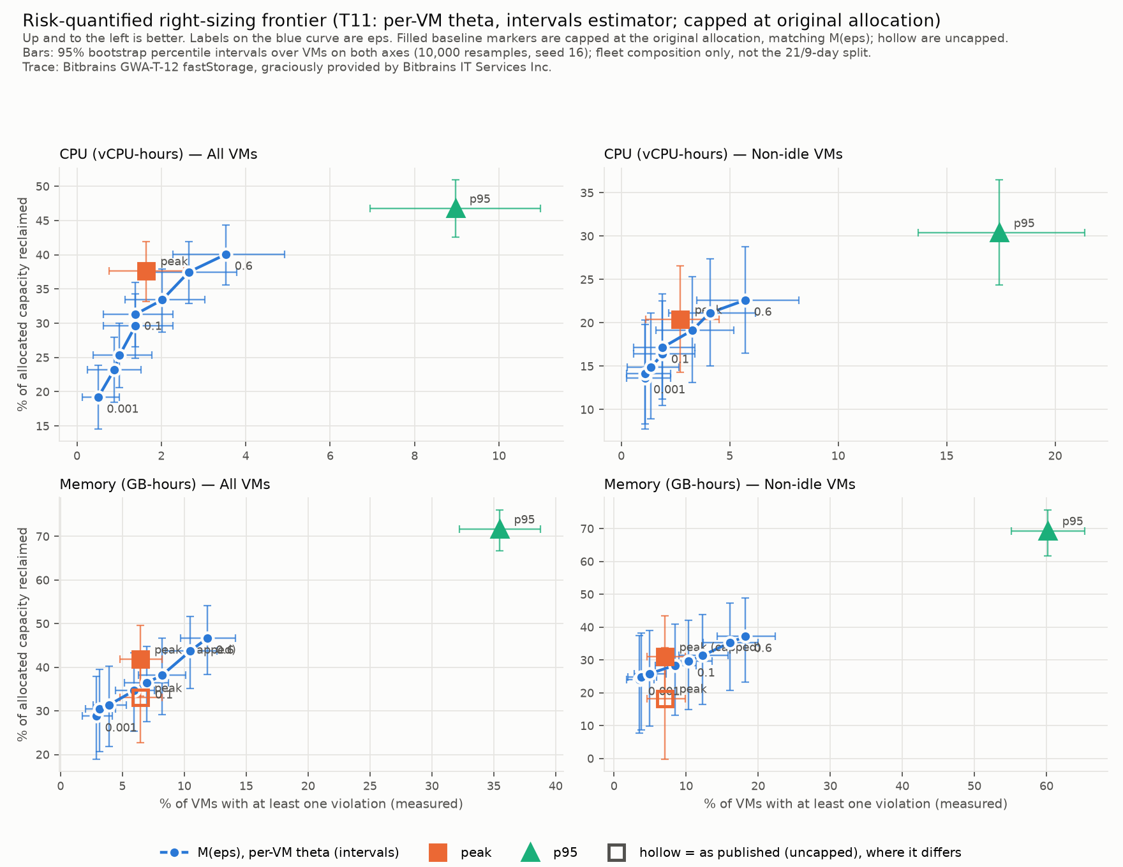
P95 reclaims the most because it breaks the most
35.5%
of VMs P95 breaks on memory, for the largest reclamation (71.7% of GB-hours)
2.9–11.9%
memory risk that M(ε) spans. Below peak's 6.4% it is the only non-trivial option
0
baselines beaten by any M(ε) point where the curves overlap
Bars: 95% bootstrap intervals over VMs, B = 10,000. n = 792 all VMs, 367 non-idle. Same axes for every method: share of VMs violated (x) against capacity reclaimed (y).
Notes:
The comparative slide from Review 2, redrawn with intervals on both axes. P95 reclaims the most and carries by far the most risk. M(eps) gives the operator a dial into the low-risk region, but where it overlaps a baseline it does not beat it. The next slide puts a number on that.

Slide 7
At equal risk, M(ε) reclaims less than capped peak
M(ε) minus peak_capped at equal measured risk, pp, 95% paired bootstrap CI
Cell | A0–A3 | B7
CPU, all | −6.21 to −4.40 | −4.85
Memory, all | −7.09 to −2.97 | −1.97
CPU, non-idle | −4.70 to −1.85 | −1.69
Memory, non-idle | −4.19 to −1.72 | −1.00
All VMs, CPU
−5.56 [−11.07, −2.47]
All VMs, memory
−6.30 [−9.18, −3.45]
Non-idle, CPU
−2.15 [−4.02, 0.30] c
Negative in every split and every cell. Three of four bootstrap intervals exclude zero.
Non-idle, memory
−3.61 [−5.71, −1.66]
−12
−9
−6
−3
0
Dashed amber: conditional interval, undefined in 1 of 10,000 resamples.
H1's comparator (P95) is out of reach, so this comparison against the baseline the frontier does overlap is exploratory, not H1. Matched points interpolate linearly between the two bracketing ε values.
Notes:
This is the comparison H1 would have made if its comparator were reachable. Paired bootstrap, 10,000 resamples. At the same measured risk, M(eps) reclaims two to six points less than simply capping the peak. Three of four intervals exclude zero; non-idle CPU reaches zero. The splits overlap heavily, so their agreement is consistency, not a second interval.

Slide 8

All three hypotheses fail, each for a stated reason
H1
Dominance over P95
H2
Calibration
H3
Zero-risk reclamation
NOT SUPPORTED
NOT SUPPORTED
NOT SUPPORTED
THRESHOLD
THRESHOLD
THRESHOLD
+15% vCPU-h and +10% GB-h over P95, at P95's measured risk
Under 2 of 5 points outside the 95% binomial interval, and ECE < 0.05
≥ 25% vCPU-h or ≥ 20% GB-h with zero violation events
MEASURED
MEASURED
MEASURED
M(ε) peaks at 3.5% CPU and 11.9% memory risk; P95 sits at 9.0% and 35.5%. No matched point exists.
CPU 3 of 5 and memory 4 of 5 points fall outside the interval.
0%. Only as-provisioned has zero violations.
WHAT WORKS
WHAT WORKS
WHAT WORKS
A low-risk dial: 28.9% of GB-h at 2.9% risk, the only option below peak's 6.4%.
ECE 0.025–0.029 passes. CPU is inside the interval at ε = 0.005 and 0.01, memory at ε = 0.05.
Near-zero risk is reachable: 28.9% GB-h with 97.1% of VMs safe; 19.2% vCPU-h with 99.5% safe.
WHY IT STILL FAILS
WHY IT STILL FAILS
WHY IT STILL FAILS
ε = 0.6 is 1-in-2,829; P95 is 1-in-20.
Demand leaves the observed range.
A few VMs violate at any reduction.
Reference configuration, 792 VMs, 21/9 split. What works is reported, but it does not change any verdict: no threshold, comparator or sweep range was moved.
Notes:
The verdicts on the reference configuration. H1 is not evaluable rather than failed, because its statistic does not exist on the swept range; we did not reformulate it or extend the sweep to rescue it. H2 fails on the binomial clause. A recommender that never violates would score ECE 0.033, inside the 0.05 bound, so the ECE clause has no power here, which we report as a weakness of our own pre-registration. H3: nothing is reclaimed at zero risk. The green panels are what does hold. Below peak's risk, M(eps) is the only option, reclaiming 28.9 percent of memory with 97 percent of VMs safe. Calibration holds at three of the ten points, in the middle of the range. And at epsilon 0.001 only 4 of 792 VMs violate on CPU and 23 on memory. None of that changes a verdict, because the thresholds were fixed in advance. If asked 'so the method failed?': yes, and we know why. Demand leaves the range the observation window saw, and our own diagnostic points to drift-aware sizing as the next step.

Slide 9
Ask for a 0.1% chance of exhaustion, observe 2.9%
6 / 6
splits reject H2, in all four scope and resource cells
19–30×
memory risk over target at ε = 0.001, in every 14- and 21-day split
0.033
ECE of a method that never violates: inside the 0.05 bound, so that clause cannot fail
Anti-conservative below ε ≈ 0.05, conservative above: the measured curve is far flatter than the target. Dotted: 95% bootstrap CI over VMs, B = 10,000.
Notes:
Calibration. The dashed grey line is what the operator asked for; the orange line is what happened on memory. At the low end we ask for a tenth of a percent and observe almost three percent. At the high end it is the other way round. The pre-registered statistic is the binomial test plus ECE: memory has 4 of 5 points outside the interval, CPU 3 of 5, so H2 is not supported, in every split. Serial correlation, the suspect we pre-registered, is not the cause: switching theta off changes nothing detectable.

Slide 10

Why we did not rescue the hypotheses
THE TEMPTING FIX
WHY IT IS NOT ALLOWED
Extend ε past 0.6, or compare with capped peak instead of P95
P95's risk needs ε ≈ 1 − 10⁻⁵⁸. A new comparator is a new hypothesis, and M(ε) loses that comparison too (−2.2 to −6.3 pp).
H1
Dominance
Keep only the ECE clause, or recalibrate using the 9 held-out days
Dropping the failed clause moves the goalposts, and ECE cannot fail here. Tuning on held-out days breaks the information constraint.
H2
Calibration
Score only the VMs that never violate, for example the idle ones
Choosing the subset after seeing outcomes guarantees a pass and tests nothing. Nearest honest miss: 28.9% GB-h with 23 VMs violating.
H3
Zero risk
The legitimate route: a new hypothesis on fresh data
Pre-register H2′ for a drift-aware M(ε), with thresholds fixed first, and test it on Rnd July and September 2013, which no committed result uses. H1–H3 stay exactly as reported.
Notes:
The obvious question is whether these hypotheses could be made to pass. Each one could, but only by changing the test after seeing the data. H1: P95's risk is out of reach, and switching the comparator to capped peak is a new hypothesis that M(eps) also loses. H2: we could keep only the ECE clause, which cannot fail here, or recalibrate on the held-out days, which breaks the rule that recommenders never see evaluation data. H3: we could score only the VMs that never violate, which tests nothing. The honest route is a new pre-registered hypothesis, H2-prime, for a drift-aware method, tested on the two Rnd months that no result has touched. The original verdicts stay as they are.

Slide 11
The cap is the whole gain; the tail model adds nothing
CPU, all VMs
The cap is the core
θ off
+0.70 [−1.67, 4.61] c
Without it the gap falls by 47 pp (CPU) and 68 pp (memory): the fitted tail asks for more than the VM ever had.
θ runs
+0.35 [−0.63, 3.71]
snap off
−8.50 [−13.45, −2.47]
u = q0.90
+1.20 [−0.87, 3.66]
u = q0.98
−1.09 [−5.01, 2.26]
θ does nothing measurable
Every θ off and θ runs interval contains zero, under either estimator.
Memory, all VMs
θ off
+0.93 [−0.33, 3.90] c
θ runs
+0.38 [−0.34, 1.56]
We did not re-pick
snap off
+5.47 [1.80, 9.08]
u = q0.98 adds +5.26 pp on memory. Switching to it now would be fitting on the evaluation window, so q0.95 stays.
u = q0.90
−0.56 [−1.80, 1.11]
u = q0.98
+5.26 [3.40, 7.62]
−12
−8
−4
0
+4
+8
One switch flipped per arm: shift in the matched-risk gap against the reference arm, pp, 95% paired bootstrap CI. c / dashed: conditional interval. Cap off is off this scale: CPU −47.03 [−79.53, −30.62], memory −67.84 [−99.14, −34.79].
Notes:
Which component causes the gain? One switch flipped per arm, paired shift in the matched-risk gap against capped peak. The answer is the cap at the original allocation, which comes from the data model, not from extreme-value theory. Removing the dependence correction changes nothing detectable. A higher threshold would have helped memory, but choosing it from this table would be fitting on the evaluation window, so we kept the pre-registered q0.95.

Slide 12
The verdicts hold on every split
day 0
day 7
day 14
day 21
day 30
Headline 21/9
A0 14/9
A1 14/9
A2 14/9
A3 14/9
B7 7/9
observation (recommender sees)
evaluation (held out, 9 days)
Gap
H2
Drift
Negative against capped peak in every split and every cell.
Not supported in every split: 2 to 5 of 5 points outside.
30–38% of VMs exceed their observation peak on memory; median ratio 2.4–3.5×.
Not an interval: neighbouring evaluation windows share 74% of their days, so the spread across splits is a lower bound on split sensitivity. The pre-registered 21/9 split stays the headline.
Notes:
The bootstrap resamples VMs but holds the 21/9 split fixed, so it cannot say whether the result is a property of days 21 to 30. The multi-split analysis covers that axis. The split plan was approved before anything ran, and the headline split reproduces both published frontiers byte for byte. All three findings hold on every split.

Slide 13
Four runs per configuration: mean and variance
Family A re-runs every configuration on four 14/9-day splits (A0–A3). Memory, all 792 VMs; sample SD (ddof = 1), variance = SD².
Configuration | Runs | Reclaimed % mean | SD | Variance | Risk % mean | SD | Variance
peak_capped | 4 | 44.47 | 0.22 | 0.05 | 6.30 | 1.17 | 1.36
P95 | 4 | 71.44 | 1.44 | 2.07 | 34.84 | 1.17 | 1.38
M(ε = 0.001) | 4 | 29.68 | 0.21 | 0.04 | 2.27 | 0.54 | 0.29
M(ε = 0.01) | 4 | 32.23 | 0.66 | 0.43 | 2.77 | 0.94 | 0.88
M(ε = 0.1) | 4 | 37.43 | 0.69 | 0.48 | 5.23 | 1.29 | 1.66
M(ε = 0.6) | 4 | 46.94 | 0.87 | 0.75 | 10.11 | 1.29 | 1.67
Matched-risk gap against capped peak, mean ± SD over 4 runs (pp)
−5.54 ± 0.79
−4.76 ± 1.74
−3.00 ± 1.23
−2.79 ± 1.26
CPU, all VMs
memory, all VMs
CPU, non-idle
memory, non-idle
A lower bound on variance: the splits overlap, so runs are correlated. Inference uses the bootstrap, not this SD. Source: evidence/17_multisplit.txt.
Notes:
This answers 'at least three runs per configuration with mean and variance'. Each configuration ran on four 14/9-day splits. The run-to-run SD is small next to the differences between methods: P95's reclamation varies by 1.4 points while it sits 25 to 42 points above every other policy. One caveat to be ready for: in the theta-off ablation arm, two matched-risk cells are defined on only 2 of the 4 runs, and we say so.

Slide 14


The verdicts replicate on a second fleet
Result | fastStorage | Rnd (Aug 2013)
Usable VMs | 792 of 1,250 | 316 of 500
H1: max M(ε) vs P95 risk, CPU | 0.035 vs 0.090 | 0.063 vs 0.146
H1: max M(ε) vs P95 risk, memory | 0.119 vs 0.355 | 0.155 vs 0.399
H2: points outside, CPU / memory | 3/5, 4/5 | 2/5, 4/5
H3: zero-risk reclamation | 0% | 0%
Gap vs capped peak, CPU all (pp) | −5.56 | −4.35 (cond. [−8.06, −2.13])
Gap vs capped peak, memory all (pp) | −6.30 | −2.85
Nothing changed
Same gates, ε sweep, catalog, seeds and thresholds. All three verdicts and the cap finding replicate.
Weaker on memory
The deficit replicates in sign on every cell, but on Rnd only the CPU intervals exclude zero.
Azure was the pre-registered replication set. It has no memory demand series, so it cannot replicate any memory claim; we report that rather than drop it.
Notes:
The rubric names multiple workloads. Rnd is one month, August 2013, of the second GWA-T-12 trace, run with nothing changed. The usable fractions are nearly identical, but that is two opposite differences cancelling: Rnd has fewer capacity glitches and a larger sub-2 GB tail. Both fleets come from one provider, which stays an external-validity threat.

Slide 15
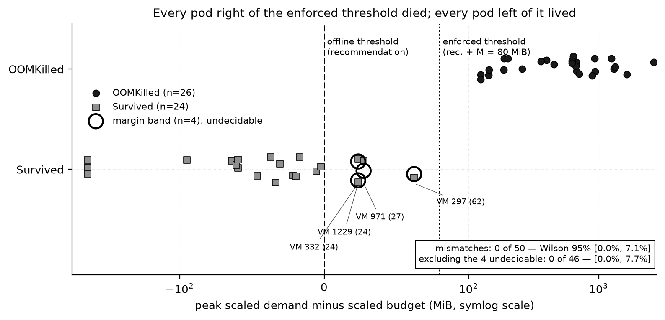

The memory rule matches the kernel; CPU is not validated
50 / 50
VMs where peak demand against the enforced limit reproduces the kernel's OOM verdict. Mismatch below 7.1% (Wilson 95%).
CPU inversion
VM 332 never exceeds its CPU allocation yet is throttled in 97.7% of slices; VM 951 runs at 213% of its limit and is throttled in 11.4%. At 1/16 scale the replay harness, not the workload, used the quota.
50 VMs replayed as pods on a kind cluster; the Linux kernel enforces each memory limit and OOM-kills any pod that crosses it.
Notes:
The cluster testbed was closed after Review 1 and not re-run. Compared naively: 26 true positives, 4 false negatives, 0 false positives, 20 true negatives. All 4 false negatives sit between the recommendation and the enforced limit, which adds the 80 MiB agent margin. Compared like with like, 50 of 50. The CPU rule is a different story, and we say plainly that it is not validated.

Slide 16

Five Review 2 claims did not survive the protocol
# | Type | Claimed in Review 2 | What survives
1 | Significance | θ off is "marginally ahead" | Every interval contains zero
2 | Significance | q0.98 is "inconsistent across resources" | It improves memory; its CPU effect is indistinguishable from zero
3 | Significance | Deficit vs capped peak holds on all four cells | It holds on three; non-idle CPU's interval reaches zero
4 | Substitution | 29× miscalibration cited as calibration evidence | Replaced by the pre-registered binomial test: same verdict, different reason
5 | Construction | "21 of 21 low-ε violators drifted" | Near-identity; what survives is that 30–38% exceed the observation peak
Three read a reproducible point estimate as an effect. The protocol that withdrew them is the strongest argument for using it.
Notes:
We lead with this rather than hide it. Each correction came from a Review 3 tool: the first three from the bootstrap, the fourth from computing H2's named statistic, the fifth from the multi-split analysis. At eps = 0.001 the allocation is at or above the observation peak for all but 1 to 3 VMs, so 'every violator exceeded its observation peak' is close to true by definition.

Slide 17




What this setup cannot prove
Construct
bias: either way
Internal
bias: understates M(ε)
The CPU violation rule is not kernel-validated at 1/16 scale. Demand clipped at the original allocation hides its true size above it.
Duplicate zero-demand rows inflate n_eval on 65 VMs. A swept flag was once accepted and silently ignored; every swept parameter now has a test.
External
bias: unknown
Conclusion
bias: understates uncertainty
Both fleets come from one provider, one month each, in 2013. 300 s sampling hides sub-sample bursts. Azure has no memory series.
The bootstrap covers fleet composition only and treats VMs as independent. Splits overlap. The ECE clause has no power.
Notes:
What we cannot prove, in four standard categories, each with the direction it biases the results. The most consequential is the scope of the bootstrap: a demand shock shared across VMs is not represented. The silently ignored flag is the most instructive: in Review 2, the threshold flag was written into the run config but never reached the fit, which would have produced three identical ablation arms. Five-minute averaging can only hide violations, so every count is a lower bound.

Slide 18

Live demo, run on stage
1
run.bat test
About 6 minutes, all local
125 unit tests in 8 files; the violation rules and the information constraint are tested
Before the review
2
run.bat demo
setup.bat run once; .venv on the laptop
data\demo_input holds 1007, 1226 and 332.csv
No internet needed
Whole pipeline on 60 generated VMs, no download: split, baselines, M(ε) sweep, frontier plot
3
run.bat demo-vm
If something breaks
Three real Bitbrains VMs, one at a time: allocation, use, every policy's flavour and its 9-day outcome
"dataset missing": demo-vm needs data\demo_input; demo and test work without it
A bad trace file is named with its reason and skipped, not a crash
Fallback: captured output in demo_out\vm\demo_vm_report.txt
4
website\index.html
Every result, interval and evidence file in one offline page, built from results/ by build_data.py
Notes:
Now the live part; we run it rather than show a video. First the test suite, so you can see it pass. Then the synthetic demo, which runs the whole pipeline end to end without the dataset. Then demo-vm on three real Bitbrains VMs, which is the next slide. Finally the website, which bundles every committed result. One demo run is an illustration; the statistics are the campaign.

Slide 19

Three real VMs: what each policy chose and what happened
VM | Given | peak | P95 | M(0.001) | M(0.1)
1007 | 8 vCPU, 16 GB | 8 GB safe | 4 GB safe | 8 GB safe | 4 GB safe
1226 | 8 vCPU, 24 GB | 16 GB 2 violations | 8 GB 23 violations | 16 GB 2 violations | 16 GB 2 violations
332 | 4 vCPU, 16 GB | 4 GB safe | 2 GB 74 violations | 4 GB safe | 4 GB safe
Memory allocation chosen and the outcome over the 9 held-out days (memory violation events). Every policy chose 4 vCPU on 1007 and 1226 and 1 vCPU on 332, with no CPU violations.
VM 332: P95 alone fails
VM 1226: the drift case
Peak use was 2.5 of 16 GB. M(ε) needs 2.24–2.48 GB and snaps up to 4 GB; P95 takes 2 GB, saves 432 GB-h more, and runs out of memory 74 times.
Its observed memory peak was 9.5 GB, yet the held-out days broke even 16 GB, so every policy failed. No tail fitted to the past saw it coming.
run.bat demo-vm writes demo_out\vm\demo_vm_report.txt, demo_vm_per_policy.csv and run_config.json. This trace was graciously provided by Bitbrains IT Services Inc.
Notes:
The output of run.bat demo-vm on three real VM files, copied unchanged from the Bitbrains trace. 1007 is safe under every policy. 332 shows P95 alone failing: it shrinks memory to 2 GB and runs out 74 times. 1226 is the failure mode behind H2: demand in the evaluation window left the range the observation window contained, and no policy fitted to that window survives it.

Slide 20
The suite passes; the bootstrap prints every interval
make test · 30 Oct 2026
make bootstrap · evidence/16_bootstrap.txt (B = 10,000, seed 16)
$ make test
test_baselines.py 35/35 passed
test_replay_agent.py 3/3 passed
test_evt.py 41/41 passed
test_hypotheses.py 13/13 passed
test_bootstrap.py 16/16 passed
test_multisplit.py 9/9 passed
test_demo_guard.py 4/4 passed
test_demo_vm.py 4/4 passed
125 tests, 0 failures
$ make bootstrap
MATCHED-RISK GAPS vs peak_capped (pp)
scope res gap_pp gap_lo gap_hi excl_0
all_vms cpu -5.555 -11.07 -2.47 True
all_vms mem -6.297 -9.18 -3.45 True
non_idle cpu -2.153 cond -4.02 0.30 False
non_idle mem -3.609 -5.71 -1.66 True
wrote results/bootstrap/matched_risk_gaps_ci.csv,
ablation_shifts_ci.csv, run_config.json
(719 s)
Bootstrap columns condensed from the captured console output. Where the curves stop overlapping, the undefined share is printed and the strict interval is withheld (amber row). The same seed reproduces every interval exactly.
Notes:
Left: the unit tests, rerun on 30 October 2026, every file passing; the suite only ever grows, and test_baselines.py has not changed since Review 1. Right: the bootstrap's matched-risk gap table, condensed from evidence/16_bootstrap.txt: 10,000 resamples of VMs, seed 16, 719 seconds.

Slide 21

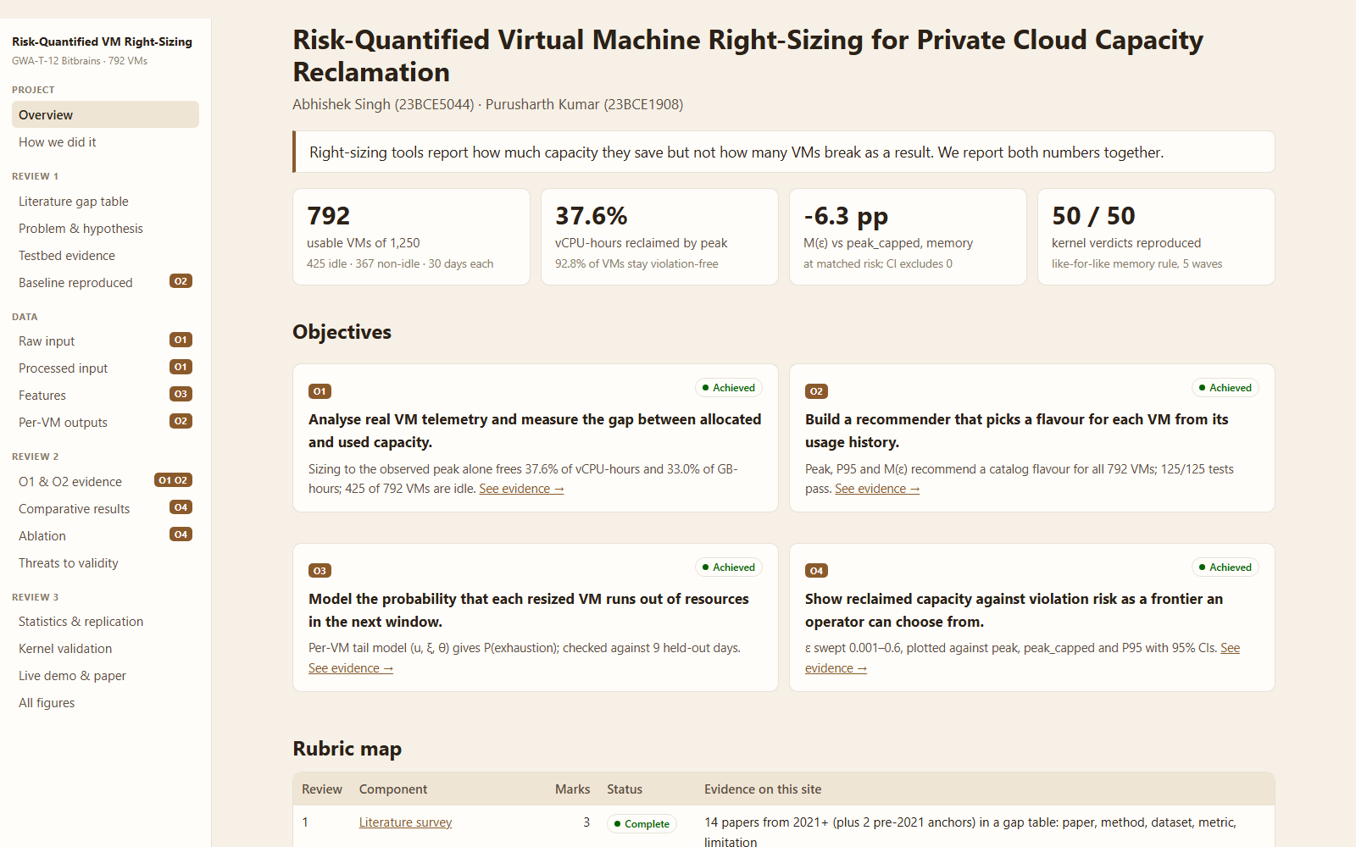
Paper, code and website
IEEE CONFERENCE FORMAT · 6 PAGES
Code
Website
Risk-Quantified Virtual Machine Right-Sizing for Private Cloud Capacity Reclamation
github.com/AbhishekSingh444/
vm-rightsizing
Introduction and related work
125 tests that run without the licensed dataset
One make target per result; run_config.json beside every table
setup.bat + run.bat for a fresh Windows laptop
Trace data excluded by licence
System and data model
Proposed method M(ε) and baselines
Experimental setup and evaluation
18 pages, no server. build_data.py bundles results/, evidence/ and figures/, so no number is typed in by hand.
Threats to validity
Conclusion; 23 references
paper/ (PDF and LaTeX source)
Notes:
Documentation. The paper is in IEEE conference format, six pages, with every section the rubric asks for. The code is on GitHub, with tests that run on small hand-made data so anyone can check them without the licensed dataset; setup.bat and run.bat get a fresh Windows laptop running with only Python. The website is a static page under website/, generated from the committed results, so it cannot drift from the paper.

Slide 22
What we can claim
1
2
3
The method fails its hypotheses
The cap is the gain
The protocol is the contribution
Not evaluable against P95, not calibrated, nothing reclaimed at zero risk. At matched risk it reclaims 2.2–6.3 pp less than capped peak.
All measurable advantage comes from a constraint the data model already implied, not from the tail model.
Matched risk, intervals that report undefinedness, split sensitivity and kernel validation withdrew five of our own claims.
Notes:
To close, three claims, each as strong as the evidence allows. One: the method failed its hypotheses, and we can say exactly why: demand leaves the range the observation window saw, and no tail fitted to that range can anticipate it. Two: the only measurable gain is the cap. Three: the protocol that caught all this is the contribution. Thank you; happy to take questions.

Slide 23
References and acknowledgement
[1] Qin et al., How Different are the Cloud Workloads?, IEEE/IFIP DSN 2023.
[2] Coach: All-Resource Oversubscription in Cloud Platforms, arXiv:2501.11179, 2025.
[3] Majd et al., Right-sizing Recommendations (RSR), IEEE/WIC WI-IAT 2025.
[4] CLOUDADV: Decision-Aligned Instance Sizing under Drift, arXiv:2606.31470, 2026.
[5] Kollu et al., Cloud resource forecasting on VM traces, Trans. ETT 35(1), 2024.
[6] Pan et al., MagicScaler, PVLDB 16(12), 2023.
[7] Zou et al., OptScaler, PVLDB 17(12), 2024.
[8] Zhou, Zhang, Delimitrou, AQUATOPE, ASPLOS 2023.
[9] Qiu et al., AWARE, USENIX ATC 2023.
[10] Zhang et al., AAPA, arXiv:2507.05653, 2025.
[11] BACC: Budget-Aware Calibration and Control, arXiv:2606.20575, 2026.
[12] Pozdniakova et al., SLA-Adaptive HPA Threshold, Electronics 13(7), 2024.
[13] Luo et al., Erms, ASPLOS 2023.
[14] Rzadca et al., Autopilot, EuroSys 2020.
[15] Ambati et al., SLOs for Harvest VMs, USENIX OSDI 2020.
[16] Coles, An Introduction to Statistical Modeling of Extreme Values, Springer 2001.
[17] Ferro and Segers, Inference for clusters of extreme values, JRSS-B 65(2), 2003.
[18] Efron and Tibshirani, An Introduction to the Bootstrap, 1993.
[19] Wilson, Probable inference, JASA 22(158), 1927.
[20] Guo et al., On calibration of modern neural networks, ICML 2017.
Dataset. This trace was graciously provided by Bitbrains IT Services Inc. GWA-T-12 (fastStorage and Rnd), Grid Workloads Archive, TU Delft; Shen, van Beek and Iosup, IEEE/ACM CCGrid 2015.
Notes:
The full list, as in the paper's bibliography. The Bitbrains acknowledgement is a licence requirement and must stay on this slide.

