Slide 1



Course : Machine Learning
Lecture On : CNN | Pre assignment
Instructor : Aditya Bhattacharya

Slide 2
Today’s Agenda
1
Problem Statement
2
Dataset Understanding
3
Project Pipeline
4
Starter Code Walkthrough

Slide 3
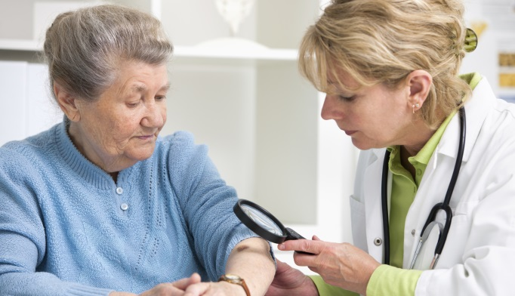
Problem Statement
Problem statement: To build a CNN based model which can accurately detect melanoma. Melanoma is a type of cancer that can be deadly if not detected early. It accounts for 75% of skin cancer deaths. A solution which can evaluate images and alert the dermatologists about the presence of melanoma has the potential to reduce a lot of manual effort needed in diagnosis.

Slide 4
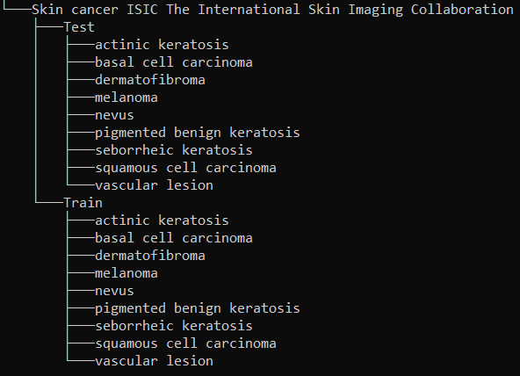
Dataset Understanding
The dataset consists of 2357 images of malignant and benign oncological diseases, which were formed from the International Skin Imaging Collaboration (ISIC). All images were sorted according to the classification taken with ISIC, and all subsets were divided into the same number of images, with the exception of melanomas and moles, whose images are slightly dominant. The data set contains the following diseases:
Actinic keratosis
Basal cell carcinoma
Dermatofibroma
Melanoma
Nevus
Pigmented benign keratosis
Seborrheic keratosis
Squamous cell carcinoma
Vascular lesion

Slide 5
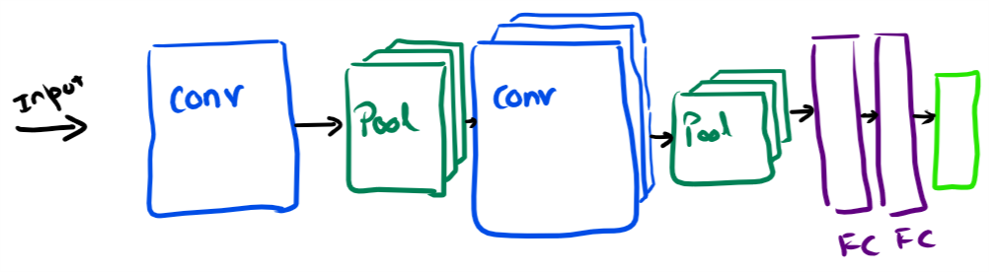
Project Pipeline
NOTE: You don't have to use any pre-trained model using Transfer learning. All the model building process should be based on a custom model.
Data Reading/Data Understanding → Defining the path for train and test images
Dataset Creation→ Create train & validation dataset from the train directory with a batch size of 32. Also, make sure you resize your images to 180*180.
Dataset visualization → Create a code to visualize one instance of all the nine classes present in the dataset
Model Building & training :
Create a CNN model, which can accurately detect 9 classes present in the dataset. While building the model rescale images to normalize pixel values between (0,1).
Choose an appropriate optimizer and loss function for model training
Train the model for ~20 epochs
Write your findings after the model fit, see if there is evidence of model overfit or underfit
Choose an appropriate data augmentation strategy to resolve underfitting/overfitting

Slide 6
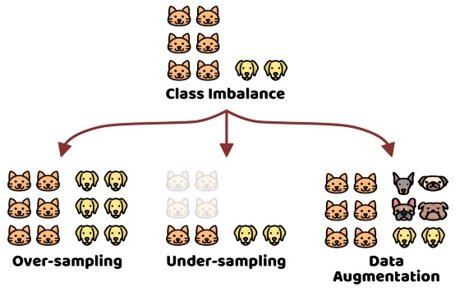
Project Pipeline
Model Building & training on the augmented data :
Create a CNN model, which can accurately detect 9 classes present in the dataset. While building the model rescale images to normalize pixel values between (0,1).
Choose an appropriate optimizer and loss function for model training
Train the model for ~20 epochs
Write your findings after the model fit, see if the earlier issue is resolved or not?
Class distribution: Examine the current class distribution in the training dataset
- Which class has the least number of samples?
- Which classes dominate the data in terms of the proportionate number of samples?
Handling class imbalances: Rectify class imbalances present in the training dataset with Augmentor library.
Model Building & training on the rectified class imbalance data :
Create a CNN model, which can accurately detect 9 classes present in the dataset. While building the model rescale images to normalize pixel values between (0,1).
Choose an appropriate optimizer and loss function for model training
Train the model for ~30 epochs
Write your findings after the model fit, see if the issues are resolved or not?
https://www.tensorflow.org/tutorials/images/data_augmentation

Slide 7
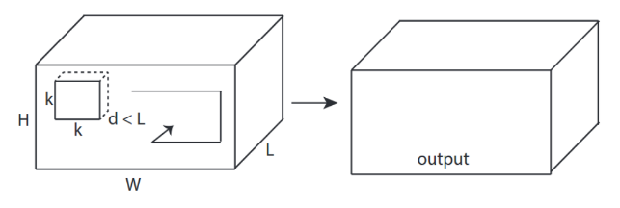

convolutional network
In the case of 3D convolutions, the kernel that is used to perform convolutions on the image or the feature map has an additional dimension namely depth.
The kernel performs convolutions by moving in all three dimensions that is x, y, and z-axis. The third dimension is considered to be time as 3D convolutions are used mostly for video classification.

Slide 8
Let’s see the starter code now !

Slide 9
Summary
Discussed about the CNN assignment problem statement and the dataset
Discussed about the project pipeline
Discussed and described the key aspect of the starter code for getting hands on exposure
Discussed about general tips and points to consider when applying Deep Learning solutions using CNNs

Slide 10
Thank You !
Important Links
https://www.tensorflow.org/api_docs/python/tf/keras/preprocessing/image_dataset_from_directory
https://www.tensorflow.org/tutorials/images/cnn
https://www.tensorflow.org/tutorials/images/data_augmentation
https://www.tensorflow.org/api_docs/python/tf/keras/layers/experimental/preprocessing/Rescaling
https://www.tensorflow.org/api_docs/python/tf/keras/layers/experimental/preprocessing/RandomFlip

