Slide 1
esports
By abhishek

Slide 2
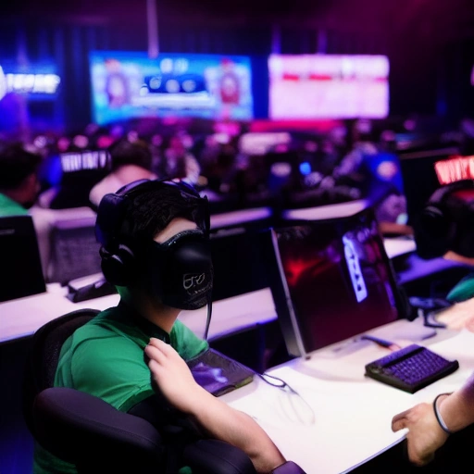
Esports: The Rise of Competitive Gaming
Definition: Organized, competitive video gaming, often played by professionals.
Growing Popularity: Massive audience and revenue growth in recent years.
Key Genres: MOBAs, FPS, Fighting Games, Strategy Games.
Example Titles: League of Legends, Counter-Strike, Overwatch 2.

Slide 3
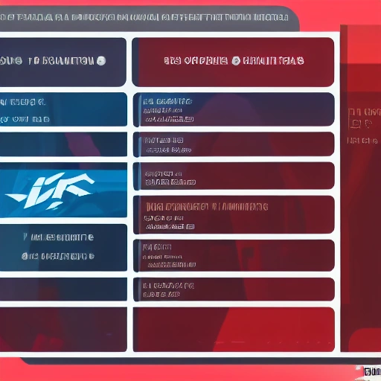
Esports Ecosystem: Players & Teams
Professional Players: Dedicated individuals, often salaried, practicing and competing.
Team Organizations: Structures providing support, training, and branding.
Scouting and Development: Identifying and nurturing talent at amateur levels.
Player Health: Importance of physical and mental well-being.

Slide 4
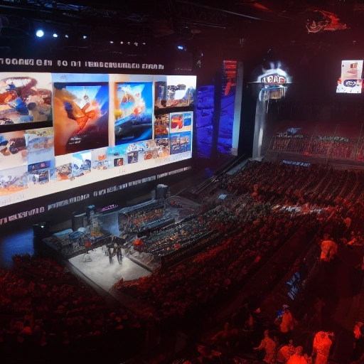
Esports Ecosystem: Tournaments & Leagues
Major Tournaments: Organized competitions with large prize pools and prestige.
League Structures: Recurring seasonal competitions with promotion/relegation.
Streaming Platforms: Twitch, YouTube providing broadcast and viewer engagement.
Sponsorships & Advertising: Key revenue streams for teams and events.

Slide 5

The Business of Esports: Revenue & Investment
Revenue Streams: Sponsorships, advertising, media rights, merchandise, ticket sales.
Market Growth: Exponential growth attracting significant investment.
Investment Opportunities: Teams, leagues, platforms, and infrastructure.
Challenges: Regulation, sustainability, and profitability.

Slide 6
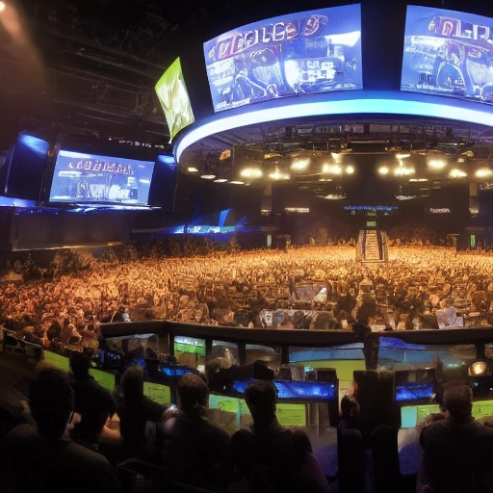
The Future of Esports
Continued Growth: Expected expansion into new regions and demographics.
Emerging Technologies: VR/AR integration, AI for enhanced gameplay.
Integration with Traditional Sports: Partnerships and cross-promotional opportunities.
Conclusion: Esports becoming a mainstream entertainment phenomenon.

Slide 7
Thank You!

