Slide 1

EEG-BASED USER IDENTIFICATION SYSTEM USING
1D-CONVOLUTIONAL LONG SHORT-TERM MEMORY NEURAL
NETWORKS WITH WAVELET TRANSFORM
Abhishek Singh Kushwaha
Akhilesh Singh Kushwaha

Slide 2
Outline
Introduction
Datasets
Methodology
Proposed Enhancement
Results
Conclusion

Slide 3
Introduction
Problem Statement: Traditional user identification systems, such as passwords and fingerprints, have vulnerabilities to theft and forgery.
EEG as Biometrics: EEG signals are unique and difficult to mimic, offering a more secure biometric solution.
Objective: Propose a novel 1D-Convolutional LSTM neural network to enhance EEG-based user identification with wavelet transform

Slide 4
Datasets
Physionet EEG Motor Movement/Imagery Dataset
Subjects: 109 individuals performing physical and imaginary tasks.
Channels: 64 EEG channels with sampling frequency of 160 Hz.
Preprocessing: Normalization and segmentation into 1-second windows (160 × 64 samples).
Experimental Settings:
Different experiments with 4, 16, 32, and 64 EEG channels.

Slide 5
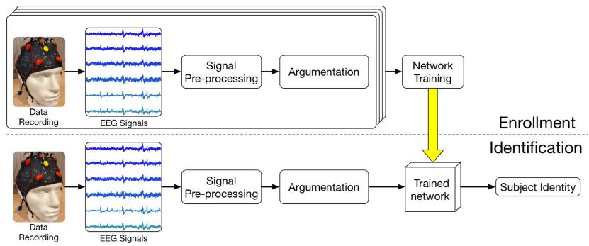
Overview of the proposed EEG-based biometric identification system

Slide 6
Experiment Methodology
Preprocessing:
Normalize EEG signals across time.
Segment into 1-second epochs with 160×64 samples.
Model Training:
Data split: 90% for training/validation (3:1 ratio), 10% for testing.
Optimization: Adam optimizer, dropout for regularization.
Comparison Models: CNN, LSTM, and 1D-Convolutional LSTM.
Evaluation Metrics: Rank-1 accuracy

Slide 7
Proposed Enhancements
Improving Signal Processing:
Implemented advanced feature extraction method called wavelet transform to handle non-stationary signals.
Implemented Models:
Comparison of CNN, LSTM, and CNN-LSTM hybrid approaches with wavelet transform and without wavelet transform.
Demonstrate improvements from CNN-LSTM over standalone CNN and LSTM.

Slide 8
What is Wavelet Transform?
Wavelet Transform:
Breaks down a time-domain signal into smaller frequency components.
Keeps both time and frequency information for each part of the signal.
It is especially useful for non-stationary signals like EEG, where frequency characteristics change over time.
Wavelet Function:
A wavelet transform decomposes a signal into approximate coefficients and detailed coefficients for multiple frequency bands (scales).
For a 1D signal of length N, the wavelet transform might output fewer or more coefficients than the original signal length
Different wavelets (e.g., Daubechies) have different lengths and overlaps.
The overlap extends the signal during decomposition.
Libraries: Pywt

Slide 9
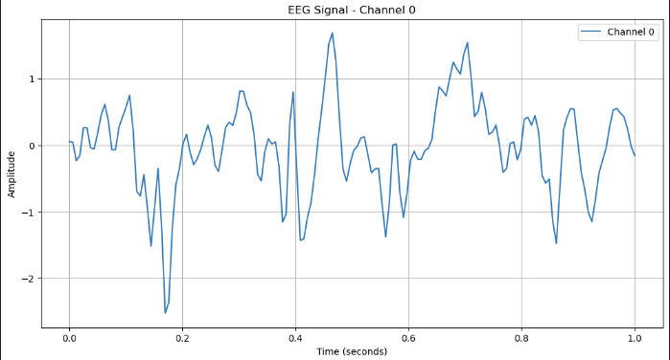
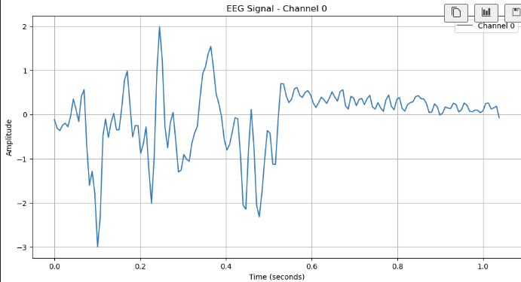
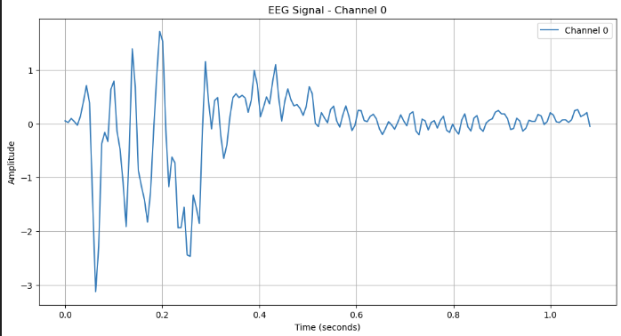
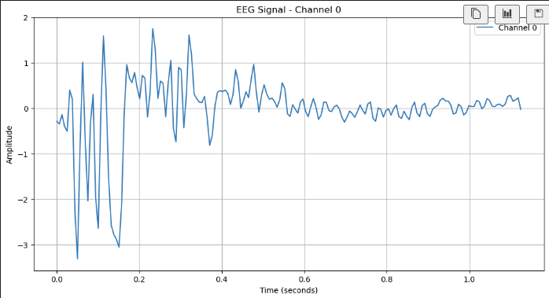
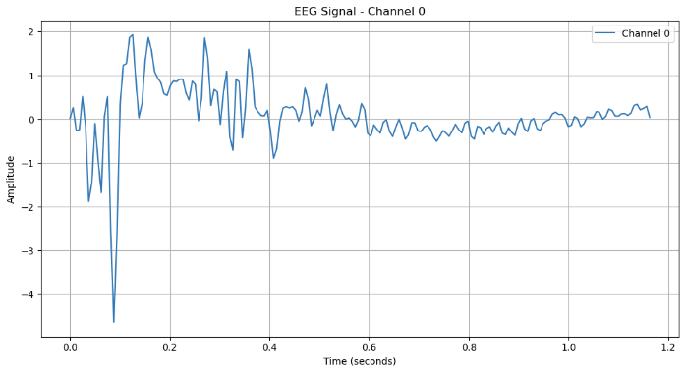
DWT

Slide 10
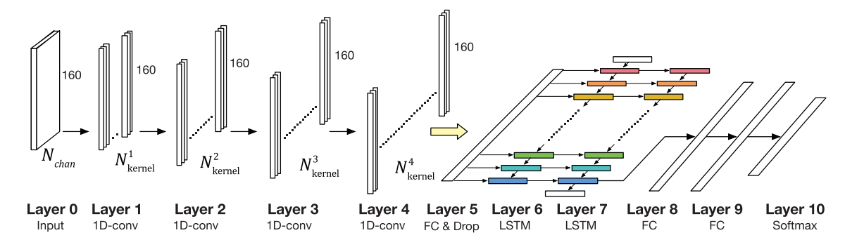
Model Architecture

Slide 11
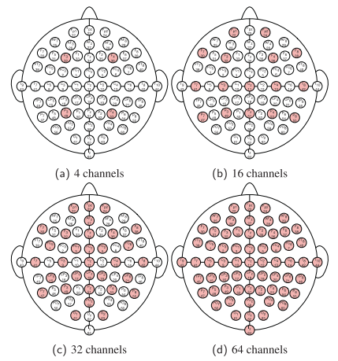
Channels

Slide 12
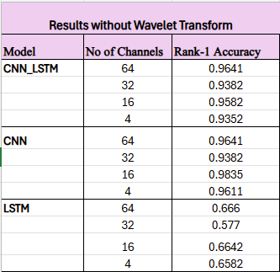
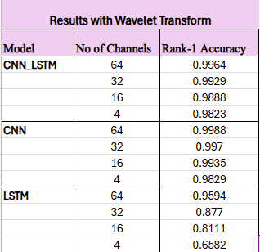
Results
Performance Comparison:
Effectiveness of Reduced Channels:
64-channel proposed approach achieves the highest accuracy.

Slide 13
Conclusion
The 1D-Convolutional LSTM model improves upon existing EEG-based identification systems.
Achieves high accuracy with fewer channels, reducing system cost and complexity.

Slide 14

Thank You

