Slide 1
Secure Data Hiding In Images Using Steganography
CAPSTONE PROJECT
Presented By: Abhishek Singh
Student Name: Abhishek Singh
College Name & Department :
College Name & Department : Bundelkhand University Jhansi & Electronics Communication Engineering

Slide 2
OUTLINE
Problem Statement
Technology used
Wow factor
End users
Result
Conclusion
Git-hub Link
Future scope

Slide 3
Problem Statement
In the digital era, ensuring data security and privacy is crucial. Traditional encryption techniques are often susceptible to detection and interception. Our project addresses this issue by utilizing steganography to conceal secret messages within images. This approach enables secure communication without arousing suspicion.

Slide 4
Technology used
Programming Language:
Python - https://www.python.org/ftp/python/3.13.2/python-3.13.2-amd64.exe
Libraries:
OpenCV for image processing - pip install opencv-python
Platform: Windows
RAM - 8.00GB
System type - 64-bit operating system, x64-based processor
Tools: Visual Studio Code
Go to the official VS Code download page: https://code.visualstudio.com/download

Slide 5
Wow factors
User-Friendly Interface: Simple inputs for cover image, message, and password.
Enhanced Security: User-defined password for both encryption and decryption.
High-Quality Output: Preserves image quality with JPG format.
Versatile Decryption: Validates password to ensure authorized access.
Educational Value: Hands-on learning in steganography, cryptography, and image processing.
These features collectively enhance the functionality, security, and educational value of my project.

Slide 6
End users
Cybersecurity Professionals: Protect sensitive information by embedding it in images.
Journalists and Whistleblowers: Communicate covertly in regions with restricted freedom of speech.
Artists and Creatives: Add hidden messages or layers of meaning to their artwork.
Researchers and Academics: Develop and improve steganography techniques.
Everyday Users: Enhance privacy by hiding personal information within images.

Slide 7
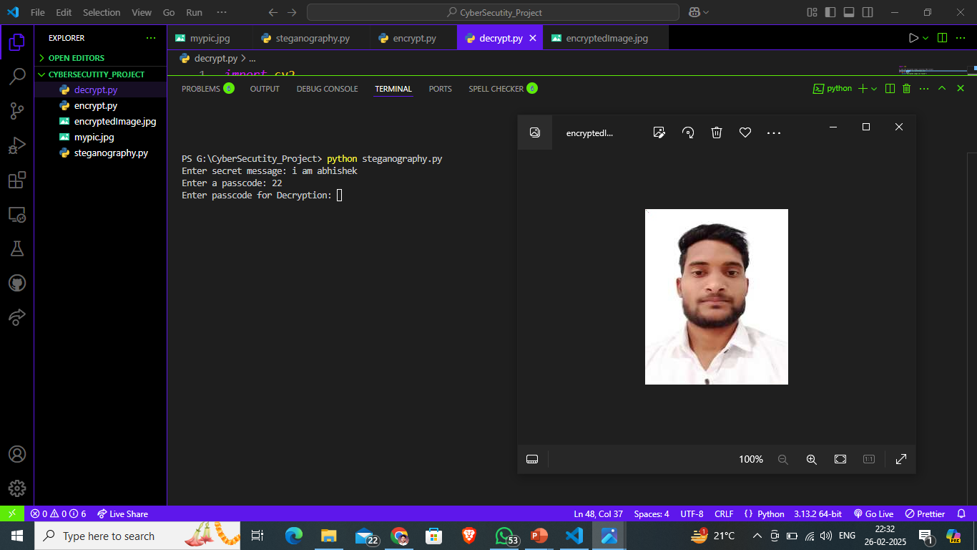
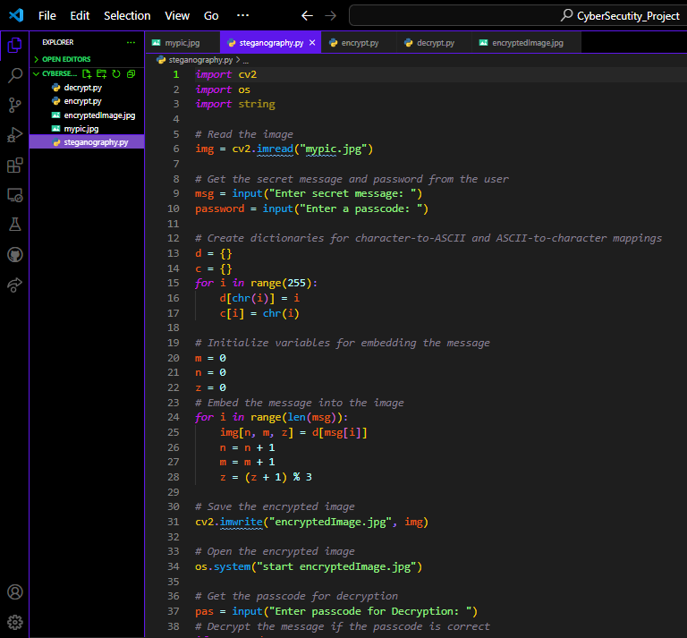
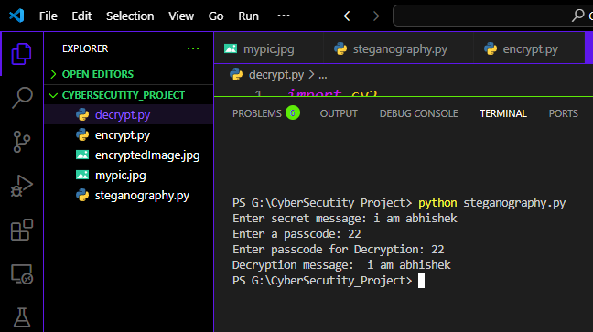
Results

Slide 8
Conclusion
This Python-based steganography tool securely embeds and retrieves confidential messages within images, ensuring access only for authorized individuals. By using user-provided passwords for encryption and decryption, it maintains privacy and data protection. The tool generates an output image ("EncryptedImage.png") that preserves the original's visual integrity, making it a reliable method for secure communication through image-based steganography.

Slide 9
GitHub Link
https://github.com/AbhishekSinghaniya2002/-Secure-Data-Hiding-In-Images-Using-Steganography

Slide 10
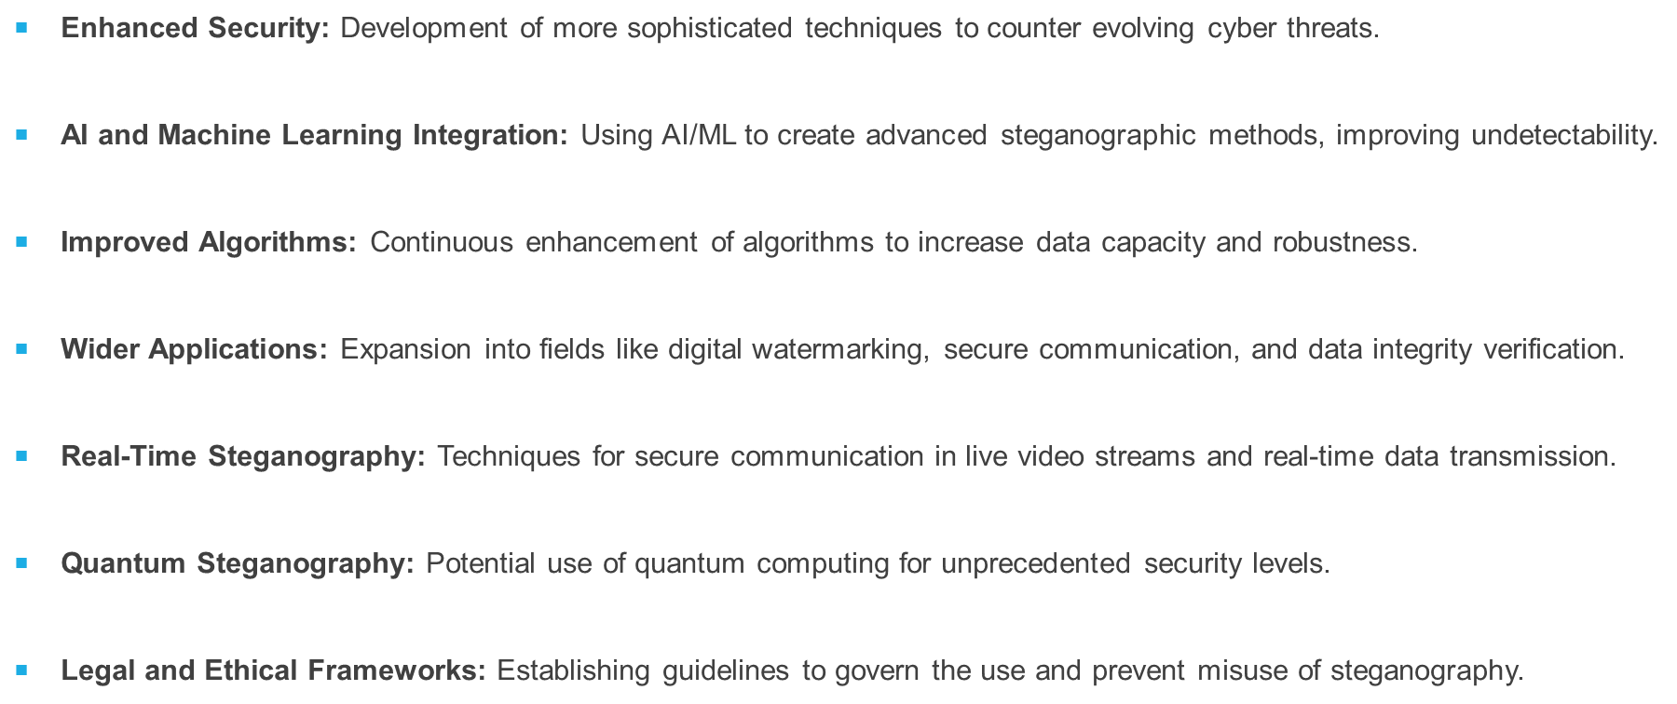
Future scope(optional)

Slide 11
THANK YOU

