Slide 1



AI-Driven Insights and Data Visualization
Presented by :-
Akshay Bhor
Ujwala Sangale
Aniket Shewale
Abhishek Sinha
Sandip Institute of Technology and Research Center, Nashik
Under the Guidance of
Prof. Abhay R. Gaidhani
Department of Information Technology,
SITRC, Nashik

Slide 2
Introduction
Data visualization goes beyond mere charts and graphs it's a means of transforming raw data into actionable knowledge.
In our project, we have embarked on a journey to explore, analyze, and visualize data related to healthcare trends, economic indicators and environmental changes.

Slide 3
Literature Review
An research of the literature on online data visualization tools reveals a growing interest in web-based platforms designed to create, share, and interact with data visualizations.
Research in this field explores various aspects, including the development and features of online visualization software, user experiences, collaborative capabilities, and the impact of these tools across different domains.
As technology continues to advance, this area continues to evolve, with a focus on accessibility, usability, and real-time data representation.

Slide 4
Problem Statement
Data visualization serves several important purposes and fulfils various needs in the context of data analysis, communication, and decision-making. Here are some key reasons why data visualization is essential: Simplifying Complex Data, Enhancing Data Understanding, Identifying Patterns and Trends, Supporting Data Exploration, Facilitating Decision-Making, Data Quality Assessment
Challenges with Current Data Visualization Tools:
Data Privacy and Security
Limited Customization
Learning Curve
Limited Export Options
Scalability
Accessibility

Slide 5
Objectives
To Uncover Insights: We aim to uncover hidden patterns, trends, and insights within our dataset, shedding light on critical aspects.
To Communicate Effectively: Through compelling visualizations, we strive to communicate complex data in a manner that is understandable and engaging for a diverse audience.
To Drive Informed Decision-Making: By presenting our findings clearly, we hope to empower individuals and organizations to make informed decisions.
Machine Learning and AI Integration: Utilizes AI algorithms to enhance data analysis.

Slide 6
Proposed Work
We aim to make an open source application that provides a better User interface and user experience, more export options of files, and more customized output while providing a secure environment to users for visualizing their confidential data.
In sum, such an application would empower users, boost data-driven decision-making, and contribute to more secure, efficient, and creative use of data across various sectors, ultimately fostering growth and progress.

Slide 7
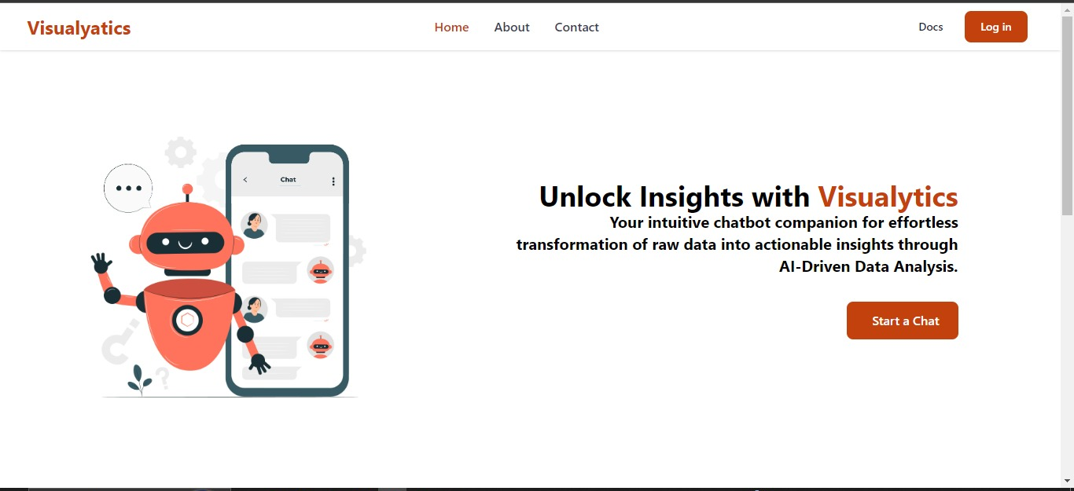
Home/Landing Page

Slide 8
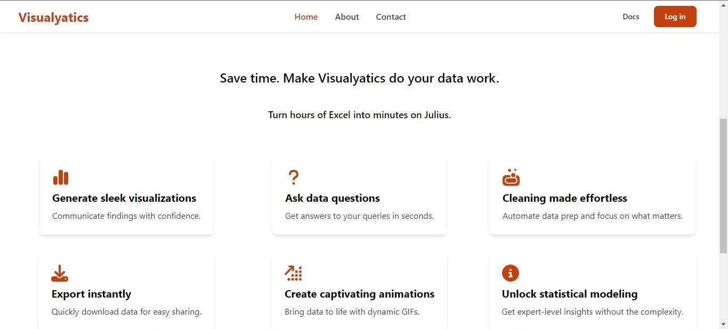
Home/Landing Page

Slide 9
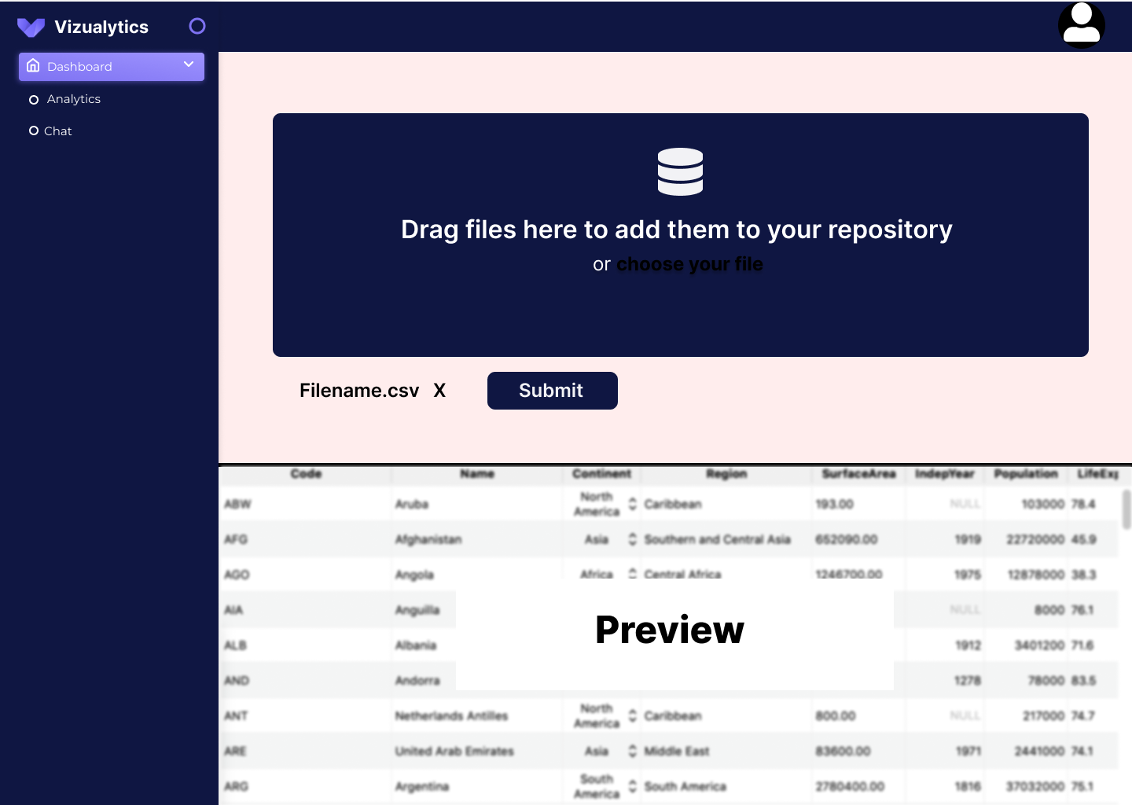
Dashboard Page

Slide 10
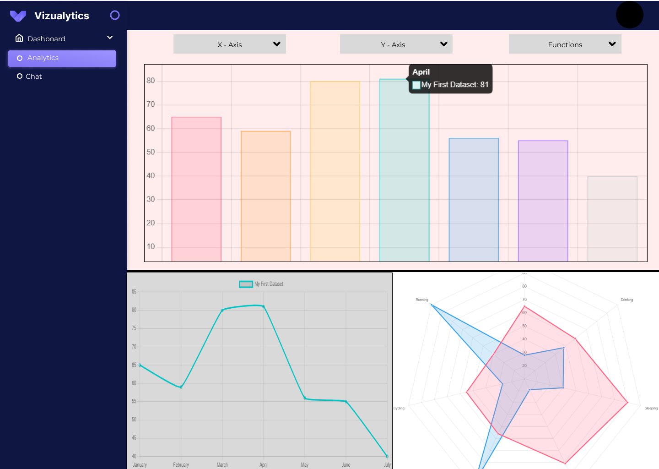
Analytics Page

Slide 11
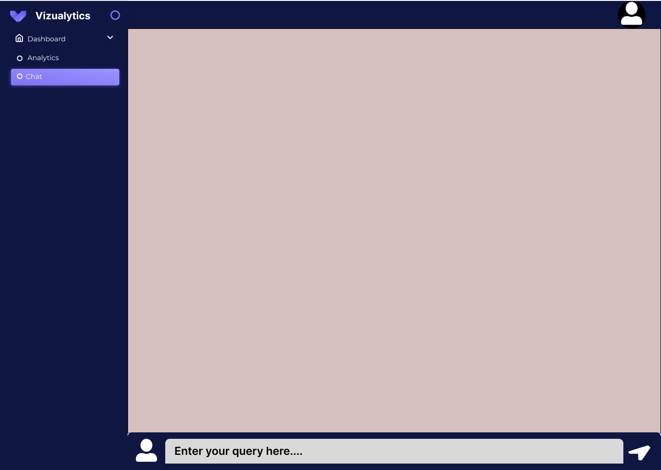
Chat Page

Slide 12
Future Scope
User Feedback Integration
Accessibility and Inclusivity
Mobile-Friendly Design
Collaboration and Sharing
Data Enrichment and Integration

Slide 13
Conclusion
Our proposed data visualization application addresses critical challenges in data analysis by offering enhanced user experience, security, and customization. Leveraging cutting-edge technology, it streamlines processes, promotes efficient decision-making, and ensures data privacy. With AI integration, real-time collaboration, and scalability, it accelerates change by empowering users to gain deeper insights from their data, fostering innovation across sectors. This innovation signifies a significant leap in data utilization, promising a more informed, efficient, and secure future for data-driven decision-making.

Slide 14
Authors Publication
https://ieeexplore.ieee.org/document/8986941
https://ieeexplore.ieee.org/document/9835803
https://ieeexplore.ieee.org/document/7364125

Slide 15
References
[Fabian Nagel; Giuliano Castiglia; Gemza Ademaj; Juri Buchmller; Udo Schlegel; Daniel A. Keim]. “cpmViz: A Web-Based Visualization Tool for Uncertain Spatiotemporal Data”.
[Tableau].“What Is Data Visualization? Definition, Examples, And Learning Resources”.
[IBM]. “What is Data Visualization?”.
[JavaTpoint]. “What is Data Visualization?”.

Slide 16
Thank You

