Slide 1
Online Hall Booking Management System
“HALL MANAGEMENT”
Presented By:
Name: Abhishek Sumeet Toppo

Slide 2
Problem Definition
As we are aware regarding the current process of booking the hall in the CSED department, every time if any user(student/faculty) who wants to book a hall then they have to do it manually i.e. they have to run to the CSED department every time in order to book a hall or cancel a booking. Booking hall manually is very difficult either because the hall is not available for the particular date and time or because there is too much crowd that arises at the same time for booking a hall. Even if everything is cleared a user has to wait in queue for making the choices of selection. Thus a manual booking method is not an effective and efficient way of booking a hall

Slide 3
Drawbacks Of Existing System
◆ Chances Of Mistakes Increases: It’s difficult for a person to be 100% accurate. There can be chances of mistakes to occur during data entry
◆ Increased Workload: Taking input from the user and they entering into the system increase an extra workload of the staffs and also increases the chances of mistakes too.
◆ Time Consuming: For booking hall, it can be done only during office hours. After this, no booking is to be done and if anyone wants to book a hall then he/she has to wait for the next day. Thus its time consuming and doesn’t saves precious time of the user.

Slide 4







Input and Output
Operation | Input | Output
Admin | Insert correct email_id and password. Insert hall details, update hall details, view hall details like hall name,projector availability, roomtype(Ac/Non Ac),Hall location and seat capacity Admin has the option to delete the hall if the hall is no longer required or some work is to be performed so no one can select that hall Admin can click on view all booked hall details Admin can click on view feedback button | Direct admin to admin dashboard for “successful login” Hall details will be added. Hall details can be inserted successfully, updated successfully and viewed successfully. Hall details will be deleted successfully. Booked hall details will be shown here. Shows all the feedback that is done by the users.

Slide 5
Operation | Input | Output
User | New user can register on to the website by entering name, password, email_id, phone number and user type Login by entering correct email_id and password User can update his profile by changing phone number, department and user type. User should select a hall click on corresponding book button. User fill in the form by entering purpose of booking the hall, date of commencement and the slot at which user wants the hall and then click on reserve now button. User can cancel the booked hall if the hall is no longer required only when its date and slots have not arrived otherwise no cancel button will be shown. User can send his/her positive or negative feedbacks too where user enters subject and message and click on send button | User will be registered on to website successfully. On successful login user is directed to the user dashboard. User details will get updated successfully. It will direct user to confirm booking page where user can see booked slots of the selected hall and a form for booking the selected hall. Booking confirmed message be shown. Hall will be removed easily with a message of hall cancelled successfully. Feedback will be send to the admin.

Slide 6
Motivation and Relevance's
We can get rid of the above stated problems by using this web application. This application provides a platform so that every user by himself/herself at anyplace and at any time can book a hall and cancel their booking easily without any difficulty. It makes the booking and cancelling process very easier for the user regardless of waiting in a queue and straggling also this process is very time consuming and it lessen the work of the user to run to the CSED department to book a hall.

Slide 7
Entity Relationship Diagram

Slide 8
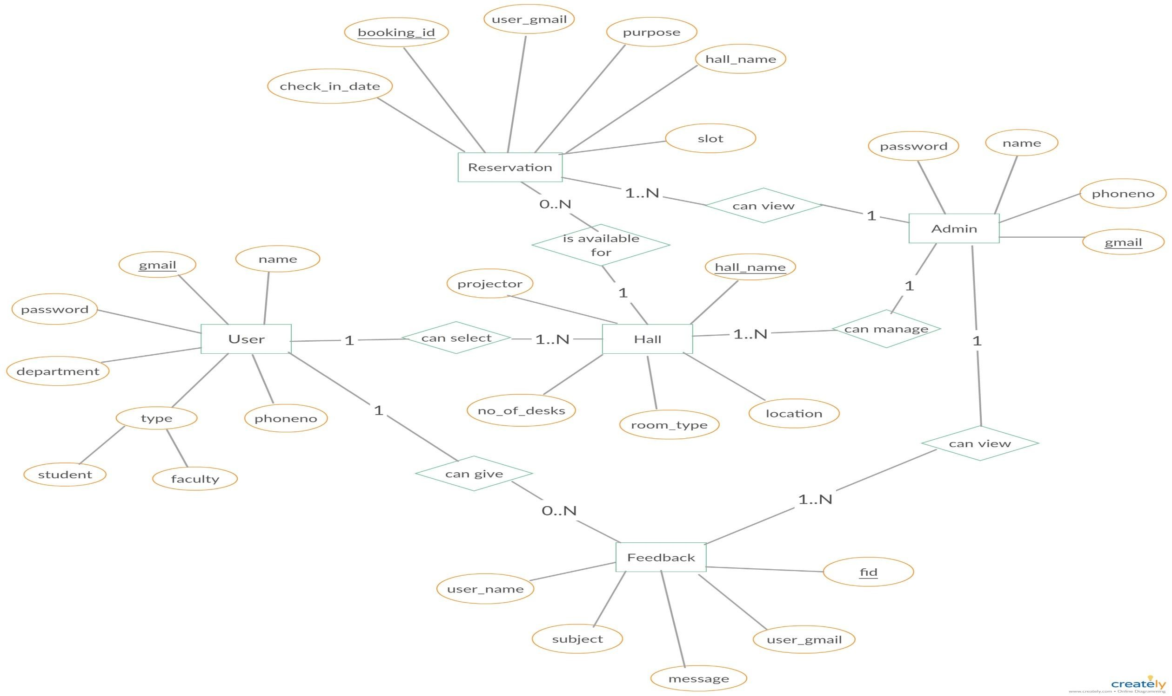

Slide 9
Use Case Diagram

Slide 10
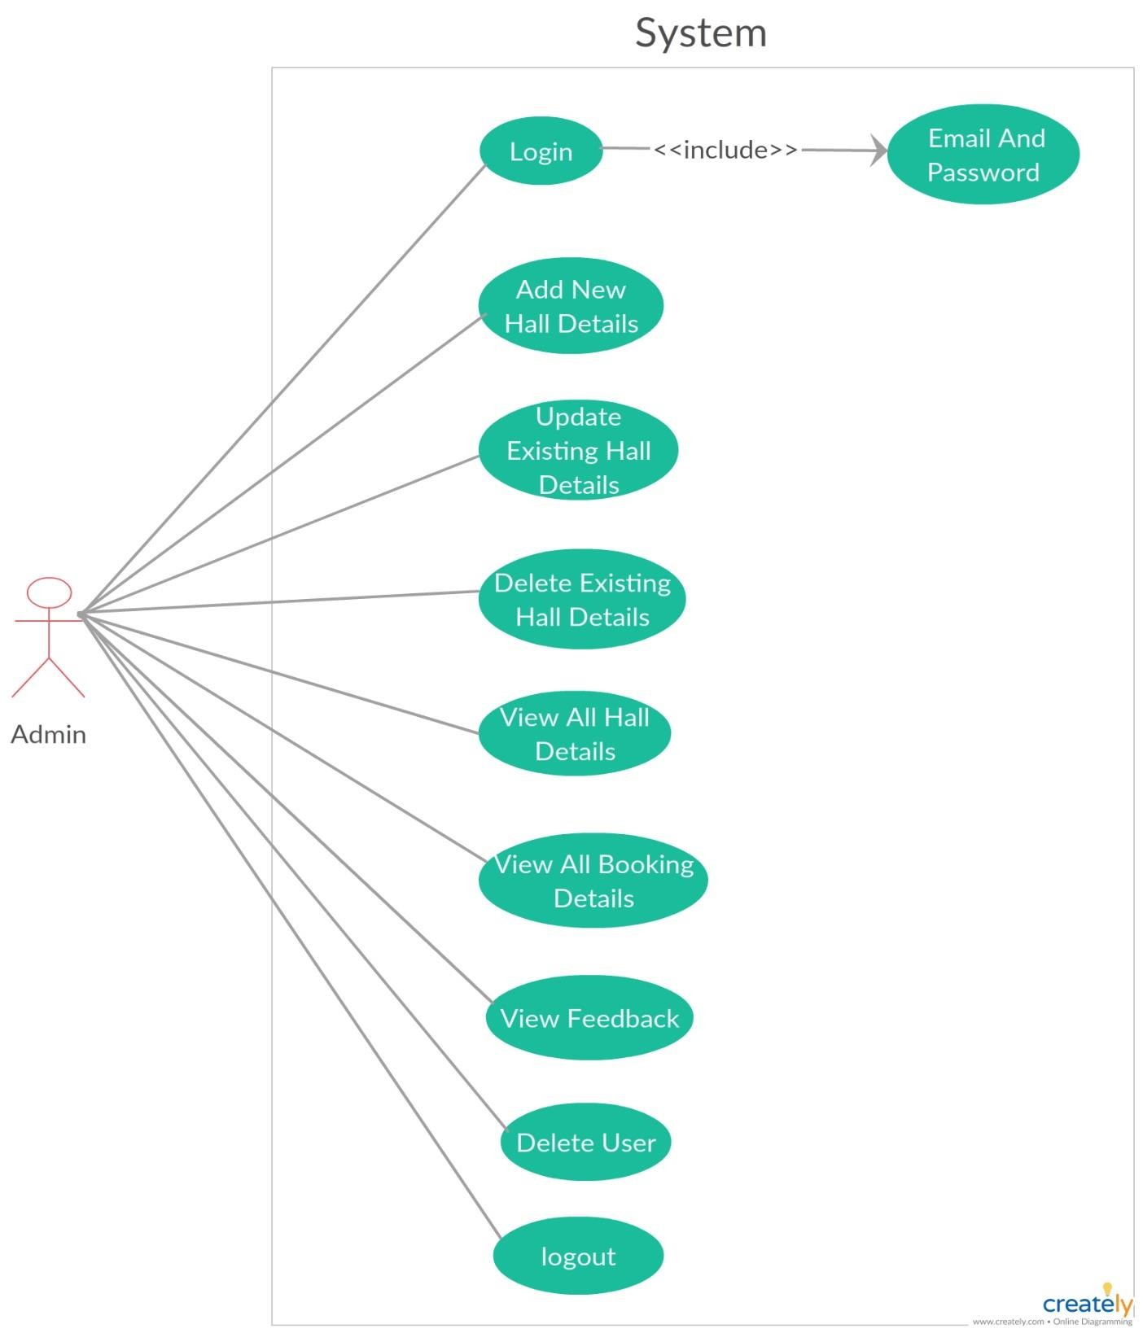
This | figure | represents | the
Use | Case | Diagram | of
Admin. A use case diagram
depicts the
pictorial
representation of what all
function an admin can perform to manage a proper flow of booking a hall.

Slide 11
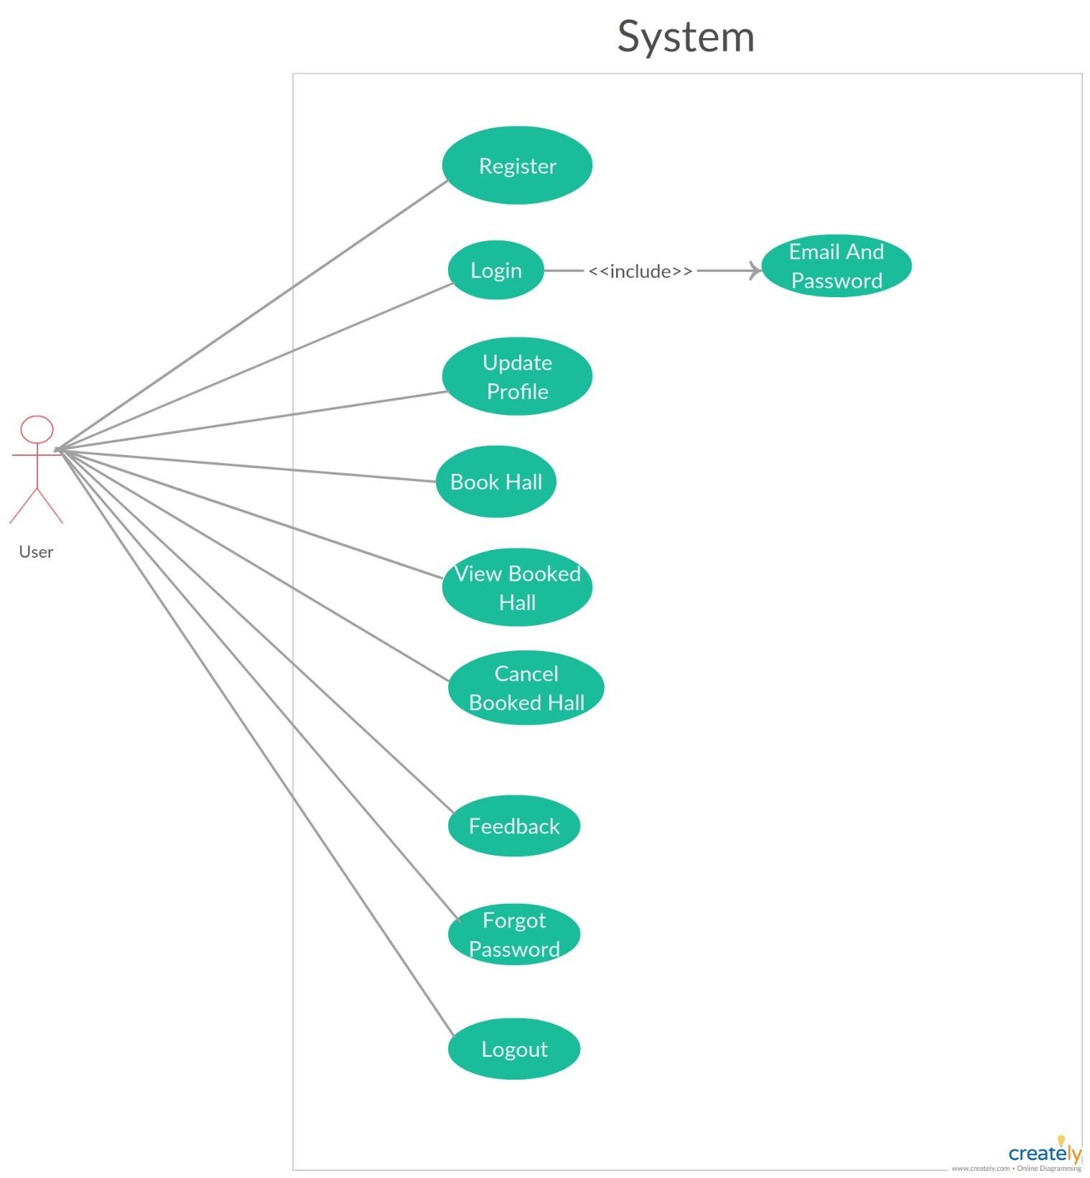
This figure represents the Use Case Diagram of User. A use case diagram depicts the pictorial representation of what all functionalities a user can perform during a process of booking a hall.

Slide 12
Implementation Phase

Slide 13
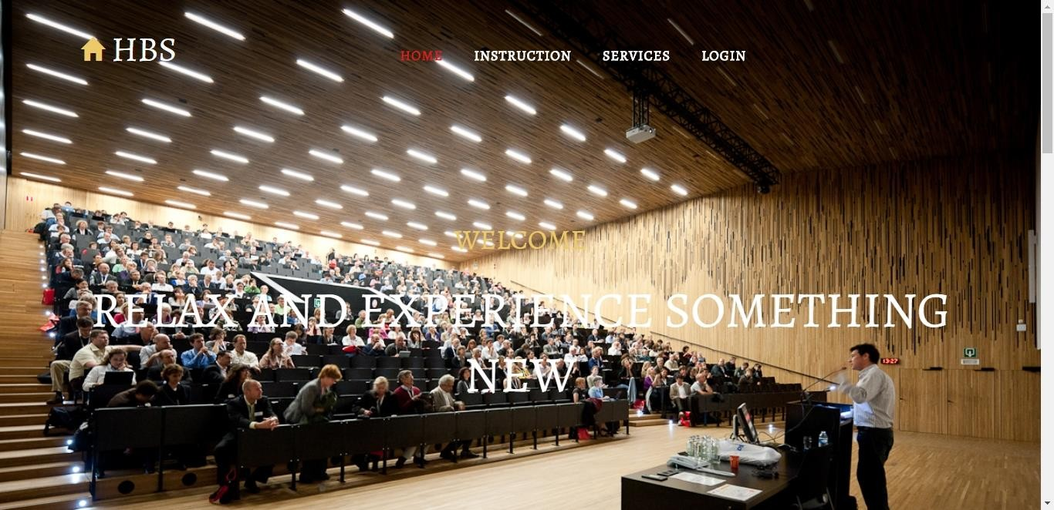
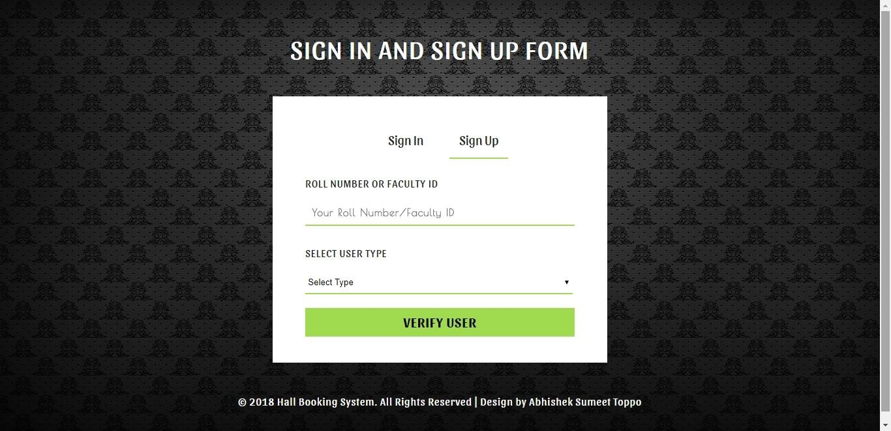
HOME PAGE
This is the main startup page of the project.
USER VERIFICATION
User verification is to be done here to check whether a user is an existing member of CSED department or not. Here user needs to enter his/her roll number/faculty id and user type whether they are student or faculty and click on verify user button.

Slide 14
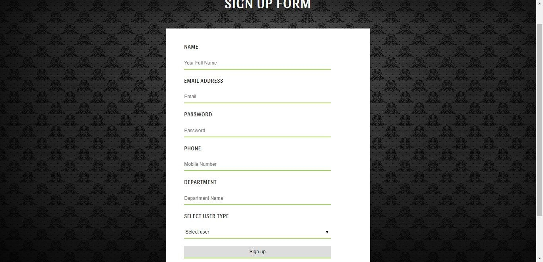
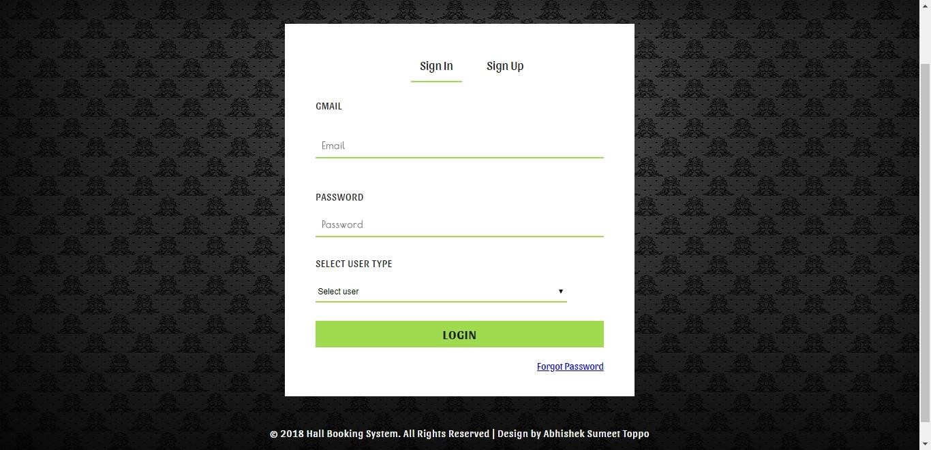
SIGN UP PAGE
After proper verification is done then only user is redirected to the sign up page where user needs to register themselves on to the website by filling in the details like name, email_id, password, phone number, department and user type and then after click on sign up button user get register themselves on to the website.
USER LOGIN PAGE
User can login by providing the correct email_id and password. A message of “login successfully” will be shown on the screen for correct email_id and password otherwise a message of “wrong email_id and password” will be shown.

Slide 15
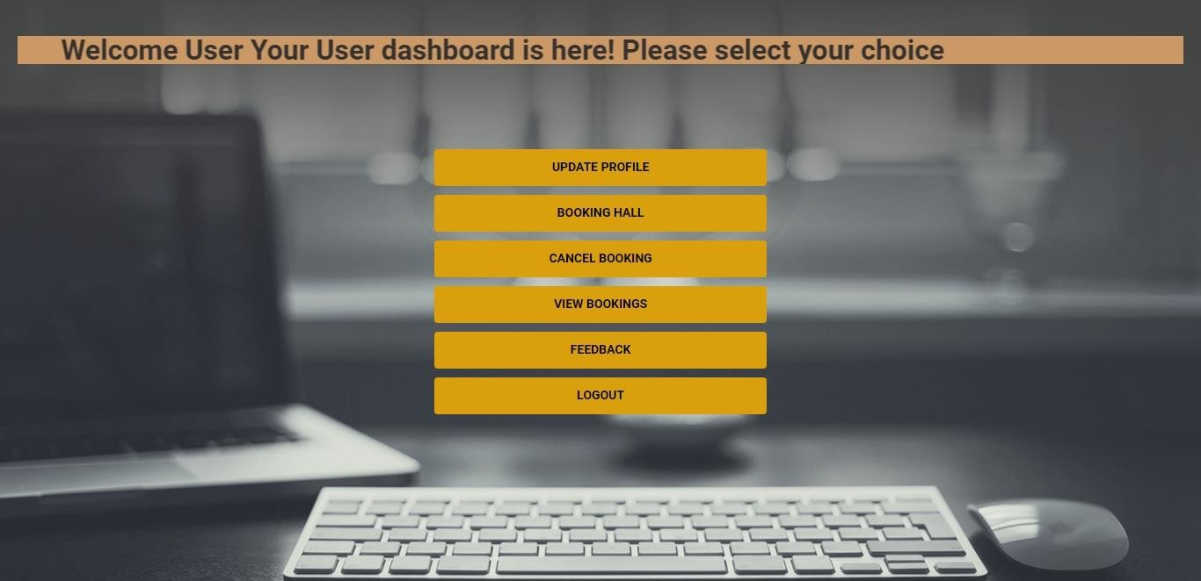
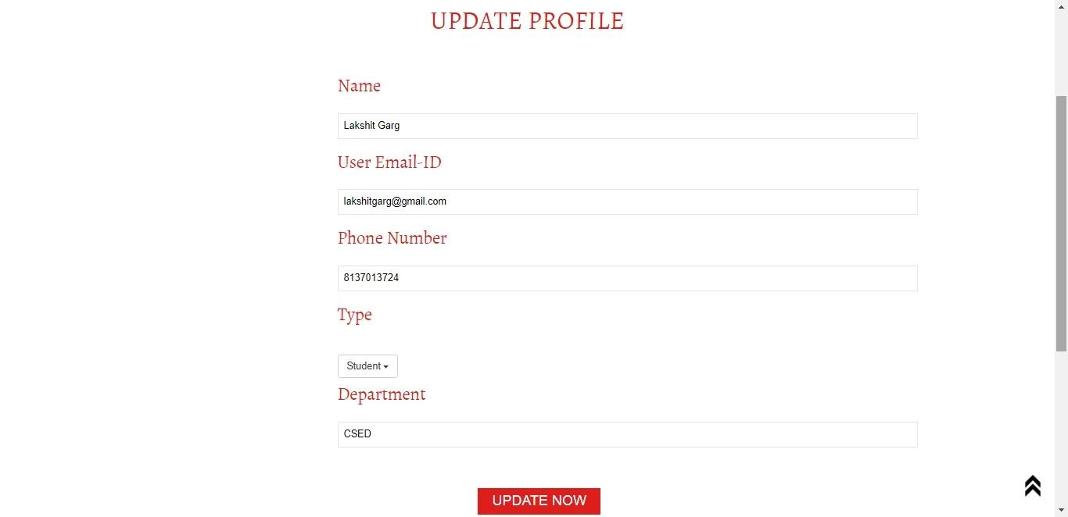
USER DASHBOARD
After successful login is done user is redirected to the user dashboard which generally include update profile button, booking hall button, cancel booking button, view booking button, feedback button and logout button when user wants to logout from his/her session.
UPDATE PROFILE
By clicking on the update profile button from the user dashboard, user is redirected to update profile page where user can update his/her profile.

Slide 16
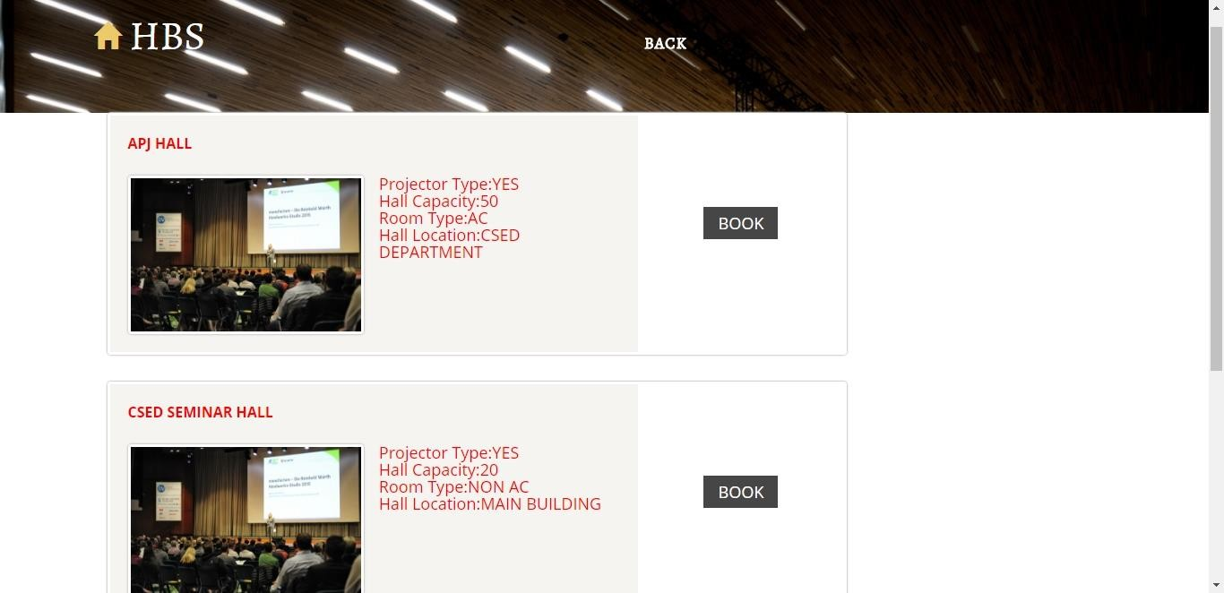
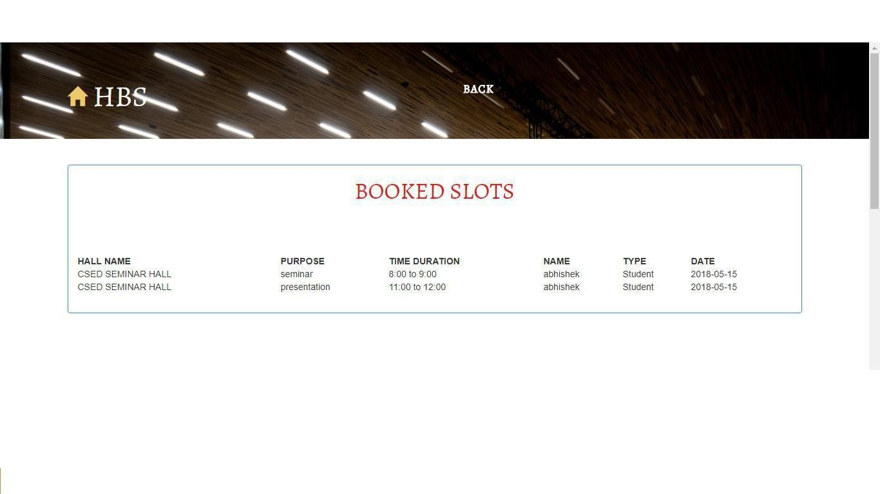
SELECTING A HALL
After clicking on booking button from the user dashboard, user is redirected to booking page where user can select one hall and click on the book button corresponding with a hall.
SELECTED HALL BOOKED SLOTS
After selecting one hall, user can see the booked slots of the selected hall. This booked slot includes hall name, purpose, time duration, name of user who book the hall, user type and date.

Slide 17
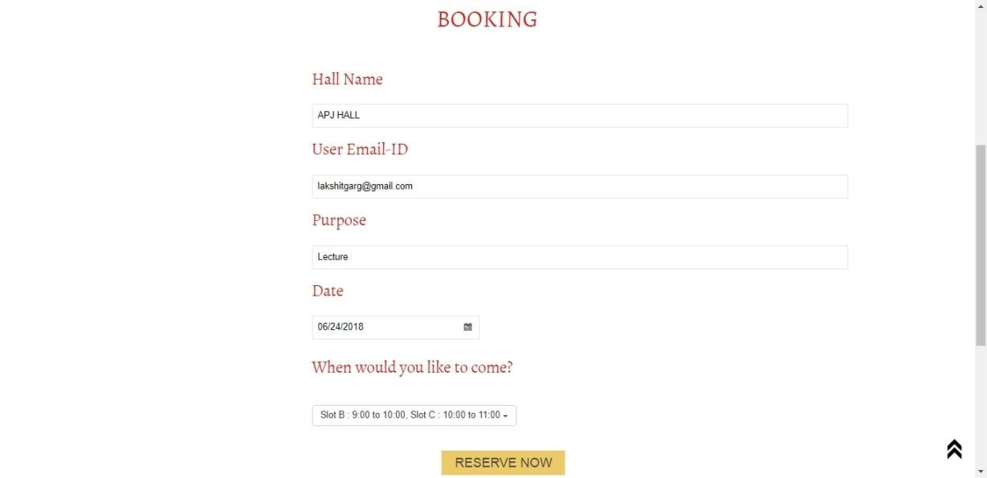
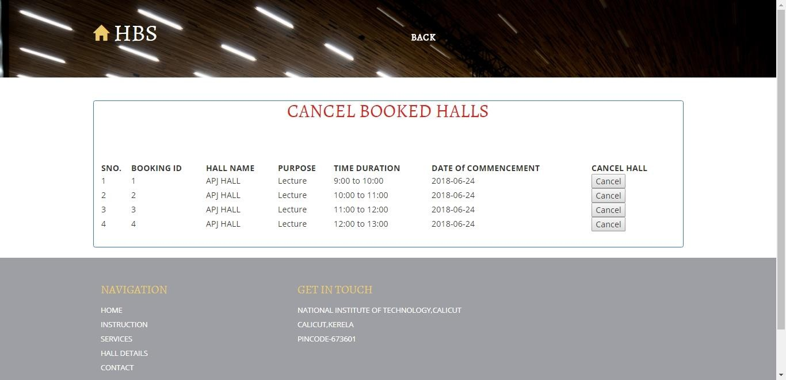
CONFIRM RESERVATION OF HALL
After user have filled the form and click on reserve now button then a message of “booking confirmed” will be shown on the screen to highlight that your booking is done successfully.
CANCEL RESERVATION OF HALL
From the user dashboard, user can click on cancel
booking button if user thinks that the booked hall is no longer required by him/her. Here user needs to click on cancel button corresponding with the hall that the user wants to cancel.

Slide 18
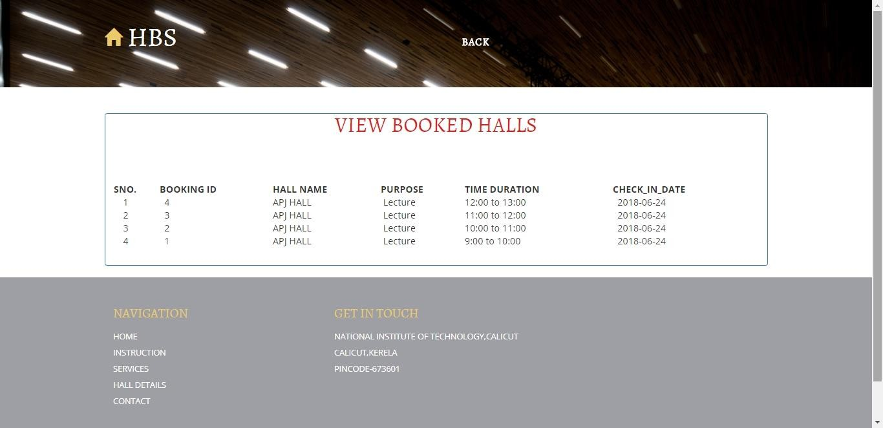
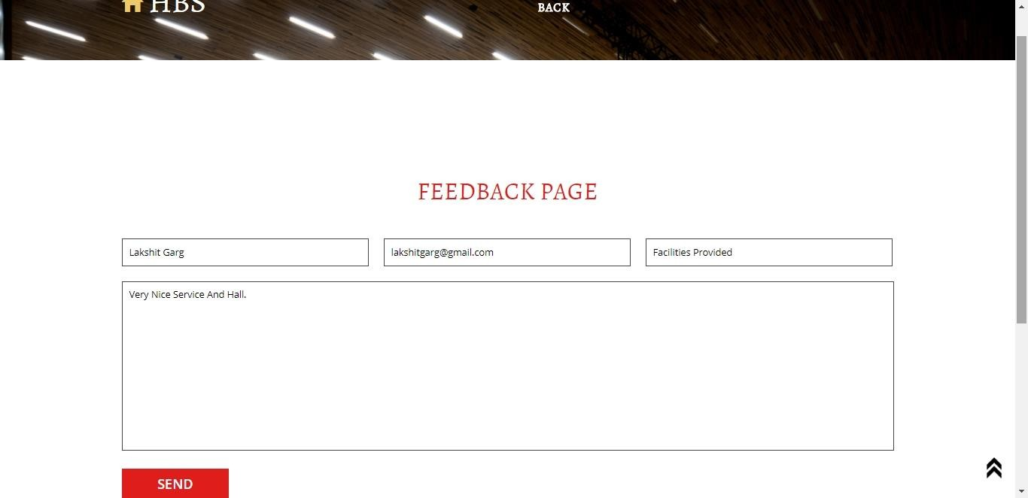
VIEW BOOKING DETAILS
From the user dashboard, user can click on view bookings to view what all halls that he/she has booked till now.
USER SENDS FEEDBACK
User can select feedback button from the user dashboard
to send his/her reviews regarding the hall provided.

Slide 19
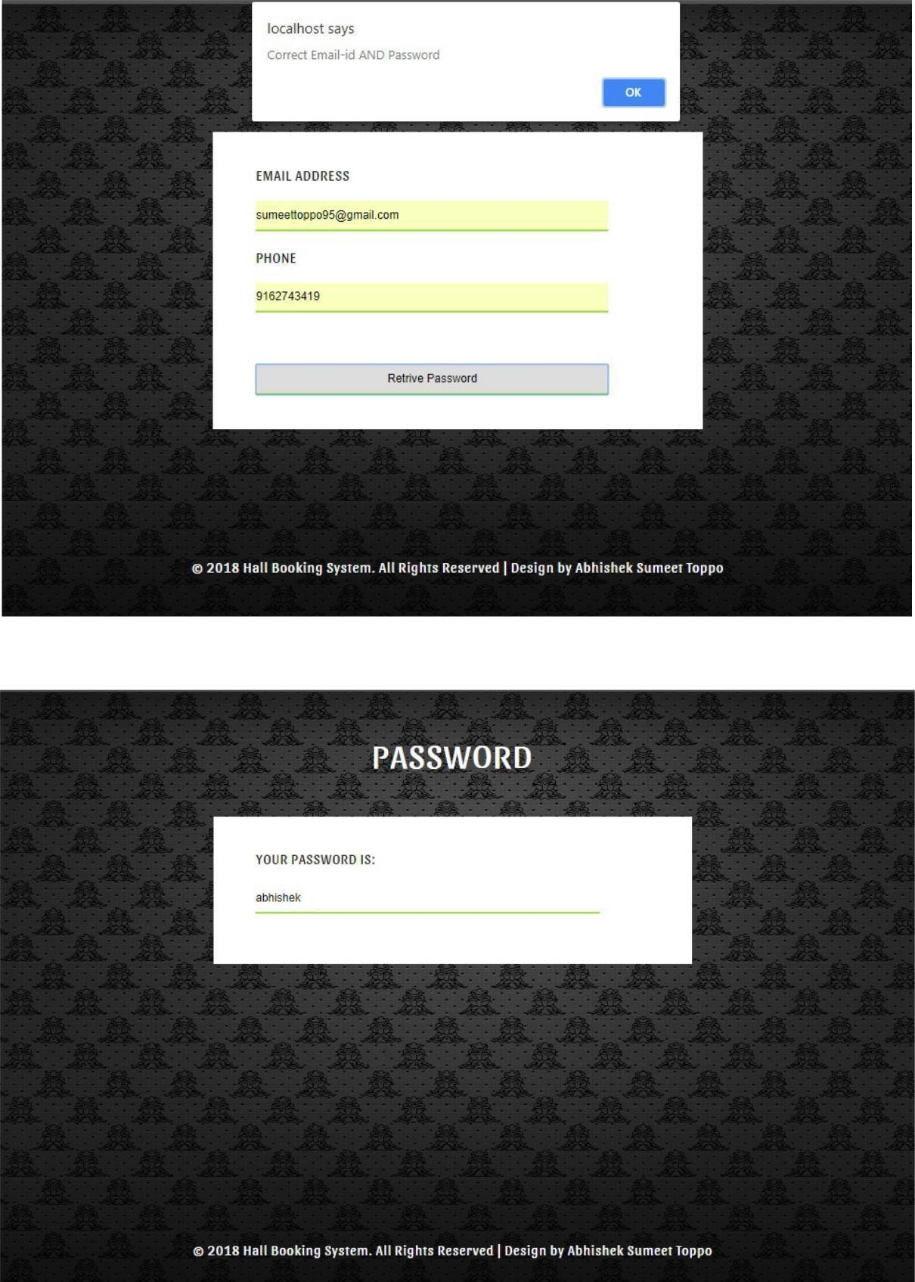
FORGOT PASSWORD
If somehow user forgets his/her password then he/she can click on forgot password button from the login page which asks the user to enter his/her correct email_id and phone number and click on retrieve password button. If the users enters the correct email_id and phone number then his/her set password will be shown on the screen otherwise a message of “wrong email_id and phone number” will be shown.

Slide 20
Conclusion
This application makes all the process hassle free for the user. This system replaces the existing system with more features also the system provides security to user documents. Here this application comes as a savior and manages to maintain all the confidentiality and provides an ease by making this process simpler and quicker. This system thus reduces the load of the user and make them feel free to book a hall from any where and at anytime without there requirement of any third party. Thus this system helps in making the use of resources efficiently and effectively.

Slide 21
Thank You

