Slide 1
What can we understand from Video Games Exploratory Data?
Group 5: Riddhi Mavani, Veer Karadia, Abhishek Taware

Slide 2
Introduction
As per 2020 reports, video games are a $170 billion industry. At some stage of life, we all have played some kind of video game or the other and using this dataset, we plan on analyzing how the popularity of video games have transitioned over the years, which genres were popular at different points of times, what do we make of different publishers, consoles, genres etc.

Slide 3
Dataset: Video Game Sales (1980 - 2018)
Name | Platform
Year of Release | Genre
Publisher | North American Sales
Japan Sales | European Union Sales
Rest of the World Sales | Developer
Critic Score | User Score
Global Sales | Ratings
Notes:
Dimensions of the data,

Slide 4
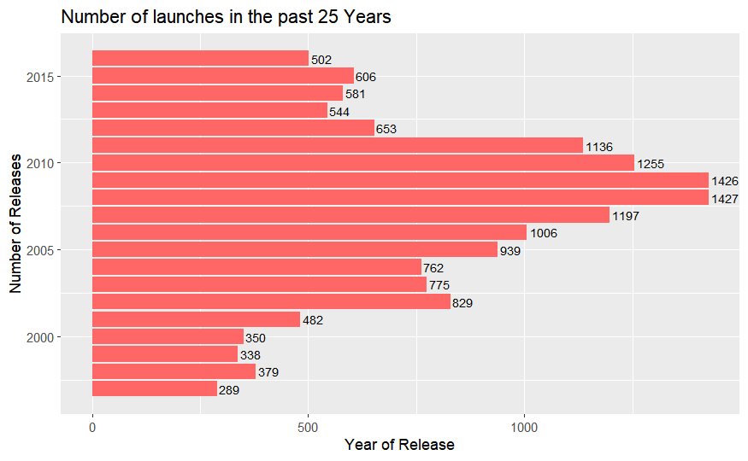
How many new games were launched each year in the last 25 Years?

Slide 5
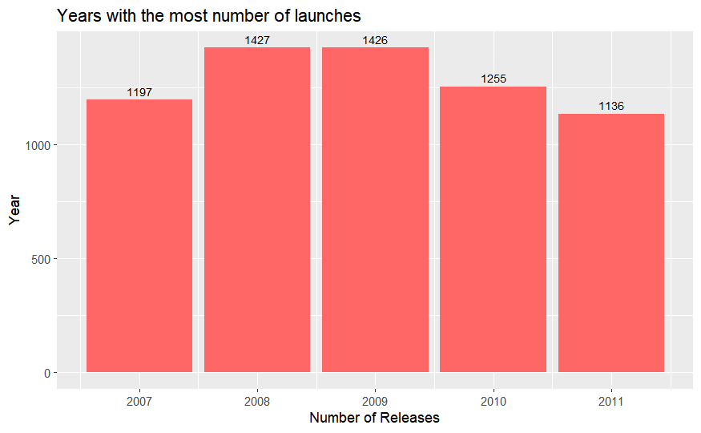
What were the years that saw most number of launches?

Slide 6
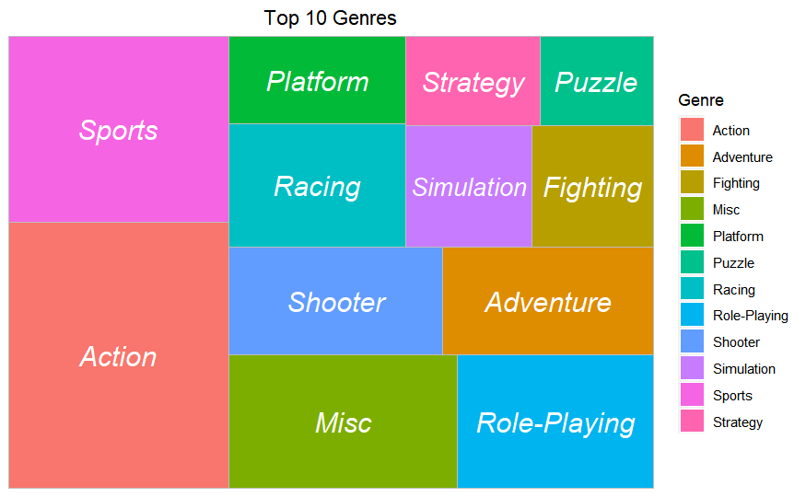
What are the most popular genres?

Slide 7
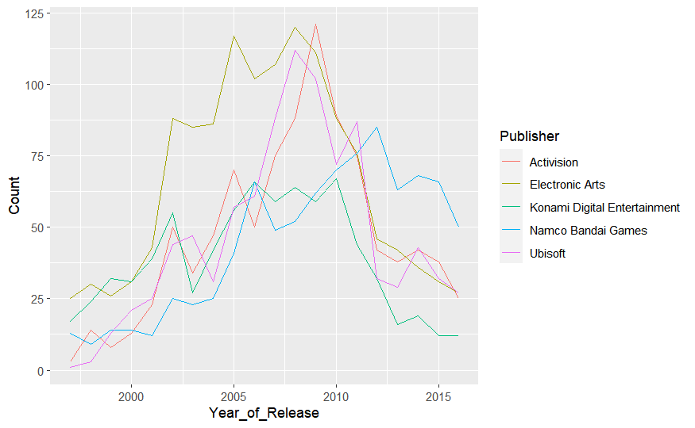
What were the launch trends of the Top 5 Publishers for the last 20 years?

Slide 8
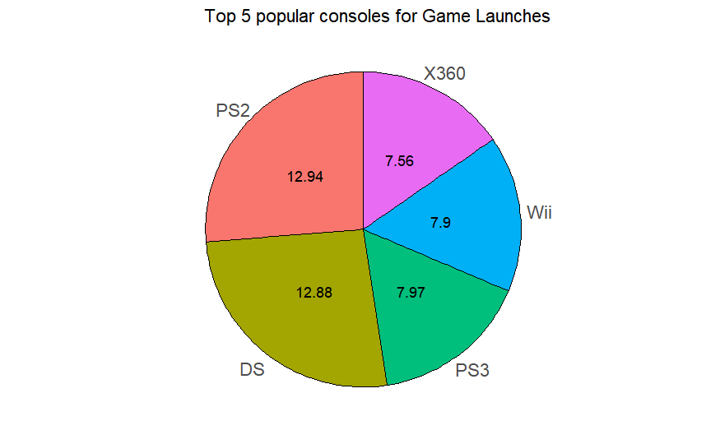
What are the most popular platforms?

Slide 9
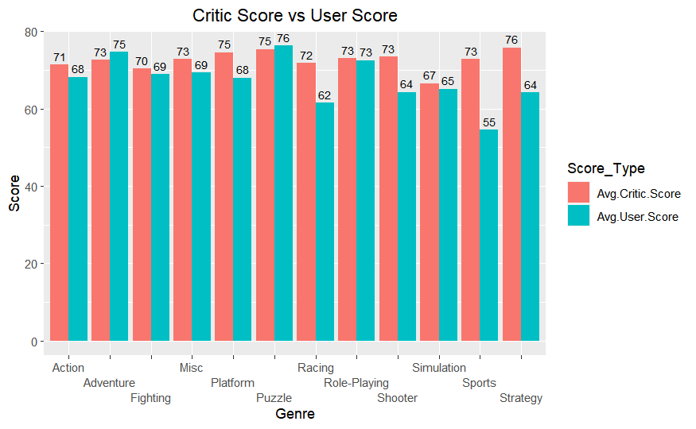
How do the Critic’s Ratings compare to User Ratings for different Genres?

Slide 10
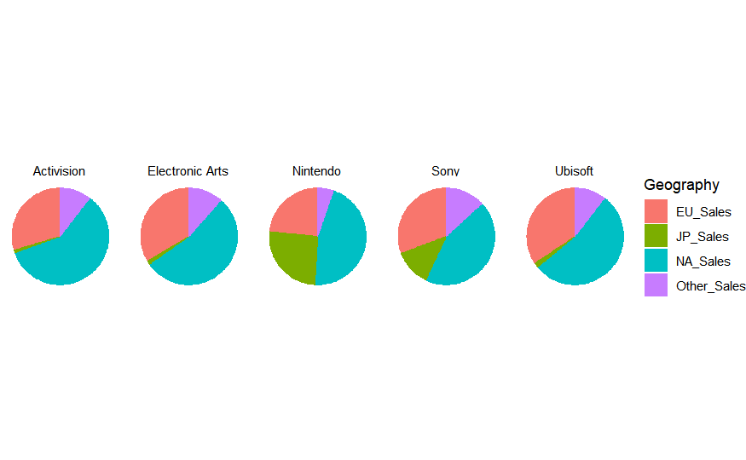
How does the Geographical Distribution of Sales look for the Top 5 Publishers

Slide 11
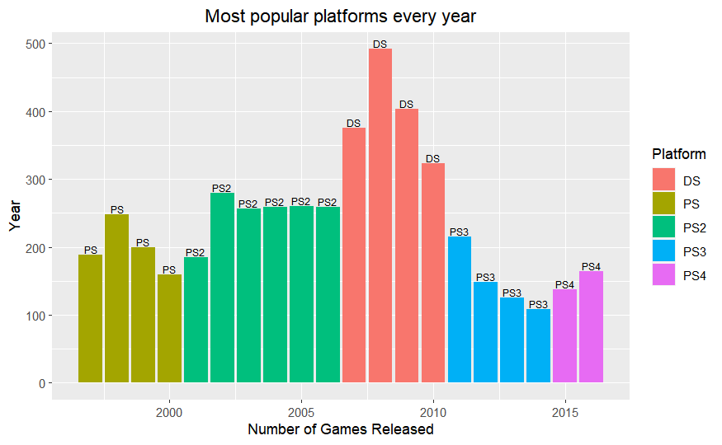
What are the most popular platforms every year?

Slide 12
Conclusion
The years 2007 - 2011 saw the highest number of game launches.
Action is the most popular genre among users & publishers followed by Shooting, Sports, and Role Playing.
Between 2001 - 2009, EA has launched the most number of games after which it was a mixed bag Year on Year.
Sony’s PS2 & Nintendo’s DS have been the most popular gaming consoles.
The comparison of Critic Score vs User Score tells us how the opinion of the two groups differs over various genres.
The continent of North America constitutes to majority of the sales revenue of the Top 5 Publishers
Sony’s Playstation Series has dominated the chart for most of the years in the past 20 years except for the patch of 2007 - 2010 wherein Nintendo’s DS beat Sony as the most popular console.

Slide 13


