Slide 1
IE6600 Sec05 Group 4 - Hackathon
Abhishek Hemantkumar Taware
Vidyun Akila Sundhara Raaman

Slide 2
Introduction & Problem Statement
Calling 911 has created a lot of differences between life and death in the United States of America. People find it as a lifeline during difficult situations. The number of 911 calls received everyday is high and analyzing the calls and taking the right step to balance the needs of the people is important. The needs of the people can be easily understood by a graphical illustration of the data.

Slide 3
Dataset: Seattle 911 Calls (2009 - 2017)
CAD CDW ID | Event Clearance Code
Event Clearance Description | Event Clearance Group
Event Clearance Date | Street
District / Sector | Incident Location
Initial Type Group | Initial Type Subgroup
At Scene Time | Year
Month | Day Number
Weekday | Hour

Slide 4
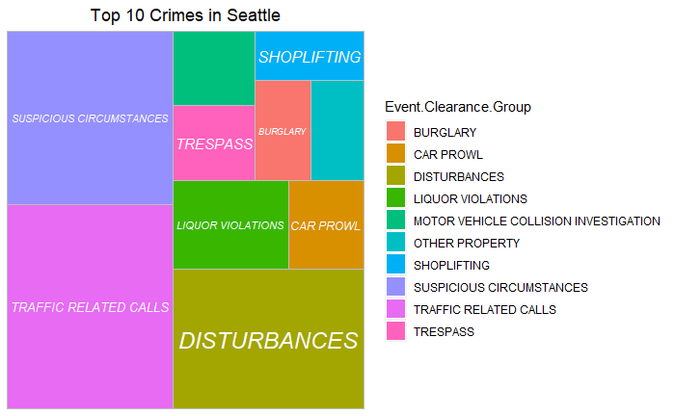
What were the Top 10 types of call events in Seattle?

Slide 5
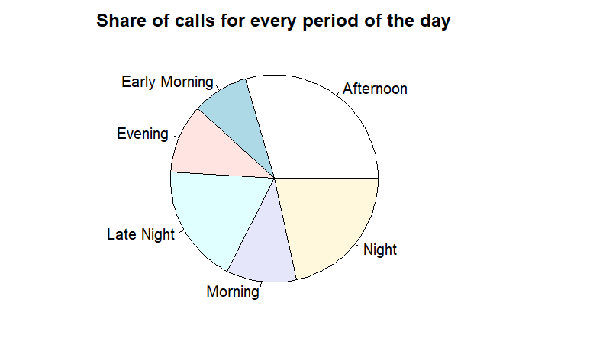
What were the time periods which saw most number of calls?

Slide 6
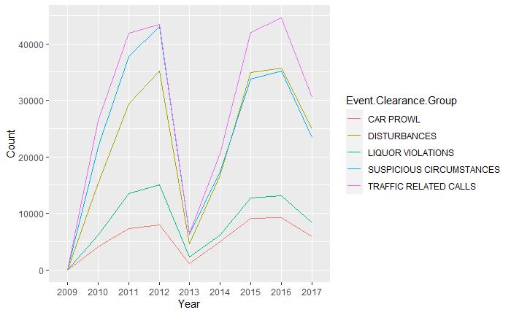
Which type of events were reported the most over the years?

Slide 7
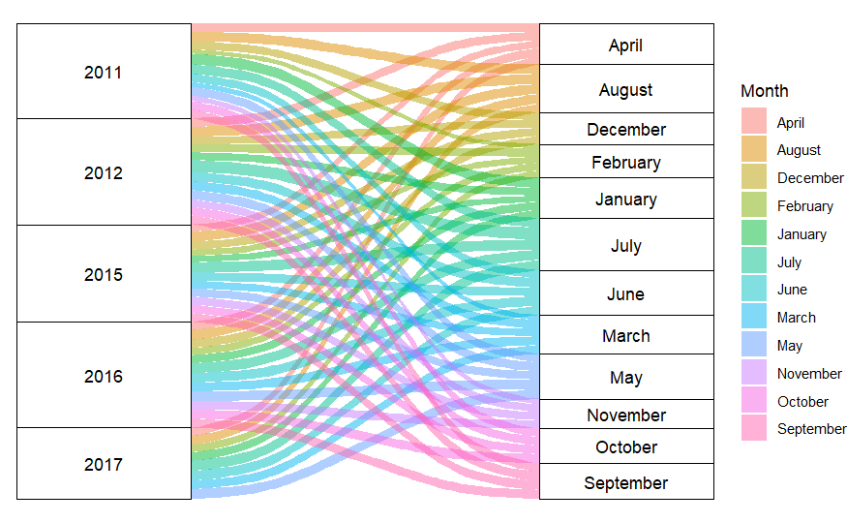
What was the distribution of calls over different months every year?
Notes:
Better representation than Stacked

Slide 8
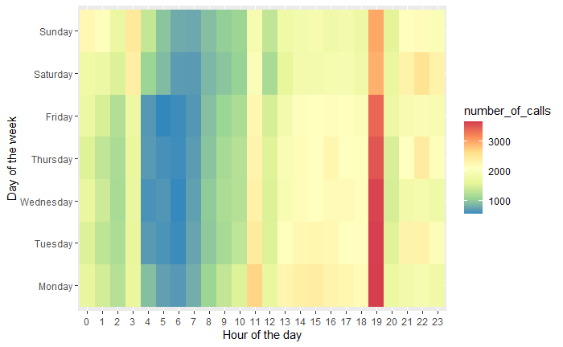
What was the distribution of calls over different days and time periods?

Slide 9
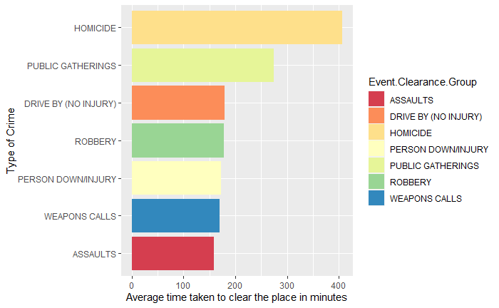
Which call types take the most time to clear?

Slide 10
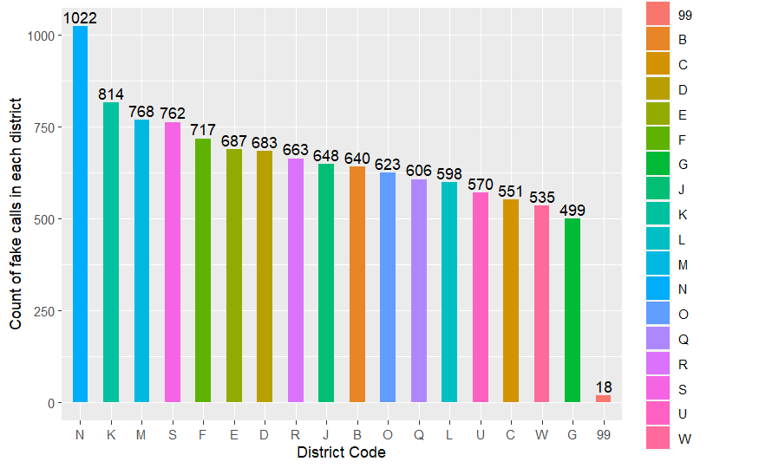
Which districts reported most number of fake calls?

Slide 11
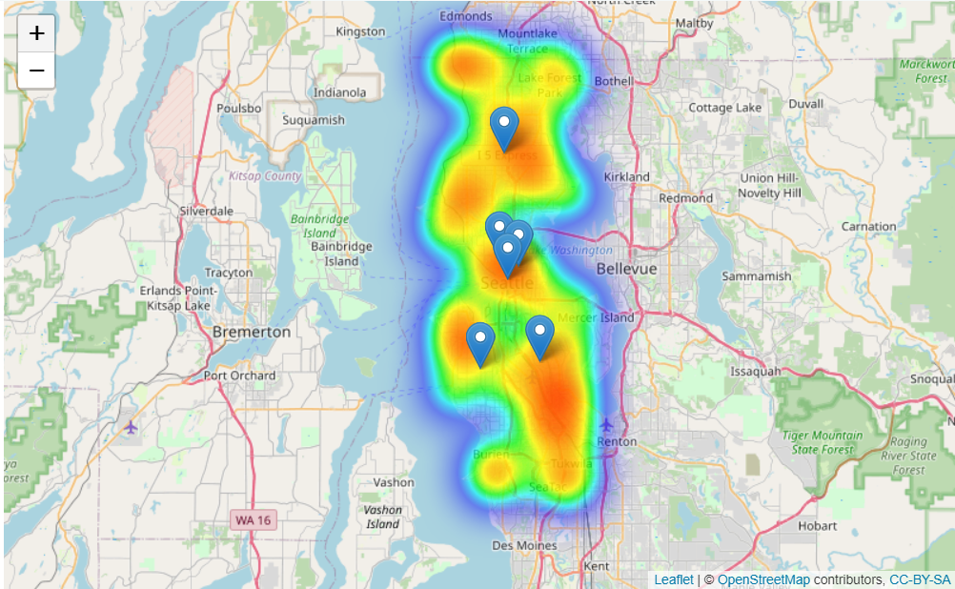
From which areas were most number of calls made?

Slide 12
Conclusion
Events related to disturbing the people’s day-to-day lives(Traffic, Disturbances) calls are high in Seattle.
People panic less during weekends and call 911 less.
Fatal related events take lot of time to clear the location.
The police precincts in Seattle is well placed and covers nearly every frequent 911 call locations.
Most number of calls are received during the months of July, August and October.
The number of Fake calls from District Code N is higher than other districts.
The top 5 call types have declined for the 1st time since 2013 showcasing the reduced frequency of calls.

Slide 13
References
Dataset: https://kaggle.com/sohier/seattle-police-department-911-incident-response/
Leaflet Library: https://rstudio.github.io/leaflet/
Open Data Program: https://data.seattle.gov/
New Dataset: https://data.seattle.gov/Public-Safety/Call-Data/33kz-ixgy

