Slide 1



NYCAirBNB_EDA
View in Power BI
Last data refresh:
1/19/2022 8:41:02 PM UTC
Downloaded at:
1/19/2022 8:42:18 PM UTC

Slide 2
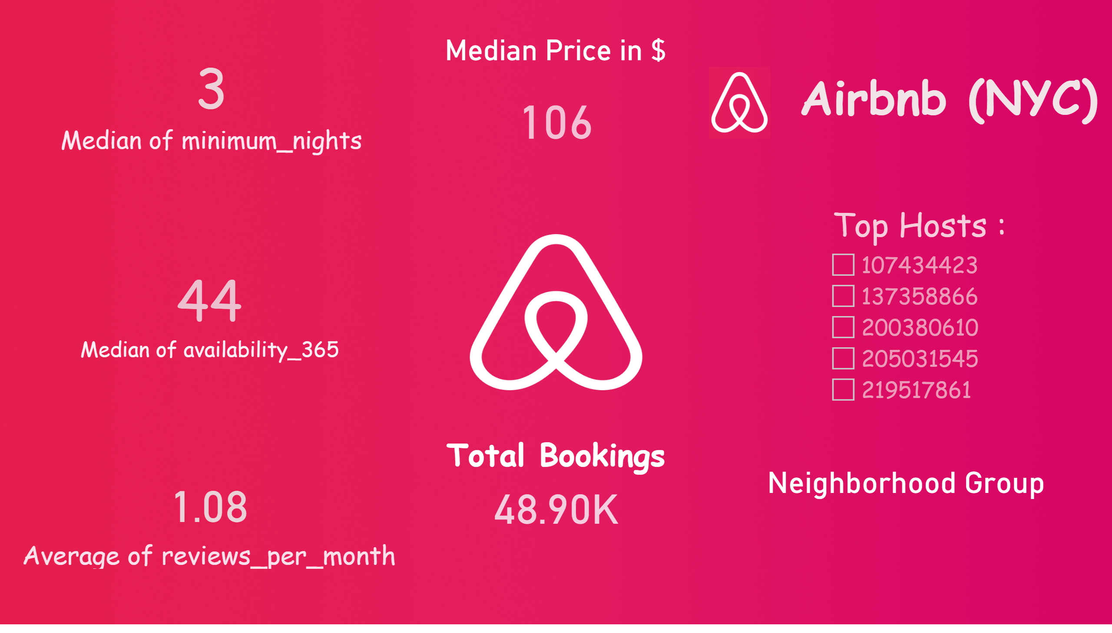
Top Hosts
Notes:
textbox
No alt text provided
slicer
No alt text provided
Median Price in $
No alt text provided
Total Bookings
No alt text provided
Reviews Per Month
No alt text provided
card
No alt text provided
card
No alt text provided
Neighborhood Group
No alt text provided
image
No alt text provided

Slide 3
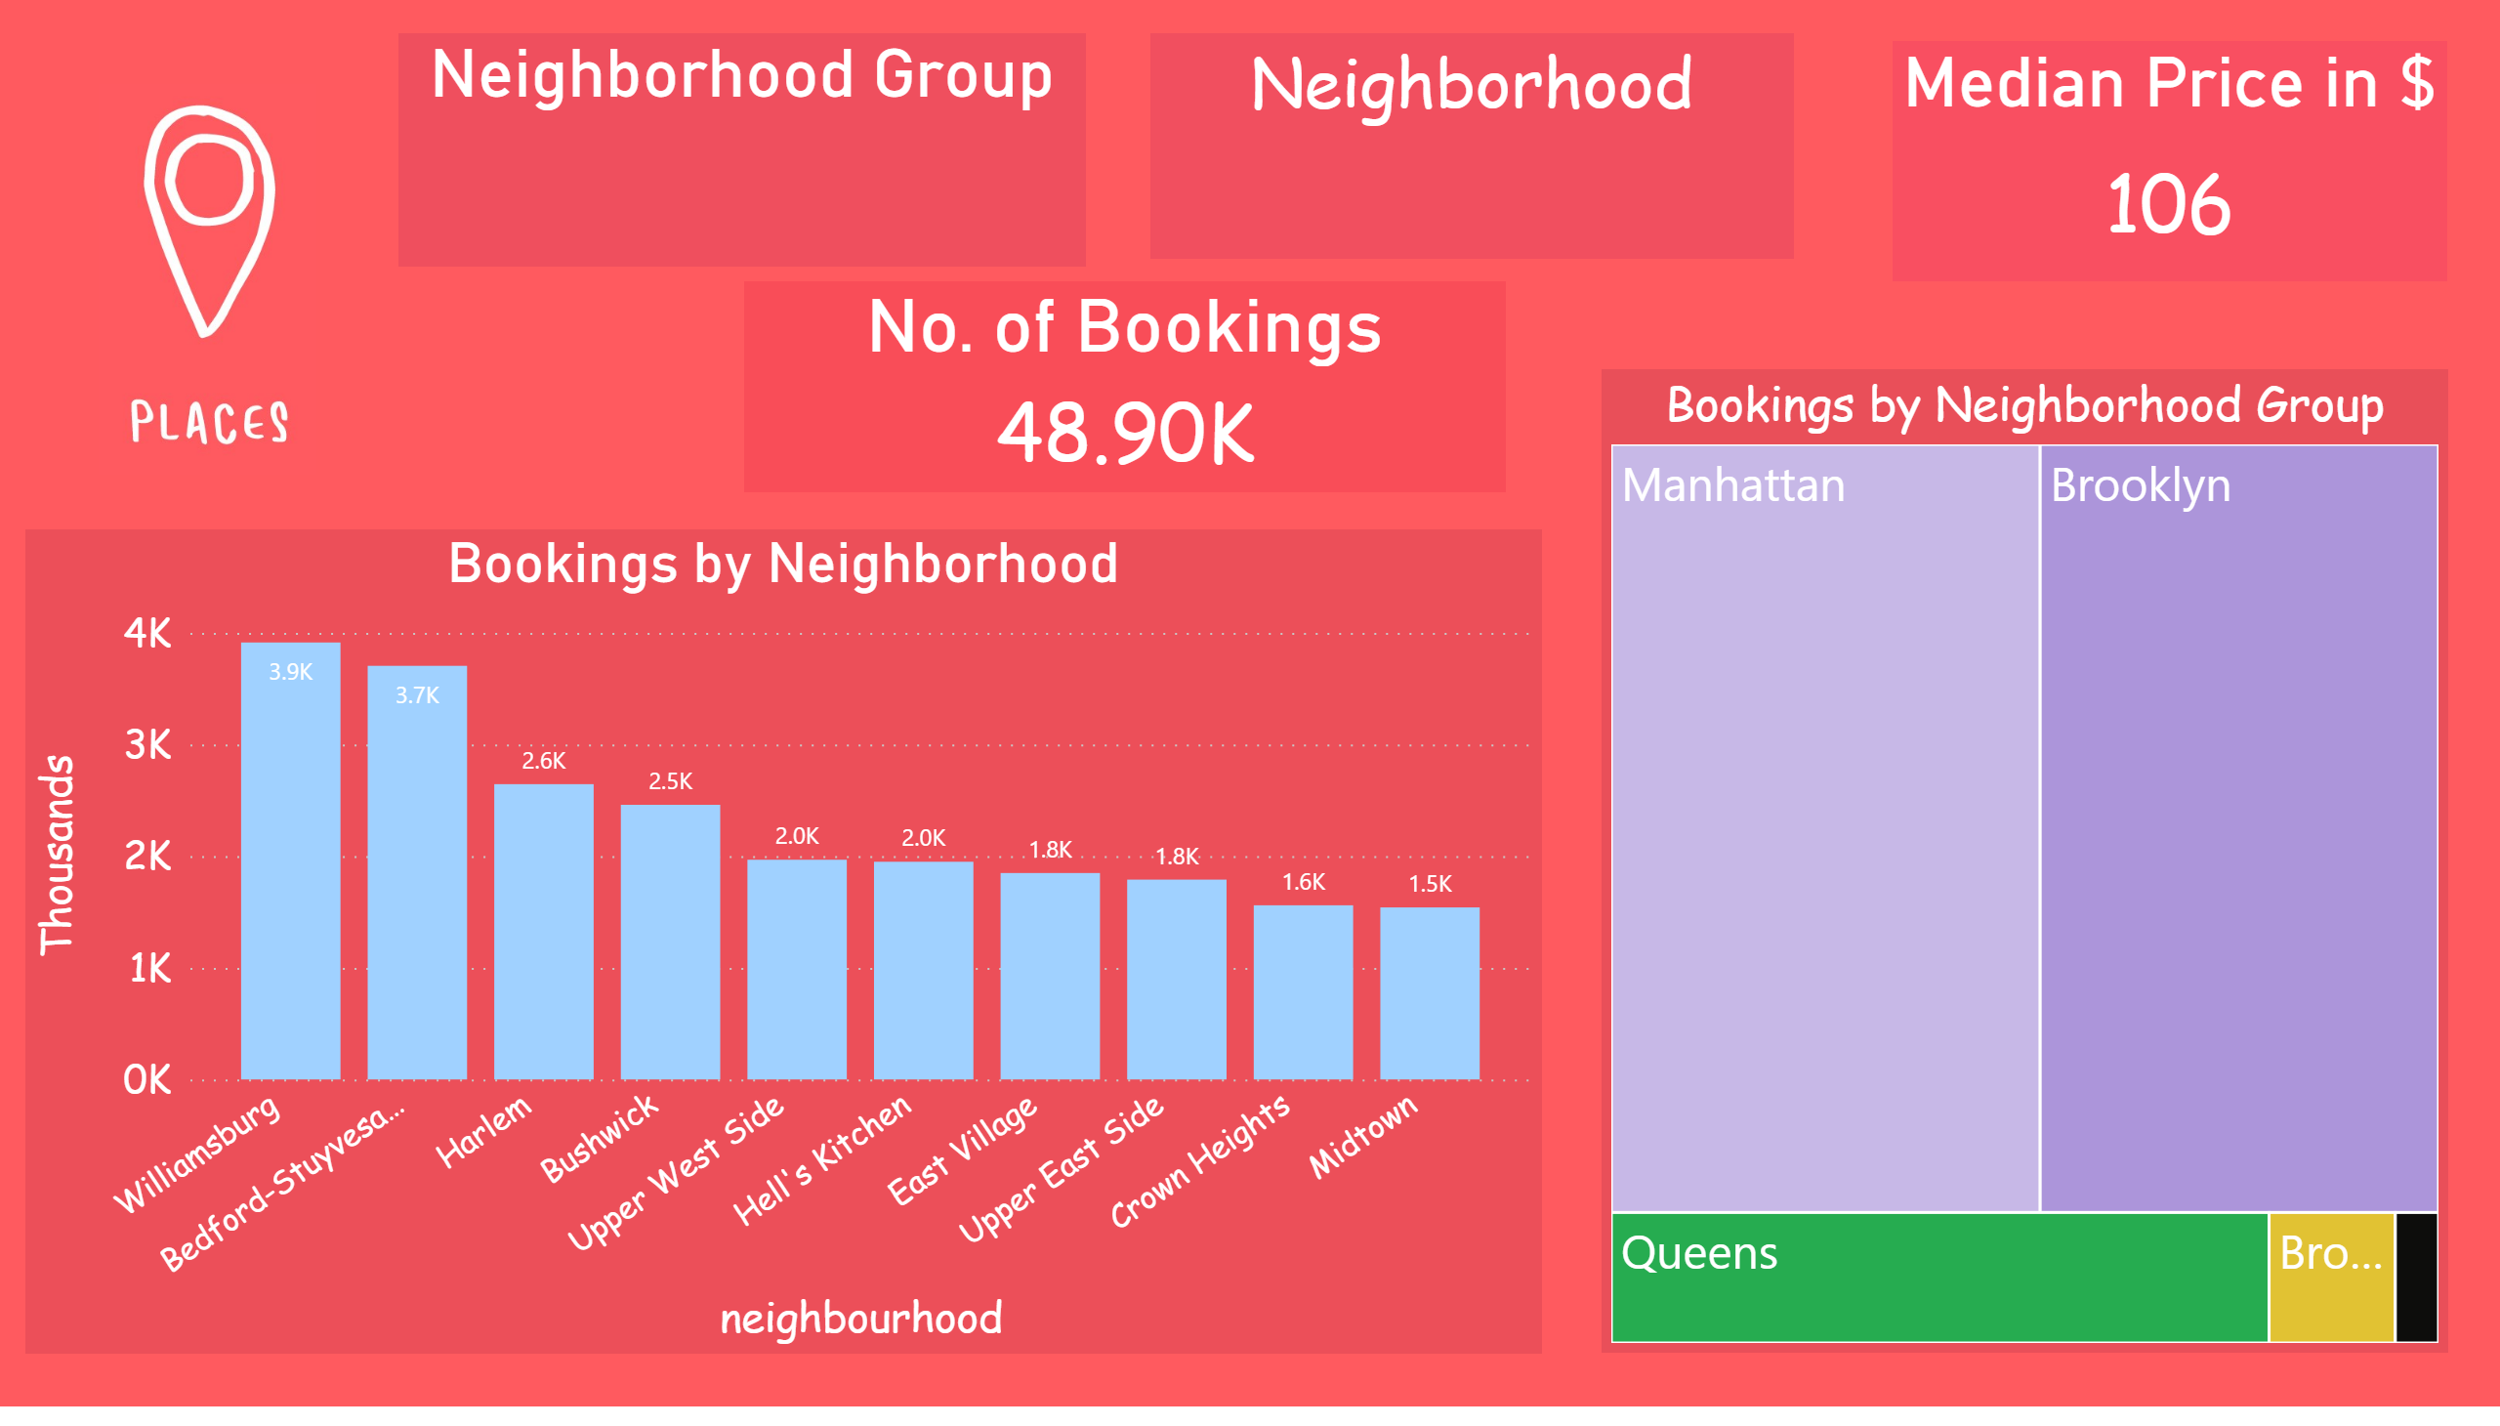
Area
Notes:
Bookings by Neighborhood
No alt text provided
Bookings by Neighborhood Group
No alt text provided
Neighborhood
No alt text provided
Neighborhood Group
No alt text provided
No. of Bookings
No alt text provided
Median Price in $
No alt text provided
image
No alt text provided

Slide 4
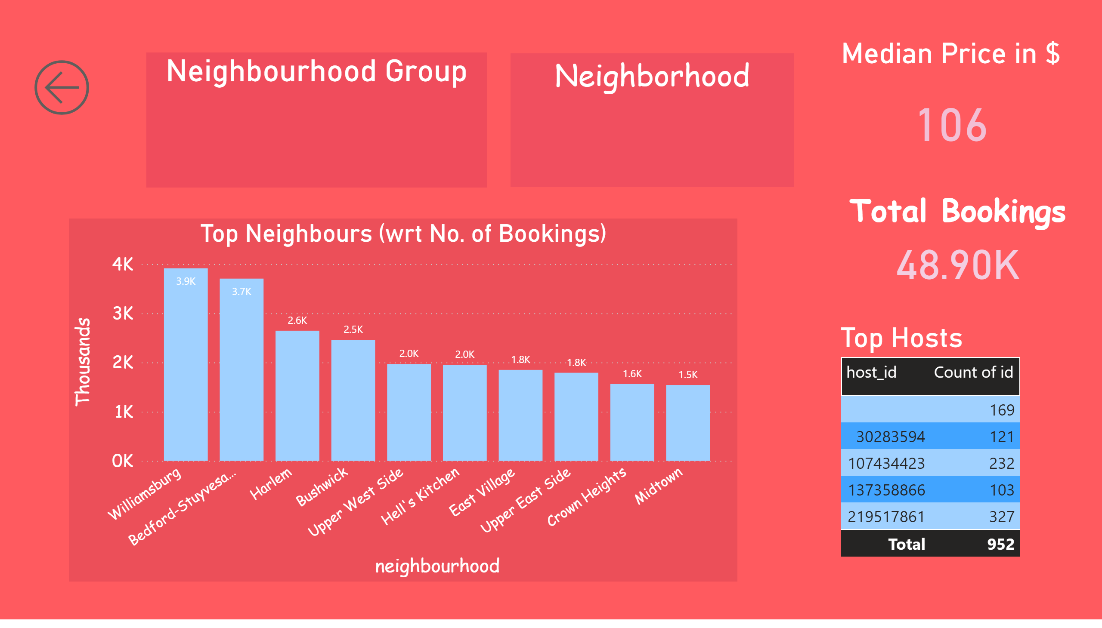
Sub-Areas
Notes:
Top Neighbours (wrt No. of Bookings)
No alt text provided
actionButton
No alt text provided
Neighbourhood Group
No alt text provided
Median Price in $
No alt text provided
Total Bookings
No alt text provided
Top Hosts
No alt text provided
Neighborhood
No alt text provided

Slide 5
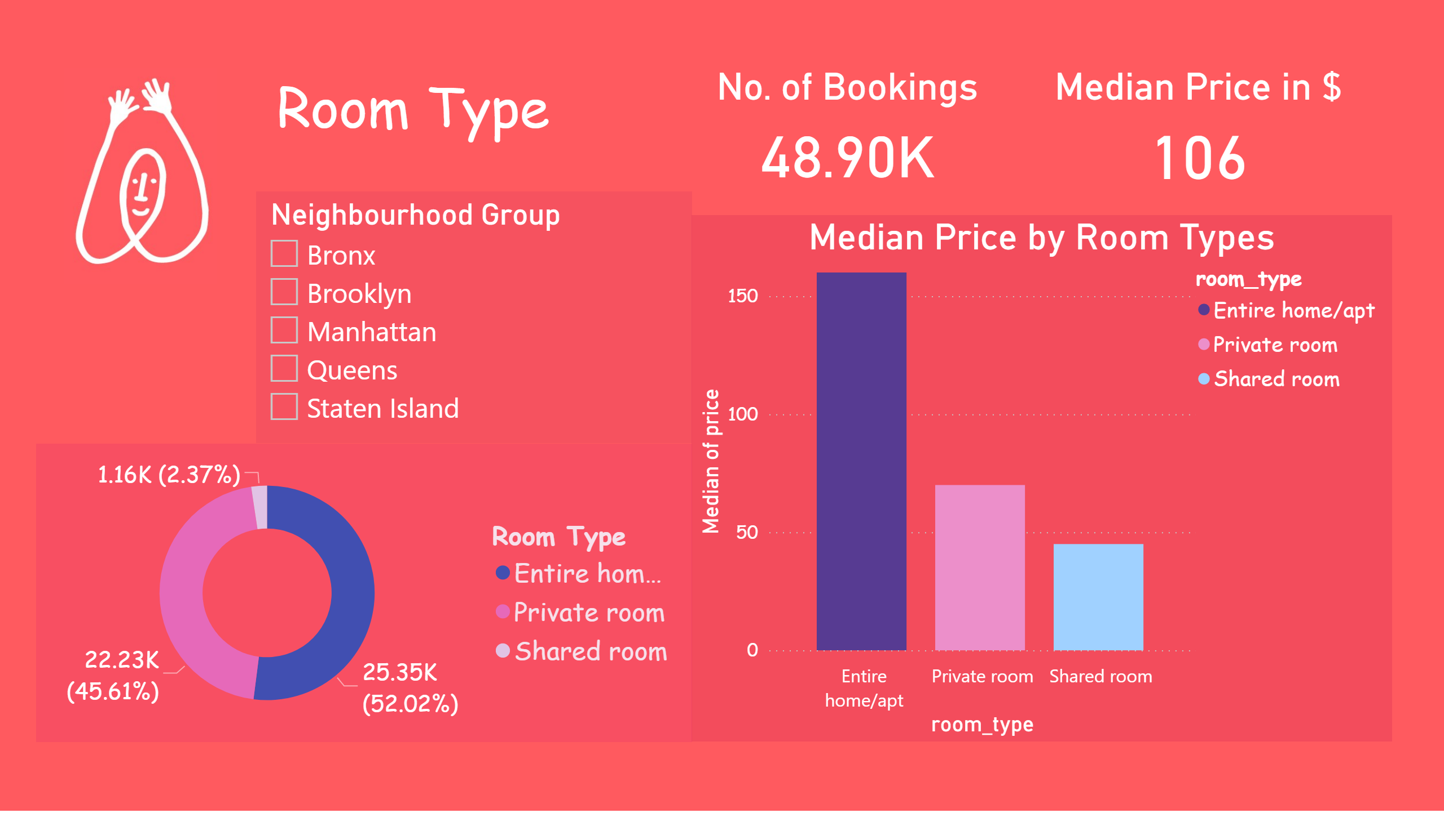
Room Types
Notes:
Median Price by Room Types
No alt text provided
donutChart
No alt text provided
image
No alt text provided
textbox
No alt text provided
Median Price in $
No alt text provided
slicer
No alt text provided
No. of Bookings
No alt text provided

