Slide 1

Team Members
Saisha Luitel
Reebhusha Maiya Amatya
Ruksana Shakya
Abhishek Thapa

Slide 2
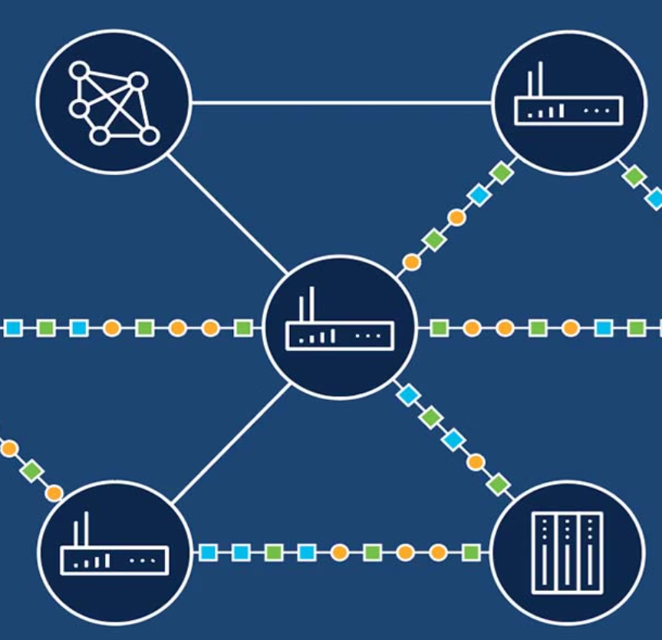
This presentation includes
Design of a scalable network for a large insurance firm with 1 Head Office & 7 branches.
Focus on secure, redundant, and future-ready infrastructure.
Head Office features dual ISP links for failover and high availability.
VLAN segmentation is used to isolate Admin, Finance, Loan, and IT departments.
Dynamic routing (RIP & OSPF) ensures efficient communication across sites.
DHCP with reserved IPs supports scalability and easier device management.

Slide 3
Key DHCP Features in Network Design
Automated IP Assignment
Reserved IP
VLAN-Aware DHCP
Localized DHCP Servers

Slide 4
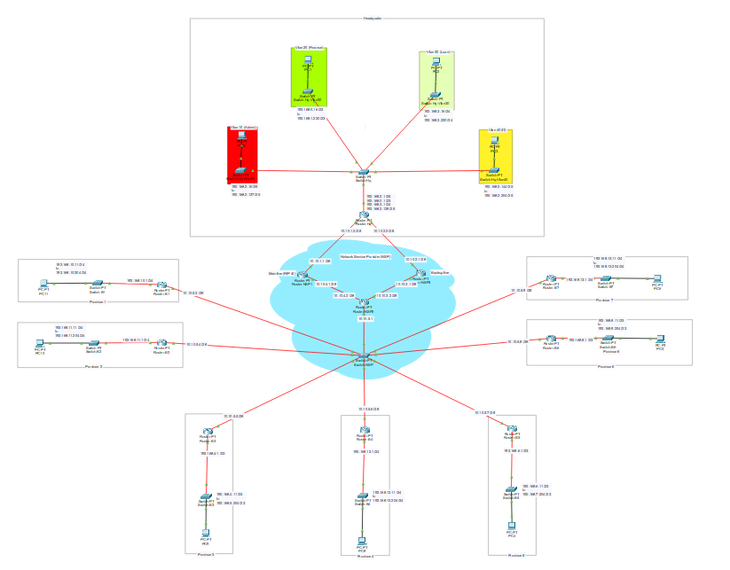
Network Topology
Centralized Hub at the Head Office.
VLAN segmentation at the Head Office
Redundant ISP Links

Slide 5
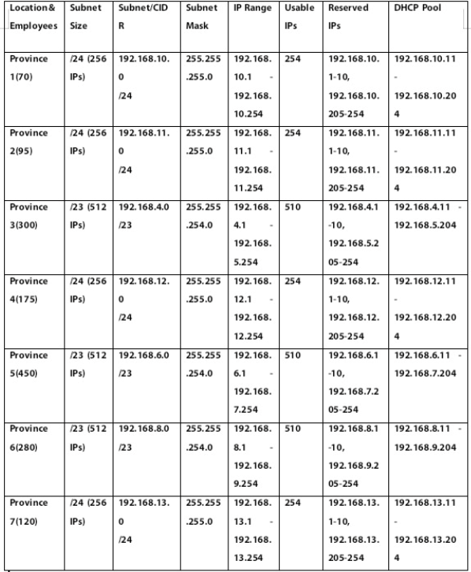
IP Addressing and DHCP plan table
Subnetting based on Branch Size
DHCP Pool with Reserved IPs
Consistent Addressing Scheme

Slide 6
Branch Connectivity & Network Services
Redundant WAN links (Connectivity)
Routing protocol (Network Communication)
DHCP setup (Network service)

Slide 7
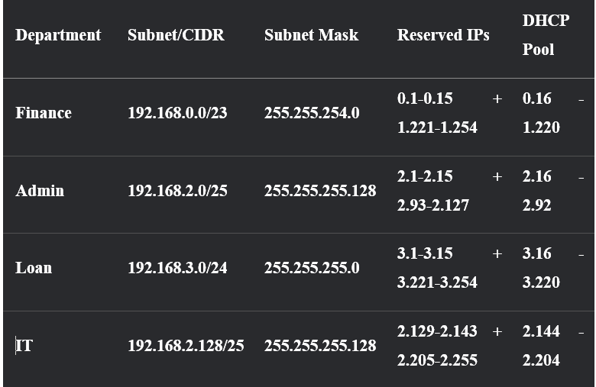
Headquarters

Slide 8
About Headquarter Vlan
Departmental VLANs in the Head Office
Router-on-a-stick Configuration
DHCP setup configuration
Reserved IP Management

Slide 9
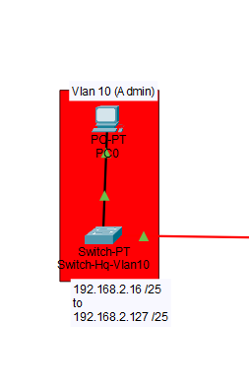
In Vlan 10, Admin
IP network of : 192.168.2.0/24 with
subnet mask of 255.255.255.128,
gateway of : 192.168.2.1

Slide 10
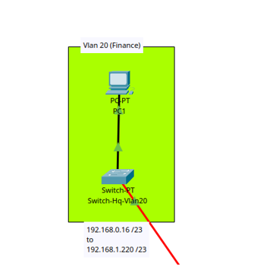
In Vlan 20, Finance IP network of : 192.168.0.0 & 1.0/23 with subnet mask of 255.255.254.0, gateway of: 192.168.0.1

Slide 11
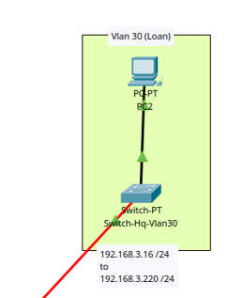
In Vlan 30, Loan
IP network of: 192.168.3.0/24 with
subnet mask of 255.255.255.0,
gateway of: 192.168.3.1

Slide 12
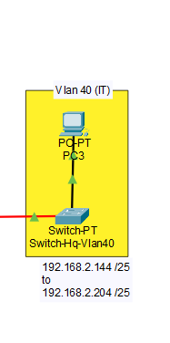
In Vlan 40, IT
ip network of : 192.168.2.12/25 with
subnet mask of 255.255.255.128,
gateway of : 192.168.2.129

Slide 13
About Branches
Here, we have
Seven Branches Across Provinces
NSP-Backed Connectivity
Branch-Level DHCP Configuration
Reserved Ips for Scalability

Slide 14
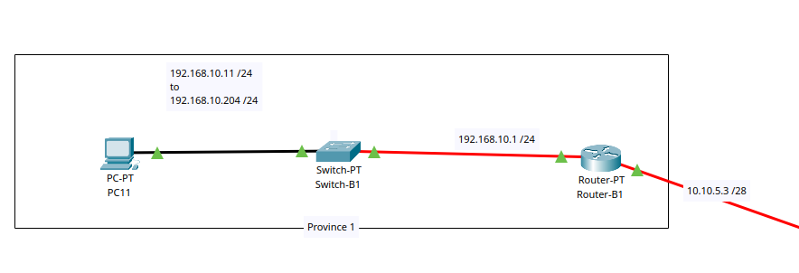
Branch 1
IP addressof: 192.168.10.0/24 with
subnet mask of 255.255.255.0,
gateway of: 192.168.10.1

Slide 15
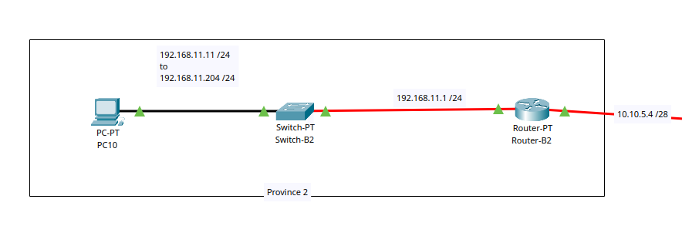
Branch 2
ip address of : 192.168.11.0/24with
subnet mask of 255.255.255.0 ,
gateway of : 192.168.11.1

Slide 16
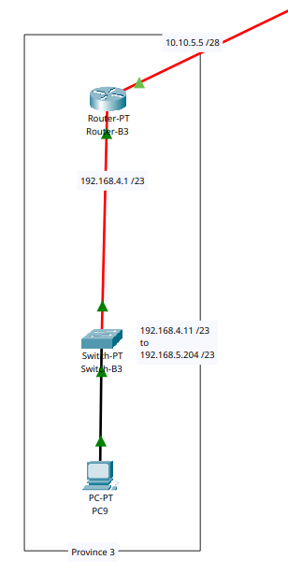
Branch 3
IP address of : 192.168.4.0/23 & 192.168.5.0 with
subnet mask of 255.255.254.0,
gateway of: 192.168.4.1

Slide 17
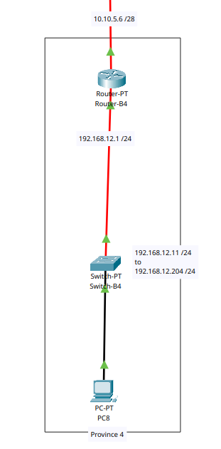
Branch 4
ip addressof : 192.168.12.0/24 with
subnet mask of 255.255.255.0 ,
gateway of : 192.168.12.1

Slide 18
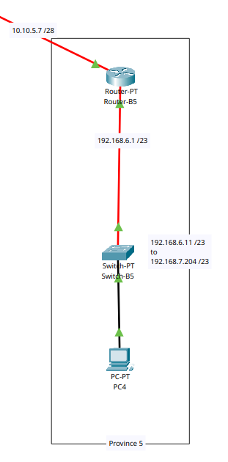
Branch 5
ip address of : 192.168.6.0/23 & 192.168.7.0/23 with
subnet mask of 255.255.254.0,
gateway of: 192.168.6.1

Slide 19
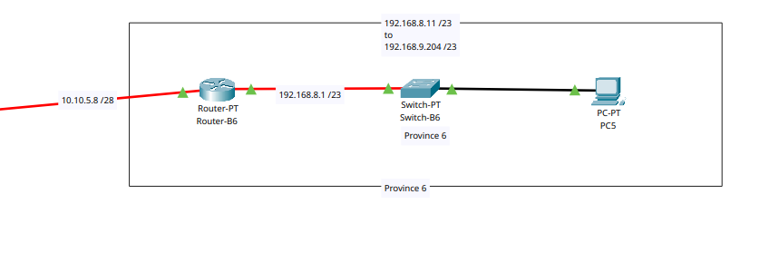
Branch 6
IP address of: 192.168.8.0/23 with
subnet mask of 255.255.254.0,
gateway of: 192.168.8.1

Slide 20
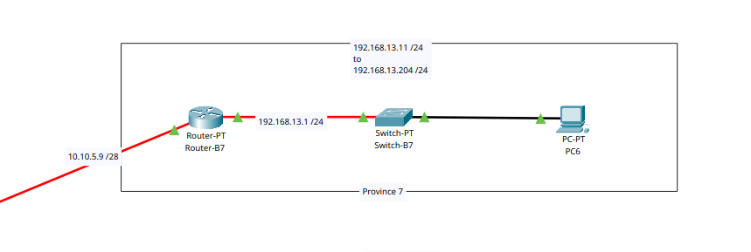
Branch 7
IP address of : 192.168.13.0/24with
subnet mask of 255.255.255.0 ,
gateway of : 192.168.13.1

Slide 21
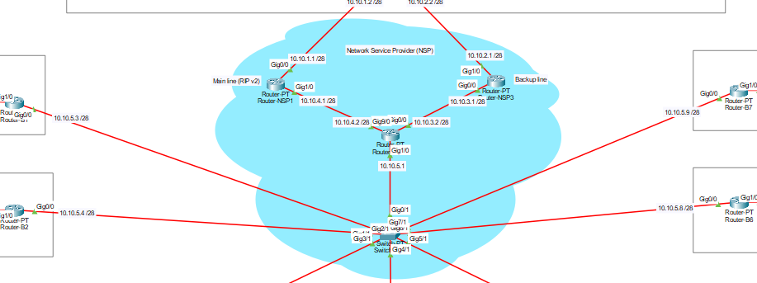
Network Service Provider (NSP)
10.10.5.5 /28
10.10.5.7 /28
10.10.5.6 /28
Nsp are organizations that provide public and private network services like internet and intranet.
Notes:
Ruskana 10.10.x.x / 28 ko network used by nsp to provide ip and coverage

Slide 22
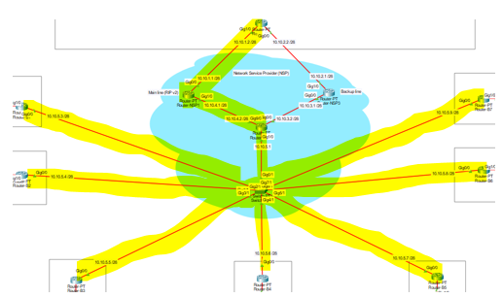
About Connection
Default Line Connection
The yellow highlighted part shows the default route and its dedicated IP address.
Notes:
Ruksana primary route

Slide 23
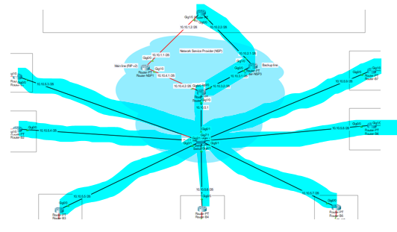
Fail-Safe Redundancy Connection
In case of any failure in default network. It will use the given path highlighted using blue.
Notes:
Ruksana secondary or backup interface for fail safe

Slide 24
Conclusion
Real-world Application
Balanced Design
Future-Ready Infrastructure
Standards-Based Approach

