Slide 1

Real Time Gaze Tracking and Applications
Project At- Delhi Institute of Tool Engineering
-By Abhishek Tyagi : 42370211217

Slide 2
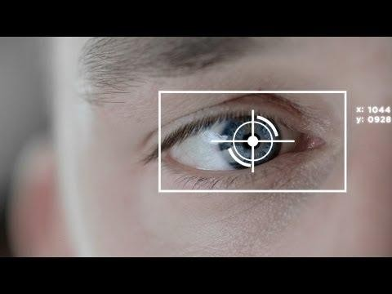
Problem Statement
2
Create real time gaze tracking application which will use for different security aspect.
More info on how to use this template at www.slidescarnival.com/help-use-presentation-template
This template is free to use under Creative Commons Attribution license. You can keep the Credits slide or mention SlidesCarnival and other resources used in a slide footer.

Slide 3

Objectives And Scope of Project
3
-Pupil Detection.
-Handle screen by gaze.
-Calibrate data

Slide 4

“
5
Human psychology and eye-mind hypothesis,that amount of time spends thinking about an Object is directly proportional to time spent looking at it.

Slide 5
Applications
6
» Gaming world.
» Security Domain.
» Medical Field.
-We focus On security domain.

Slide 6

-Authentication access by gaze
8
-Data Monitoring/Calibrating
-Avoid Shoulder Surfing

Slide 7
Authentication access By gaze
9
The process or action of proving or showing something to be true, genuine, or valid.
The process or action of verifying the identity of a user or process.

Slide 8
Data Monitoring
10
-Sensitive Data monitorate and calibrate by user’s.

Slide 9
Shoulder Surfing
11
The of spying on the user’s of cash dispensing machines or any other device in order to obtain their personal identification number , password
, sensitive data ,etc.

Slide 10
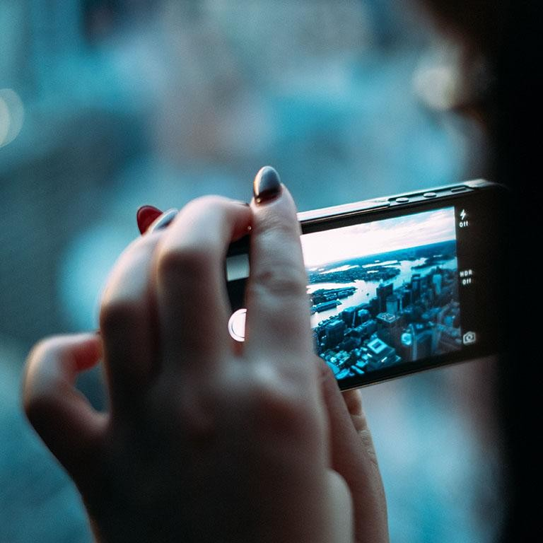
-Javascript
-Python
Software’s
12
-Android
-OpenCV

Slide 11
EXPLAIN IDEAS
13
Accurate Pupil Detection
Matching Device Coordinates
Data Calibration

Slide 12
Algorithms:
14
-SURF -(Speed Up Robust Feature).
-HaarCascade Algorithms
-RANSAC Algorithms.
-HeatMap algorithm.

Slide 13
Algorithms:
15
SURF(SpeededUp Robust Featrures): 1.Detection.
2.Description. 3.Matching.

Slide 14
Algorithm
16
RANSAC(RANdom SAmple Consensus):
-adopted by the computer vision community.
-esampling technique that generates candidate solutions by using
the minimum number observations (data points) required to estimate the underlying model parameter.

Slide 15
Algorithm:
17
1:Select randomly the minimum number of points required to determine the model parameters.
2Solve for the parameters of the model.
3:Determine how many points from the set of all points fit with a predefined toler- ance.
4:If the fraction of the number of inliers over the total number points in the set exceeds a predefined threshold τ, re-estimate the model parameters using all the identified inliers and terminate.
5:Otherwise, repeat steps 1 through 4 (maximum of N times).

Slide 16
Implementation:
18
*Javascript:
-Implementation of gaze tracking System.
-clmtracker.
-Regression & Calibration.
-Tracker

Slide 17
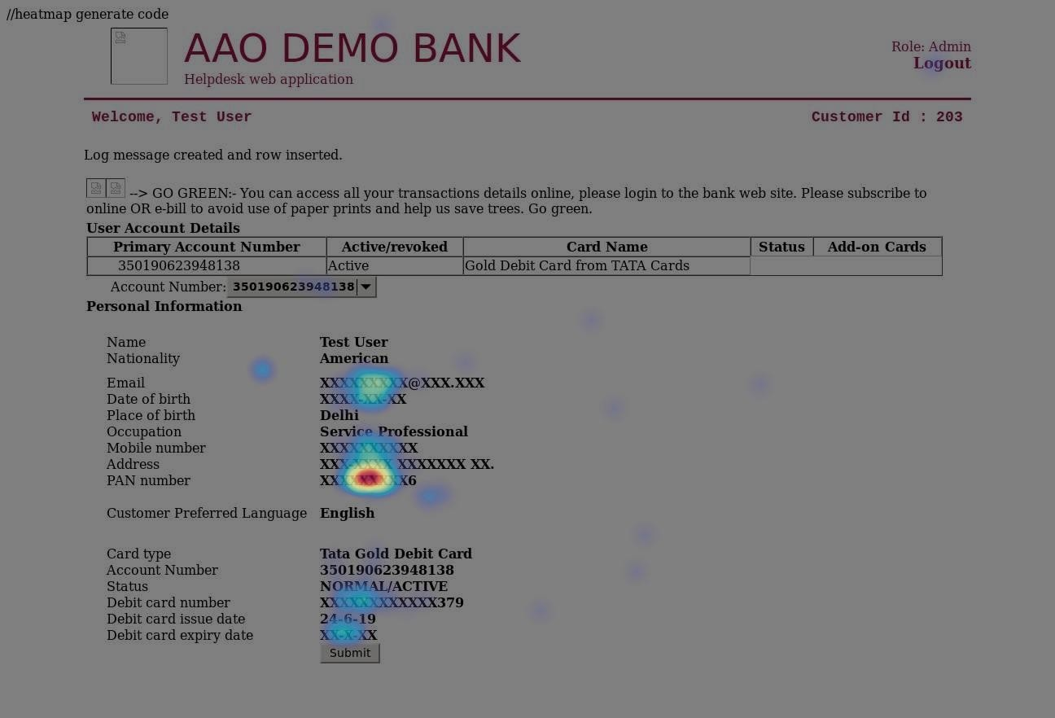
Heatmap:
19

Slide 18
Graphical Password Authentication System:
20
-Using gaze ,we implement the graphical Password authentication System. #Testing & analysis:
-on 16 people ,I tested this project.
-almost 95% result is correct.

Slide 19

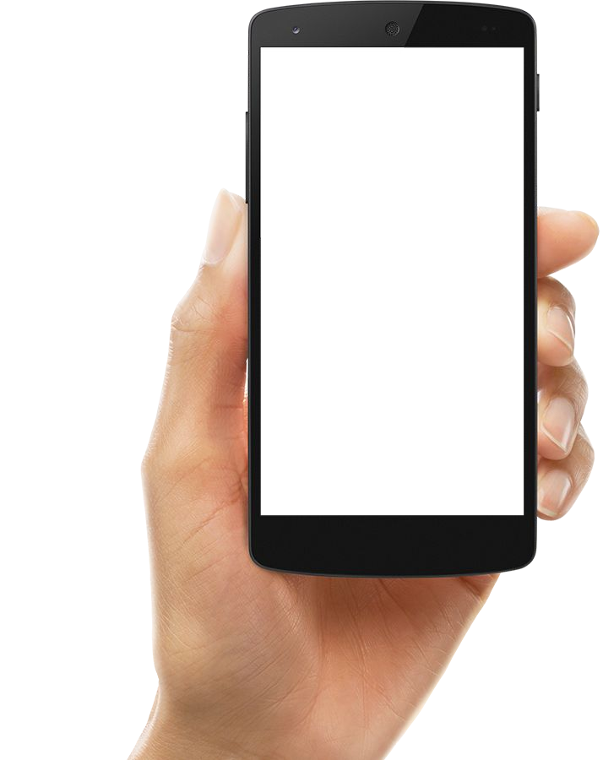
Learning
21
-Agile Methodology
-Open Source vision techniques.
-Human-Computer Interaction(HCI).
-Security Constraint

Slide 20
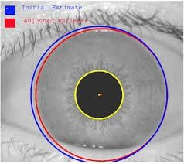

Current State Of Project
Place your screenshot here
23
-able to capture area according to gaze.
-Using heatmap we can Calibrate data.
-We developed graphical password authentication System.

Slide 21
Future Scope:
24
-Medical Field.
-Gaming Era

Slide 22
SOUPS(Symposium On Usable Privacy and Security):
-This conference eld in June 2017, we will going to publish this paper after completion of remaining factor.
25

Slide 23
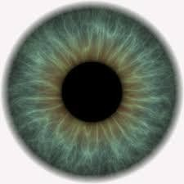
Place your screenshot here
26
Conclusion
“Prevention is always better than cure” as D.Erasmus said.
-Provide security using gaze technology.

Slide 24
References
27
-V. a. Gevers, "Accurate Eye Center Location and Tracking Using Isophote Curvature," IEEE Conference on Computer Vision and Pattern Recognition, 2008
-Institute for Neuro- and Bioinformatics, University of L¨ubeck, Ratzeburger Allee 160, D-23538 L¨ubeck, Germany,"ACCURATE EYE CENTRE LOCALISATION BY MEANS OF
GRADIENTS",2013
-Wen Hao Lui,"Real-time Webcam Gaze-tracking",2014.
-Alexandra Papoutsaki,"ScalableWebcam Eye Tracking Using User Interactions",2014.

Slide 25
THANKS!
28
Any questions?

