Slide 1
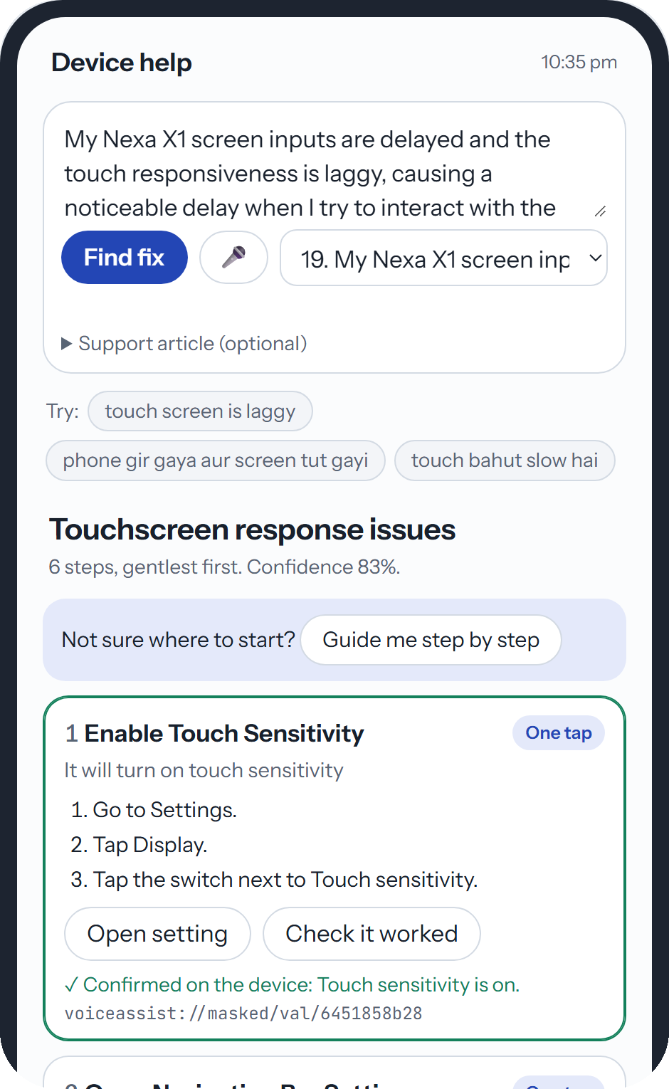
Samsung PRISM GenAI Hackathon 2026 · Theme 02 · Demo round
FixFlow
Smart Guided Troubleshooting Engine
A phone complaint in the user's own words goes in. A short, ordered fix plan comes out, with one-tap links into Settings, built only from the support article.
Team SRMIST_QueueQueueing
SRM Institute of Science and Technology
Abhinav Kumar · Abhishek Verma · Ayushi Paul · Ketki Gonnade
Notes:
ABHINAV (about 10 s)
Good morning. We are team SRMIST_QueueQueueing from SRM, and this is FixFlow, our engine for Theme 02. You describe a phone problem in your own words, and FixFlow returns a short, ordered fix plan with one-tap links into Settings, built only from the support article.

Slide 2


Understanding the problem
Turn a vague complaint into a fix the user can tap
WHAT COMES IN
WHAT MUST GO OUT
“My Nexa X1 screen inputs are delayed and the touch responsiveness is laggy, causing a noticeable delay when I try to interact with the device.”
Touchscreen response issues
1
Enable Touch Sensitivity
One tap
FixFlow
2
Open Navigation Bar Settings
One tap
Official kit, complaint 19
3
Check Screen Protectors
By hand
Its support article (SIIS text)
4
Check Usage and Moisture
By hand
5
Check Charger
By hand
A catalog of 578 Settings deeplinks
6
Restart Your Device
Last resort
Pure JSON, official schema
Catalog deeplinks only
Restart and reset always last
No fix in the article: no_match
Repeat < 300 ms, new < 8 s
FixFlow · Team SRMIST_QueueQueueing
2 / 9
Notes:
ABHINAV (about 30 s)
Here is the task as we understood it. In: a complaint like this official one, its support article, and a catalog of 578 Settings deeplinks. Out: a strict JSON plan. Settings fixes first, each with a one-tap deeplink from the catalog, then checks by hand, and restart always last. This is the real plan FixFlow returns for this complaint. And if the article has no fix, we must say no_match, never guess.

Slide 3
Caveats identified
Six catches we found in the official kit
1
The article may not fit
2
AI models invent steps
3
Deeplinks are masked codes
Complaint 6 is about a tablet's dark screen; its article is about multi-window. A plan here would be invented.
An LLM adds tips, settings and web links that the article never mentions.
Only the descriptions can be matched, and 138 switches come as on/off twins. The wrong twin undoes the fix.
Extract: relevance check
Extract: citation check
Deeplinks: action-aware search
4
One line, several problems
5
Many wordings, one plan
6
The sample breaks the spec
Complaint 17 holds three complaints in one line. Each needs its own plan.
Rewordings and Hinglish must get the same plan, and a repeat must answer in under 300 ms.
The kit's sample output has 8- and 12-word descriptions; the spec says 5 to 7, starting “It will”.
Understand: problem split
Language + Memory
Contract gate: we follow the spec
FixFlow · Team SRMIST_QueueQueueing
3 / 9
Notes:
ABHINAV (about 35 s)
Reading the kit closely, we found six catches. Complaint 6 comes with an article that does not fit, so any plan would be invented. LLMs add steps the article never mentions. Deeplinks are masked codes, and 138 switches have on and off twins. Complaint 17 holds three problems in one line. One problem comes in many wordings, even Hinglish. And the kit's own sample breaks the five-to-seven word rule, so we follow the spec. The green tag on each card is the module that handles it. Over to Abhishek.

Slide 4



Core architecture
Memory first. A new problem passes four checked stages
Complaint
Language
Memory
Seen before
1 to 82 ms, $0, no LLM
Answer
typed or spoken, English or Hinglish
Hinglish to English, offline rules
exact or same-meaning match, symptom guard
pure JSON plan, then saved to memory
input
code, no LLM
code, no LLM
new problem
1 Understand
2 Extract
3 Deeplinks
4 Contract gate
normalise, split problems, 8 to 10 rewordings
steps from the article, each citing its sentence
hybrid search over the 578-entry catalog
every rule checked in code
LLM or rules
LLM or rules
code, no LLM
code, no LLM
Runs with no AI key
Every LLM stage has a rules path. CPU only, one Docker image.
Gemini is optional
Flash-Lite with a model fallback chain and a 7 s budget per call, then rules.
Same meaning, same plan
Temperature 0, fixed seed, and memory return identical plans.
FixFlow · Team SRMIST_QueueQueueing
4 / 9
Notes:
ABHISHEK (about 45 s)
A complaint first goes through Language, where Hinglish becomes English, then Memory. If we have seen the problem before, in any wording, we answer in 1 to 82 milliseconds, at zero cost, with no LLM. That is the blue path.
A new problem passes four stages: Understand, Extract, Deeplinks, and a contract gate that checks every rule in code. Then the plan is saved to memory.
Purple stages can use the LLM; grey ones are plain code. Every LLM stage also has a rules path, so FixFlow runs with no AI key, and if Gemini is slow we fall back within the time budget.

Slide 5

Core technology modules
Three core modules keep every answer grounded
Grounded extraction
The article is split into numbered sentences. Every step must cite them, and code deletes any step whose words are not in the sentences it cites.
2.60 / 3
step accuracy on the official lines; 2.73 on held-out scenarios
Deeplink mapper
Keyword (BM25) plus meaning search over catalog descriptions, never the masked code. It picks on vs off and the exact screen, then copies the entry verbatim.
100%
link precision. LLM picking links: 75%, keyword rules: 58%
Guarded memory
Each plan is stored with its complaint and 8 to 10 rewordings. A hit needs close meaning and the same symptom, so a flicker complaint never gets the cracked-screen plan.
87.5%
of held-out rewordings get the same plan; 0 wrong hits
Contract gate in code: 100% schema-valid, 100% rule compliance and 0 web links on the official, dev and held-out sets
FixFlow · Team SRMIST_QueueQueueing
5 / 9
Notes:
ABHISHEK (about 40 s)
Three modules keep answers grounded. Grounded extraction: every step must cite article sentences, and code deletes any step that is not really there. Step accuracy is 2.6 out of 3.
The deeplink mapper is search, not the LLM: it picks on versus off and the exact screen. 100 percent precision, against 75 when the LLM picked links.
Guarded memory reuses a plan only for the same symptom: 87.5 percent of held-out rewordings get the same plan, with no wrong hits. Let's see it working.

Slide 6

Demo video
FixFlow in under two minutes
IN THE VIDEO
0:00
An official complaint becomes a 6-step plan. One tap opens the setting, and its check confirms it.
0:30
The same problem in new words: same plan, from memory, in about 20 ms.
0:50
A Hinglish complaint, shown as “Understood as”, gets the same plan.
Demo video plays here
1:10
An article that does not fit: no_match, nothing invented.
1:25
A new problem is taught with one article; a rewording is then answered from memory.
FixFlow · Team SRMIST_QueueQueueing
6 / 9
Notes:
VIDEO (about 1 min 50 s, with its own voice-over)
Abhishek: 'Here is FixFlow working.' Click the video (insert it over the dark frame: Insert, Video, This Device; set it to start on click). In Teams, share the screen with 'Include sound' on.
If the video fails, describe it: an official complaint becomes a six-step plan and one tap applies a setting and checks it; a reworded complaint and a Hinglish one get the same plan from memory in milliseconds; an article that does not fit gives no_match; and a new problem is taught with one article and no code. Then hand over to Ayushi.

Slide 7
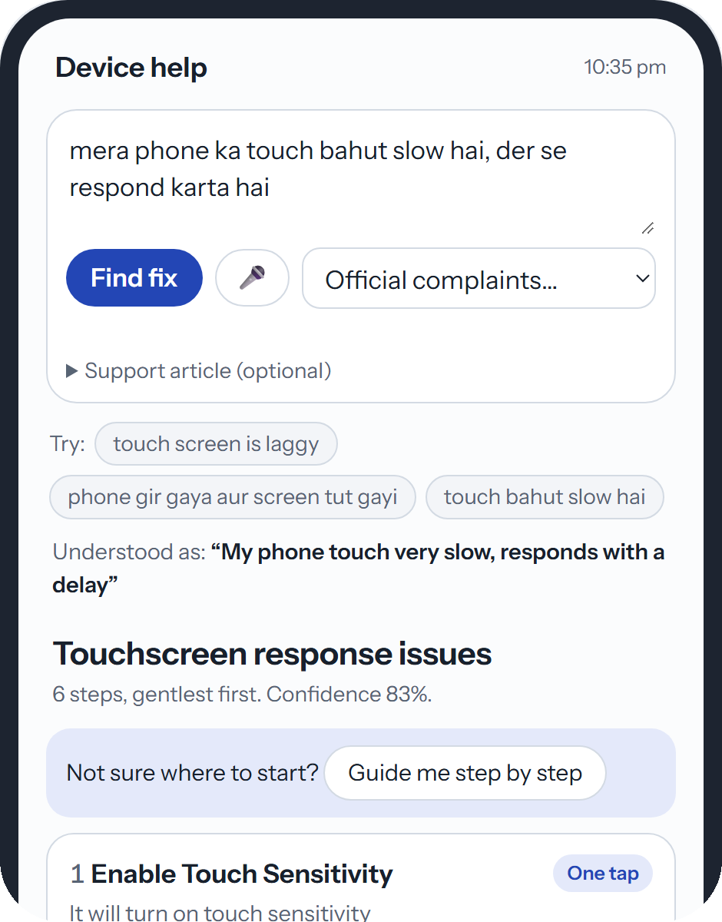



Extension for Samsung
Built for the way Samsung users in India ask for help
Hinglish, understood offline
“mera phone ka touch bahut slow hai” is read as English and gets the touchscreen plan. Our Hinglish set: right plan 3 of 15 before, 11 of 15 now, 0 wrong. Devanagari Hindi goes through Gemini.
Tap the fix, then verify it
One-tap steps carry the catalog's deeplink plus its validation deeplink (570 of 578 entries have one), so the device can open the screen and confirm the change. The demo UI simulates the device.
Voice and step-by-step guidance
The complaint can be spoken (browser speech), and “Guide me step by step” walks through one step at a time until it is fixed.
No complaint text has to leave the server
Rules mode needs no API key and no GPU: one Docker image on a CPU. Outputs stay brand-neutral, checked by a test.
Hinglish in, same plan out, 27 ms
FixFlow · Team SRMIST_QueueQueueing
7 / 9
Notes:
AYUSHI (about 45 s)
What this means for Samsung, using only what we have built. First, Hinglish: 'mera phone ka touch bahut slow hai' is read as English offline and answered from memory in 27 milliseconds. On our Hinglish set, right plans went from 3 of 15 to 11 of 15, with no wrong answers.
Second, tap and verify: one-tap steps carry the catalog's deeplink and its validation link, so the device can confirm the fix. Our demo simulates the device.
Third, voice input and a step-by-step guided mode. Fourth, in rules mode no complaint text leaves the server: no API key, no GPU, one Docker image.
(Only if asked, as ideas, not built: the API could sit behind Bixby or Samsung Members, verify results could reorder plans by what really fixes problems, and the catalog already has SmartThings appliance entries. Also: 0 of 183 English test texts were misread as Hinglish.)

Slide 8
Scalability
A new problem needs one article and zero code
Add the support article
No code, no retraining
Compile it once
Rules 0.3 s, $0. Gemini 2.6 s, $0.0004
Answer every rewording
From memory, P95 under 50 ms, $0
Memory lookup stays fast as it grows
8 / 8
7 / 8
P95 lookup time (ms) by number of stored problems
new problem types got a plan with 0 code changes (battery, charging, Bluetooth, camera)
rewordings of the new problems got the right plan; 0 false hits on 5 unrelated
555 / 556
98 req/s
phone Settings screens in the catalog reached by search, 0 wrong
with 50 users at once, 0 errors, P95 642 ms, one CPU worker
FixFlow · Team SRMIST_QueueQueueing
8 / 9
Notes:
KETKI (about 45 s)
How easy is it to cover new scenarios? One article, zero code. We added eight new problem types, like battery, charging, Bluetooth and camera, without touching the code. Each article is compiled once, in 0.3 seconds with rules or 2.6 seconds with Gemini, and every rewording is then answered from memory in under 50 milliseconds. Seven of eight rewordings got the right plan, with no false hits.
Search reaches 555 of 556 phone Settings screens. Lookup stays at 39 milliseconds with a hundred thousand stored problems, and one CPU worker served 50 users at once at about 98 requests per second, with zero errors.

Slide 9
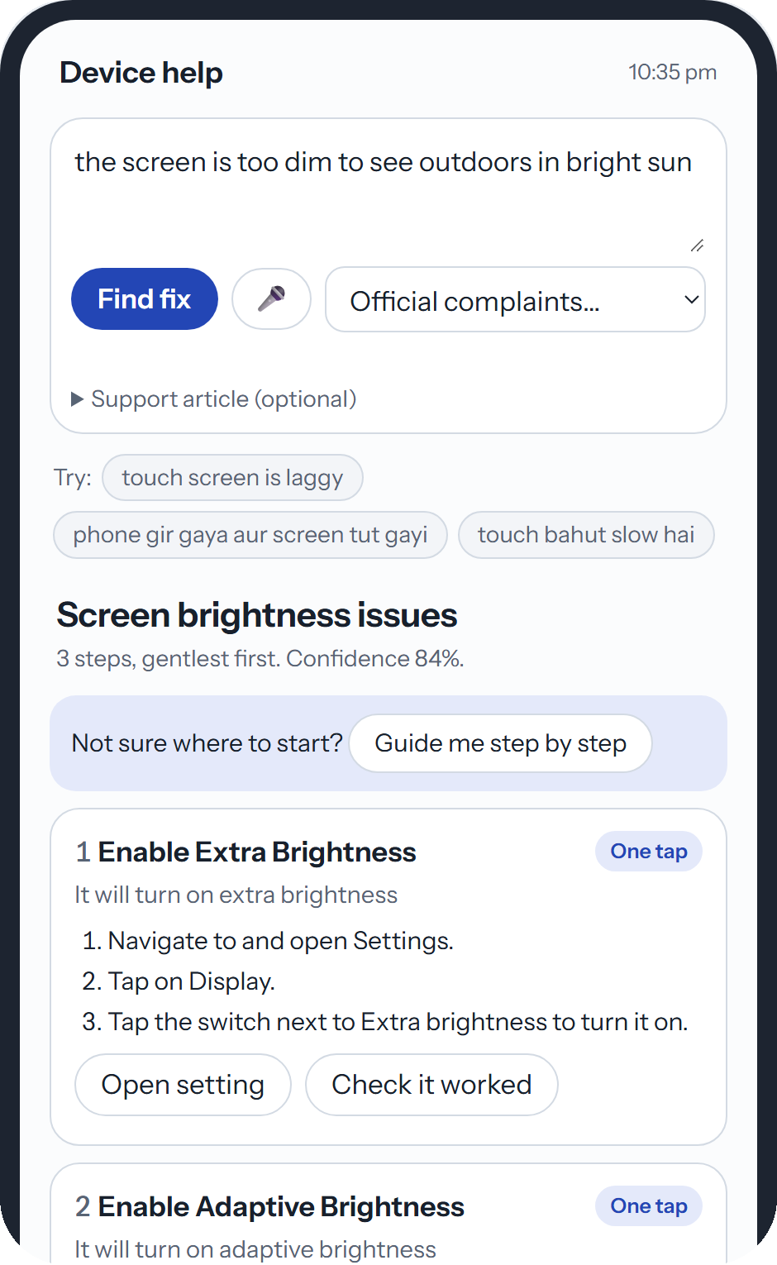
Thank you
We are happy to take your questions.
Grounded every step cites the support article
Exact every deeplink is copied from the catalog
Fast repeats come from memory in milliseconds, at $0
Scalable a new problem is one article, no code
Team SRMIST_QueueQueueing
Abhinav Kumar · Abhishek Verma · Ayushi Paul · Ketki Gonnade
Notes:
KETKI (about 10 s)
To sum up: grounded, exact, fast and scalable. Thank you, and we are happy to take your questions.

Slide 10
Backup for Q&A
Results on the official and held-out sets
Metric (target)
Official D1
Held-out D2b
Deeplink mapping ablation
Same extraction, only the mapper changes (D1 + D2, on gold)
Schema-valid / rule compliance (99% / 95%)
100% / 100%
100% / 100%
Web links in output (0)
0
0
Hybrid BM25 + dense (ours)
100% precision relevance 1.88 cost $0
Settings steps with a catalog deeplink (90%)
100%
100%
Step accuracy, gold proxy (0 to 3)
2.60
2.73
Full-LLM mapping
75% precision relevance 1.76 cost $0.00125
Step accuracy, LLM judge (0 to 3)
1.94
2.06
Deeplink relevance (0 to 2) / precision
2.00 / 100%
1.82 / 91%
Keyword rules
58% precision relevance 1.29 cost $0
Says no_match at the right time
95%
90%
FixFlow · Team SRMIST_QueueQueueing
Backup 1
Notes:
BACKUP (show only if asked)
Numbers from metrics.md (3 Oct compile, shipped cache). D1 = the 20 official lines; D2b = 10 held-out scenarios written before the final changes and never tuned on.
Gold labels for D1 are AI-assisted with a human spot-check pending, which is why we also report an independent LLM judge (a stronger Gemini model that never sees the gold labels).
Ablation: eval/ablation.py, extraction held fixed so only the deeplink mapper changes.

Slide 11
Backup for Q&A
Known limits, and what the engine does about them
Limit
Limit
Hardest unseen rewordings: 75% hits
Gemini free tier is often overloaded
On the final never-tuned set D3c, 75% hits and 62.5% right plan (target 80%). Two look-alike black-screen complaints got the flicker plan. Reported as is; the held-out set D3b reaches 91.7% / 87.5%.
503 and 429 errors are common. The adapter tries other models, then the rules path answers inside the budget. Every request still returns a valid plan (14 of 32 cold runs used the LLM).
Limit
Limit
Answer key is AI-assisted
Some article mismatches slip through
Gold labels for the official lines were written with AI help; a human check is pending. An independent LLM judge is reported next to them.
One official line pairs a TV aspect-ratio article with a phone complaint; the LLM still builds a plan there.
FixFlow · Team SRMIST_QueueQueueing
Backup 2
Notes:
BACKUP (show only if asked)
Likely questions and short answers:
Why not let the LLM pick deeplinks? The ablation: 75% precision and it costs money; our search reaches 100% at $0, and links are copied verbatim, never generated.
What if the LLM is down? Every LLM stage has a rules path; the service never returns a non-JSON error. With LLM_PROVIDER=off it runs fully offline.
How does it scale to 10k scenarios? Compile each article once (batch), then serve rewordings from memory; lookup is 39 ms P95 at 100k stored problems.
How do you stop wrong cache hits? Similarity threshold plus a symptom guard plus the article hash when an article is sent; 0 false hits on unrelated complaints.
Why is D3c below target? We wrote it before the last changes and did not tune on it after seeing the result.

