Slide 1

SAMSUNG PRISM
Generative AI
Hackathon
3rd Edition 2026 – 27
Theme ID - 02 · Smart Guided Troubleshooting Engine · Project: FixFlow
Team Name - SRMIST_QueueQueueing
College Name - SRM Institute of Science and Technology
Member Name & Email 1- Abhinav Kumar (Reg. No. RA2411003010993), ak8045@srmist.edu.in [primary member]
Member Name & Email 2- Abhishek Verma (Reg. No. RA2411003012011), av8372@srmist.edu.in
Member Name & Email 3- Ayushi Paul (Reg. No. RA2411003010997), ap1547@srmist.edu.in
Member Name & Email 4- Ketki Gonnade (Reg. No. RA2411003010739), kg0184@srmist.edu.in
Submission Github link - https://github.com/AbhishekVerma295/SRMIST_QueueQueueing_PRISM_Theme02
Notes:
Presenter: Abhinav Kumar
Introduce the team and Theme 02. One line: FixFlow turns a vague device complaint into a grounded, one-tap, verifiable fix.

Slide 2




Theme
Theme 02 · Smart Guided Troubleshooting Engine
“My screen flickers and the battery dies fast.”
≈15 min
manual triage per scenario
Customers describe symptoms, not Settings screens.
A support agent reads long knowledge articles, picks the steps that apply and orders them safely, about 15 minutes per scenario.
The user then hunts through nested Settings menus to act on the advice.
Our task: turn the complaint (+ the knowledge article) into clean, ordered steps as JSON, each Settings step with an exact one-tap deeplink, served in under 300 ms for known issues.
Millions
of support interactions
10k+
scenarios in production
Notes:
Presenter: Abhinav Kumar
Problem in our own words: vague complaints, 15-minute manual triage, users lost in Settings. The deliverable is a REST API returning structured JSON with deeplinks.

Slide 3

Existing Solutions & Gaps
Approach today | How it works | Gap
Manual agent triage | Agent reads knowledge articles and writes steps by hand | ≈15 min per case; inconsistent order; no deeplinks
FAQ / keyword search | Returns whole articles that match words | User still has to extract steps and find the screens
Generic LLM chatbot | Free-form answer from model memory | Invents steps and web links; wrong or parent-menu screens; not auditable
Rule / decision trees | Hand-built flows per issue | Brittle to new wording; does not scale to 10k+ scenarios
Static deeplink lists | Links per topic | No link between a complaint and the exact screen or toggle
What is missing, and what FixFlow is designed for
Grounded: only steps that exist in the reference article · Exact: the right screen and the right on/off operation from the official catalog
Safe: least disruptive first, restart/reset last · Instant: repeats and paraphrases answered from a validated cache · Verifiable: the fix can be checked
Notes:
Presenter: Abhinav Kumar
Walk through the table: every existing approach fails on at least one of grounding, exact screen, safe order, speed or scale.

Slide 4







Our Solutions & Architecture Diagram
FixFlow: a REST engine that returns a schema-valid, ordered, deeplinked plan as JSON. The model proposes; code decides.
[4]
[3]
[0]
[1]
[2]
✓
REST API
Fast-path cache
Query enrichment
Grounded extraction
Deeplink mapping
Contract gate
POST /v1/troubleshoot
GET /health
L1 exact + semantic
L2 normalised complaint
normalise, split intents,
8–10 variations
LLM cites numbered
sentences; code verifies
Feature Graph, hybrid
BM25 + embeddings
schema + every rule
checked in code
LLM layer
Offline rules path
Data
Gemini Flash-Lite, auto-selected. Model fallback chain, retry with backoff, 8 s online budget, JSON-schema output, temperature 0.
No key or provider outage → rules parser with the same mapper and gate. Never fails; always JSON.
Official kit: 578-entry deeplink catalog, 20 reference articles. Pre-validated plan cache (SQLite) ships in the Docker image.
Notes:
Presenter: Abhishek Verma
Architecture left to right. Stress the two guarantees: steps must cite the article, deeplinks are copied verbatim from the catalog. Mention the offline fallback.

Slide 5
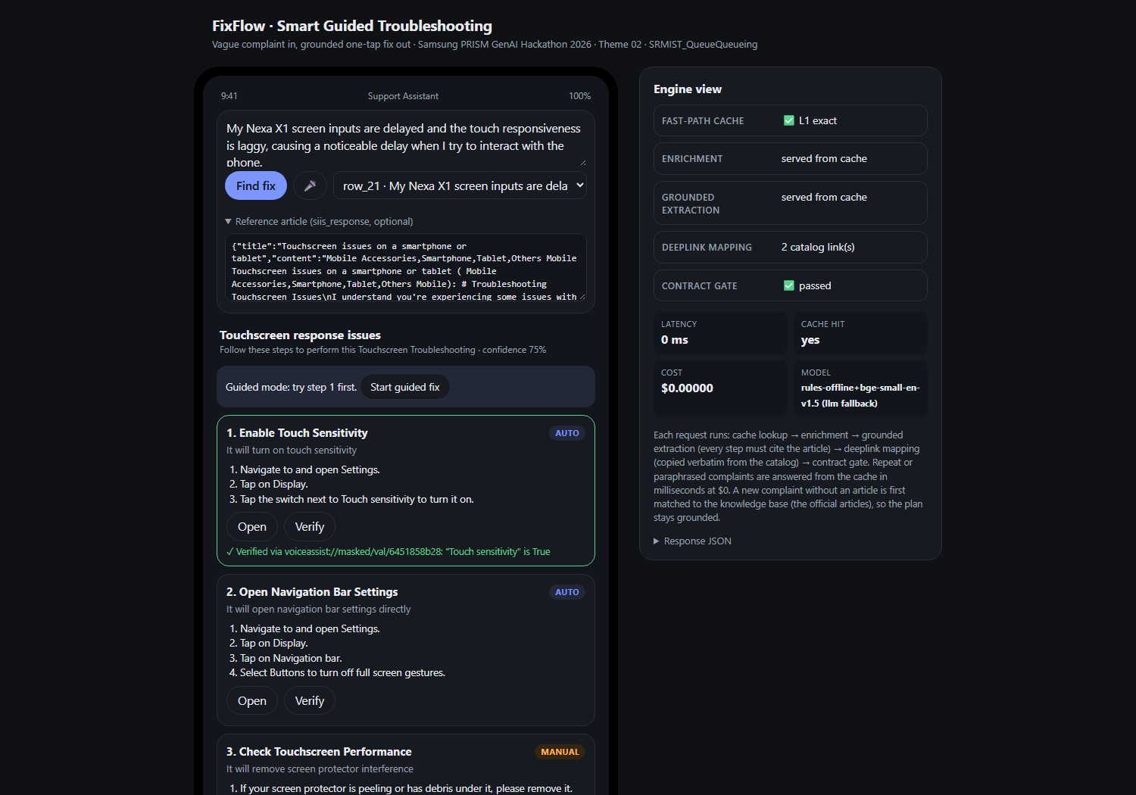




Demo & Product Walkthrough
Describe the problem
Type, speak, or pick one of the 20 official complaints.
Get an ordered plan
Settings toggles → checks → service → restart/reset last.
Tap → Verify
Open applies the setting; the validation deeplink confirms it (“Touch sensitivity is True”).
Guided mode
One step at a time: “Fixed?” or “Next”.
Engine view
Cache / LLM / rules path, latency, cost, dropped unsupported steps.
Run: docker compose up → localhost:8000
Video: https://drive.google.com/drive/folders/1ATDX614AjhvJfmq3afcTFr0g-L0GjvHL?usp=drive_link
Live UI served by the API: phone view (left) and engine view (right)
Notes:
Presenter: Abhishek Verma
Show the demo flow: sample complaint, ordered plan, Open then Verify, guided mode, and the engine view proving the cache hit and $0 cost.

Slide 6





Tools and tech stack used
Python 3.12
Gemini API
FastAPI · Uvicorn · Pydantic v2 (official schema.py, unchanged)
Flash-Lite (3.x) via REST, JSON-schema output, provider-agnostic adapter
Retrieval
Storage
fastembed BAAI/bge-small-en-v1.5 (ONNX, CPU) · rank-bm25 · NumPy
SQLite plan cache with embedded keys · JSON feature graph
Delivery
Quality
Docker + docker-compose · model and cache baked in · /health
pytest (47 hermetic tests) · evaluation harness · ablation · gold labels
Demo UI
Built with
Static HTML/JS served at / · Web Speech API for voice input
Claude Code as the engineering assistant
Notes:
Presenter: Abhishek Verma
CPU-only stack; runs with or without an API key. Point out the official schema is imported unchanged and 47 tests guard every contract rule.

Slide 7
Impact & Use case
Customer self-service
Support-agent assist
Knowledge base at scale
Inside a voice assistant or support app: the user says the problem and gets one-tap fixes with verification.
The agent pastes the complaint; FixFlow returns an ordered, cited plan in milliseconds instead of ≈15 minutes.
Compile every knowledge article once into validated plans; serve millions of repeats from the cache at $0.
≈15 min → ms
100%
$0
0
manual triage vs cached plan
catalog-valid deeplinks (no wrong screen)
per repeat / paraphrase (cache)
invented web links (scrubbed + verified)
Who benefits: customers (faster fixes, fewer service visits), support teams (less handling time, consistent answers), the product team (one reusable mapping for 10k+ scenarios).
Notes:
Presenter: Ayushi Paul
Three use cases and the impact numbers. Emphasise reusability: compile once, serve millions.

Slide 8
Innovation highlights, results and limitations
Innovation
Results
Limitations
Citation-verified extraction: code rejects steps not in the article
Action- and depth-aware deeplinks (exact screen, right operation)
Closed-loop Tap → Verify with validation deeplinks
Trust-tiered, symptom-guarded two-level cache
Outage-proof: model fallback chain + offline rules
Gates 100%: schema, rules, 0 URL leaks, catalog-valid links (D1 + D2)
Deeplink precision 100%; relevance 2.00 (D1) / 1.71 (D2) of 2
Step-accuracy proxy 2.20 (D1) / 2.88 (D2) of 3; abstention 90% / 100%
Cache P95: 0 ms exact, 48 ms unseen paraphrase; 81.8% hit
Ablation: hybrid 1.76 rel / 100% precision vs rules 1.29 / 58%
Provider outage: the LLM built 12 of 20 official plans; the rest used rules
Paraphrases: every hit had the right symptom; 59% the exact same article
Offline relevance is coarse; LLM sometimes drops a section
Gold labels by one annotator; D2 used once for error analysis
Contract puts service escalation before restarts
Notes:
Presenter: Ayushi Paul
Be honest here: results are strong on the automated gates and deeplinks; limitations include the provider outage and the paraphrase article ambiguity. Full tables in metrics.md.

Slide 9

What’s next
Step 1
Step 2
Step 3
Step 4
Compile the full base
Learn the best order
Real device verification
Multilingual + on-device
Run the batch compiler over all 10k+ articles into the pre-validated cache, with a human review tier.
Telemetry-driven ordering: which step fixes each symptom most often.
Execute Tap → Verify against live device state through the validation deeplinks.
Hindi / Hinglish intake via LLM enrichment; small on-device model for the offline path.
Worklet fit: the engine, evaluation harness and batch compiler already exist; the next step is scale and live-device integration, not a rewrite.
Notes:
Presenter: Ayushi Paul
Roadmap from prototype to worklet, four steps.

Slide 10

Brownie points slide( differentiation)
Measured, not claimed
Held-out paraphrases, 4-domain scenarios, gold labels, and a scripted 3-way ablation, with honest limits.
Outage-proof, proven
During a real Gemini 503 outage, 30 of 32 cold requests fell back to rules and every one stayed contract-valid.
Closes the loop
Validation deeplinks confirm the fix actually happened, not just a link to a screen.
Contract-exact
Official schema unchanged, every rule enforced in code, brand-neutral outputs, 47 hermetic tests.
Zero-friction to judge
docker compose up: model and validated cache baked in; runs with no API key.
Full-LLM mapping baseline implemented (eval/ablation.py); not completed due to the provider outage.
Notes:
Presenter: Ketki Gonnade
Differentiation: measured evaluation, proven fallback, closed-loop verification, contract exactness, one-command run. Point at the ablation chart.

Slide 11
Checklist- Updated on Public GitHub
Working prototype code — public GitHub repo: Y (github.com/AbhishekVerma295/SRMIST_QueueQueueing_PRISM_Theme02, tag PRISM_GENAI_HACKATHON_Y2026)
README with reproducible setup instructions: Y (docker compose up, or Python 3.12 + 3 commands)
Demo video, max 5 minutes: https://drive.google.com/drive/folders/1ATDX614AjhvJfmq3afcTFr0g-L0GjvHL?usp=drive_link
Presentation file (PPT or PDF): Y (docs/SRMIST_QueueQueueing.pptx and .pdf)
Everything referenced here is inside the tagged commit PRISM_GENAI_HACKATHON_Y2026: code, README, Dockerfile, results.jsonl, metrics.md, this deck (PPTX + PDF) and the video link.
Notes:
Presenter: Ketki Gonnade
Confirm each checklist item and the release tag.

Slide 12
Thank you
FixFlow · Theme 02 · SRMIST_QueueQueueing
Abhinav Kumar · Abhishek Verma · Ayushi Paul · Ketki Gonnade
Repository: github.com/AbhishekVerma295/SRMIST_QueueQueueing_PRISM_Theme02 Tag: PRISM_GENAI_HACKATHON_Y2026
Organised by the Language AI Team and the PRISM Team, Samsung R&D Institute India
Notes:
Presenter: Ketki Gonnade
Close: thank the jury, repeat the one-liner, invite questions.

