Slide 1
Airline Passenger Satisfaction
Presented By :
Abhishek Wasnik
Prathamesh Patil
Shrikant Chormale

Slide 2
Problem Statement:
The objective of this project is to guide an airlines company to determine the important factors that influences the customer or passenger satisfaction.
Customer satisfaction plays a major role in affecting the business of a company therefore analyzing and improving the factors that are closely related to customer satisfaction is important for the growth and reputation of a company.

Slide 3
WORK FLOW
Data Collection
and
Understanding
Data Wrangling & Feature Engineering
EDA
Model Selection and Evaluation
Preparation of data for model building.
Conclusions

Slide 4
DATA COLLECTION AND UNDERSTANDING
Gender
Customer Type
Age
Type of Travel
Class
Flight Distance
Inflight WIFI service
Departure/Arrival time convenient
Ease of Online booking
Gate location
Food and drink
Online boarding
Seat comfort
Inflight entertainment
On-board service
Leg room service
Baggage handling
Checking service
Inflight service
Cleanliness
Departure Delay in Minutes
Arrival Delay in Minutes
satisfaction

Slide 5
We had a Airplane Flight Passenger Satisfaction Data for our analysis and model building
Instances = 129880 , Features = 25 , Size = 3247000
We have dropped 'Unnamed' and 'id' column , as id is unique for each passenger

Slide 6
Data Wrangling and Feature Engineering:
Categorical Features: Gender, Customer Type and Type of classes, flight distance, satisfaction
Numerical Columns:
We had zero null values in our dataset
Zero Duplicate entries found

Slide 7
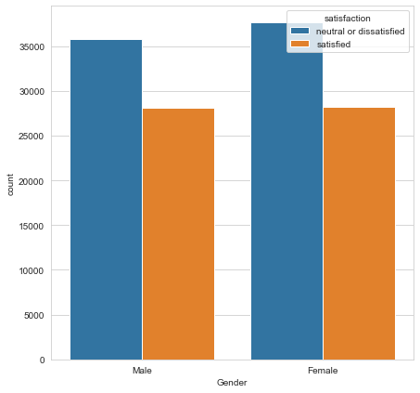
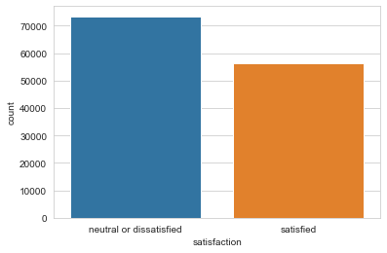
EDA
.
Females and males are satisfaction probability almost equal. Male %44, Female %43 satisfaction
we can see that passenger neutral or dissatisfied are more than satisfied

Slide 8
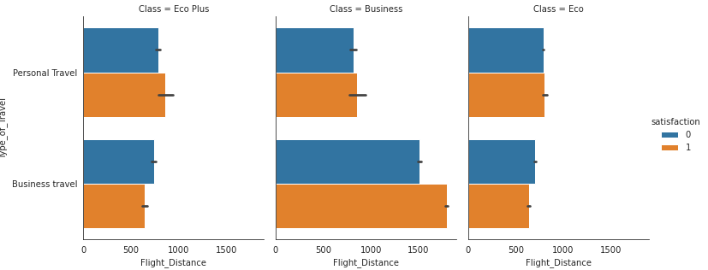
EDA

Slide 9
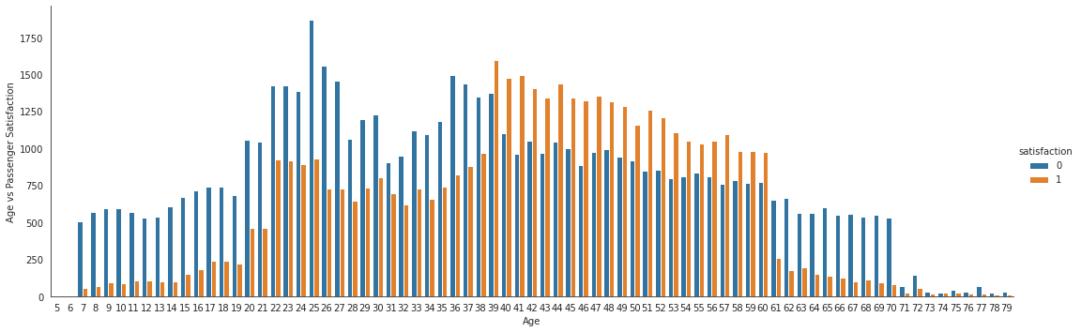
EDA
We can see that the 1-30 years old is generally neutral or dissatisfied with the flight. 39-60 years old is generally satisfied with the flight.

Slide 10
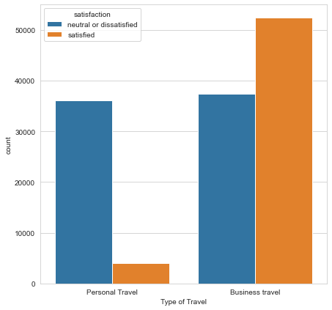
EDA
Personal travel is %90 neutral or dissatisfied with the flight

Slide 11
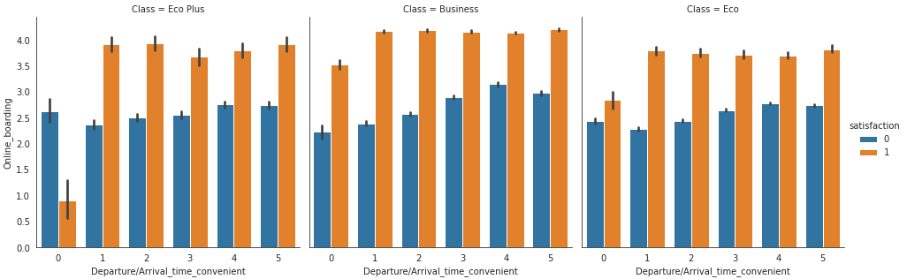
EDA

Slide 12
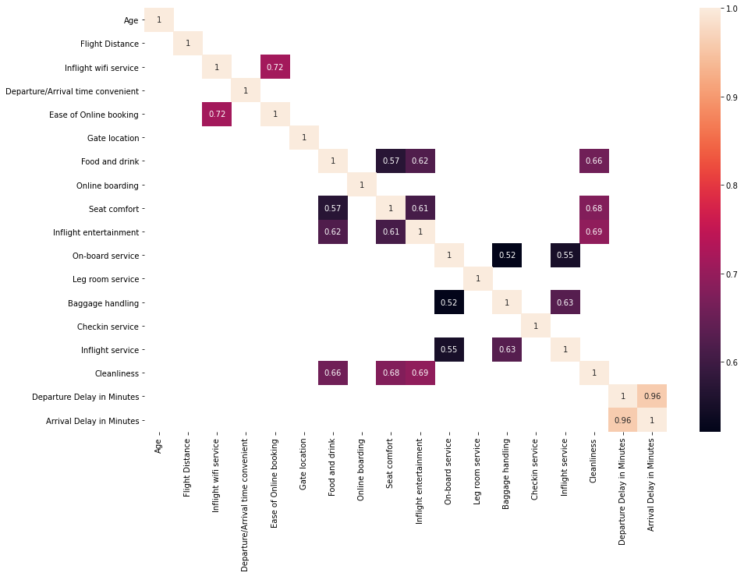
EDA

Slide 13
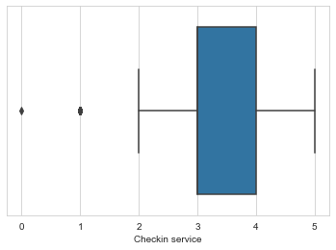
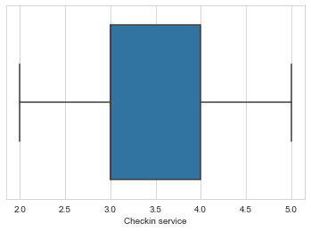
EDA

Slide 14
Model Selection and Evaluation
Eight models are used in this project to check for maximum efficiency. They are,
1] Logistic Regression
2] Naive Bayes
3] K-Nearest Neighbors
4] Decision Tree
5] Support Vector Machine
6] Random Forest
7] Bagging Classifier
8] AdaBoost

Slide 15
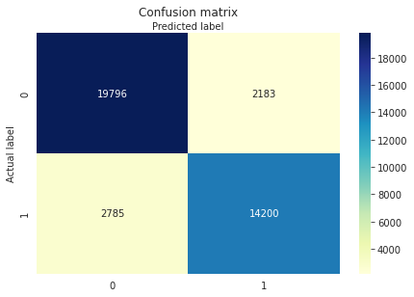
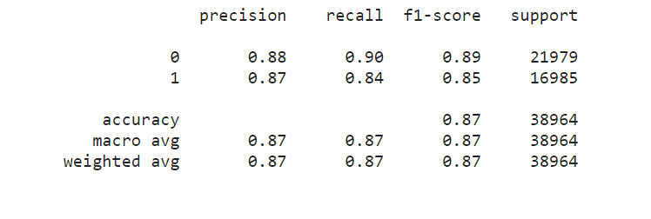
Logistic Regression

Slide 16

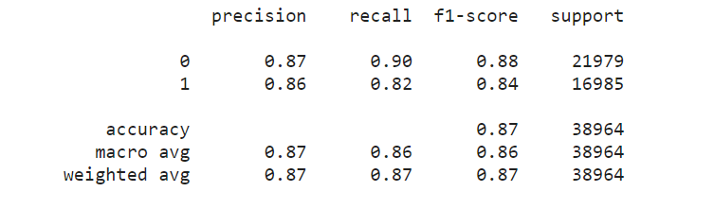
Naïve Bayes Classifier

Slide 17

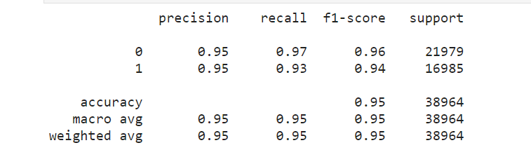
Decision Tree Classifier

Slide 18

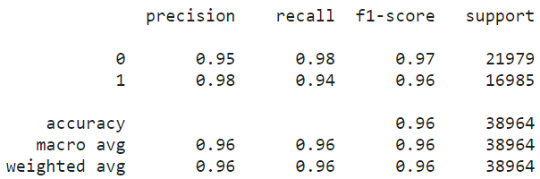
Random Forest Classifier

Slide 19

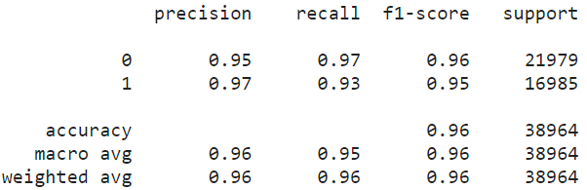
Random Forest Classifier(using hyper parameter)

Slide 20

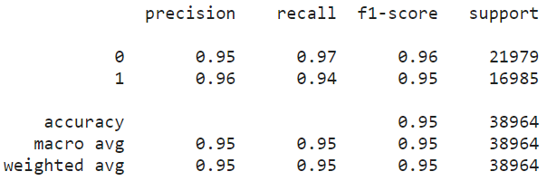
Support Vector Machine

Slide 21

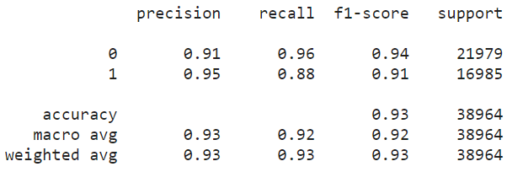
K Nearest Neighbors

Slide 22

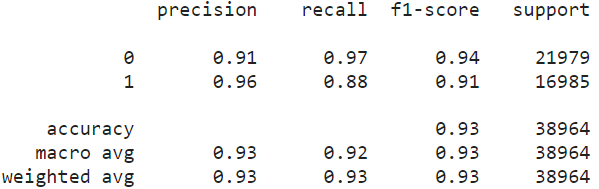
K Nearest Neighbor (Using Hyper Parameter)

Slide 23
Model Comparison
MODEL | TRAIN ACCURACY | TEST ACCURACY
Logistics Regression | 0.8730256500505 | 0.8724976901755
Naive Bayes | 0.8668001231906 | 0.866030181706
Decision Tree Classifier | 1.0 | 0.9459757725079
Random Forest Classifier | 1.0 | 0.9622215378297
Support Vector Machine | 0.95682 | 0.94755
K Nearest Neighbors | 0.65680 | 0.64530
MODEL | TRAIN ACCURACY | TEST ACCURACY
Bagging Classifier | 0.9691583439658 | 0.960655990144
Pasting | 0.9691583439658 | 0.960655990144
Ada boost | 1.0 | 0.960655990144
XGB Classifier | 0.9753068766773 | 0.962580843855
Gradient Boosting | 0.9409674864710 | 0.9395852581870

Slide 24
Conclusion
After analyzing all the models we can conclude that predictors Online boarding, Inflight wi-fi service, Type of Travel did played a major role for Flight Passenger Satisfaction
Comparing the accuracy of the different models, Random Forest is the best among the classification models

