Slide 1

Customer Shopping Behavior Analysis
3,900 transactions · 18 features · 4 product categories

Slide 2
Dataset at a Glance
3,900
18
Transactions
Features
37
4
Missing Values
Categories
Review Rating column
Clothing, Accessories, Footwear, Outerwear

Slide 3

Python: Data Preparation
Clean
Imputed missing Review Ratings by category median
Standardize
Renamed columns to snake_case
Engineer
Created age_group & purchase_frequency_days
Load
Exported cleaned data to PostgreSQL

Slide 4
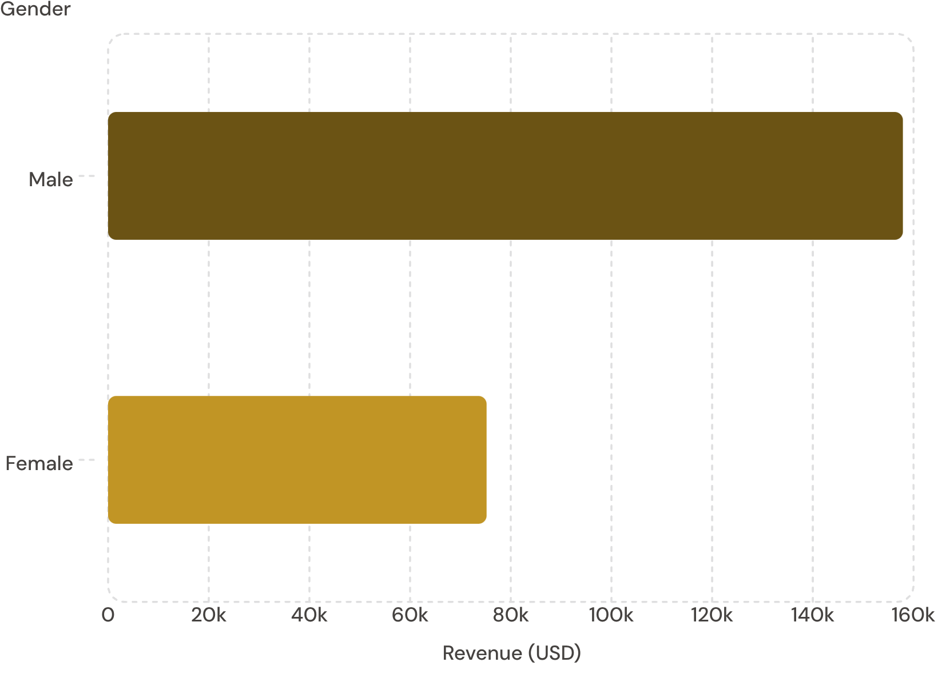
Revenue by Gender
Key Finding
Male customers generated 2.1× more revenue than female customers.
Male: $157,890 · Female: $75,191

Slide 5
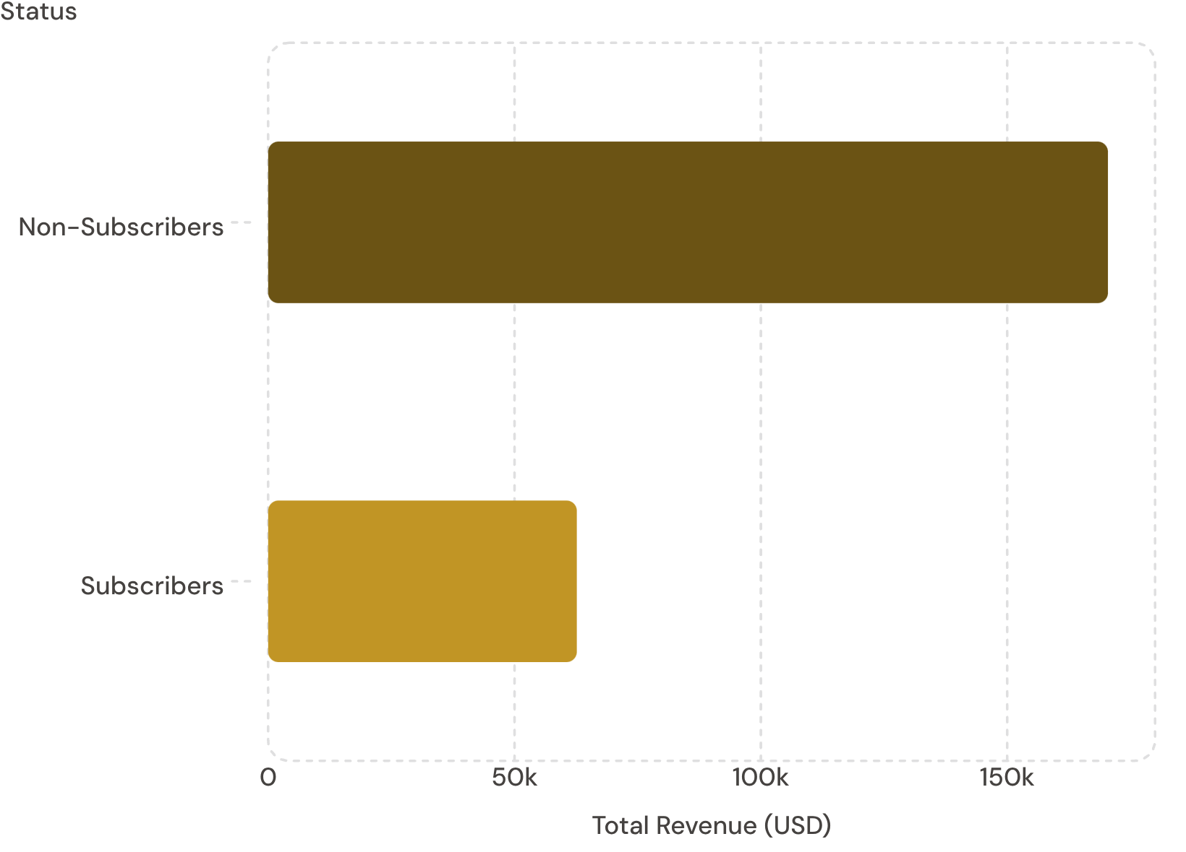
Subscribers vs. Non-Subscribers
Insight
Non-subscribers drive 73% of revenue despite similar average spend.
Only 27% of customers are subscribed — a major growth opportunity.

Slide 6
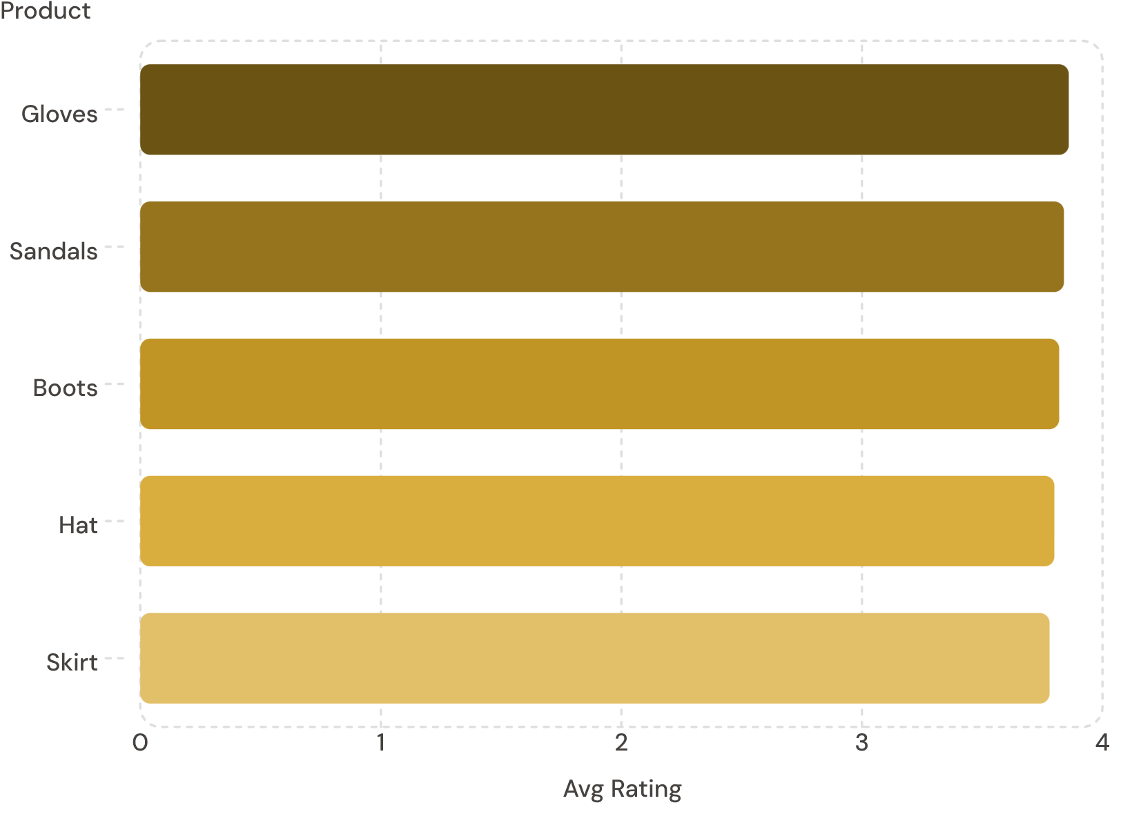

Top Products & Discount Patterns
Top 5 by Review Rating
Most Discounted Products
Hat
50% discount rate
Sneakers
49.66% discount rate
Coat
49.07% discount rate

Slide 7
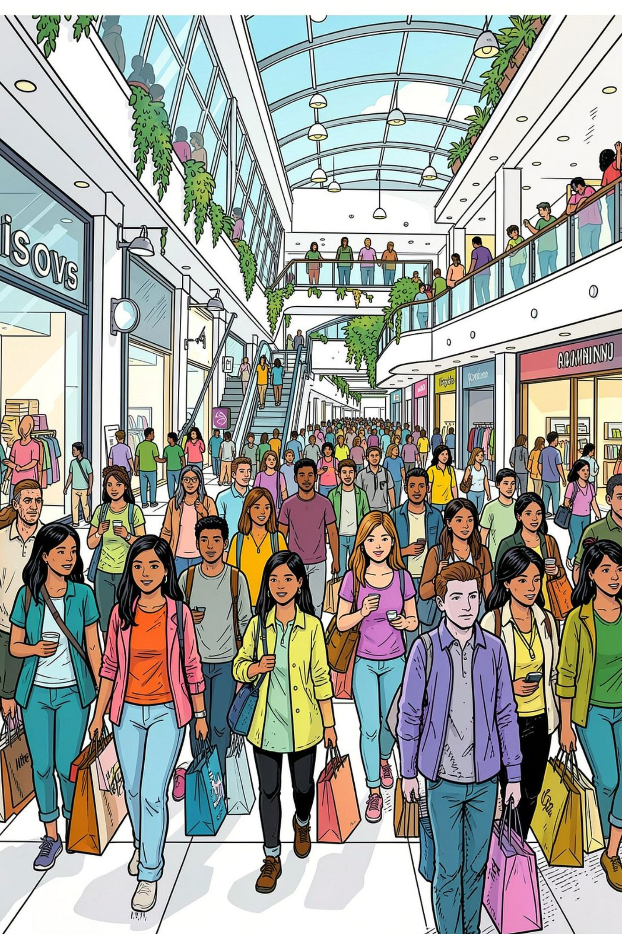
Customer Segmentation
Loyal
Returning
3,116 customers
701 customers
New
83 customers
839 customers used discounts while spending above average. 958 repeat buyers (5+ purchases) hold subscriptions.

Slide 8
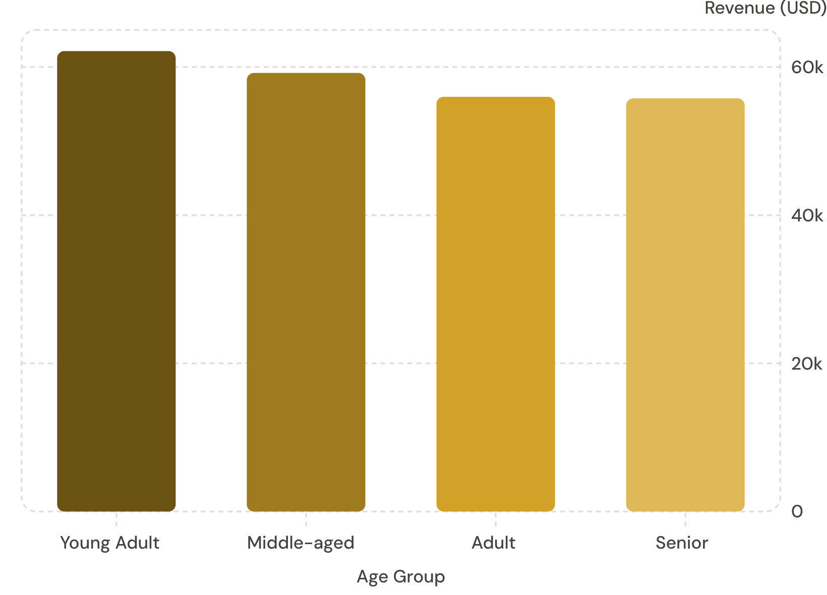
Revenue by Age Group
Takeaway
Young Adults lead in revenue contribution, but spend is relatively even across all age groups.
Express shipping averages $60.48 vs. Standard at $58.46.

Slide 9
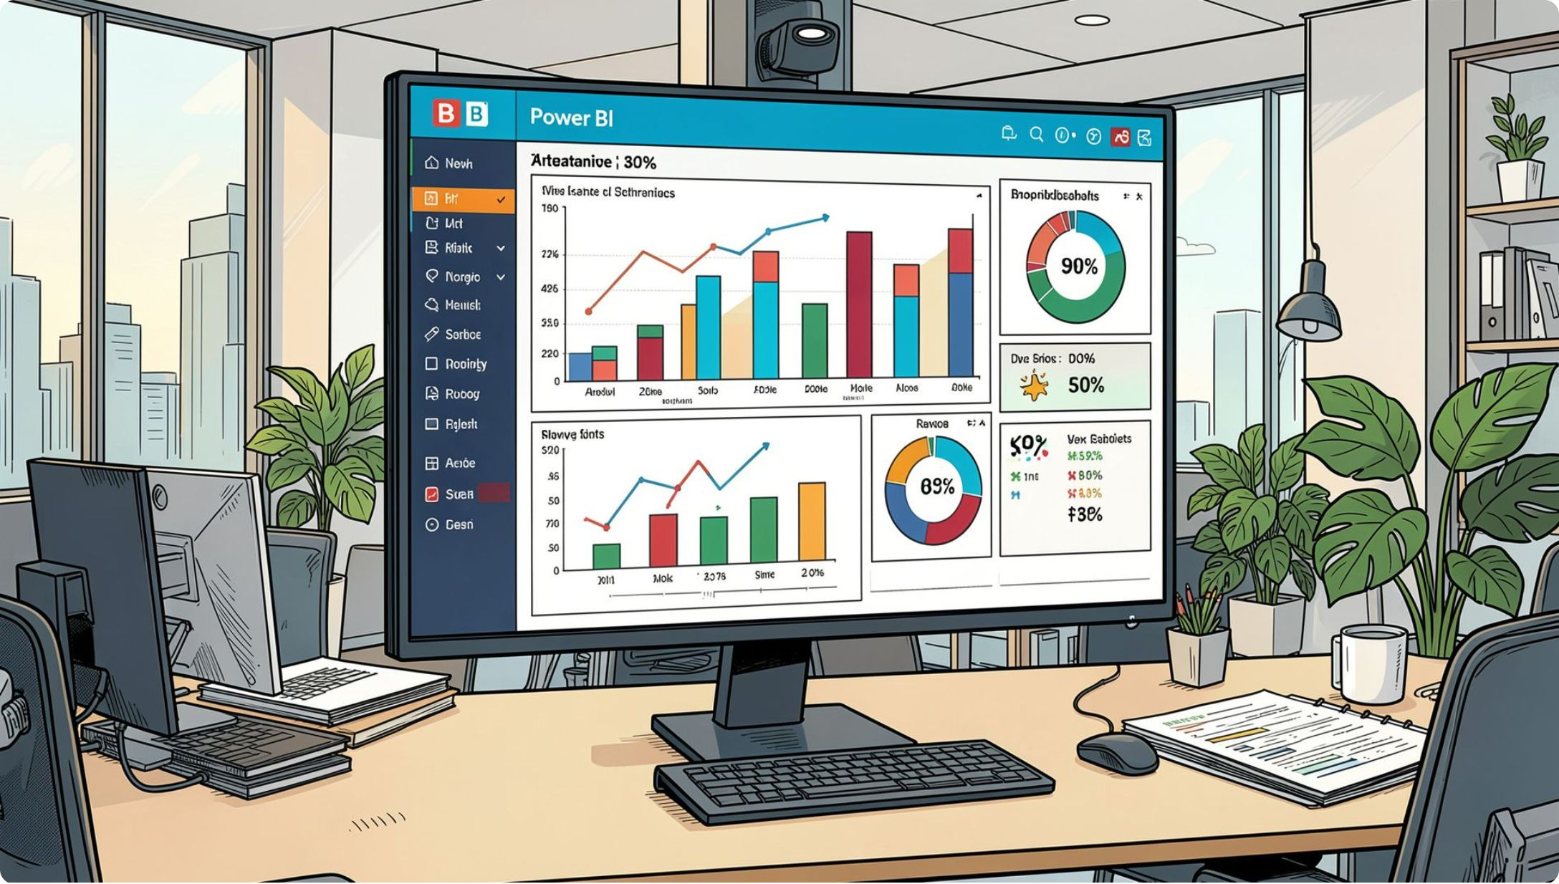
Power BI Dashboard
Key Metrics
3.9K Customers
$59.76 Avg Purchase
3.75 Avg Rating
27% Subscribers
Interactive filters: Gender, Category, Shipping Type, Age Group

Slide 10





Business Recommendations
Boost Subscriptions
Promote exclusive subscriber benefits
Loyalty Programs
Reward repeat buyers toward "Loyal" segment
Review Discount Policy
Balance sales lift with margin control
Targeted Marketing
Focus on high-revenue age groups & express-shipping users

