Slide 1
Travel Planner Agent
CAPSTONE PROJECT
Presented By:
Student name : Abhishek Sanjay Dani
College Name : MIT Academy Of Engineering, Alandi Pune
Department : Electronics & Telecommunications

Slide 2
OUTLINE
Problem Statement
Technology used
Wow factor
End users
Result
Conclusion
Git-hub Link
Future scope
IBM Certifications

Slide 3
Problem Statement
Travelers often face difficulty managing trip planning due to scattered information, changing conditions, and lack of personalization. Manually organizing destinations, bookings, and schedules can be time-consuming and inefficient.
Proposed Solution: An AI-powered Travel Planner Agent that uses real-time data to generate personalized itineraries, recommend transport and stays, provide live weather and map updates, manage bookings, and optimize travel plans — all in one smart, seamless assistant.

Slide 4
Technology used
IBM Watson Assistant – Conversational AI for travel queries
IBM Cloud Services – Hosting and integration
IBM Granite model

Slide 5
IBM cloud services used
IBM Cloud Watsonx AI Studio
IBM Cloud Watsonx AI runtime
IBM Cloud Agent Lab
IBM Granite foundation model

Slide 6
Wow factors
This AI-powered travel assistant redefines the way trips are planned by simplifying the entire itinerary creation process. It enables travelers to plan efficiently, stay within their budget, and confidently discover new destinations using intelligent, real-time recommendations.
Standout Capabilities:
🔹 Creates tailored travel plans based on individual budgets, trip duration, and interests
🔹 Delivers up-to-date weather and travel data to support better planning
🔹 Offers curated suggestions for destinations and activities aligned with the user’s profile
🔹 Provides flight and hotel options through seamless API integration
🔹 Helps manage trip costs with accurate budgeting and optimization tools
🔹 Supports natural, multilingual conversations for a smooth and inclusive user experience
interests.

Slide 7
End users
Individual travelers
Travel agencies
Tourism companies
Corporate event planners

Slide 8
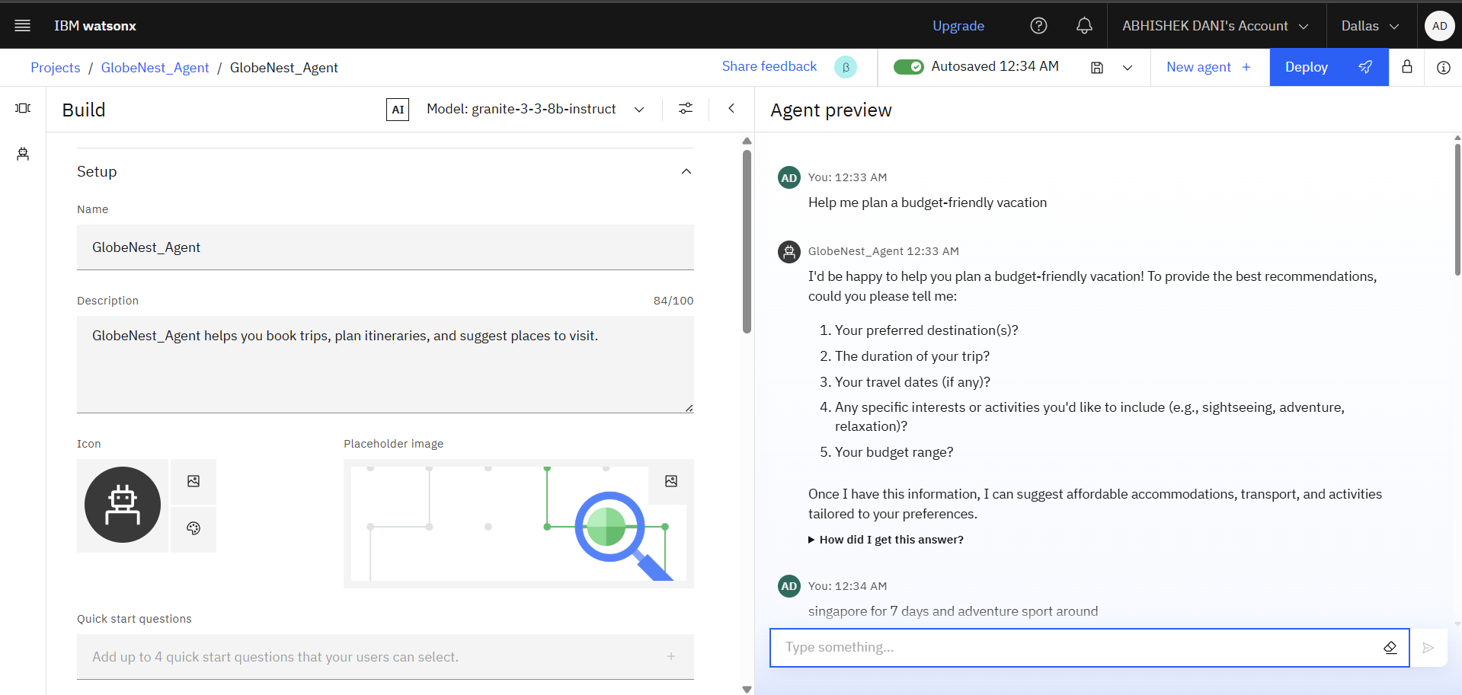
Results

Slide 9
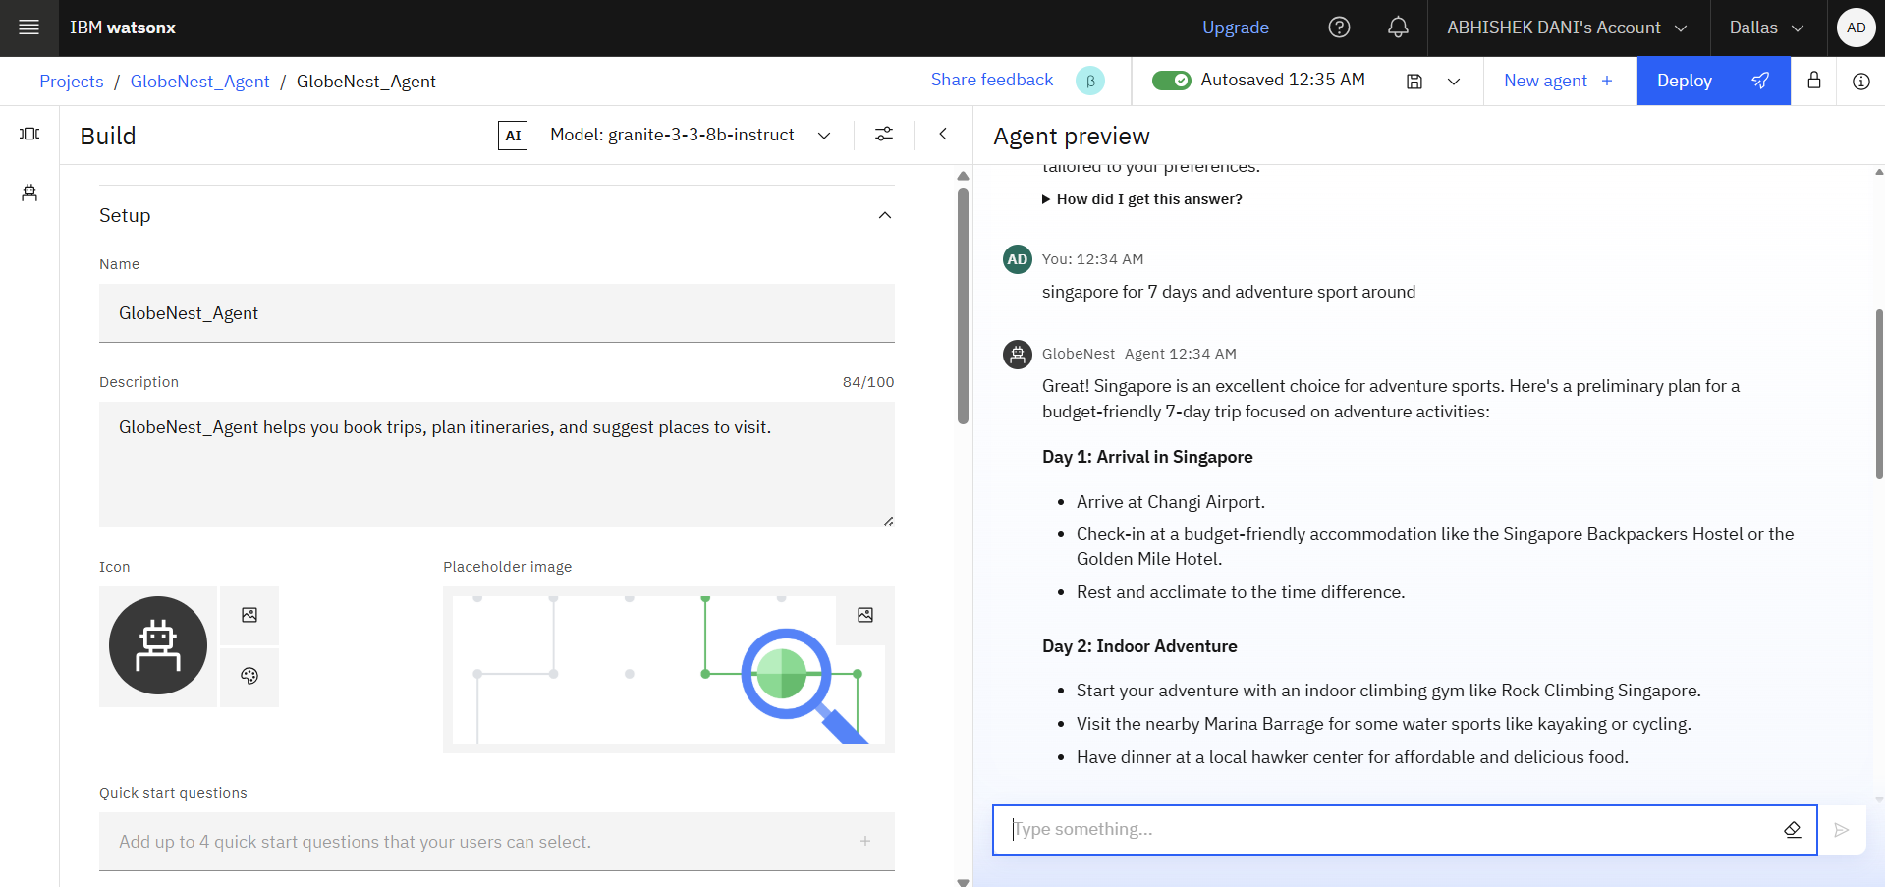
Results

Slide 10
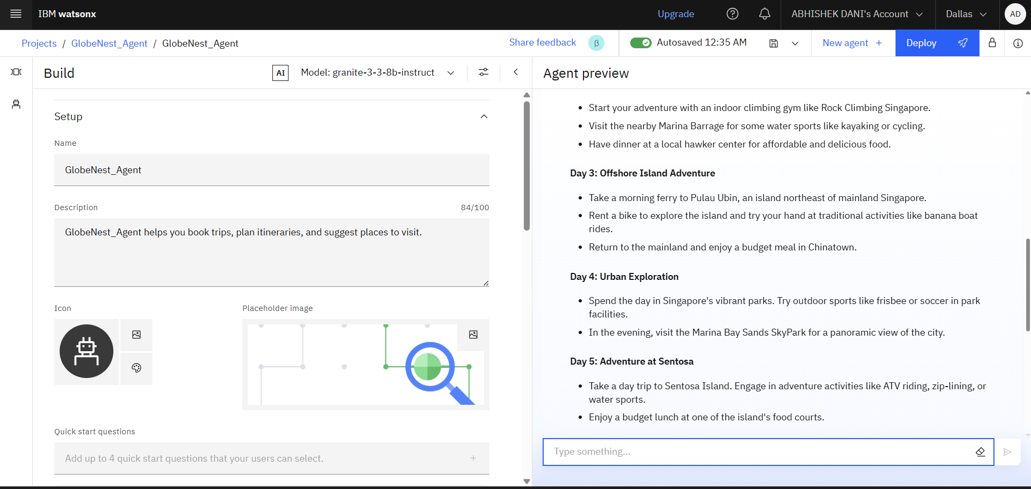
Results

Slide 11
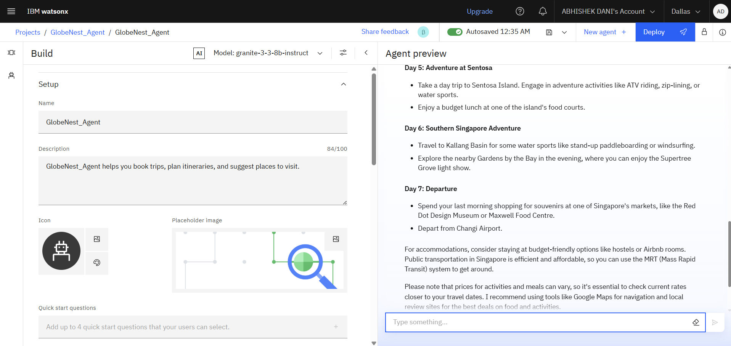
Results

Slide 12
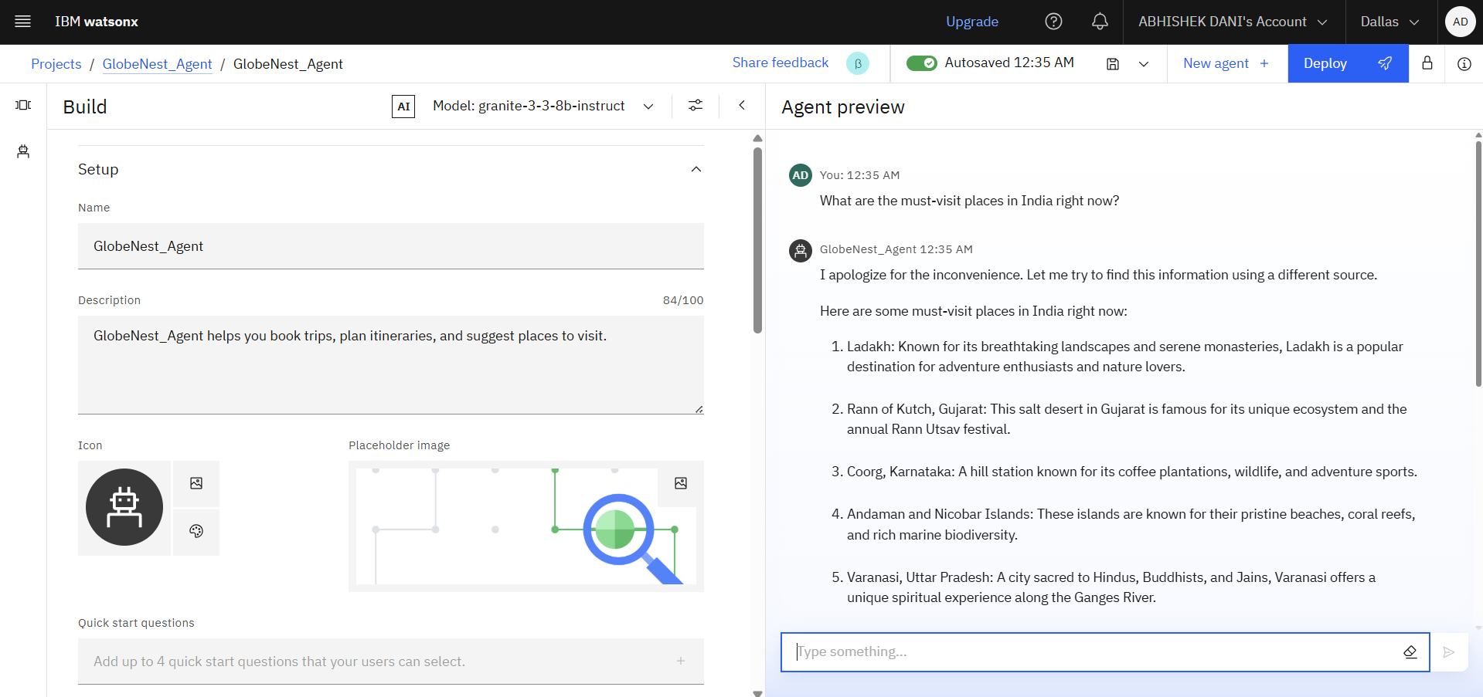
Results

Slide 13
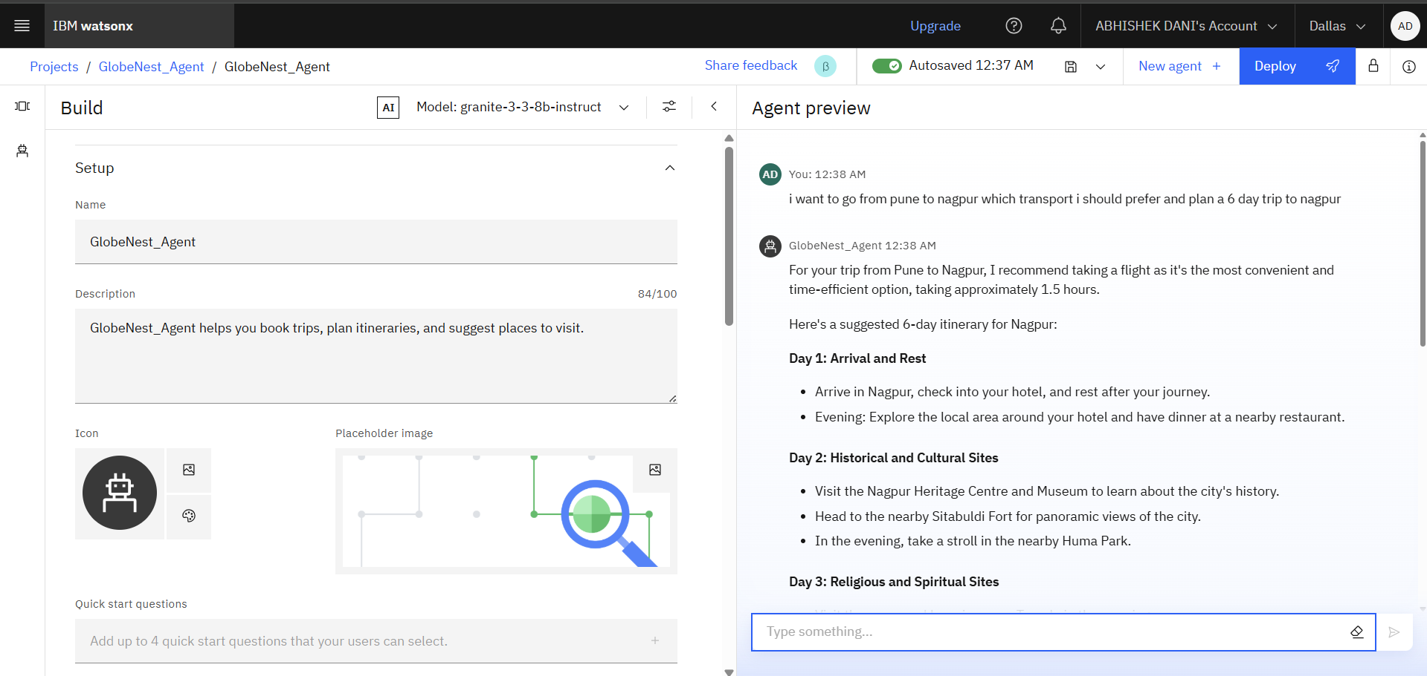
Results

Slide 14
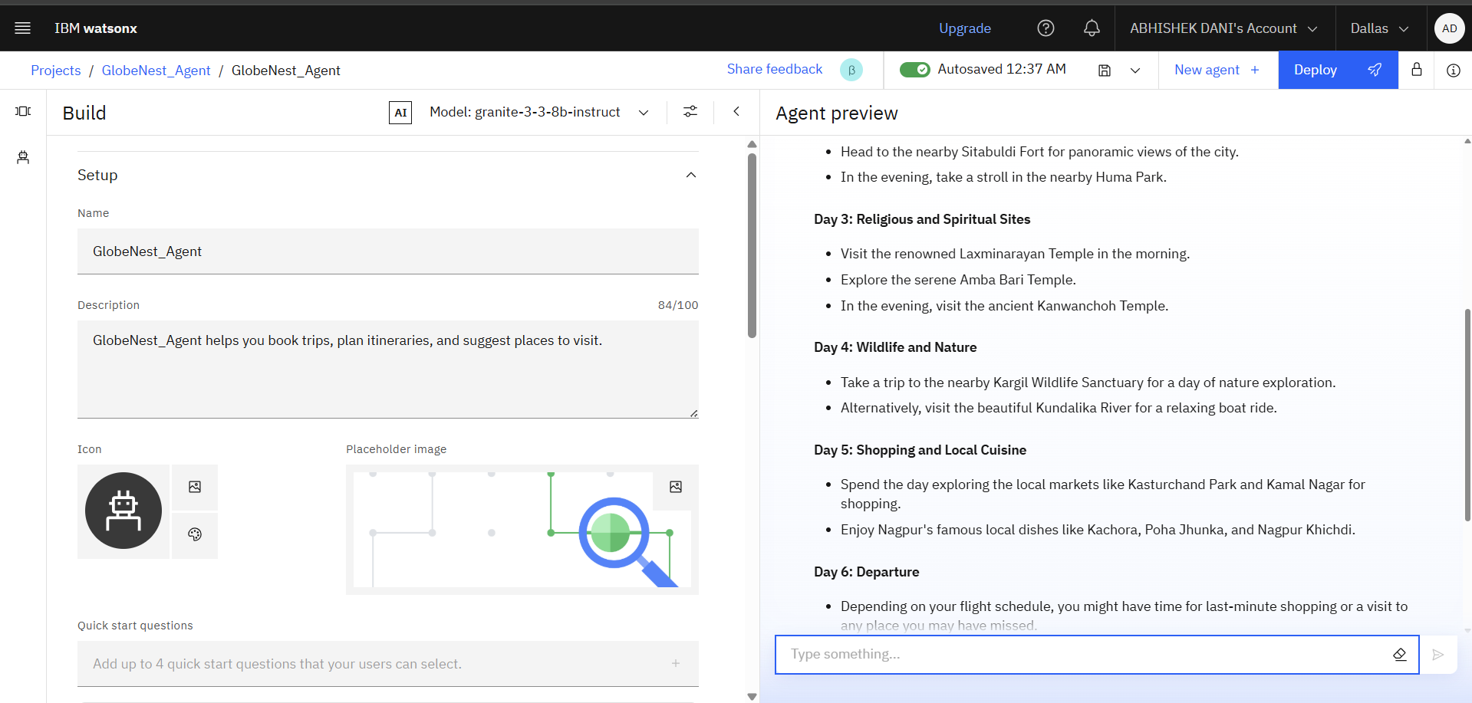
Results

Slide 15
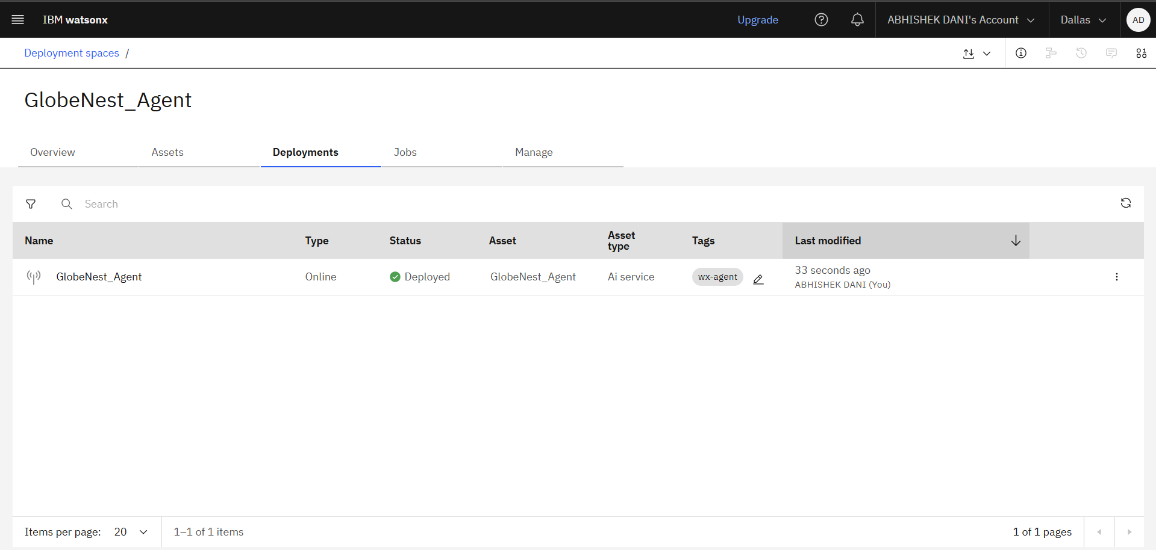
Results
Deployed AI Agent

Slide 16
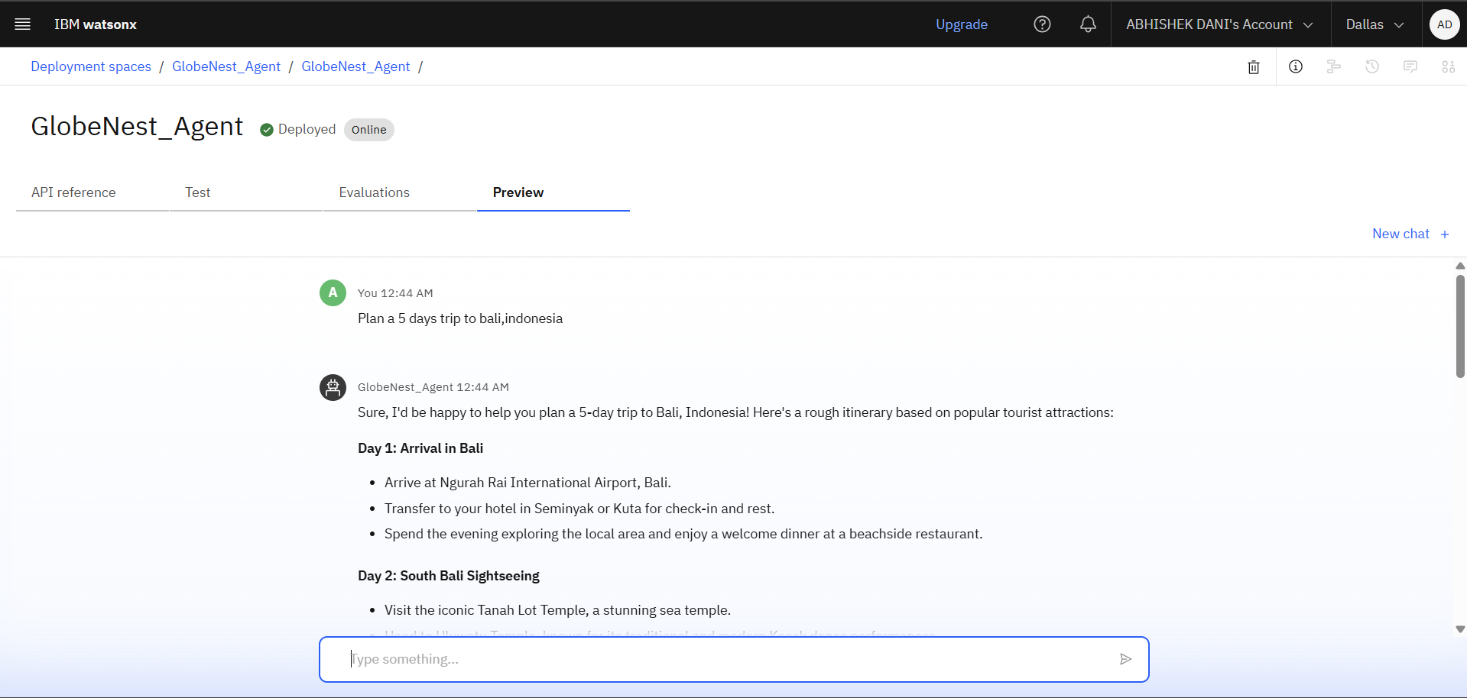
Results
Deployed AI Agent

Slide 17
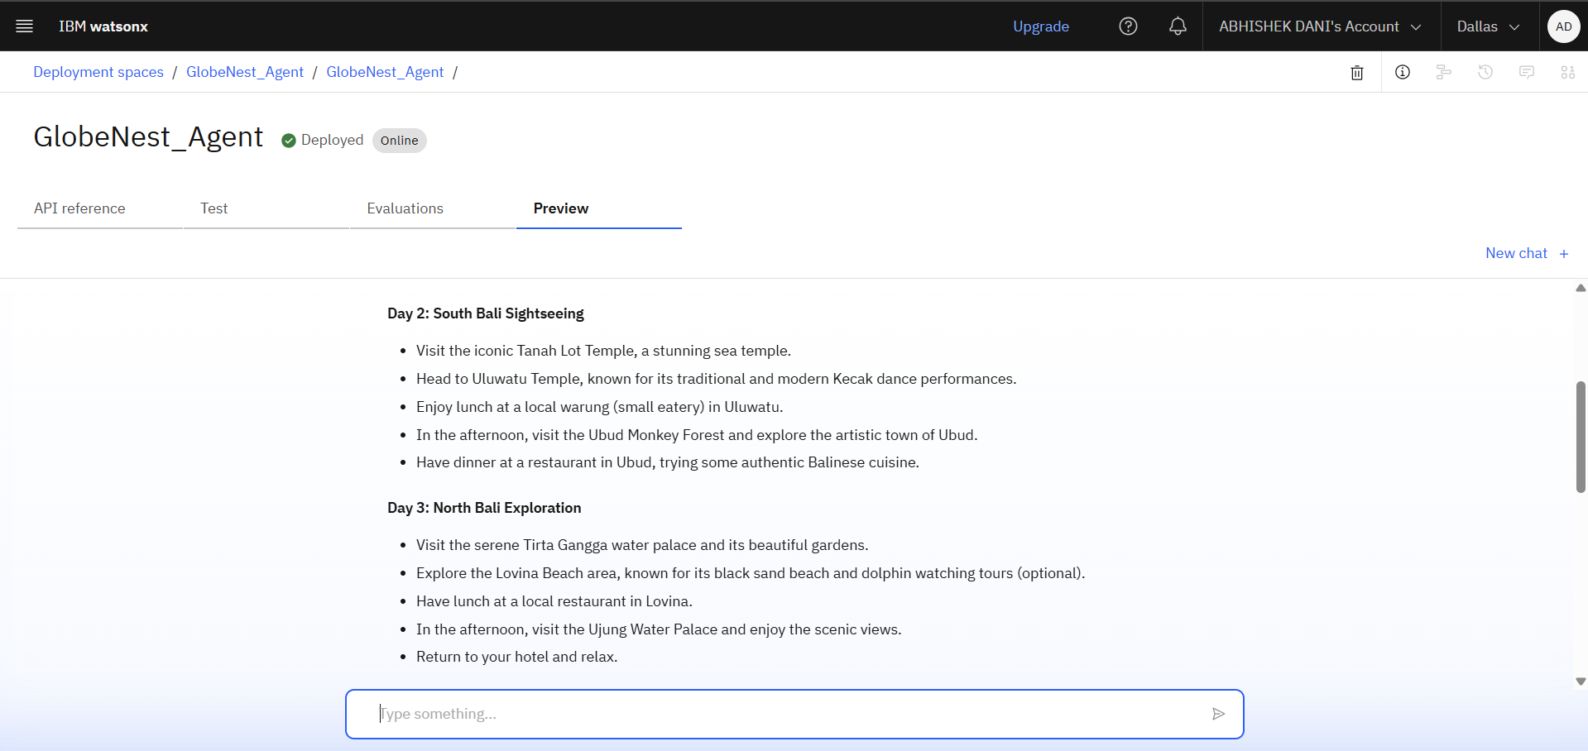
Results
Deployed AI Agent

Slide 18
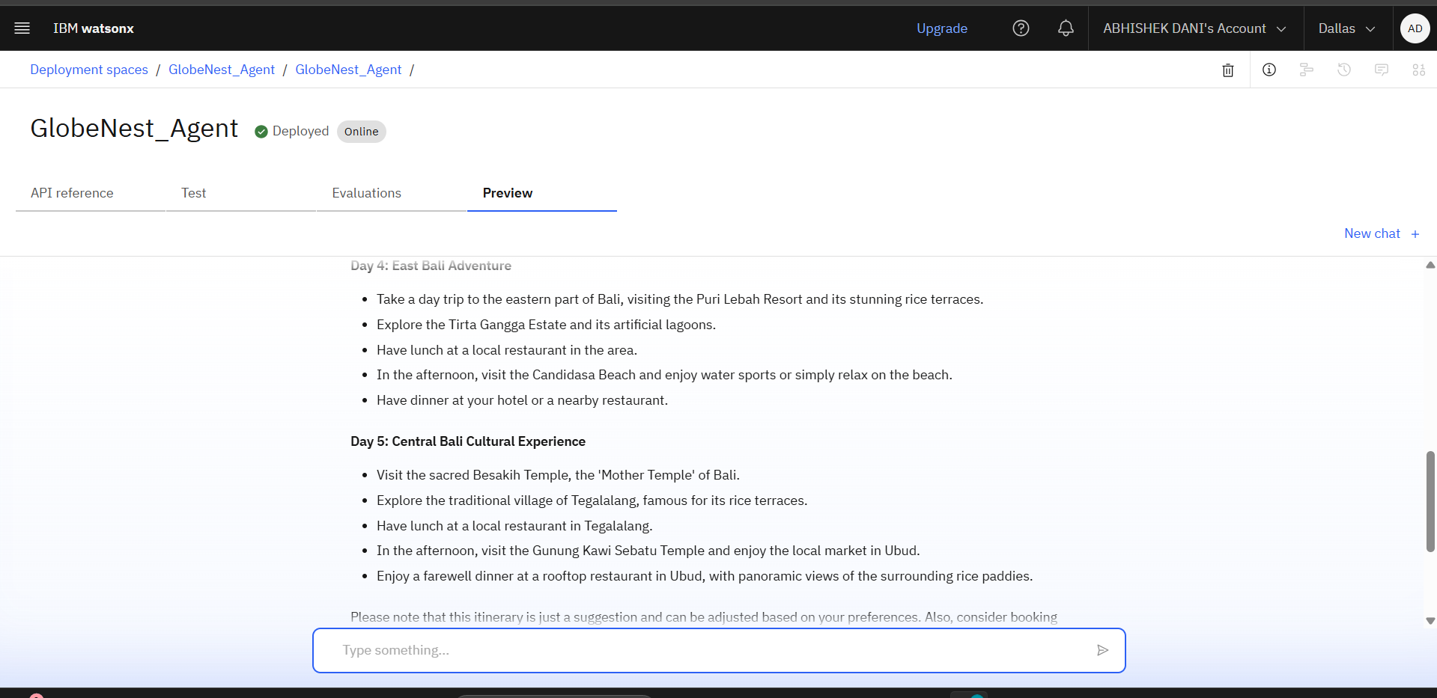
Results
Deployed AI Agent

Slide 19
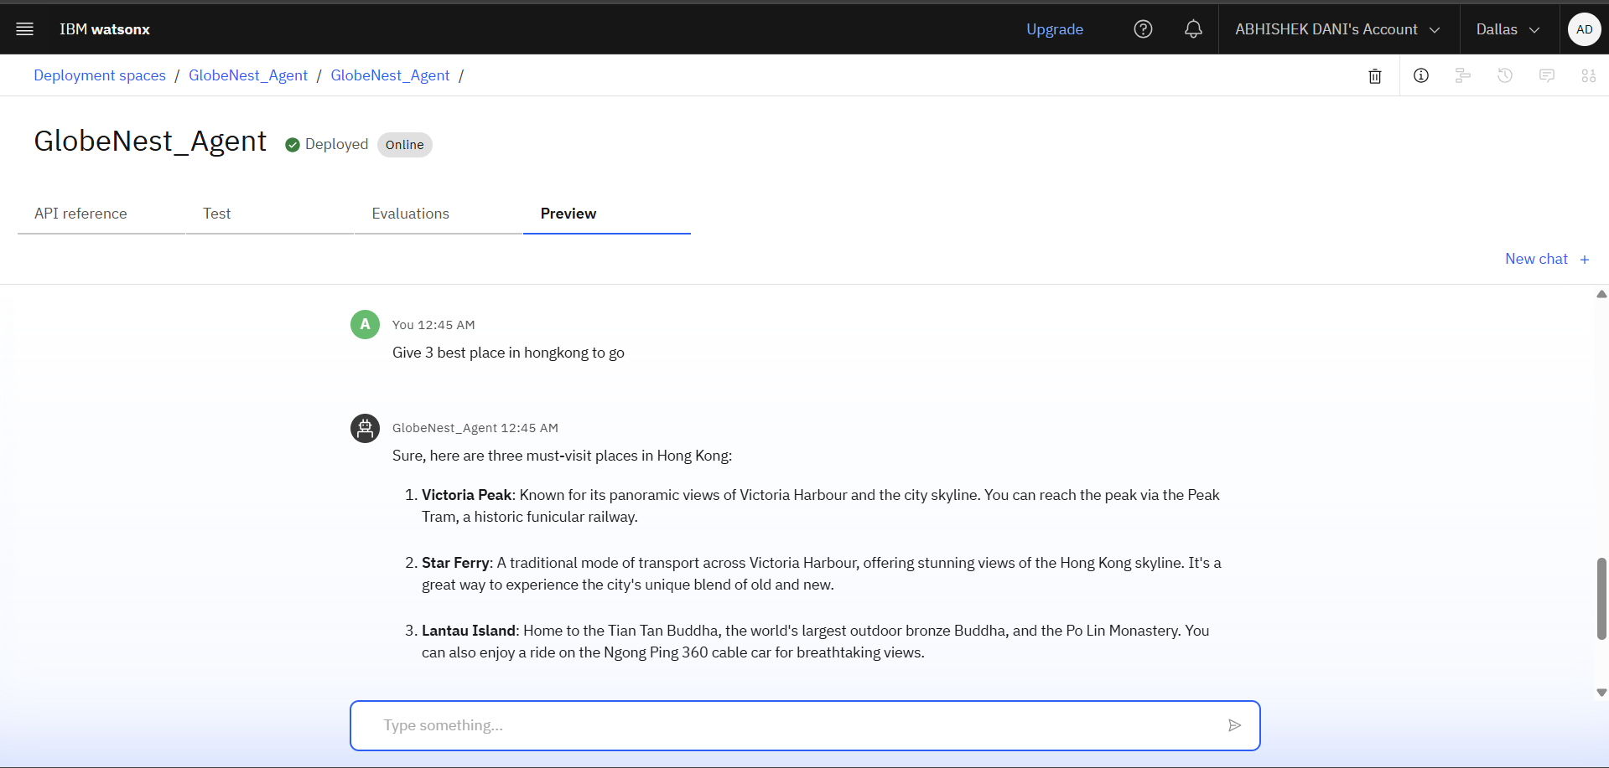
Results
Deployed AI Agent

Slide 20
Conclusion
✅ GlobeNest Agent redefines travel planning using IBM Watson AI and IBM Cloud services.
✅ Combines all trip-related tasks into a single, intelligent platform.
✅ Provides personalized itineraries, real-time travel insights, and smart recommendations via a conversational interface.
✅ Eliminates the need to switch between multiple websites or apps.
✅ Helps users plan more efficiently, save time, and reduce stress.
✅ Serves as a valuable solution for individual travelers and travel agencies alike.

Slide 21
Future scope
Multilingual support to enhance accessibility
Machine learning–based personalized recommendations
AI-powered tools for smart budget planning
Mobile app version for on-the-go travel management
Voice-enabled assistant for interactive planning
AR/VR features for immersive destination previews

Slide 22
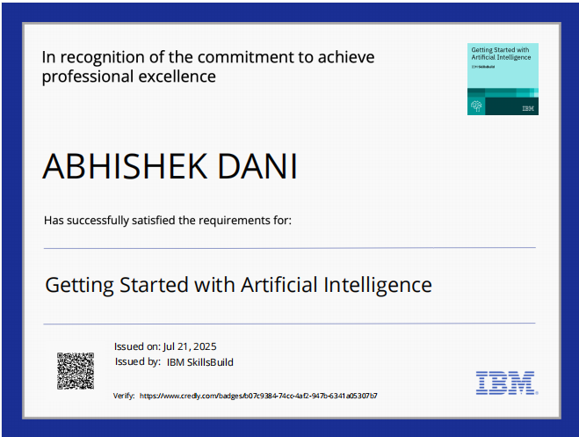
IBM Certifications
Screenshot/ credly certificate( getting started with AI)

Slide 23
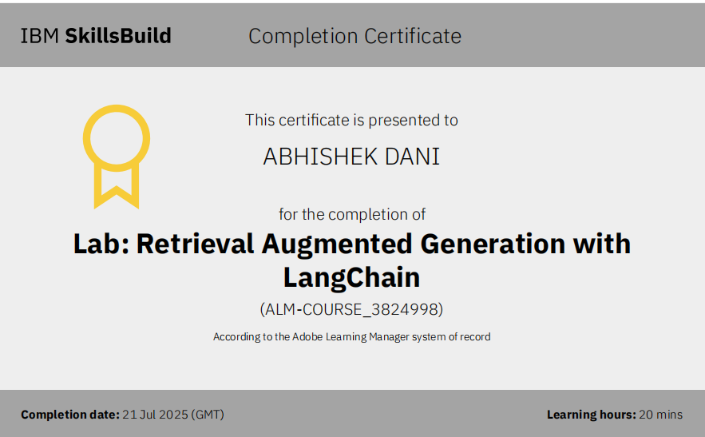
Attach your RAG LAB certificate here

Slide 24
GitHub Link
GitHub Link : https://github.com/Abhishekdanii/GlobeNest-Agent-AI-Travel-Planner.git

Slide 25
THANK YOU

