Slide 1
String
A string is a sequence of character.
A string is initiated as follows.
String Name;
Name=new String("Abhishek")
Note: String is a class but used like a datatype.
String name="Abhishek"
*String Methods operate on java Strings. They can be used to find length of string, convert to lowercase etc.
Some of the commonly used String methods are :

Slide 2
Name. Length()
It shows the length of Strings.
Ex- String name="Abhishek"
Return length of String name=8 in the case.

Slide 3
Name.toLowercase()
* Return a new String which has all the lowercase character from the
String name.
Example:- String Name=“ABHISHEK”
Name.toLowercase()
OUTPUT:
abhishek

Slide 4
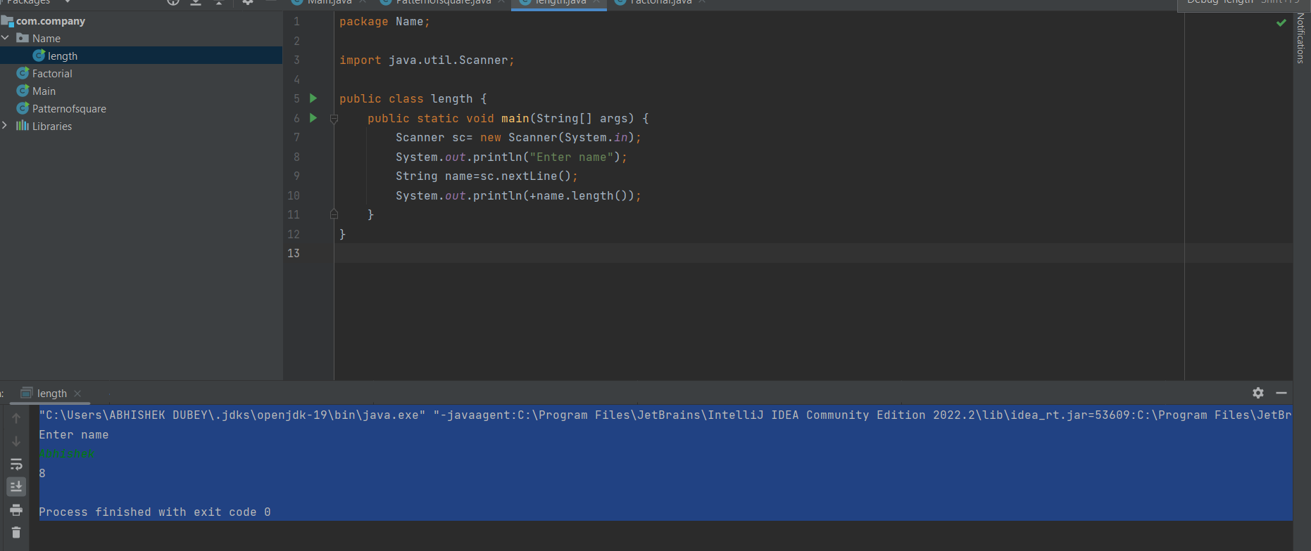

Slide 5
