Slide 1
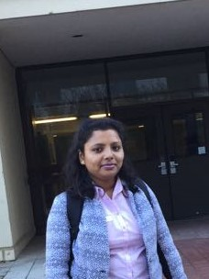
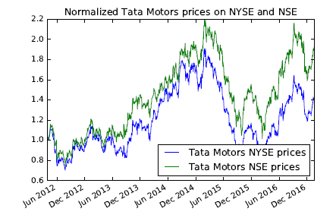
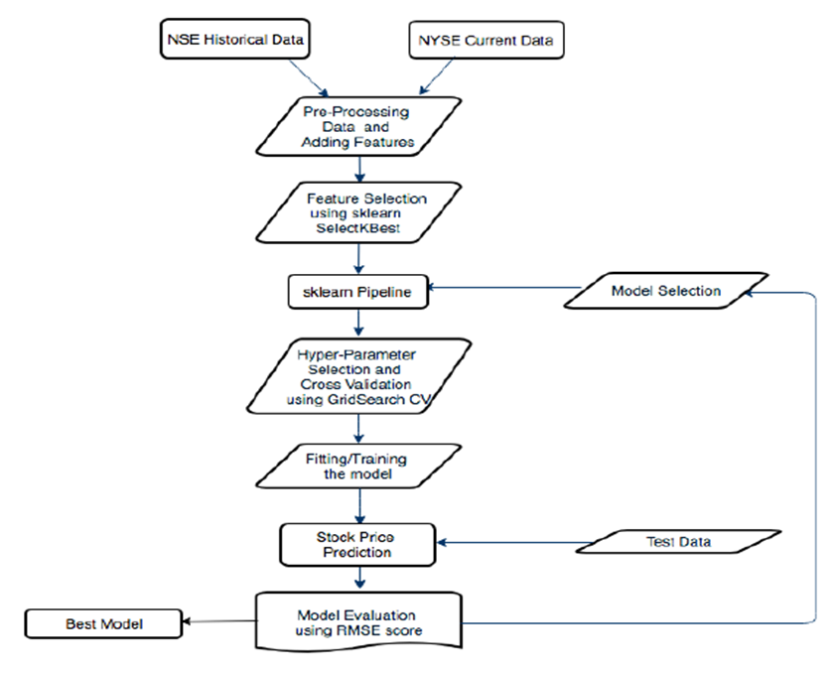
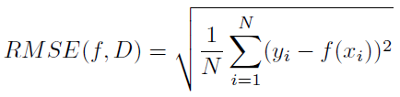
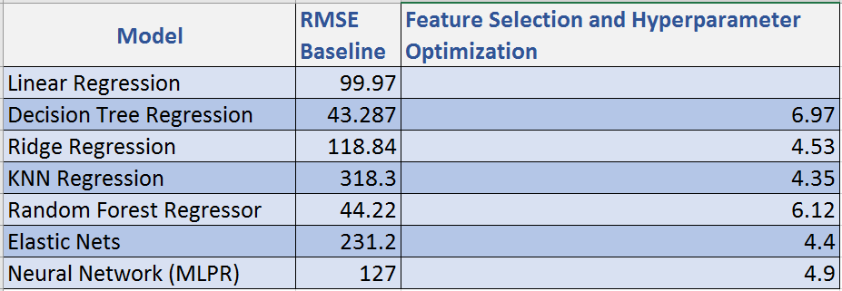
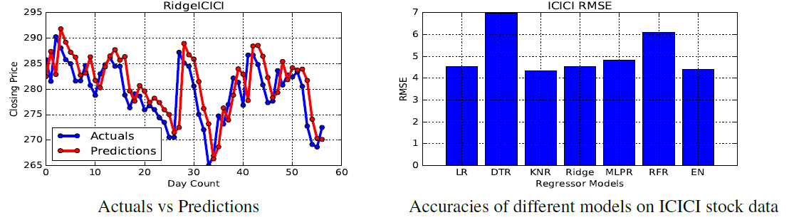
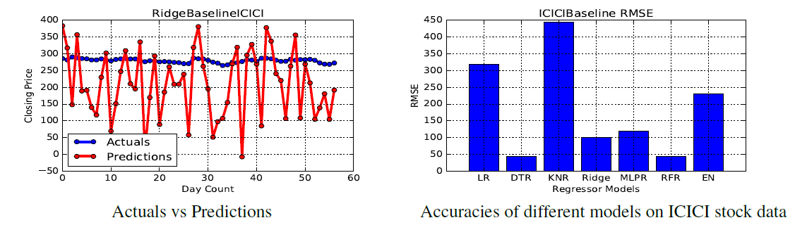
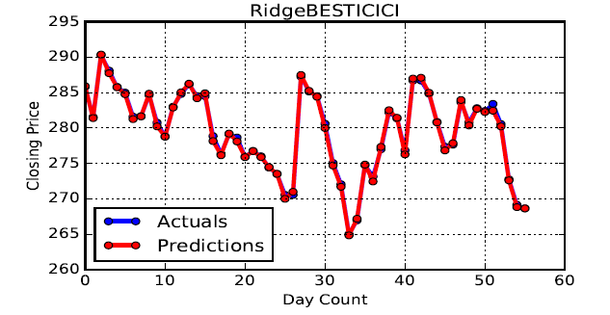
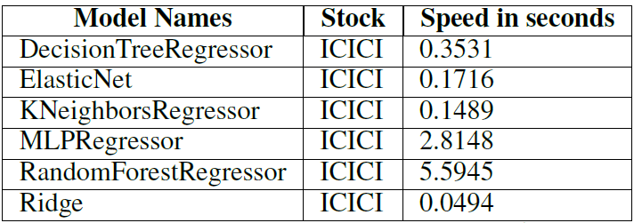
NLP
Machine Learning
Data Visualization
Lopamudra Pal
MS UMass CS, 2016-2018
Seeking: Full Time Summer 2018
Data Analyst Intern, AuCode, NLP, Controversy Detection
Visual Analytics Research Intern, Prof Georges Grinstein, Data Visualization, Machine Learning
Performance Tester, Cognizant, Load Runner, IBM Rational Performance Tester
Time Series Analysis of Cross-Listed Stocks
Machine Learning Regression Problem
Accurate Stock Prediction – The Problem
Volatile Stock Prices
Probable Factors – Political Events, Changing
Interest Rates, Varying Forex rates etc.
Cross-Listed Stocks – Similar Trend
Innovation – Add Cross-Listed Stock Features
Dataset
Historical NYSE and NSE stock data from https://finance.yahoo.com and pre-processed.
Training Data Mar 2012 – Jan 2017
Solution
Preprocessing to remove missing values, combining NYSE and NSE features, dropping untraded rows, adding new features (Rolling Mean, Daily Returns) and following day price as gold values.
Models – Linear Regression (Baseline), Decision Tree Regressor, Ridge Regression, KNN Regressor, Random Forest Regressor, Elastic Nets, MLP Regressor
Pipeline – Features selection plus regression models
Hyperparameter Selection – Grid Search cross-validation
Evaluation -
Model Performance after features selection and optimization
Normalization – RMSE 0.33 Speed
Results
Model Performance before feature selection and optimization
Future Work
Perform experiments on larger datasets
Add features extracted from textual analysis of news
Consider the classification problem of cross-listed stocks
Perform experiments on other stocks
Related Work
Classification problem of stocks on single exchange
Analyzing Technical Indicators in stock prediction
Application of Neural Networks in stock prediction
Identify qualitative factors for improved prediction
lpal@cs.umass.edu | 508-808-8257 | Amherst MA 01002
www.linkedin.com/in/lopamudra-pal
Seeking...
Full Time in Data Science, Data Analysis, Machine Learning, NLP, Data Visualization
Project Partner - Sanketh Kokkodu Balakrishna

