Slide 1



dashboard1
View in Power BI
Last data refresh:
3/19/2023 5:27:46 PM UTC
Downloaded at:
3/20/2023 9:01:43 AM UTC

Slide 2
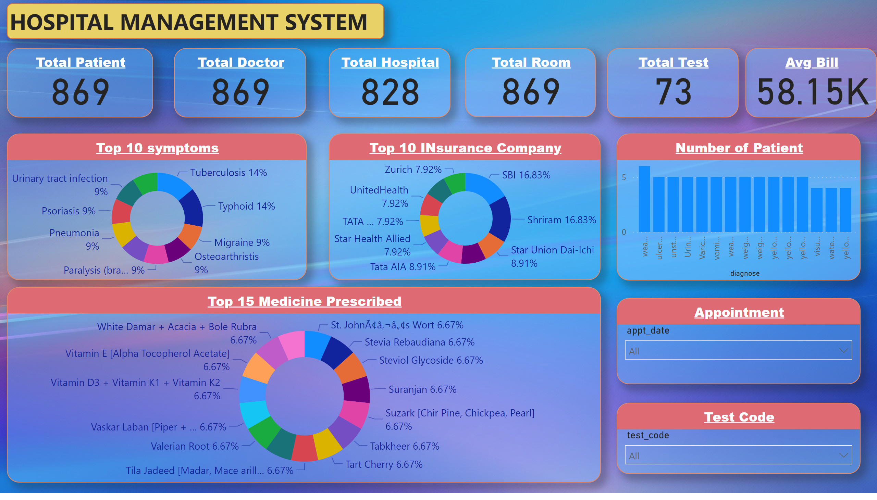
Page 1
Notes:
textbox
No alt text provided
Total Patient
No alt text provided
Total Doctor
No alt text provided
Total Hospital
No alt text provided
Total Room
No alt text provided
Top 10 symptoms
No alt text provided
Top 10 INsurance Company
No alt text provided
Top 15 Medicine Prescribed
No alt text provided
Total Test
No alt text provided
Number of Patient
No alt text provided
Avg Bill
No alt text provided
Appointment
No alt text provided
Test Code
No alt text provided

