Slide 1

http://igniteitserve.com/
A quick snapshot: ML Algorithms

Slide 2

Case Study- Retailx Price Prediction
Retailx Portal is an online marketplace that allows individuals to buy and sell new and used items, such as electronics, jewellery, apparel, shoes, books, CDs, DVDs and home accessories. The company was established in Japan and subsequently extended its operations to US and UK markets.

Slide 3
Agenda
Ensemble Learning Techniques
DECISION TREE
REGRESSION ALGORITHM
RANDOM FOREST
REGRESSION ALGORITHM
Advantages
Parameter tuning

Slide 4
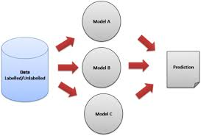
Definition
Ensemble techniques combine individual models together to improve the stability and predictive power of the model

Slide 5
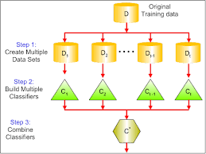
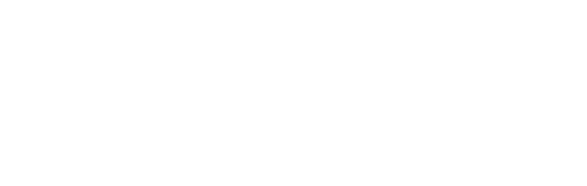
Ideology
Certain models do well in modeling one aspect of the data, while others do well in modeling another
Instead of learning a single complex model, learn several simple models and combine their output to produce the final decision
In ensemble learning, other models strength performs offset on individual model variances and biases
Ensemble learning will provide a composite prediction where the final accuracy is better than the accuracy of individual models

Slide 6

Significance
Robustness
Accuracy
Ensemble models incorporate the predictions from all the base learners
Ensemble models deliver accurate predictions and have improved performances

Slide 7
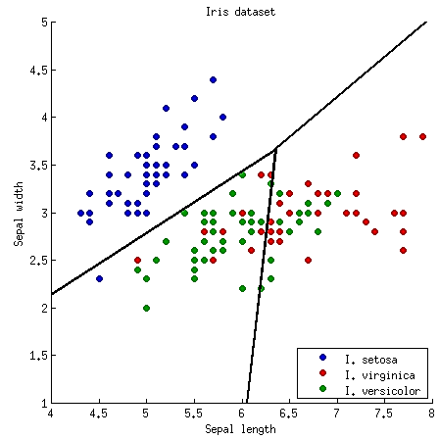
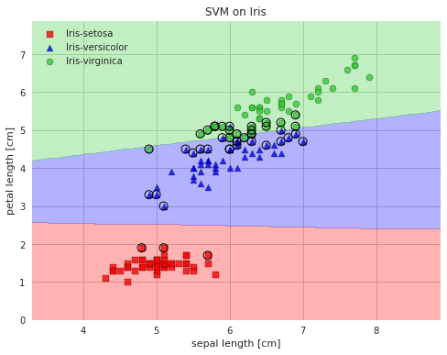
Ensemble Learning Methods- Averaging
50
[50, 0, 0]
setosa
True
petal width ≤ 0.8
150
[50, 50, 50]
setosa
False
46
[0, 1, 45]
virginica
54
[0, 49, 5]
versicolor
Petal width ≤ 1.75
100
[0, 50, 50]
versicolor
Decision Tree
Logistic Regression
SVM
p1 + p2 + p3
P =
3
Equal weights are assigned to different models

Slide 8
Weighted Averaging
50
[50, 0, 0]
setosa
True
petal width ≤ 0.8
150
[50, 50, 50]
setosa
False
46
[0, 1, 45]
virginica
54
[0, 49, 5]
versicolor
Petal width ≤ 1.75
100
[0, 50, 50]
versicolor
Decision Tree
Logistic Regression
SVM
50
35
15
w1 + w2 + w3 = 1
Each model is assigned a different weight
P = w1 * p1 + w2 * p2 + w3 * p3

Slide 9

Bagging
Bagging or bootstrap aggregation reduces variance of an estimate by taking mean of multiple estimates
Original
Training data
D
Create randomly sampled datasets of the original training data ( bootstrapping )
STEP 1
….
D1
D2
D
D
Resamples
t-1
t
STEP 2
Build and fit several classifiers to each of these diverse copies
Models
C1
C2
^{C}t-1
C_{t}
STEP 3
Take the average of all the predictions to make final overall prediction
C*

Slide 10

Boosting Algorithm
STEP: 01
STEP: 02
STEP: 03
Train a classifier H1 that best classifies the data with respect to accuracy
Identify the region where H1 produces errors, add weights to it and produce a H2 classifier
Exaggerate those samples for which H1 gives a different result from H2 and produces H3 classifier
Repeat step 02 for a new classifier

Slide 11
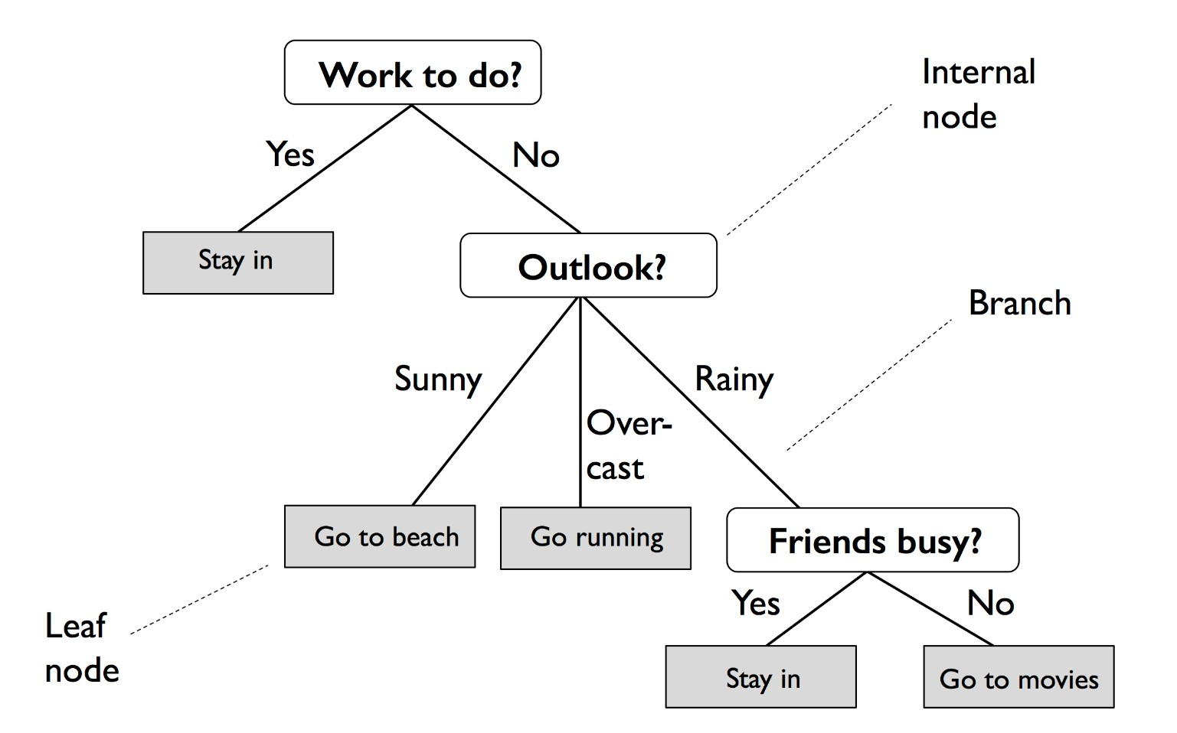
Decision Tree
Decision Trees (DT) can be used both for classification and regression.
The advantage of decision trees is that they require very little data preparation.
They do not require feature scaling or centering at all
They are also the fundamental components of Random Forests, one of the most powerful ML algorithms.
Unlike Random Forests and Neural Networks (which do black-box modelling), Decision Trees are white box models, which means that inner workings of these models are clearly understood

Slide 12


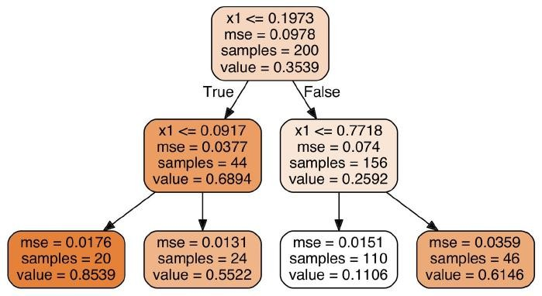



DECISION TREE REGRESSION ALGORITHM
Consider data with two independent variables, X₁ and X₂.
The algorithm splits data into two parts. Split boundaries are decided based on reduction in leaf impurity.
The algorithm keeps on splitting subsets of data till it finds that further split will not give any further value.
Calculate average of dependent variables (y) of each leaf. That value represents the regression prediction of that leaf.
This tree splits leaves based on x₁ being lower than 0.1973. At second level, it splits based on x₁ value again.
At each node, the MSE (mean square error or the average distance of data samples from their mean) of all data samples in that node is calculated. The mean value for that node is provided as “value” attribute.

Slide 13
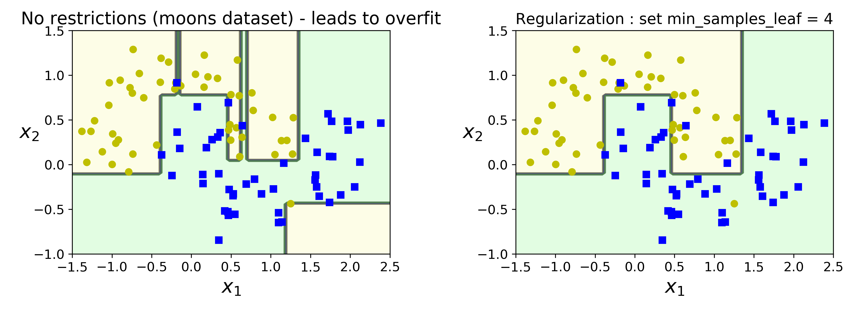
DT: Regularization
The decision tree on the right is restricted by min_samples_leaf = 4. ** moons dataset **
The model on the left is overfitting, while the model on the right generalizes better.

Slide 14
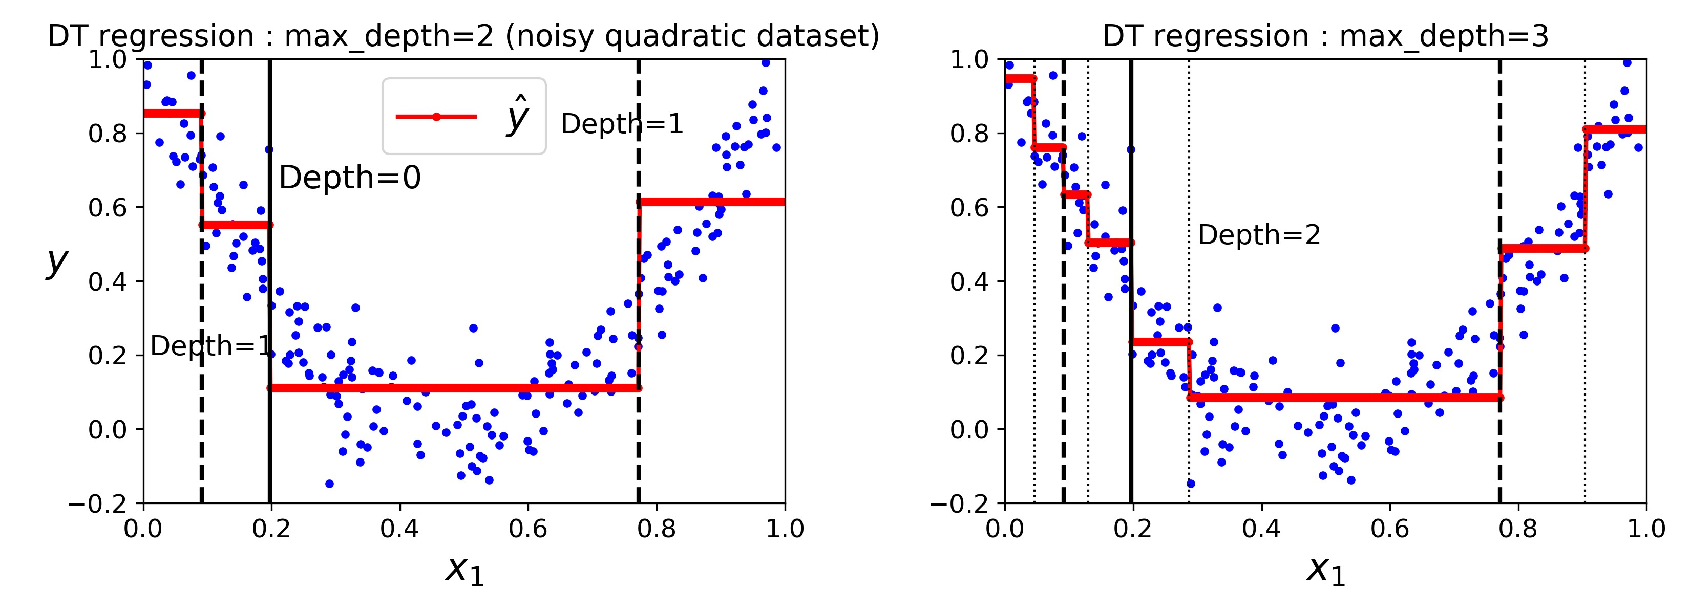
DT - Depth

Slide 15
DECISION TREE: REGULARIZATION
Decision Trees are non-parametric models, which means that the number of parameters is not determined prior to training. Such models will normally overfit data.
In contrast, a parametric model (such as a linear model) has a predetermined number of parameters, thereby reducing its degrees of freedom. This in turn prevents overfitting.
To prevent overfitting, one must restrict the degrees of freedom of a Decision Tree. This is called regularization.
FEATURES OF REGULARIZATION
Regularization is any modification made to the learning algorithm that reduces its generalization error but not its training error.
In addition to varying the set of functions or the set of features possible for training an algorithm to achieve optimal capacity, one can resort to other ways to achieve regularization.

Slide 16


WAYS TO REGULARIZE DECISION TREES
max_depth – limit the maximum depth of the tree
min_samples_split – the minimum number of samples a node must have before it can be split
min_samples_leaf – the minimum number of samples a leaf node must have
min_weight_fraction_leaf – same as min_samples_leaf but expressed as a fraction of total instances
max_leaf_nodes – maximum number of leaf nodes
max_features – maximum number of features that are evaluated for splitting at each node

Slide 17
Random Forests
Random forests are utilized to produce decorrelated decision trees
RF’s create random subsets of the features
Smaller trees are built using these subsets creating tree diversity
Ensemble Learning uses the same algorithm multiple times or a group of different algorithms together to improve the prediction of a model.
Random Forests use an ensemble of decision trees to perform regression tasks.
To overcome overfitting, diverse sets of decision trees are required. Since we are using multiple decision trees, the bias remains the same as that of a single decision tree. However, the variance decreases and thus we decrease the chances of overfitting
Features 1, 2,3,4
Features 1,2
Features 2,3
Features 3,4
Features 1,4
i

Slide 18
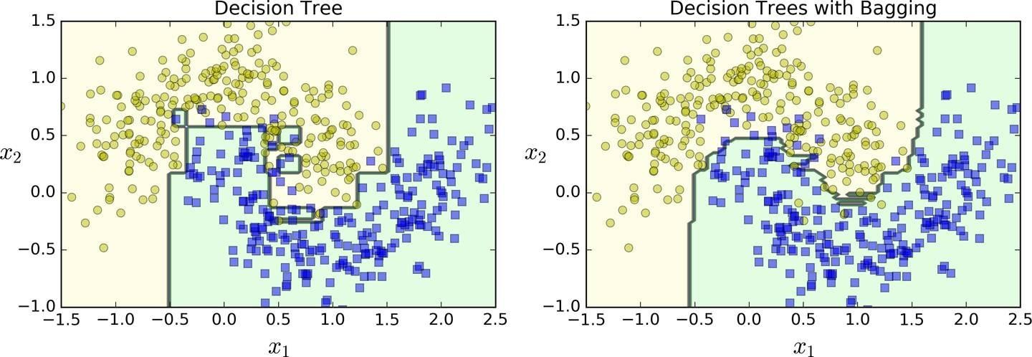
RANDOM FOREST REGRESSION ALGORITHM
Pick any random K datapoints from the dataset
Build a decision tree from these K points
Choose the number of trees you want (N) and repeat steps 1 and 2
For a new data point, average the value of y predicted by all the N trees. This is the predicted value.
A single decision tree vs. a bagging ensemble of 500 trees

Slide 19
Random Forest Advantages
Random Forests are opaque, which means it is difficult to visualize their inner workings.
However, the advantages outweigh their limitations since you do not have to worry about hyperparameters except k, which stands for the number of decision trees to be created from a subset of samples.
RF is quite robust to noise from the individual decision trees. Hence, you need not prune individual decision trees.
The larger the number of decision trees, the more accurate the Random Forest prediction is. (This however comes with higher computation cost).

Slide 20
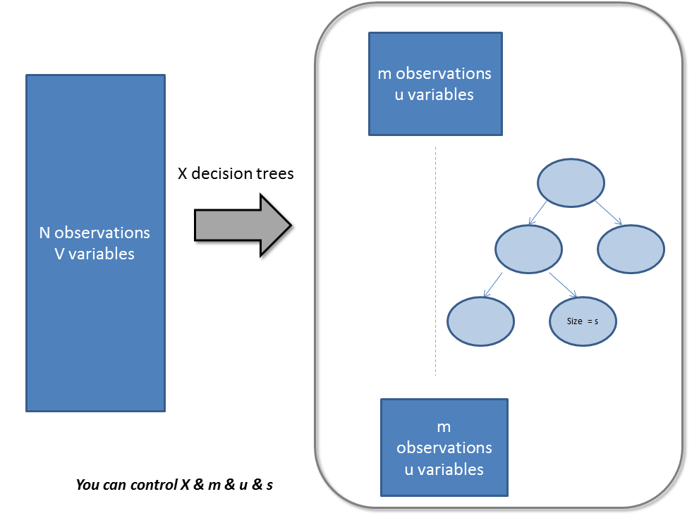
Parameters / levers to tune Random Forests
max_features:
These are the maximum number of features RF is allowed to try in individual tree
n_estimators :
This is the number of trees you want to build before taking the maximum voting or averages of predictions. Higher number of trees give you better performance but makes your code slower.
min_sample_leaf :
Leaf is the end node of a decision tree. A smaller leaf makes the model more prone to capturing noise in train data
n_jobs :
This parameter tells the engine how many processors is it allowed to use. A value of “-1” means there is no restriction whereas a value of “1” means it can only use one processor
oob_score :
This is a RF cross validation method. It is very similar to leave one out validation technique, however, this is so much faster. This method simply tags every observation used in different tress. And then it finds out a maximum vote score for every observation based on only trees which did not use this particular observation to train itself

