Slide 1

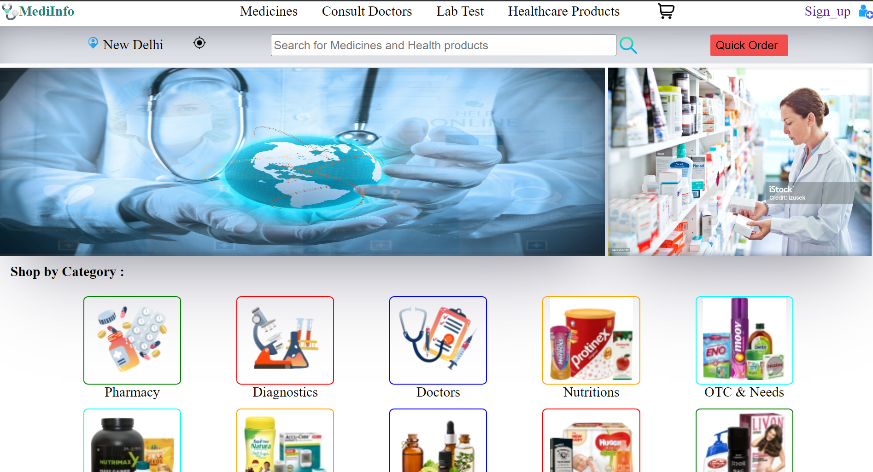
MediInfo :
Your Trusted Medicine Information And
Buying Website
Welcome to MediInfo, the ultimate platform for accessing detailed medicine information and making safe and convenient purchases. Discover how MediInfo can transform your healthcare journey.

Slide 2

Purpose of MediInfo:
1
Empowering Patients
MediInfo aims to empower patients by providing reliable and up-to-date medicine information, enabling informed healthcare decisions.
Ensuring Safety
We prioritize your safety by offering detailed insights into medications, such as uses, dosages, side effects, and drug interactions.
Convenience
MediInfo brings convenience at your fingertips, allowing you to search, compare, and purchase medicines from licensed pharmacies.
2
3

Slide 3
Accuracy :
Trust the wealth of accurate and verified medicine information provided by healthcare professionals and experts.
Time Saving :
Skip the hassle of browsing multiple websites. Find all the information you need in one place.
Peace of Mind :
Get peace of mind with our comprehensive medicine safety features and reliable customer reviews.
Benefits of using MediInfo:

Slide 4
Features of MediInfo:
Comprehensive Medication Database
Access extensive information on a wide range of medicines, including prescription, over-the-counter, and herbal remedies.
Interactive Search Function
Easily search for medicines by name, condition, or active ingredient to quickly find the information you need.
Real-Time Availability
Check the availability of medicines from reputable pharmacies, ensuring you can easily purchase what you need.

Slide 5
How to Navigate the Website:
1
Homepage
Get an overview of featured medicines, access quick search options, and explore informative articles.
2
Medicine Search
Use the search bar to find detailed information on specific medicines relevant to your needs.
3
Medicine Pages
Explore comprehensive medicine profiles, including uses, dosage guidelines, side effects, and precautions.

Slide 6
Creating an Account on MediInfo:
Step 1: Sign Up
Click on the "Sign Up" button, provide your email and create a secure password.
Step 2: Personalize Profile
Complete your profile by adding relevant information such as allergies and current medications.
Step 3: Verification
Verify your email address to activate your account and unlock all of MediInfo's features.

Slide 7
Searching for Medicine Information:
Effortless Search
Simply enter the medicine name, active ingredient to access detailed information within seconds.
In-Depth Details
Find comprehensive profiles with uses, dosages, precautions, contraindications, and more.
Side Effects & Warnings
Discover potential side effects and necessary precautions to ensure safe usage.

Slide 8
Buying Medicine on MediInfo:
Verified Pharmacy Partners
Connect with licensed pharmacies ensuring high-quality, genuine medications.
Easy Ordering Process
Add items to your cart, choose preferred payment options, and enjoy doorstep delivery with tracking.
Review & Ratings
Make informed decisions through customer ratings and reviews for each pharmacy and product.

Slide 9
Conclusion:
Our medicine information web app empowers you to be well-informed about your medications. Join our community of user.
THANK YOU!!

