Slide 1

Flow of seminar
Introduction
Problem Description
Literature Survey
System Overview
Conclusion
References

Slide 2
1. Introduction
While implementing DevOps (development and operations) in agile, it is essential that the development team must have continuous engagement with the operational team throughout the life cycle of particular software development. This practice increase understanding the business goals along with limitations and constraints of software. DevOps is a culture that combines principles and practices to bridge the gap between discrete teams of Development and IT Operations.
DevOps supports Agile release cycle by communicating specifications and design documents together. The sharing of these documents is essential as it is mandatory to figure out the nuances of continuous development and continuous integration of the product to speed up the entire process.
Here some of the practical aspects of applying DevOps to e-commerce web-application based project using some of the DevOps tools are discussed.

Slide 3
2. Problem Description
Project management has become one of the most important pillars that are helping businesses run without any glitch in their processes. Despite the presence of different project management approaches, Agile is considered as one of the most practical and flexible software development mechanisms that exist today. And DevOps is an approach to software development that enables teams to build, test, and release software faster and more reliably by incorporating agile principles and practices. Hence suitable approaches are made for software implementation and development.

Slide 4
3. Literature Survey
[1]. Continuous and Integrated Software Development using DevOps
Author : Aayush Agarwa, Subhash Gupta, Tanupriya Choudhury
Description of the work :
Continuous Delivery (CDE), Continuous Deployment (CD) is a key practice for making software development process reliable and faster. The feedbacks from the Production and Operations team are made available to the developer at frequent stages facilitating improvement and automation.
CD implies that the application’s source code can be immediately pushed to production without any manual decision making
Continuous integration (CI) is the practice of automating the integration of code changes from multiple contributors into a single software project. It's a primary DevOps best practice, allowing developers to frequently merge code changes into a central repository where builds and tests then run.
Advantages:
Software errors can be found and eliminated much more efficiently in the development process.
The continuous delivery pipeline makes it much easier for developers to troubleshoot problems.
Drawback:
Continuous change requires continuous monitoring and reporting.
Resource management must be responsive.

Slide 5
3. Cont...
[2]. DevOps as a Service: Pushing the Boundaries of Microservice Adoption
Author : Demetris Trihinas, Athanasios Tryfonos, Marios D. Dikaiakos, George Pallis
Description of work:
DevOps as a service is an emerging philosophy in application development. It moves traditional collaboration to development and operations team to the cloud, where many of the processes can be automated using stackable virtual development tools.
It is a combination of practices and tools that act together on increasing the velocity of delivering applications at a faster pace in comparison of using traditional software development processes.
Microservices architecture is tailor-made for DevOps with its services-based approach that allows organizations to break down the application into smaller services. This enables delivery teams to tackle individual services as separate entities—ultimately simplifying the development, testing, and deployment.
Advantage:
1. DevOps as a Service largely eliminates manual work, as every change a development team makes, is automatically tracked.Reduced energy cost.
2. Operations teams can now easily find which lines of code have been committed, who initiated and authorized a deployment, and much more, without having to approach developers for information.
Drawback :
1. To be able to outsource a DevOps infrastructure, you will need to have a particular degree of software development expertise.
2. DevOps usually prioritize speed over security when developing software. The use of cloud services may cause some security risks.

Slide 6
3. Cont...
[3]. Evolution Of Handling Web Applications Up To the Current DevOps Tools
Author: Christian A, Rodriguez, Lia Molinari, Fernando G, Tinetti
Description of work:
Most of the development cycle, application architecture, and environment for development, testing and QA (Quality Assurance) has changed in the past years.
The CMS (Content Management System) is a classical PHP-MySQL application, that began being the solution to a specific web site, and it was reused in/adapted to other several different web sites and web portals.
A content management system (CMS) is an application that is used to manage content, allowing multiple contributors to create, edit and publish. Content in a CMS is typically stored in a database and displayed in a presentation layer based on a set of templates like a website.
Advantages:
Code deployment tools are simple to use, it runs from the terminal and its able to update several sites in parallel from SCM (software configuration management) tools.
Simple to use the same configurations in all environment.
Drawbacks:
Several complex environment are hard to handle and test for correctness. (e.g., PHP complie in new OS).
Shared settings must be mannually copied before the first installion or update.

Slide 7
3. Cont...
[4]. Agile techniques and frameworks based on the requirements for e-commerce applications
Author : Seyyedeh Sanaz Mousavi Monfared, Ali Kamandi.
Description of the work :
In the field of e-commerce, the use of powerful software systems and providing business needs has great importance for survival.
Agile methods ensure the "acceleration of time to market", "customer satisfaction" and "high quality of software”.
The purpose of the proposed framework is to categorize and assess the needs of e-commerce and examination of present techniques and patterns in agile methods and selection of appropriate patterns to improve base agile method for e-commerce applications.
Advantage :
Agile can deliver projects on time, while still benefiting from a flexible workflow.
Scrum can help teams complete project deliverables quickly and efficiently.
XP helps in reducing unnecessary programming work.
Drawbacks :
Can be impractical for small companies since implementation can be costly.
Adopting the Scrum framework in large teams is challenging.
XP requires relatively large time investment.

Slide 8
3. Cont...
[5]. Traceability Management with Impact Analysis in DevOps based Software Development
Author : Iresha Rubasinghe, Dulani Meedeniya, Indika Perera
Description of the work :
With the frequent changes of software artefacts in a DevOps environment, managing artefact consistently throughout the software development is challenging.
Traceability maintenance to cope with the continuous artefact changes is essential for successful software project management.
SAT-Analyser that establishes traceability between artefacts from the requirement gathering phase to testing phase in the software development lifecycle.
Advantage :
1. Quick evaluation of potential changes.
2. Promotes consistency between requirements.
Drawback :
1. Weekly support for other types of artefacts.
2. Scalability issues when maintaining the dynamicity of the traceability.

Slide 9
4. System Overview
Agile – Scrum Framework:
Scrum is a framework which is based on agile principles, a framework that handle simple, complicated and complex software development.
Scrum is based on continuous improvement in product and process.
Scrum deliver software frequently and it showcase the hidden problems in system development.
In scrum project move forward with series of iteration called Sprints. Each sprint size is typically two to four weeks long.
It is based on inspect and adaptive cycle. Producing product incrementally and iteratively reduces the risk and enhance visibility.

Slide 10
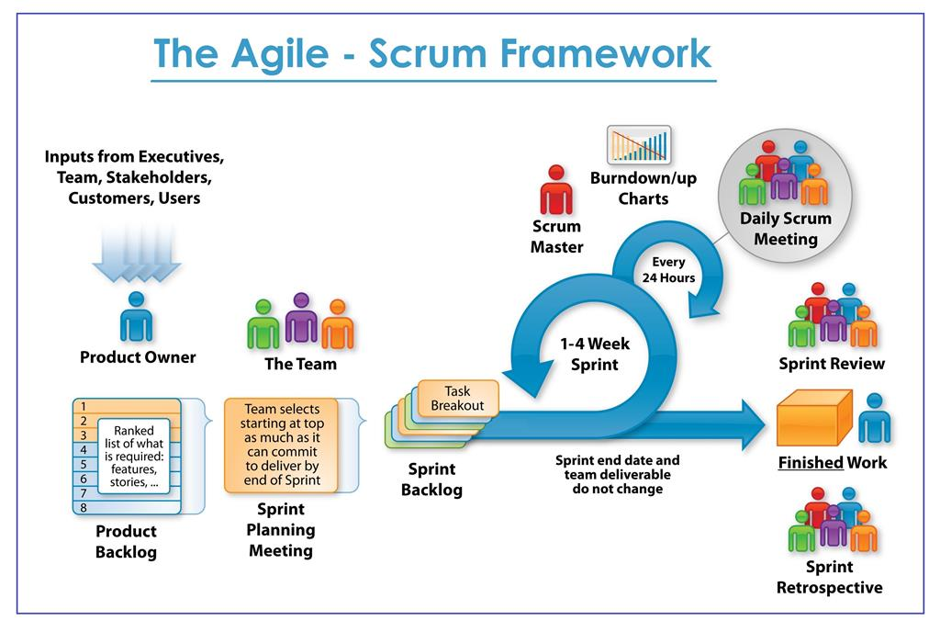
4. Cont...
Fig.1 Agile – Scrum Framework

Slide 11
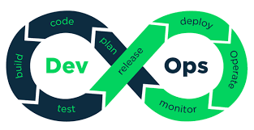
4. Cont...
Project Development Methodology
Development and operations both play essential roles in order to deliver applications. The deployment comprises analyzing the requirements, designing, developing, and testing of the software components or frameworks.
DevOps architecture is used for the applications hosted on the cloud platform and large distributed applications.
Agile Development is used in the DevOps architecture so that integration and delivery can be contiguous.
Fig.2 DevOps architecture

Slide 12
4. Cont...
Stages in DevOps Architecture:
1) Plan : DevOps use Agile methodology to plan the development. With the operations and development team in sync, it helps in organizing the work to plan accordingly to increase productivity.
2) Code : Many good practices such as Git enables the code to be used, which ensures writing the code for business, helps to track changes, getting notified about the reason behind the difference in the actual and the expected output, and if necessary reverting to the original code developed. The code can be appropriately arranged in files, folders, etc. And they can be reused.
3) Build : Without DevOps, the cost of the consumption of the resources was evaluated based on the pre-defined individual usage with fixed hardware allocation. With DevOps, the usage of cloud, sharing of resources comes into the picture, and the build is dependent upon the user's need, which is a mechanism to control the usage of resources or capacity.
4) Test : The application will be ready for production after testing. In the case of manual testing, it consumes more time in testing and moving the code to the output. The testing can be automated, which decreases the time for testing so that the time to deploy the code to production can be reduced as automating the running of the scripts will remove many manual steps.

Slide 13
4. Cont...
5) Release : Deployment to an environment can be done by automation. But when the deployment is made to the production environment, it is done by manual triggering. Many processes involved in release management commonly used to do the deployment in the production environment manually to lessen the impact on the customers.
6) Deploy : Many systems can support the scheduler for automated deployment. The cloud management platform enables
users to capture accurate insights and view the optimization scenario, analytics on trends by the deployment of dashboards.
7) Operate : DevOps changes the way traditional approach of developing and testing separately. The teams operate in a collaborative way where both the teams actively participate throughout the service lifecycle. The operation team interacts with developers, and they come up with a monitoring plan which serves the IT and business requirements.
8) Monitor : Continuous monitoring is used to identify any risk of failure. Also, it helps in tracking the system accurately so that the health of the application can be checked. The monitoring becomes more comfortable with services where the log data may get monitored through many third-party tools such as Splunk.

Slide 14
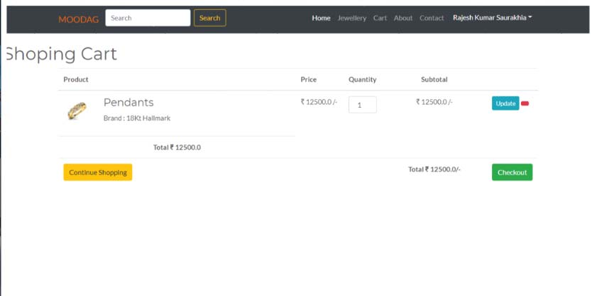
4. Cont...
DevOps Tools used in Research:
A. Jenkins:
Jenkins, an open-source continuous integration server can automate the entire process of a software project. The way by which this tool can enable pipeline access to its users is an amazing fact. In this proposed work, Jenkins is used to automatically commit code into the code repository, run test cases accordingly and also fetching the reports after performing testing.
Fig.3 CI/CD through Jenkin

Slide 15
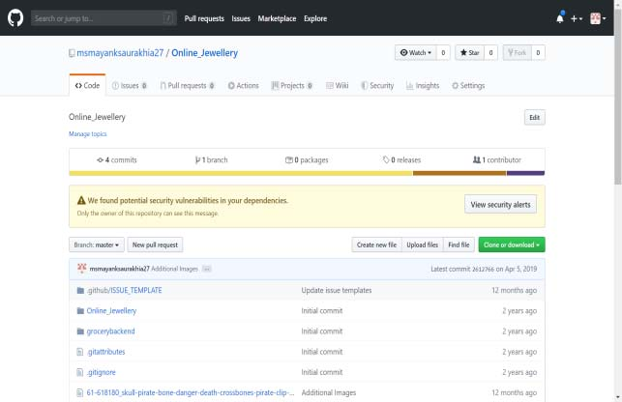
4. Cont...
B. Git:
Git is one of the widely used version control systems in IT industries nowadays. It is now treated as a standard for version control. Through this system, professionals can change the code during developing software as well as permitted to keep track of development progress. This repository can be accessed in offline mode as well. Once the work is committed locally, then a copy of the repository is synchronized with the copy residing at the server end.
Fig.4 Implementing Project through Git

Slide 16
4 Cont...
C. Gradle:
Gradle is a build automation tool known for its flexibility to build software. A build automation tool is used to automate the creation of applications. The building process includes compiling, linking, and packaging the codes. The process becomes more consistent with the help of build automation tools.
D. Maven:
Maven is a project management automation tool that enables developers to build the framework of the software product. It provides easiness for coding the wireframe infrastructure of the product in almost the entire lifecycle of the software with less time consumption. Maven is used for Java-based projects primarily but it can also manage projects effectively written in other programming languages such as Scala, Ruby, C#, etc

Slide 17
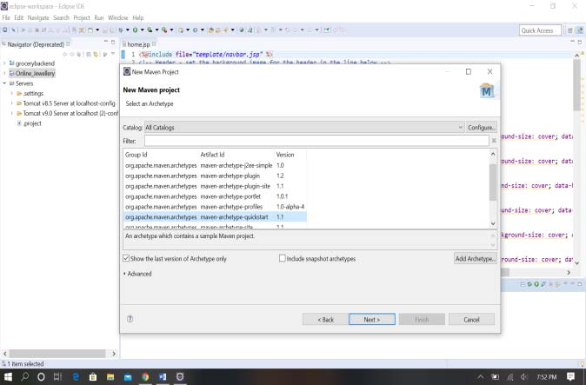
4. Cont...
Fig.5 Preparing Wireframe for Project through Maven

Slide 18
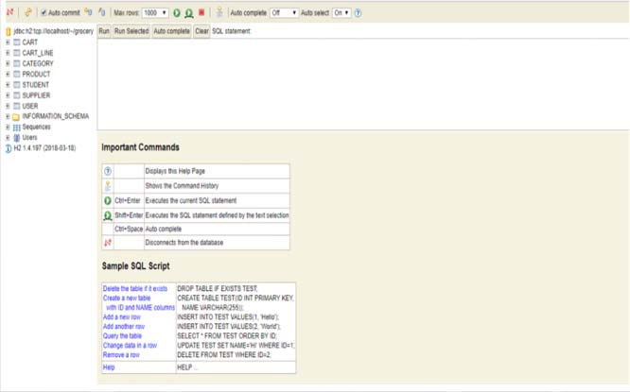
4. Cont...
E.Nagios:
Nagios is also an open-source software tool. This tool is widely used for continuous monitoring of the software products. This continuous monitoring of software products includes monitoring of applications, networks, systems, business processes, recovery processes in DevOps culture. By applying Nagios, it monitors and control the server related performance issue effectively. One of the main advantages of using Nagios tool is that it also provides assistance in detecting all types of network(s) so that communication should be established in less time.
Fig.6 Continuous Monitoring through Nagios Software Tool.

Slide 19
5. Conclusion
Agile is an iterative and incremental approach that targets collaboration among cross-functional teams, customer reviews and feedbacks and rapid releases at regular intervals. On the other hand, DevOps is a culture of combining development and operational teams together so that constant testing and delivery can take place. The proposed model have tried to maintain the right balance of agile methodologies and DevOps tools to get efficient outcomes with optimum efforts of development and operations.

Slide 20
6. References
[1] “Analyzing the Behaviour of Applying Agile Methodologies & DevOps Culture in e-Commerce Web Application” Proceedings of the Fourth International Conference on Trends in Electronics and Informatics (ICOEI 2020)IEEE Xplore Part Number: CFP20J32-ART; ISBN: 978-1-7281-5518-0
[2] Lianping Chen on “Continuous Delivery: Overcomingadoption challenges” , The Journal of Systems and Software 128 (2017) 72–86, Science Direct.
[3] Sagar Narendrasing Deshmukh on “A System for Application Deployment Automation”, International Conference on Innovations in Power and Advanced Computing Technologies [i-PACT2018].
[4] Morgan B. Kamuto, Josef L. Langerman on “Factors inhibiting adoption of Devops in large organizations”, 2017 2nd IEEE International Conference On Recent Trends In Electronics Information & Communication Technology, May 19-20, 2017, India.
[5] "Five Habits of Highly Successful Continuous Delivery Practitioners, at http://info.perforce.com/continuous-delivery-five-habits successfulpractitioners.html?sc=blog , [Last accessed: 5 March 2018]."

Slide 21
Thank you

