Slide 1
Create a Festival Stall Pre-Order and Pickup Website where people can see stall menus, place food orders online, and choose a pickup time so they don’t have to stand in long lines. Stall owners will receive the orders instantly on their dashboard and can update the order status to Preparing or Ready for Pickup to make the process faster and organized.
Group-31:
ABHISHEK KUMAR | BT22CSE095
THUDAM HARSHITH | BT22CSE072

Slide 2
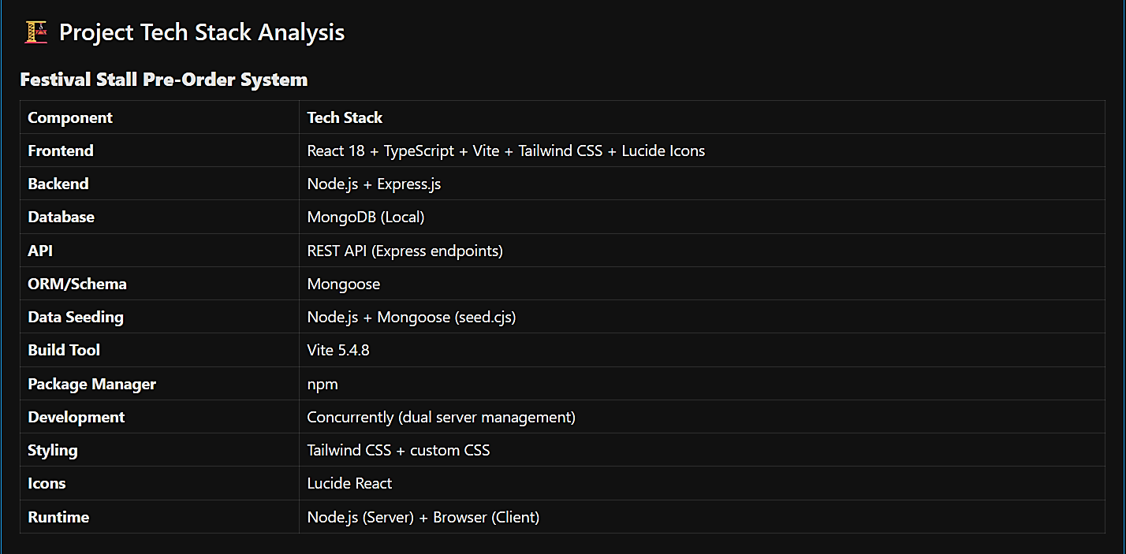

Slide 3
