Slide 1
Welcome! Smart India hackathon 2020
Organization: Government of Andhra Pradesh
Team Name :- Editha Code :- KB145
Team Members:
Abhishek Kumar (Team Leader)
Ritik Gupta
Harshita Madhok
Abhishek Khatri
Vaibhav Kumar
Ashish
Mentors Mohd Ilyas Shobhit Bhatnagar
Notes:
©Abhishek kumar

Slide 2
Brief Description
01
Problem Statement
AI & OCR: To search Telugu,Urdu & English words in pdf present in Unicode & images format.
Our Idea
We will make a online web portal where user can upload the pdf and image from which he wish to Extract and search the data. The portal will provide an interactive user interface and it will display the desired data from pdf/images with the help of OCR and Machine Learning. The platform will provide support for English, Telugu, Urdu languages.
Notes:
©Abhishek kumar

Slide 3
FEATURES
02
This portal will provide an interactive platform for any person to Extract and search data in pdf and images.
Extract Telugu, Urdu, English, text in pdf, or images.
User friendly( user can search for data in a specific language or in a combination of all 3 languages.
This portal will allow users to search data in Unicode as well in image format.
Voice Searching (User can search for data using voice).
Fast text extraction and voice searching.
It’s available for windows as well as Linux. Extendable (we can add more languages also).
It is very security (Data upload on a portal is an encrypted format)
Notes:
©Abhishek kumar

Slide 4
Advantages
03
Extract Telugu, Urdu, English, text in pdf, or images in single time.
Voice Searching.
User friendly
This portal will allow users to search data in Unicode as well in image format.
Fast text extraction and voice searching.
It’s available for windows as well as Linux.
Extendable.
It is very security.
Notes:
©Abhishek kumar

Slide 5
MODULES
04
Front end:- All UI/UX part.
Backend:-
Telugu OCR with image or pdf
English OCR with image or pdf
Urdu OCR with image or pdf
Extract Telugu, Urdu, English text from image or pdf
Text Searching (simple or voice)
Notes:
©Abhishek kumar

Slide 6
LIBRARIES AND FRAMEWORK USED
05
Tesseract is an optical character recognition engine for various operating systems.
For pdf rendering we use poppler for window.
For Front end :- HTML, CSS, JS, AJAX
For backend :- Python, Flask, ML

Slide 7
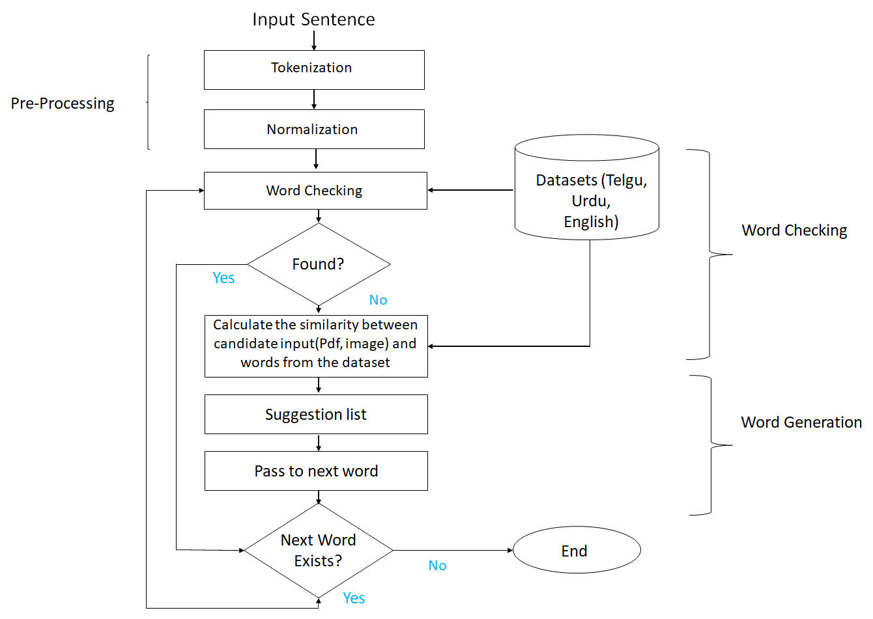
BASIC FLOW OF DATA EXTRACTION
06
Extract Data
Notes:
©Abhishek kumar

Slide 8
OCR PROCESS
07
Paper
Documents
Opening (Scanning)
Data Capture to text format
OCR
u
Verification and decrypt data
Data Save

Slide 9
FUTURE SCOPE
08
We can add all other language also in future.
We convert one to another language.

Slide 10
09
Notes:
©Abhishek kumar

