Slide 1

Scientific Calculator Application
An Interactive Python-Based Project Developed Using the Tkinter Graphical User Interface Library | NEXTHIKES IT SOLUTIONS
Presented by Abhishek Kumarr
November 2025

Slide 2
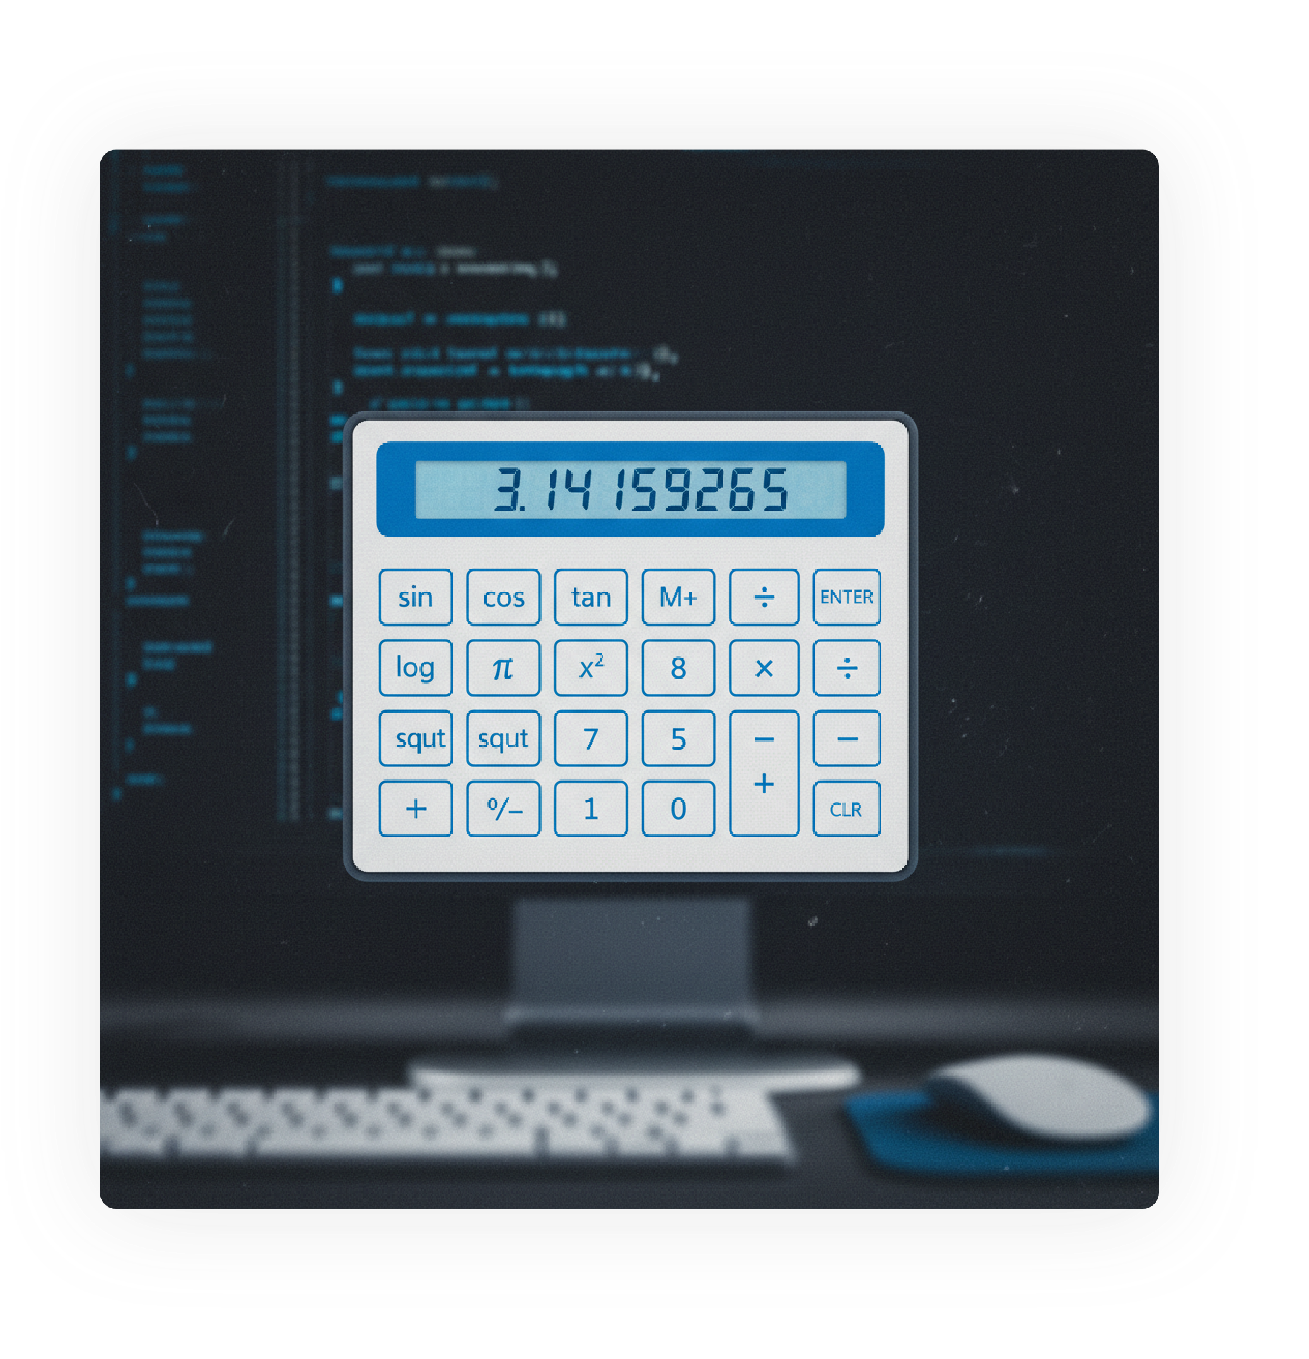

Scientific Calculator
Python-based calculator application built with Tkinter, Python's standard GUI library for creating graphical interfaces
Delivers both basic arithmetic operations and advanced scientific functions through an intuitive graphical interface
Demonstrates practical application of Python GUI programming concepts in real-world software development

Slide 3

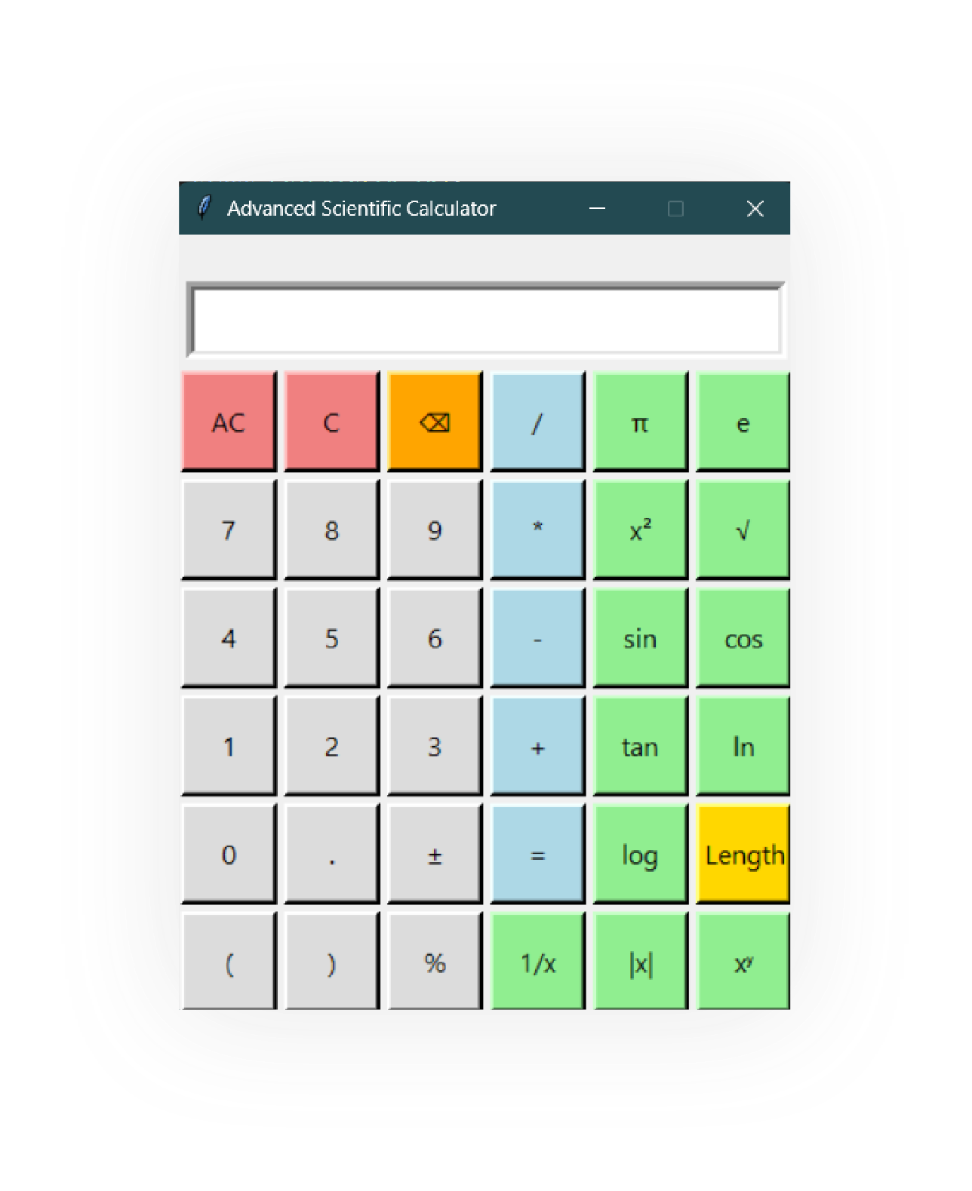
Calculator Interface
Tkinter-based GUI framework: The interface is built using Python's Tkinter library, which provides a cross-platform graphical user interface toolkit for creating interactive desktop applications
Display area: A dedicated text field that shows calculation inputs and outputs, allowing users to view their current expression and the computed results in real-time
Button layout: A comprehensive grid of buttons for operation controls, including numeric input buttons (0-9), basic arithmetic operators, and functional buttons for executing calculations and clearing the display

Slide 4






Challenges Faced
TECHNICAL
INTERFACE
Event Handling: Managing button clicks and proper function execution
GUI Layout Design: Creating organized and intuitive button layout
Expression Evaluation: Handling complex expressions and operator precedence
Widget Management: Organizing and positioning Tkinter widgets effectively
Error Handling: Managing invalid inputs and mathematical errors
Display Management: Real-time display updates with user inputs

Slide 5






Solutions Implemented
TECHNICAL
INTERFACE
Grid Layout Manager for organized button placement
Lambda Functions for efficient event handling
Eval() Function for mathematical expression evaluation
StringVar() for dynamic display updates
Math Module integration for scientific functions
Try-Except Blocks for error handling
Modular Design with separate operation functions

Slide 6
Resources Used
DOCUMENTATION
Python & Tkinter Docs
Python Math Module
Official Python documentation for Tkinter library, widgets, and GUI components with detailed methods
Reference documentation for scientific mathematical functions and operations
Tkinter Guide
Comprehensive guide covering GUI component implementation and best practices
COMMUNITY
Stack Overflow
Python Forums
Community-driven platform for troubleshooting specific implementation issues and solutions
Discussion boards for resolving development challenges and technical questions
LEARNING
Online Tutorials
GitHub Projects
Video and written tutorials focused on Tkinter GUI development techniques
Example repositories demonstrating best practices and reference implementations

Slide 7
Thank you
For any further questions or feedback, please feel free to reach out.

